Slide 1
Implementation of parallel Quicksort using OpenMP
By
Amisha Gunderia - 201071042
Srushti Gujjanwar - 201071073

Slide 2
Structure of QuickSort
You find a single element in the array (of length l), and reorder the array such that the following conditions hold:
a[j] ≤ a[p] ≤ a[k] for all 0≤ j < p, p ≤ k < l.
This means that you partition the array such that every element to the left of your pivot is smaller or equal to the pivot element and each element to the right is larger or equal. Now, if we could somehow magically sort each of these sections, then our array would be sorted right? So we just call quicksort on our two subarrays and off we go. The recursion stops when the size of the subarray is 1, as that is trivially sorted.

Slide 3
Introduction to hyper quick sort
In HyperQuickSort, the array is also divided into partitions, but multiple pivot elements are used to increase parallelism. Each partition is then sorted simultaneously by different threads within a thread block, taking full advantage of the GPU's parallel processing capabilities.
Hyperquicksort is an algorithmic improvement over traditional quicksort that uses multiple pivots for partitioning the array. It can be parallelized, but handling dependencies between pivots can be complex.

Slide 4
Explanation of the algorithm
Hyperquicksort assumes the number of processes is a power of 2. If we
arrange the processes as a hypercube, we can set up the communication patterns of the hyperquicksort algorithm so that all communications are between pairs of adjacent processes. For this reason hyperquicksort was a
particularly good fit for first-generation multicomputers, such as the Intel iPSec and the nCUBE/terl, that organized processors as a hypercube.
Let the communication network topology be an N- dimensional hypercube (i.e. the number of processors is equal to p=2N).

Slide 5
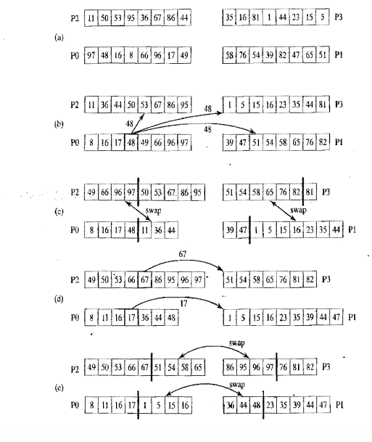
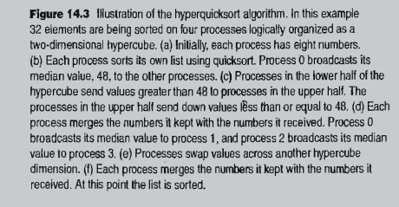

Slide 6
Each process starts with a sequential quicksort on its local list.
• Now we have a better chance to choose a pivot that is close to the true median.
• The process that is responsible for choosing the pivot can pick the median of its local list. • The three next steps of hyper quick sort are the same as in parallel algorithm
• Broadcast
• Division of “low list” and high list”
• Swap between partner processes
• The next step is different in hyper quick sort. • On each process, the remaining half of local list and the received half-list are merged into a sorted local list. • Recursion within upper-half processes and lower-half processes.

Slide 7
Introduction to parallel Quicksort
Parallel quicksort is a sorting algorithm that parallelises the quicksort algorithm to improve its performance on multi-core or multi-processor systems. It divides the array into smaller subarrays and sorts them independently in parallel, utilizing multiple threads or processors.
This parallelization allows for faster sorting of large arrays by distributing the workload among multiple processing units. The algorithm typically employs task-based parallelism, where tasks are created for sorting subarrays, and the runtime system schedules these tasks across the available parallel resources.
By utilizing parallelism, parallel quicksort can achieve faster sorting times compared to sequential quicksort implementations, especially for large datasets.

Slide 8
Differences between hyper and parallel quicksort
Parallel quicksort with OpenMP is a parallel version of the traditional quicksort algorithm. It distributes the sorting tasks among multiple threads using task-based parallelism. It is relatively easier to implement.
Parallel quicksort using OpenMP explicitly utilizes OpenMP directives and task-based parallelism to distribute the sorting tasks among multiple threads. The algorithm creates tasks for sorting subarrays, and the OpenMP runtime system schedules these tasks across the available threads.
Hyperquicksort is an algorithmic improvement over traditional quicksort that uses multiple pivots for partitioning the array. It can be parallelized, but handling dependencies between pivots can be complex.
It can be implemented in a parallel fashion by distributing the partitioning and sorting tasks among multiple threads. Each thread can work on a different pivot and sort its corresponding partition concurrently.

Slide 9
RESULT
Adding in those few lines of code definitely helps improve the runtime performance of quicksort. A few things: we could have used the sections construct with similar code. This was generally the way to do things long ago, and the more modern and preferred alternative is to use tasks. In my experience, tasks also perform better, because with sections, each thread only does the work for one section (which is equivalent to the tasks above), whereas each thread can perform the work of many tasks.

Slide 10
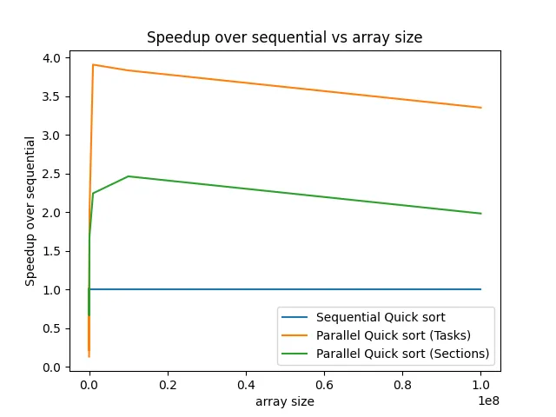
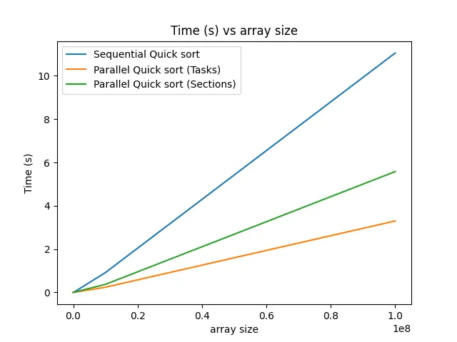

Slide 11
References:
Parallel Programming in C with MPI andOpenMP Michael J, Quinn Oregon State University
https://www.openmp.org/wp-content/uploads/OpenMPRef-5.0-0519--web.pdf
http://web.engr.oregonstate.edu/~mjb/cs575/Handouts/tasks.1pp.pdf
https://www.openmp.org/resources/tutorials-articles/
https://medium.com/basecs/pivoting-to-understand-quicksort-part-1-75178dfb9313

Slide 12
Thank you

