Slide 1
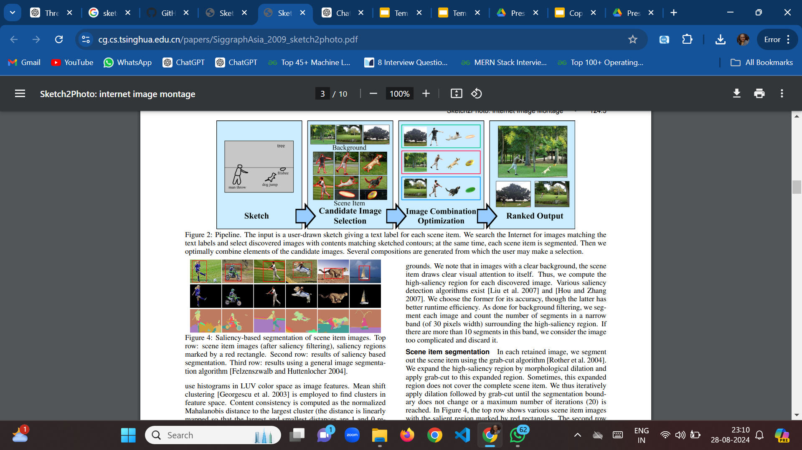
Sketch2Photo: Internet Image Montage
What is the problem?
The problem addressed in this paper is the challenge of generating photo-realistic images from casually drawn sketches with added text labels. Traditional methods either required extensive manual editing or produced unsatisfactory results, often due to poor image composition, unnatural blending, or incorrect scaling of scene elements. The goal is to create a method that can automatically and efficiently generate high-quality images from simple sketches by selecting appropriate images from the web and seamlessly blending them together.
What has been done earlier?
Earlier approaches to this problem involved various image synthesis and compositing techniques. Some key methods include:
Shape Matching and Object Recognition: Techniques like Shape Contexts were used to match and recognize objects based on their shapes in images.
Content-Based Image Retrieval: Systems retrieved images based on their content using texture, color, and shape features.
Image Cloning and Blending: Methods like Poisson Image Editing and Lazy Snapping were used for pasting and blending images, but they often resulted in visible seams or required significant manual intervention.
Photo Clip Art and Scene Completion: These approaches attempted to complete or augment scenes using large image datasets but struggled with scale consistency and natural blending.
Amisha Nayak,B421004

Slide 2
What are the remaining challenges? What novel solution proposed by the authors to solve the problem?
Remaining Challenges:
Image Selection: Automatically selecting suitable images from a large pool that match the user's sketch in both content and style while excluding those with complex or distracting backgrounds.
Seamless Blending: Achieving natural transitions between the composed images, avoiding artifacts like visible seams or scale mismatches.
Occlusion and Scale: Managing occlusions correctly when one object partially covers another and ensuring that the relative scales of objects are physically plausible.
Novel Solution Proposed by the Authors: The authors propose a method that includes two key innovations:
Novel Image Filtering Scheme: This approach filters out images with complex backgrounds, focusing on those with simple, clean backdrops that are easier to blend and match the sketch’s intent.
Hybrid Blending Approach: This method combines different blending techniques to improve the quality of image composition. It includes a numerical measure of blending quality, which helps in automatically selecting the optimal combination of images for the final output.
Amisha Nayak, B421004

