Slide 1

A Set of Assets
Batch-1 WFS-5

Slide 2
Team members
WFS 5 - Team 1 - E-Asset Management
Abhinav Srivastava | Bharat Harish Karamchandani
Abhishek Kaushal | Bhavya Chhabra
Aditi Gupta | Fareeya Khan
Amisha Bhardwaj | Kshitij Vengurlekar
Aparna Indrajit Devkate | Mauli Sanjaykumar Bhatt

Slide 3
Application Features
Well planned information architecture.
Well formatted content.
Well managed sessions.
Accessible to all users.
Made from scratch without any external Api’s.
Browser consistency.
Effective navigation.
Good error handling.
Accessible to all users.
Valid markup and clean code.
User friendly forms and color schemes.

Slide 4
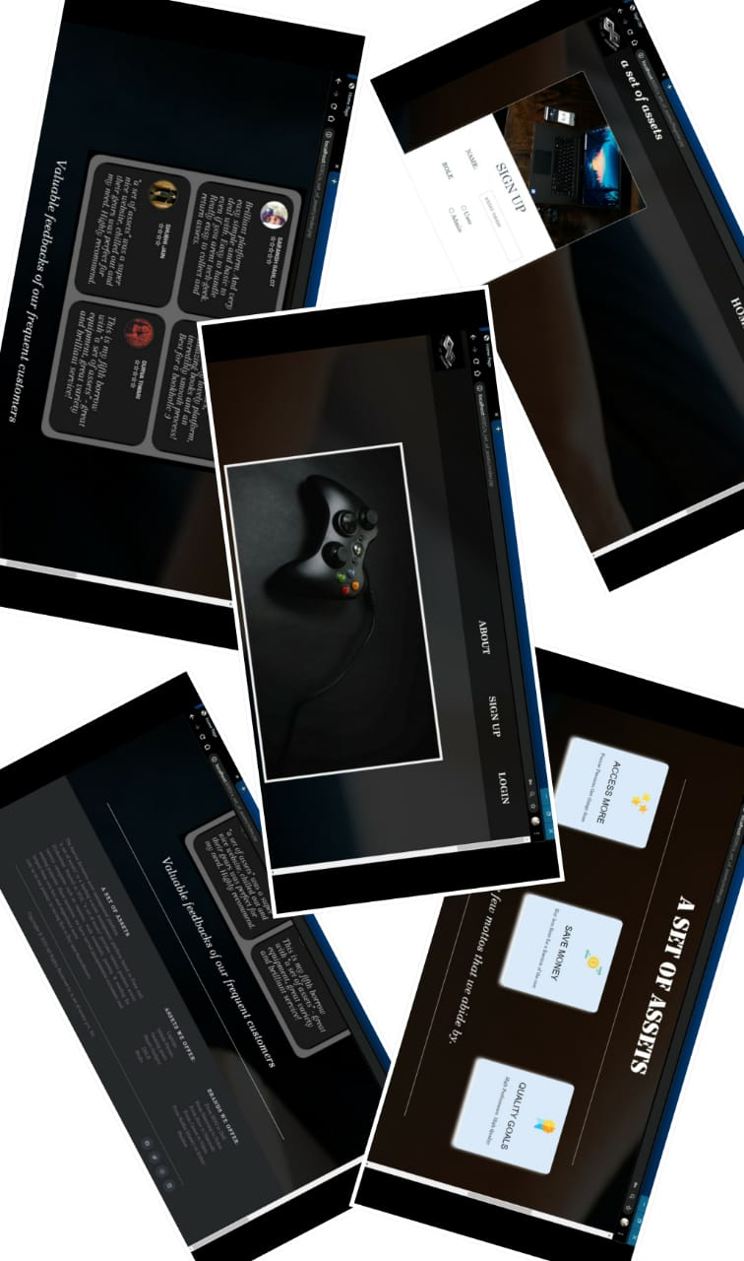
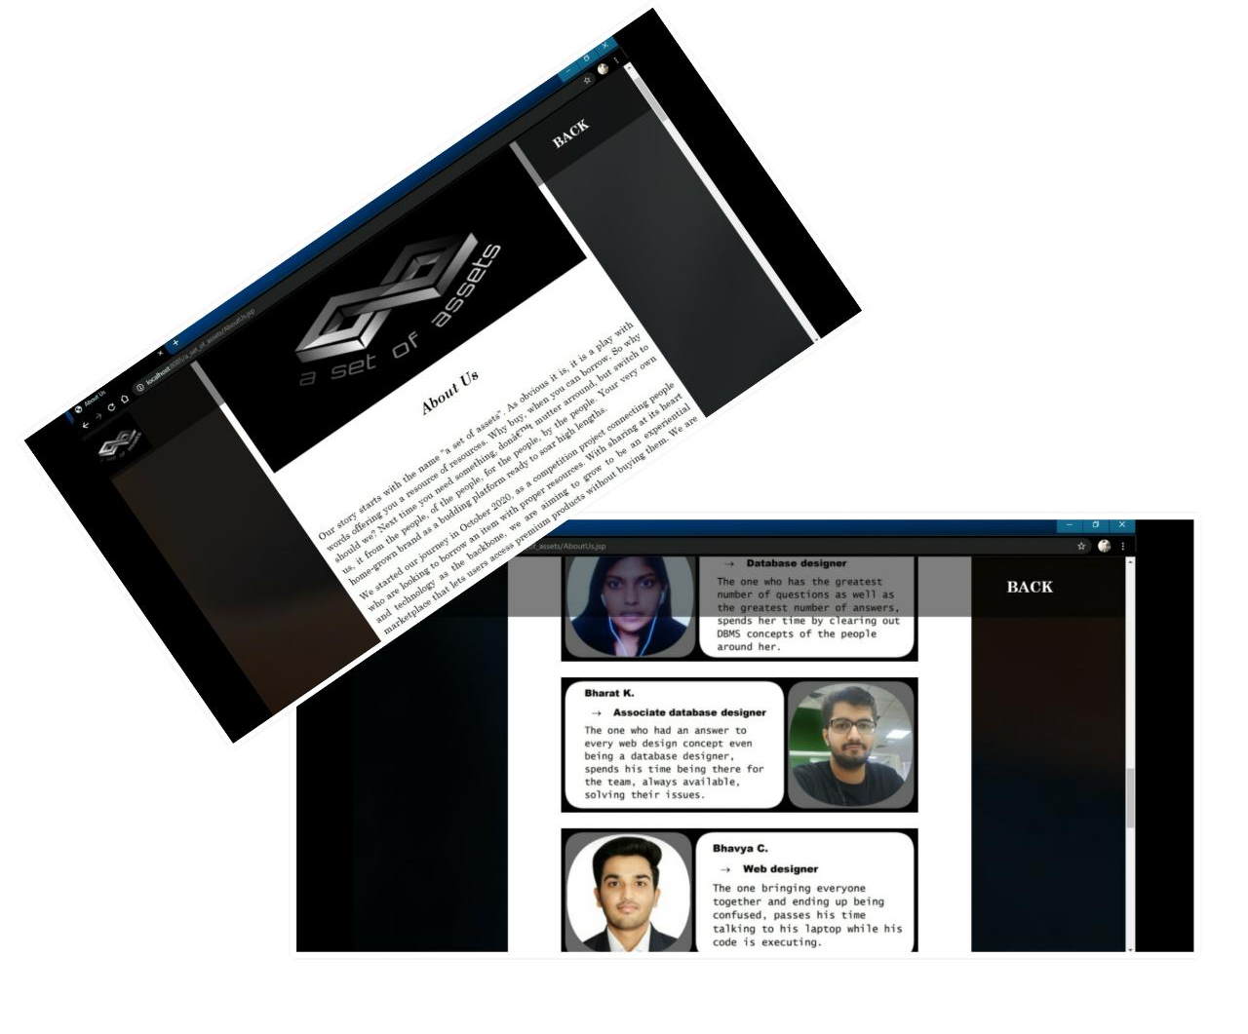
About us
Home Page

Slide 5
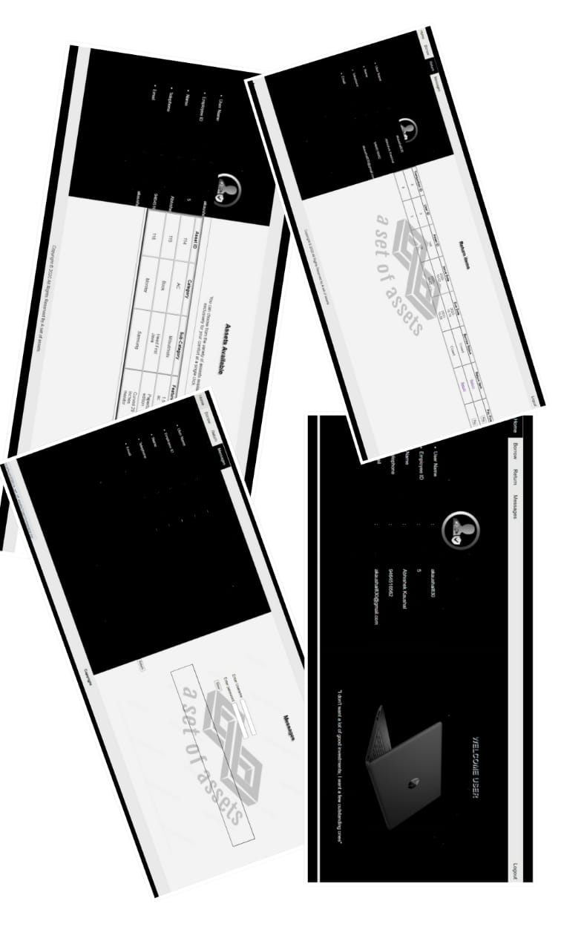
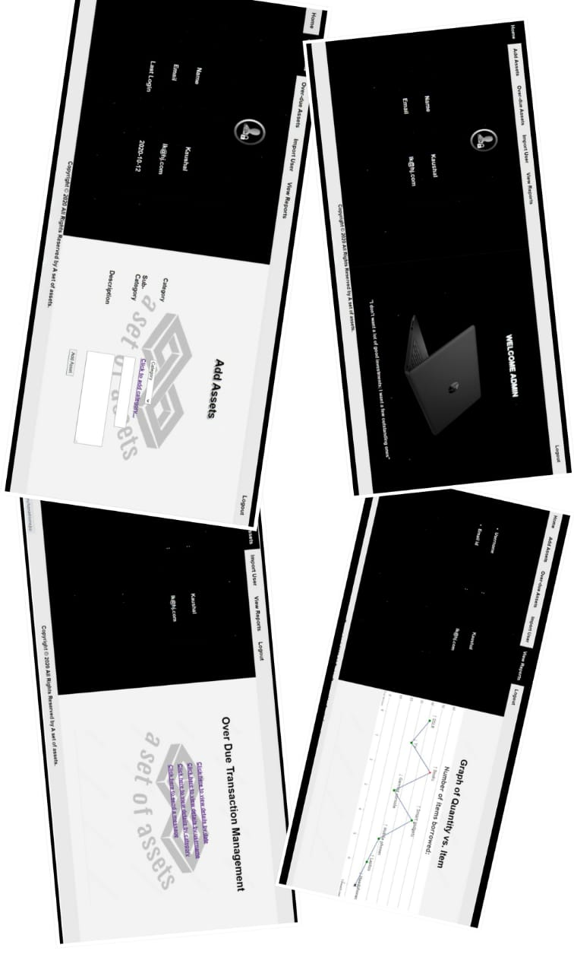
User Home Page
Admin Home
Page

Slide 6
LEARNINGS
CONCEPT
While doing this project, we cleared some major concepts such as:
MVC architecture
Transferring data or control among HTML,JSP,Servlet and JAVA.
Exception handling and transaction management.
TOOLS
Spring Tool Suite
Visual Studio Code
Sublime Text Editor
Derby
Git
Photoshop
XML Notepad
Notepad ++
Zoom
Team Viewer
COLLABORATION
Finding out every individual interest.
Distributing functionalities equally.
Integrating front-end ,database and backend of single entity with git.
Integration and debugging with daylong extensive zoom conferences.

Slide 7
THANK YOU !

