Slide 1
CSIT558_01SP25 | FINAL PROJECT:
A Comparative Study of Predicting Wildfire Likelihood and Causes Using ML Models
BY
Chaudhari, Amishaben Natavarbhai [CWID:50129394]
Javed, Syed Mehrose [CWID: 50128848]
Subhani, Muhammad Kamal [CWID: 50136417]
Thangavel Sathiyamoorthy, Punithan [CWID: 50135877]
Venkata Appala Manoj Muvvala [CWID: 50122981 ]

Slide 2
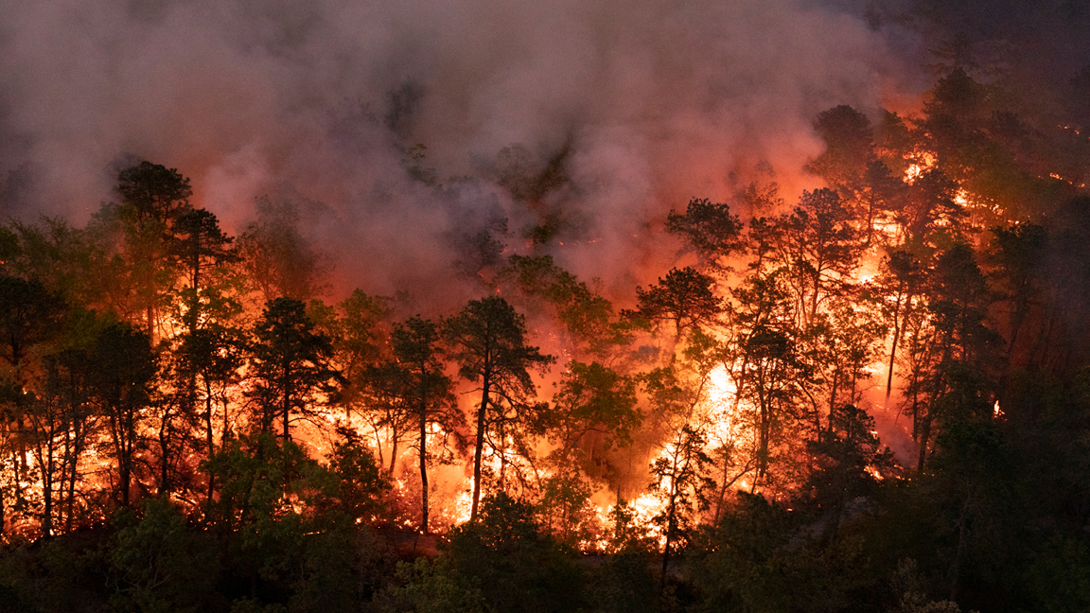
INTRODUCTION
Dataset:
Dataset on Wildfires occured in United states from Kaggle
Overview: The FPA FOD (Fire Program Analysis Fire-Occurrence Database) is a comprehensive spatial dataset of 1.88 million wildfire incidents across the U.S. from 1992 to 2015, covering 140 million acres. Compiled from federal, state, and local fire reports, it includes details like discovery date, location, fire size, cause, and land ownership. This cleaned and standardized dataset supports wildfire trend analysis, risk assessment, and predictive modeling.
Potential Applications: Wildfire prediction benefits greatly from machine learning techniques, enabling proactive risk assessment and resource allocation. Models like Random Forest and XGBoost can accurately classify wildfire causes and identify high-risk regions. Together, these tools enhance early warning systems, optimize emergency response, and support data-driven wildfire management strategies.

Slide 3
RELATED WORK
Wildfire prediction has been an active area of research in recent years, with a focus on utilizing machine learning algorithms for more accurate forecasting.
One study [1] investigates wildfire susceptibility in Portugal using Random Forest and logistic regression to analyze both environmental and human-related variables.
Other work [2] provides a comprehensive overview of machine learning models applied to forest fire prediction and detection in which the authors examine various algorithms and Deep Learning methods. The study highlights challenges such as data scarcity, imbalanced datasets, and real-time deployment limitations.
Another research [3] highlighted the strong performance of XGBoost in terms of both classification accuracy and area prediction, showcasing its suitability for real-world wildfire forecasting tasks.

Slide 4
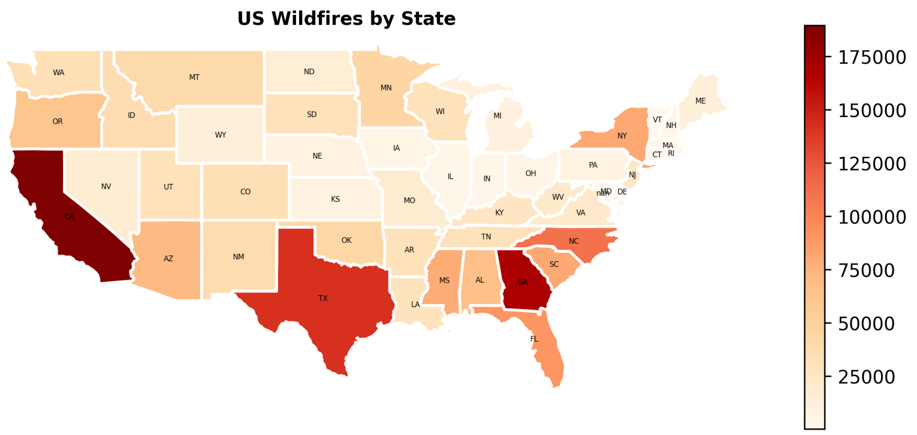
DATA OVERVIEW/ANALYSIS
The map shows the states affected by the number of fires
Helps in visualizing US states which had the most wildfires
E.g. California, Texas and Georgia

Slide 5
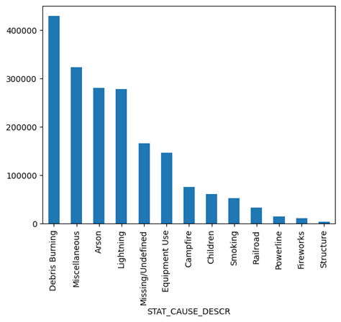
DATA OVERVIEW/ANALYSIS
The bar plot shows the wild fire causes reported in the dataset and the number of fires
Debris burning, Arson , Lightning are the major causes of fires
This can be combined with the region wise map for further analysis

Slide 6
APPROACH & IMPLEMENTATION
Data Mining Technique:
Predictive Data Mining - As we are predicting the likelihood and causes of wildfires.
Data Preprocessing:
Data cleaning e.g, Extra spaces removal, missing values handling, duplicates removal
Text normalization, date format standardization
Categorical to numerical conversion, One-hot encoding
Feature engineering e.g, Prev month fire count, duration of fire
Models/Methods Tried:
Facebook Prophet (Forecasting time series data)
XGBoost (Regression & Classification)
Random Forest (Prediction - Multiple decision trees)
Other classifiers (DecisionTreeClassifier, KNN, Logistic Regression, Linear SVC, SGD Classifier)

Slide 7
APPROACH & IMPLEMENTATION
Model Selection:
XGBoost - Wildfire likelihood prediction
  Feature scaling, hyper parameter tuning
  0.48 R²
Random Forest - Wildfire causes prediction
  SMOTE (Synthetic Minority Over-sampling Technique)
    Balances data for underrepresented classes
  62% accuracy (before tuning); 83% accuracy (after tuning)
Evaluation Metrics:
Mean Absolute Error (MAE)
Mean Squared Error (MSE)
R-squared (R²)
F1 score (Precision & Recall)

Slide 8
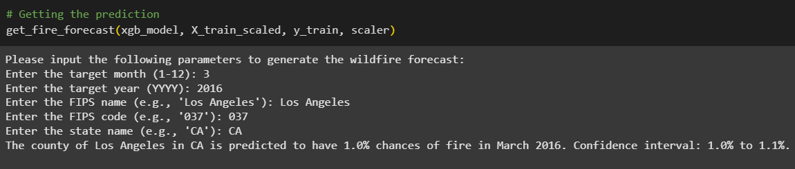
APPROACH & IMPLEMENTATION
CLI TOOL:
Command Line Interface (CLI) tool developed to help the users input required parameters to generate the desired output - wildfire likelihood prediction or the cause of the wildfire prediction.
Real-time query processing using pre-trained XGBoost model
User input: County, State, Year, and Month
Output: Wildfire risk score with 95% confidence interval
Sample Output:

Slide 9
EXPERIMENTS AND OBSERVATIONS
Model Performance:
For likelihood of wildfire prediction, the XGBoost model is moderately effective but struggles due to the inherently random and non-seasonal nature of wildfire occurrences.
For the classification of the cause of the fire, Random Forest model gave pretty decent results at 62% accuracy that got enhanced to 83% after using SMOTE to balance class distribution.
Wildfire Likelihood
Model | MAE | R²
Random Forest | ~3.79 | ~0.35
XGBoost(tuned) | ~3.37 | ~0.48
Wildfire Cause
Model | Random Forest | XGBoost (no null) | Decision Tree | KNN | Logistic Regression | Linear SVC
Accuracy | 62% | 60% | 62% | 50% | 47% | 25%

Slide 10
DISCUSSION
Model Strengths and Weaknesses:
XGBoost demonstrated strong performance in regression tasks, particularly after tuning, but lacked transparency.
Random Forest proved superior for classification, but is prone to overfitting.
Simpler models underperformed due to the complex and non-linear nature of the wildfire dataset.
Challenges and Limitations:
The lack of seasonality or temporal regularity made time series approaches like Prophet unsuitable.
Data imbalance significantly affected classification accuracy.
Lack of many contributing environmental variables (e.g., humidity, wind speed) hindered the model accuracy.

Slide 11
CONCLUSION
This study demonstrated the feasibility and effectiveness of using machine learning for both wildfire likelihood forecasting and cause classification.
Accurate forecasting and cause classification can enable more timely responses, optimized resource allocation, improved risk communication and policy development,, early fire detection in high-risk zones, and comprehensive pre- and post-event analysis.
To carry this analysis further, more environmental variables such as wind speed, temperature and humidity can be added to the dataset for a more robust and accurate predictive system.
Additionally, exploring advanced deep learning architectures such as temporal-spatial neural networks may lead to even more robust and scalable solutions.

Slide 12
REFERENCES
[1] A. Pereira, M. Santos, and L. Rodrigues, "Wildfire susceptibility mapping using machine learning techniques in Portugal," Environ. Rev., vol. 28, no. 4, pp. 402–417, 2020. [Online]. Available: https://doi.org/10.1139/er-2020-0019
[2] P. Sobha and S. Latifi, "A survey of the machine learning models for forest fire prediction and detection," Int. J. Commun. Netw. Syst. Sci., vol. 16, no. 7, pp. 131–150, 2023. [Online]. Available: https://doi.org/10.4236/ijcns.2023.167010
[3] S. Choi, J. Lee, Y. Kim, and H. Jang, "Predicting Forest Fire Area Growth Rate Using an Ensemble Algorithm," Forests, vol. 15, no. 2, pp. 321–335, 2024. [Online]. Available: https://doi.org/10.3390/f15020321
[4] Z. Xu, J. Li, S. Cheng, X. Rui, Y. Zhao, H. He, and L. Xu, "Wildfire Risk Prediction: A Review," arXiv, May 2024. [Online]. Available: https://arxiv.org/abs/2405.01607

Slide 13
REFERENCES (contd.)
[5] O. Bolukbasi, "Wildfire Data Analysis," GitHub, May 2024. [Online]. Available: https://github.com/omerbolukbasi/wildfire_data_analysis/blob/main/wildfire_data_analysis_omer_bolukbasi.ipynb
[6] E. Rodrigues, B. Zadrozny, and C. Watson, "Wildfire Risk Forecast: An Optimizable Fire Danger Index," arXiv preprint arXiv:2203.15558, Mar. 2022. [Online]. Available: https://arxiv.org/abs/2203.15558
[7] I. Zhang, "Project: Wildfire Risk and Information System," GitHub, 2021. [Online]. Available: https://github.com/irenezh1016/Project-Wildfire
[8] P. Ngwu, "Australian Wildfire Data Analysis and Visualization," GitHub, 2021. [Online]. Available: https://github.com/ngwuprince/Australian-wild-fire-data-analysis-and-visualization

