Slide 1


Revolutionizing Residentials through REALTY AI :
Harmonizing with VASTU and RERA
Presented by : Amisha Dhiman

Slide 2
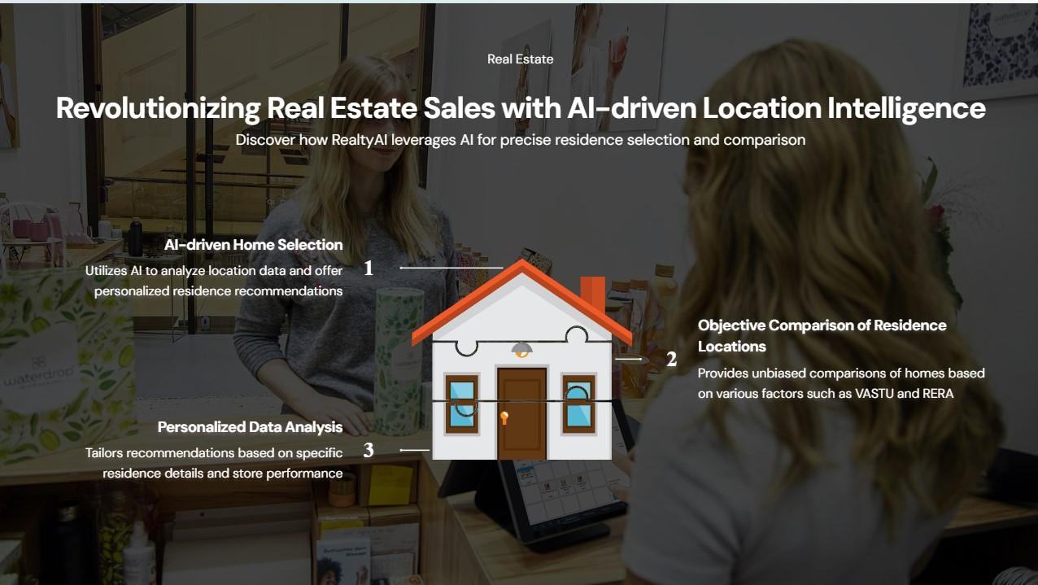

Slide 3



What’s wrong with the current condition ?
Lack of Transparency and cost inefficiencies:
Buyers often struggle to access crucial information about properties, such as authenticity of project. Manual processes may lead to money hindering brokerage .
Client satisfaction:
In a competitive market, superior client satisfaction sets businesses apart, leading to long-term success and sustainability.
Operational Complexity :
Complex property comparisons increase workload and reduce broker efficiency.

Slide 4

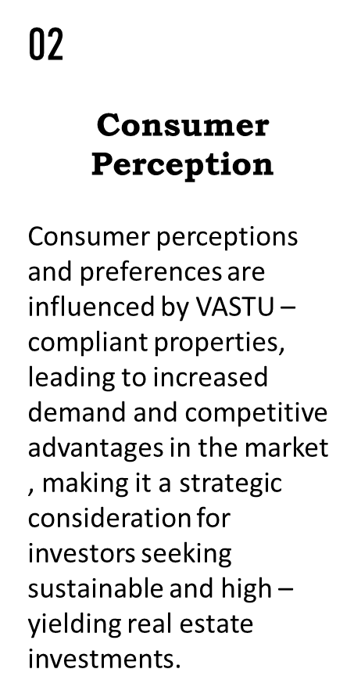
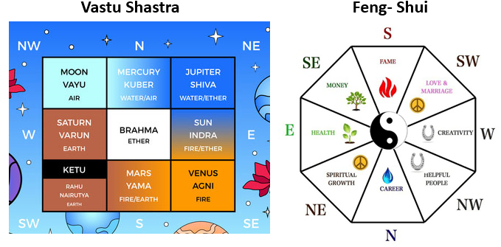
VASTU Principles in Real Estate
01
Universal Energy Alignment
Integrating VASTU principles in real estate design and development ensures the harmonization of properties with universal energies, creating spaces that promote prosperity , well – being, and positive vibrations , thereby enhancing the overall appeal and value of the properties.

Slide 5

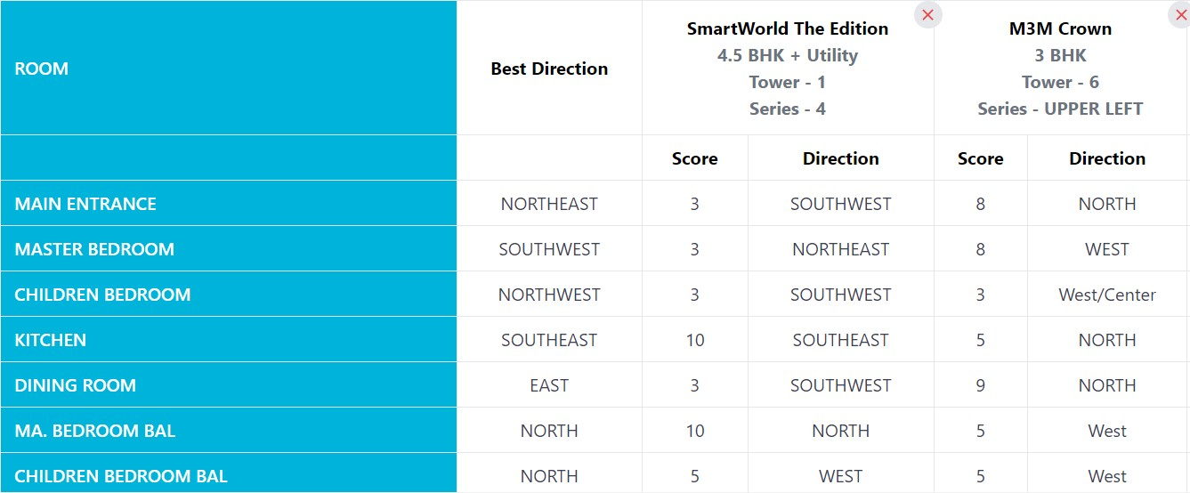
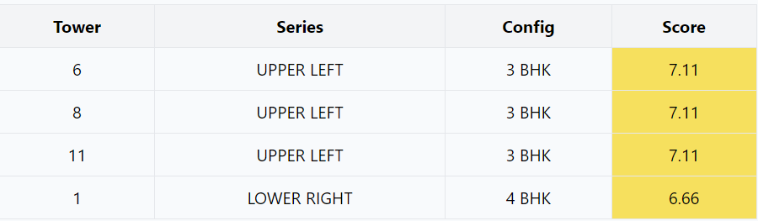
How Realty AI makes VASTU Principles easy to compare ?
Realty AI integrates VASTU principles into its algorithm to assess the alignment of real estate projects with VASTU principles , providing valuable insights for buyers and brokers .
VASTU Score
Realty AI's proprietary algorithm evaluates each real estate project based on VASTU principles, assigning a VASTU score to each tower.
Room Orientation and Comparison
Our algorithm determines the best direction for each room based on VASTU principles and compares them across properties
Room comparison

Slide 6

RERA in Real Estate
RERA stands for Real Estate (Regulation and Development) Act. It's a significant legislation in India aimed at regulating and promoting transparency in the real estate sector. RERA was enacted to protect the interests of homebuyers and to bring accountability and efficiency into the real estate industry.
RERA advantageous for brokers
Professionalism : Establishment of this state authority has brought professionalism into the brokers .
Authenticity: It authenticates brokers and promoters through certification.
Empowerment to Complaint : Brokers and promoters can now complain to the authority regarding any discrepancy in the industry or related transactions.
RERA advantageous for Buyers
Transparency : Verifying the basic project details .
Legal issues : Any litigations regarding the project
can be checked
Access to important documents
Past track record
Real estate’s agent information
Sense of trust

Slide 7
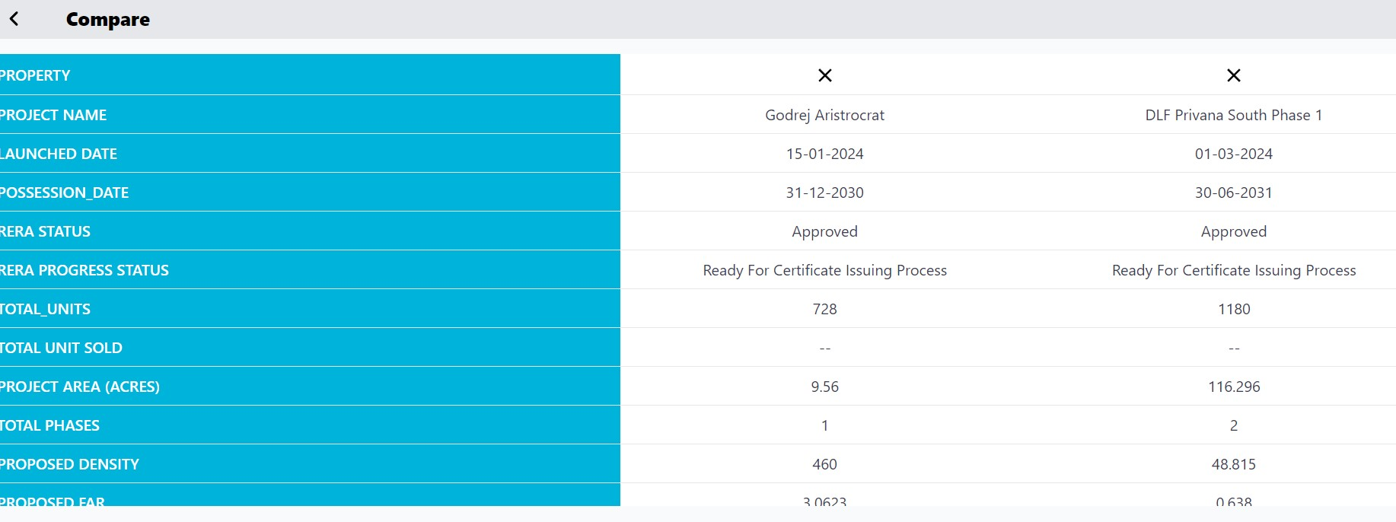
RERA integration with Realty AI
Verify RERA Regulation Status of Project:
RERA and AI technologies aim to address many of the below mentioned issues by promoting transparency, accountability, and efficiency in the real estate sector.
Delays
Quality Concerns
Finance details
Project layout
Project specifications
Legal issues
Environmental Compliance
Comparing projects with Realty AI

Slide 8



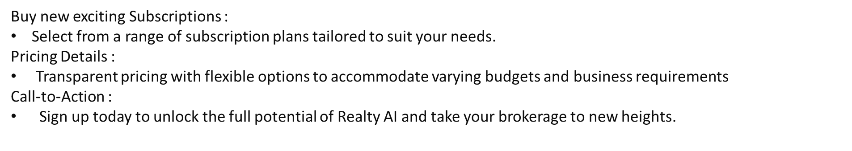
Visit our website : https://www.realtyai.net/
Visit VASTU and RERA product of Realty AI :
https://vastu.realtyai.net/home
https://rera.realtyai.net/home
Contact no :892339140

