Slide 1
GIT LEARNING
(An open source community)

Slide 2
Introduction
Git stands for “Global Information Tracker”.
It is a software developed by Linus Torvalds in 2005.
It is designed to record the changes to the file over time.
It is Distributed version control system(DVCS).
It gives us the ability to revert the files or the set of files we made changes. Hence it tracks all the type of files.
It is developed to manage projects with high speed and efficiency.

Slide 3
Features
Open Source
Scalability
Security
Speed
Distributed
Supports non-linear development
Branching and merging

Slide 4
Version Control System
Version Control System (VCS) is a software that helps software developers to work together and maintain a complete history of their work.
Following are the types of VCS −
Local version control system(LVCS).
Centralized version control system (CVCS).
Distributed/Decentralized version control system (DVCS).

Slide 5
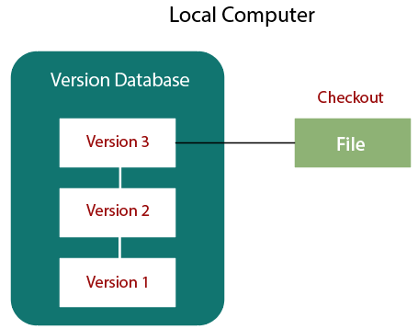
Local Version Control System
LCVS is used to copy files into another directory.
It keeps the files with timestamp directory.
LVCS helps in maintaining backup.

Slide 6
Centralized Version Control System
Centralized version control system (CVCS) uses a central server to store all files and enables team collaboration.
Major drawback of CVCS is its single point of failure, i.e., failure of the central server. Unfortunately, if the central server goes down for an hour, then during that hour, no one can collaborate at all.
And even in a worst case, if the disk of the central server gets corrupted and proper backup has not been taken, then you will lose the entire history of the project.

Slide 7
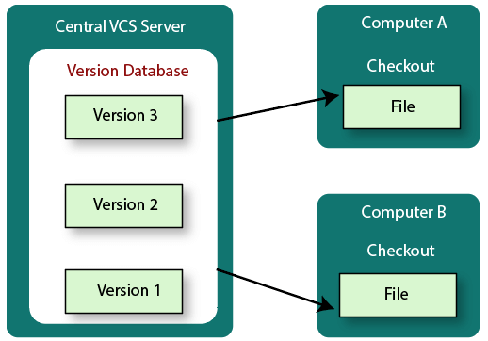
Fig CVCS

Slide 8
Distributed Version Control System
In DVCS clients not only check out the latest snapshot of the directory but they also fully mirror the repository.
If the server goes down, then the repository from any client can be copied back to the server to restore it. Every checkout is a full backup of the repository.
Git does not rely on the central server and that is why you can perform many operations when you are offline.
You can commit changes, create branches, view logs, and perform other operations when you are offline. You require network connection only to publish your changes and take the latest changes.

Slide 9
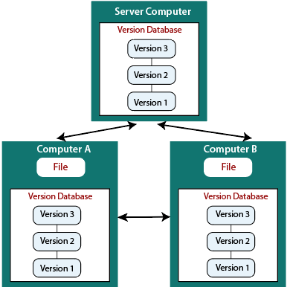
Fig DVCS

Slide 10
Advantages of Git
Free and open source
Fast and small
Implicit backup
Security
No need of powerful hardware
Easier branching and merging

Slide 11
Workflow
A VCS allows you to revert back to a previous state, revert the entire project back to a previous state, review changes made over time, see who last modified something that might be causing a problem, who introduced an issue and when, and more.
Working Directory:
The files that you see in your computer’s file system. When you open your project files up on a code editor, you’re working with files in the Working directory.
Staging Area or Index:
You can think of the staging area as a prep table where Git will take the next commit. Files on the Staging area are poised to be added to the repository.
Repository Area:
The git directory is when git stores the metadata and object database for your project.
When we commit the project changes will be stored in this area. This is what is copied when we clone a repository from another .

Slide 12
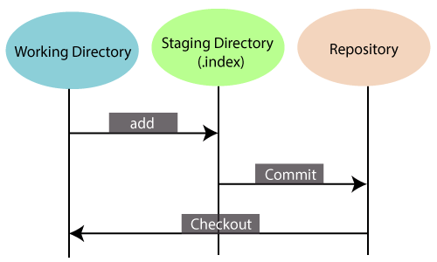
Fig: Git Workflow

Slide 13
Git Terminologies
Branch
Checkout
Cherry-picking
Clone
Fetch
HEAD

Slide 14
Index
Master
Merge
Origin
Pull/pull request
Push
Rebase
Remote
Repository
Stashing
Tag
Commit
Ignore

Slide 15
Branches:
Branches are used to create another line of development. By default, Git has a master branch, which is same as trunk in Subversion. Usually, a branch is created to work on a new feature. Once the feature is completed, it is merged back with the master branch, and we delete the branch.
Tags:
Tag assigns a meaningful name with a specific version in the repository. Tags are very similar to branches, but the difference is that tags are immutable. It means, tag is a branch, which nobody intends to modify.
Clone:
Clone operation creates the instance of the repository. Clone operation not only checks out the working copy, but it also mirrors the complete repository. Users can perform many operations with this local repository. The only time networking gets involved is when the repository instances are being synchronized.

Slide 16
Pull:
Pull operation copies the changes from a remote repository instance to a local one. The pull operation is used for synchronization between two repository instances. This is same as the update operation in Subversion.
Push:
Push operation copies changes from a local repository instance to a remote one. This is used to store the changes permanently into the Git repository. This is same as the commit operation in Subversion.
HEAD:
HEAD is a pointer, which always points to the latest commit in the branch. Whenever you make a commit, HEAD is updated with the latest commit. The heads of the branches are stored in .git/refs/heads/ directory.

Slide 17
Cherry Picking:
Cherry-picking in Git is meant to apply some commit from one branch into another branch. In case you made a mistake and committed a change into the wrong branch, but do not want to merge the whole branch. You can revert the commit and cherry-pick it on another branch.
Fetch:
It is used to fetch branches and tags from one or more other repositories, along with the objects necessary to complete their histories. It updates the remote-tracking branches.
Commits:
Commit holds the current state of the repository. A commit is also named by SHA1 hash. You can consider a commit object as a node of the linked list. Every commit object has a pointer to the parent commit object.

Slide 18
Checkout:
In Git, the term checkout is used for the act of switching between different versions of a target entity. The git checkout command is used to switch between branches in a repository.
Index:
The Git index is a staging area between the working directory and repository. It is used as the index to build up a set of changes that you want to commit together.
Master:
Master is a naming convention for Git branch. It's a default branch of Git. After cloning a project from a remote server, the resulting local repository contains only a single local branch. This branch is called a "master" branch. It means that "master" is a repository's "default" branch.

Slide 19
Merge:
Merging is a process to put a forked history back together. The git merge command facilitates you to take the data created by git branch and integrate them into a single branch.
Origin:
In Git, "origin" is a reference to the remote repository from a project was initially cloned. More precisely, it is used instead of that original repository URL to make referencing much easier.
Rebase:
In Git, the term rebase is referred to as the process of moving or combining a sequence of commits to a new base commit. Rebasing is very beneficial and visualized the process in the environment of a feature branching workflow.
From a content perception, rebasing is a technique of changing the base of your branch from one commit to another

Slide 20
Stashing:
Sometimes you want to switch the branches, but you are working on an incomplete part of your current project. You don't want to make a commit of half-done work. Git stashing allows you to do so. The git stash command enables you to switch branch without committing the current branch.
Git Ignore:
In Git, the term ignore used to specify intentionally untracked files that Git should ignore. It doesn't affect the Files that already tracked by Git.
Remote:
In Git, the term remote is concerned with the remote repository. It is a shared repository that all team members use to exchange their changes. A remote repository is stored on a code hosting service like an internal server, GitHub, Subversion and more.

Slide 21
GIT Basic Commands
Git config command
Git init command
Git clone command
Git add command
Git commit command
Git status command

Slide 22
Git push command
Git pull command
Git Branch command
Git Merge command
Git log command
Git remote command

Slide 23
Git config command
This command configures the user. The Git config command is the first and necessary command used on the Git command line. This command sets the author name and email address to be used with your commits. Git config is also used in other scenarios.
Syntax:
$ git config --global user.name “Username "
$ git config --global user.email User_email@gmail.com

Slide 24
Git init command
This command is used to create a local repository. The init command will initialize an empty repository.
Syntax:
$ git init Filename

Slide 25
Git clone command
This command is used to make a copy of a repository from an existing URL. If I want a local copy of my repository from GitHub, this command allows creating a local copy of that repository on your local directory from the repository URL.
Syntax:
$git clone URL

Slide 26
Git add command
This command is used to add one or more files to staging (Index) area.
Syntax:
To add one file :
$git add filename
To add multiple files:
$git add *

Slide 27
Git commit command
Commit command is used in two scenarios. They are as follows.
Git commit –m:
This command changes the head. It records or snapshots the file permanently in the version history with a message.
Syntax:
$ git commit -m " Commit Message"

Slide 28
b) Git commit -a
This command commits any files added in the repository with git add and also commits any files you've changed since then.
Syntax:
$ git commit -a

Slide 29
Git status command
The status command is used to display the state of the working directory and the staging area. It allows you to see which changes have been staged, which haven't, and which files aren’t being tracked by Git. It does not show you any information about the committed project history. For this, you need to use the git log. It also lists the files that you've changed and those you still need to add or commit.
Syntax:
$ git status

Slide 30
Other commands in git
Git rm command
Git reset command
Git revert command
Git diff command
Git fork command

Slide 31
Git push command
Pushing is an act of transfer commits from your local repository to a remote repo.Remote branches are configured by using the git remote command. Pushing is capable of overwriting changes, and caution should be taken when pushing.
Git push command can be used as follows.
git push origin master
This command sends the changes made on the master branch, to your remote repository.

Slide 32
Syntax:
$git push [variable name] master
Git push –all:
This command pushes all the branches to the server repository.
Syntax:
$ git push --all

Slide 33
Git pull command
Pull command is used to receive data from GitHub. It fetches and merges changes on the remote server to your working directory.
Syntax:
$ git pull URL

Slide 34
Git log command
This command is used to check the commit history.
Syntax:
$ git log
By default, if no argument passed, Git log shows the most recent commits first. We can limit the number of log entries displayed by passing a number as an option, such as -3 to show only the last three entries.

Slide 35
Git merge command
This command is used to merge the specified branch?s history into the current branch.
Syntax:
$ git merge BranchName

Slide 36
Git remote command
Git Remote command is used to connect your local repository to the remote server. This command allows you to create, view, and delete connections to other repositories. These connections are more like bookmarks rather than direct links into other repositories. This command doesn't provide real-time access to repositories.
Syntax:
$git remote add origin URL

Slide 37
Git Branch command
A branch is a version of the repository that diverges from the main working project. It is a feature available in most modern version control systems. A Git project can have more than one branch. These branches are a pointer to a snapshot of your changes. When you want to add a new feature or fix a bug, you spawn a new branch to summarize your changes.
Git master branch: The master branch is a default branch in Git. It is instantiated when first commit made on the project.

Slide 38
Operations on branch :
We can perform various operations on Git branches. The git branch command allows you to create, list, rename and delete branches. the git branch is tightly integrated with the git checkout and git merge commands.
Create branch:
You can create a new branch with the help of the git branch command. This command will be used as:
Syntax:
$ git branch <branch name>
List branch :
You can List all of the available branches in your repository by using the following command.
Either we can use git branch - list or git branch command to list the available branches in the repository.

Slide 39
Syntax:
$git branch --list
or
$git branch
Here, both commands are listing the available branches in the repository. The symbol * is representing currently active branch.
Delete Branch:
You can delete the specified branch. It is a safe operation. In this command, Git prevents you from deleting the branch if it has unmerged changes. Below is the command to do this.
Syntax:
$ git branch -d<branch name>
Another format of this command is git branch D. The 'git branch D' command is used to delete the specified branch.
$ git branch -D <branch name>

Slide 40
Delete a Remote Branch:
You can delete a remote branch from Git desktop application. Below command is used to delete a remote branch:
Syntax:
$ git push origin -delete <branch name>
Switch Branch:
Git allows you to switch between the branches without making a commit. You can switch between two branches with the git checkout command. To switch between the branches, below command is used:
$ git checkout<branch name>
Switch to master branch
You can switch to the master branch from any other branch with the help of below command.
Syntax:
$ git branch -m master

Slide 41
Rename Branch:
We can rename the branch with the help of the git branch command. To rename a branch, use the below command:
Syntax:
$ git branch -m <old branch name><new branch name>
Merge Branch:
Git allows you to merge the other branch with the currently active branch. You can merge two branches with the help of git merge command. Below command is used to merge the branches:
Syntax:
$ git merge <branch name>

