Slide 1
Project Introduction
My project is a Fraud Risk Analysis Dashboard developed using Power BI, Python, ML, AI. The main objective of this project is to analyze financial transactions and identify potentially fraudulent or high-risk transactions. I used the PaySim dataset, which contains simulated financial transaction data. I transformed the raw transaction data, created calculated columns and DAX measures, and developed an interactive dashboard to monitor transaction volume, fraud, risk levels, balance utilization, and high-value transactions
1

Slide 2
1. Business Problem
Financial institutions and digital payment platforms process a huge number of transactions every day, making it difficult to manually identify fraudulent transactions. Fraudulent activities can cause significant financial losses, affect customers, and reduce trust in the payment system.
Therefore, businesses need an automated fraud detection system that can analyze transactions quickly and identify potentially fraudulent activity.
Goal: analyze mobile-money transactions to identify behavioral, transactional, and balance-related patterns associated with fraud.
Build a model that predicts whether a transaction is legitimate or fraudulent.
Provide a practical fraud-monitoring interface so a user can enter transaction details and receive a prediction.
Important business idea: fraud detection is a highly imbalanced classification problem, so accuracy alone is not enough.
To develop a fraud detection system that can identify suspicious financial transactions and classify them as fraudulent or legitimate, helping financial organizations reduce financial losses and improve transaction security.
2

Slide 3
1. Business Problem
Transaction happens
↓
Analyze transaction details
↓
Check for suspicious patterns
↓
Fraud detection model
↓
┌───────────────┐
│ │
↓ ↓
SAFE FRAUD
✅ 🚨
2

Slide 4
DATASET
Column | Meaning
step | Time step of the transaction
type | Transaction type
amount | Transaction amount
nameOrig | Originating account
oldbalanceOrg | Original balance before transaction
newbalanceOrig | Balance after transaction
nameDest | Destination account
oldbalanceDest | Destination balance before transaction
newbalanceDest | Destination balance after transaction
isFraud | Actual fraud indicator
isFlaggedFraud | Whether the transaction was flagged
balance_utilization | Balance utilization category
amount_to_org_balance | Transaction amount relative to original balance
Risk Score | Calculated transaction risk score
Risk Level | Low/Medium/High/Critical classification
2

Slide 5
Technology Used
Technology | Purpose
Python | Main programming language
Pandas | Data loading, cleaning, and manipulation
NumPy | Numerical calculations and array operations
Matplotlib / Seaborn | Data visualization and EDA
Scikit-learn | Machine-learning models, preprocessing, and evaluation
Jupyter Notebook | Data analysis and model development
Streamlit | Web application/UI for fraud prediction
Joblib / Pickle | Saving and loading the trained ML model
PaySim Dataset | Dataset used for fraud detection
Power BI | Interactive dashboard and business/data analysis
Git/GitHub | Version control and project sharing
2

Slide 6
What your system analyzes
🔍 What your system analyzes
Your project looks at transaction characteristics such as:
Transaction type
Transaction amount
Sender's balance before transaction
Sender's balance after transaction
Receiver's balance before transaction
Receiver's balance after transaction
For Example:
Type = TRANSFER
Amount = 80,000
Sender old balance = 80,000
Sender new balance = 0
The system can identify this as potentially suspicious based on the patterns learned or rules applied.
2

Slide 7
🏢 Business Impact
Your project aims to help a financial organization:
1. Reduce financial losses 💰
Detect fraudulent transactions before they cause greater damage.
2. Improve security 🔐
Identify suspicious transaction behavior automatically.
3. Reduce manual investigation
Instead of employees checking every transaction, the system can prioritize suspicious transactions.
1,000,000 transactions
↓
Fraud detection system
↓
5,000 suspicious transactions
↓
Fraud investigation team
4. Improve customer trust
Better fraud prevention can help customers feel safer using digital payment services.
5. Enable real-time/near-real-time monitoring
A deployed model can potentially evaluate transactions as they occur, depending on the production architecture.

Slide 8
2. Dataset Understanding
Size
6,362,620 rows × 11 original columns
Target
isFraud: 0 = legitimate, 1 = fraudulent
Transaction types
PAYMENT, TRANSFER, CASH_OUT, DEBIT, CASH_IN
Original columns include step, type, amount, sender/receiver identifiers, balances, isFraud and isFlaggedFraud.
The project creates additional analytical features such as balance errors, merchant destination, transaction-to-balance ratio, hour, day and time period.
Data quality checks in the notebooks show no missing values and 0 duplicate rows.
3

Slide 9
3. Data Quality & Validation
Missing values
0 missing values across the dataset
Duplicates
0 duplicate rows removed
Identifiers
nameOrig starts with C; nameDest starts with C or M
String fields were stripped of leading/trailing whitespace.
Numeric and categorical columns were inspected through dtypes, unique values and frequency counts.
Fraud class counts: 6,354,407 legitimate vs 8,213 fraudulent transactions.
Fraud prevalence is only about 0.129%, making class imbalance a central modeling issue.
4

Slide 10
4. Feature Engineering
errorBalanceOrg
oldbalanceOrg − amount − newbalanceOrig
errorBalanceDest
newbalanceDest + amount − oldbalanceDest
isMerchantDest
1 if destination starts with M
amount_to_org_balance
amount / (oldbalanceOrg + 1e−5)
Time features: hour and day are derived from step; the dashboard also uses time_period.
large_transaction is defined in the dashboard as amount > 200,000.
These features translate raw transaction values into signals that may be more meaningful for fraud analysis.
5

Slide 11
5. Exploratory Data Analysis (EDA)
Transaction volume is dominated by CASH_OUT and PAYMENT, followed by CASH_IN, TRANSFER and DEBIT.
The fraud target is extremely imbalanced: only 8,213 of 6.36 million rows are fraud.
EDA examines relationships between transaction amount, balances, transaction type, time and fraud.
Balance-related derived features are especially useful because suspicious transactions can violate expected balance relationships.
Use the EDA charts to explain patterns first; use the ML model afterward to make predictions.
6

Slide 12
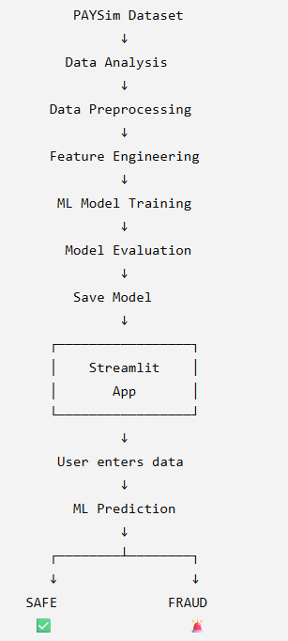
🌐 How your Streamlit application fits
6

Slide 13
6. Machine Learning Problem
Input (X)
Transaction type + amount + sender/receiver balances
Target (y)
isFraud
0 or 1
Split
70% training / 30% testing
stratified by target
The ML notebook defines y = isFraud and x = all remaining model columns.
The model pipeline ultimately uses five numeric fields plus the categorical transaction type.
Stratification preserves the rare fraud class proportion in train and test sets.
7

Slide 14
7. Preprocessing Pipeline
Numeric preprocessing
StandardScaler on amount and four balance variables
Categorical preprocessing
OneHotEncoder(drop='first', handle_unknown='ignore') on type
Classifier
LogisticRegression(class_weight='balanced', max_iter=1000)
ColumnTransformer applies the correct transformation to each data type.
Pipeline combines preprocessing and classification into one fitted object.
class_weight='balanced' gives more importance to the minority fraud class during training.
8

Slide 15
8. How the Prediction Works
1. User input
type + amount + balances
2. DataFrame
one transaction row
3. Preprocess
scale numeric + encode type
4. Logistic model
learned decision boundary
5. Output
0 / 1
The Streamlit prediction notebook loads fraud_detection_pipeline.pkl with joblib.
It creates a one-row DataFrame from the form values and calls model.predict(input_data).
Prediction 1 is displayed as potentially fraudulent; prediction 0 is displayed as not fraudulent.
9

Slide 16
9. Model Results
Accuracy
94.54%
Fraud recall
94% (class 1)
Fraud precision
2% (class 1)
Confusion matrix: TN = 1,802,246; FP = 104,076; FN = 153; TP = 2,311.
The model catches most fraud cases (high recall), but it also produces many false positives.
Therefore, the 94.54% accuracy should NOT be presented as the only measure of success.
For fraud detection, recall and precision are important because missing fraud and incorrectly flagging legitimate transactions have different business costs.
10

Slide 17
10. Streamlit Dashboard
Executive Overview
Total transactions, total volume, fraud transactions and fraud rate; transaction-type charts.
Fraud Analysis
Fraud incidents by hour and amount vs sender old balance.
Risk & Account Analysis
Risk-level breakdown and top high-risk transactions.
The dashboard loads paysim_final.csv and uses Plotly charts.
Risk rules in app.py label a row High Risk when isFraud = 1; Medium Risk when it is a large transaction or has a non-zero origin balance error; otherwise Low Risk.
A transaction-type multiselect filters the dashboard views.
11

Slide 18
11. Project Architecture
Raw PaySim data → profiling & validation → cleaning → feature engineering → EDA → model dataset → train/test split → preprocessing pipeline → Logistic Regression → saved .pkl model → Streamlit prediction app.
Supporting artifacts include notebooks for data profiling and ML, Python/Streamlit scripts, the serialized pipeline and a project presentation.
The project separates analysis/model development from the prediction interface, which makes the workflow easier to explain and deploy.
12

Slide 19
DASHBOARD OBJECTIVE
The dashboard contains slicers and cross-filtering. When the user selects a transaction type, risk level, fraud status, time period or balance utilization category, the KPIs and visualizations dynamically update based on that selection
15

Slide 20
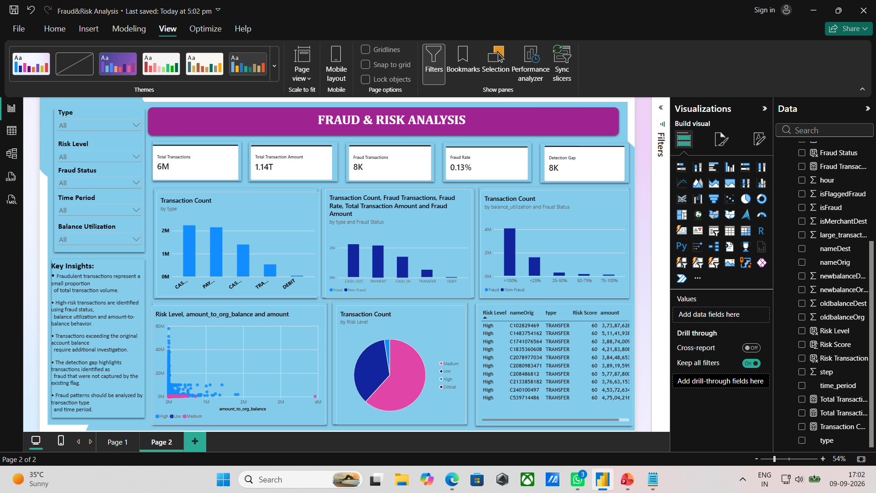
DASHBOARD
15

Slide 21
KEY INSIGHTS
Fraud represents a very small percentage of total transaction volume.
High-risk transactions require investigation even when overall fraud volume
is low.
Transaction type is an important fraud-analysis dimension.
High balance utilization can indicate potentially unusual transactions.
Transaction-to-balance ratio can identify unusual transactions.
15

Slide 22
BUSINESS BENEFITS
Benefits:
Faster fraud investigation
Easy monitoring
Risk prioritization
Interactive analysis
Reduced manual effort
Better decision-making
Easy identification of suspicious transactions
15

Slide 23
13. Important Limitation to Explain Clearly
Model limitation
High recall comes with very low fraud precision (2%). In production, many legitimate transactions could be flagged and require review.
Dashboard limitation
The current prediction UI is separate from the analytical risk dashboard. Also, the simple app.py version only demonstrates the UI and does not call the saved model.
Do not claim the model is 94% accurate at identifying fraud. The reported 94.54% is overall accuracy.
Do not say the model is production-ready. The project evidence supports a working academic prototype.
Future work: compare tree-based models, tune the decision threshold, evaluate PR-AUC, and reduce false positives.
14

Slide 24
13. Important Limitation to Explain Clearly
Model limitation
High recall comes with very low fraud precision (2%). In production, many legitimate transactions could be flagged and require review.
Dashboard limitation
The current prediction UI is separate from the analytical risk dashboard. Also, the simple app.py version only demonstrates the UI and does not call the saved model.
Do not claim the model is 94% accurate at identifying fraud. The reported 94.54% is overall accuracy.
Do not say the model is production-ready. The project evidence supports a working academic prototype.
Future work: compare tree-based models, tune the decision threshold, evaluate PR-AUC, and reduce false positives.
14

Slide 25
14. Conclusion
The project demonstrates an end-to-end fraud analytics workflow: understand → validate → engineer features → explore → model → evaluate → deploy a prediction interface.
PaySim’s severe class imbalance is the key modeling challenge.
Logistic Regression with balanced class weights successfully captures most fraud cases, but its low precision shows that further model/threshold improvement is needed.
The Streamlit interface turns the trained pipeline into a simple interactive prediction application.
Thank You
15

