Slide 1
Ubiquitous and Mobile Computing CS 528: Stud-e-Book App
Amisha Jindal, Baoxin Liu, Bhoomi Patel,
Florina Asani, Sanika Patki, Srinarayan Srikanthan
Computer Science Dept.
Worcester Polytechnic Institute (WPI)

Slide 2

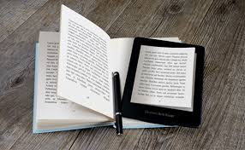
Introduction
Cool study book app which encourages students to read and study.
Provides recommendations for study books.
Makes reading and studying much more fun by offering flexibility.
Offers touch free page swipes
Picture Credits: Google

Slide 3
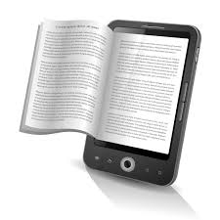

Motivation
Enjoy flexibility - Make learning fun!
Students need not carry hardcopies of study books
No need to download an e-book on machine
Refer similar books and study subject in depth
Keep all your study books in one app
Picture Credits: Google

Slide 4

Difficulty Points
Mobile Components and UI (8 points)
Android Screens
Camera
Ubiquitous Components (18 points)
Gesture detection – Proximity Sensor
Gesture detection – Gyroscope Sensor
Speech recognition: Speech-to-text
Machine learning Component (20 points)
Recommendation System
Image to Text OCR – ML Kit

Slide 5




Related Work
Picture Credits: https://www.tomsguide.com/us/pictures-story/583-best-ereader-apps.html, Google

Slide 6
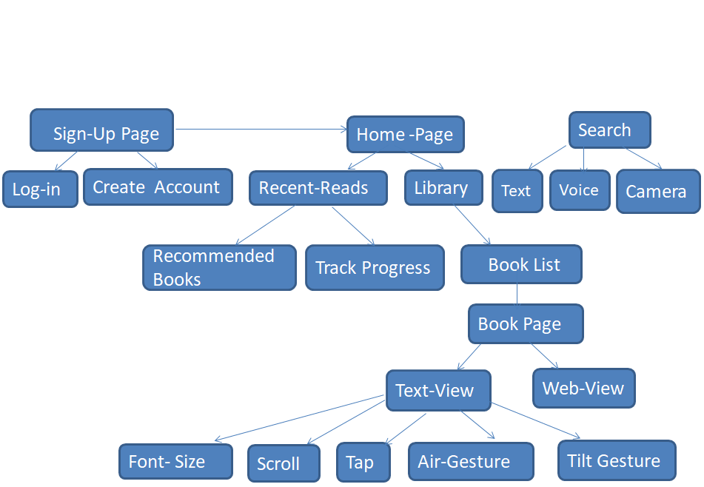
Methodology – Workflow

Slide 7



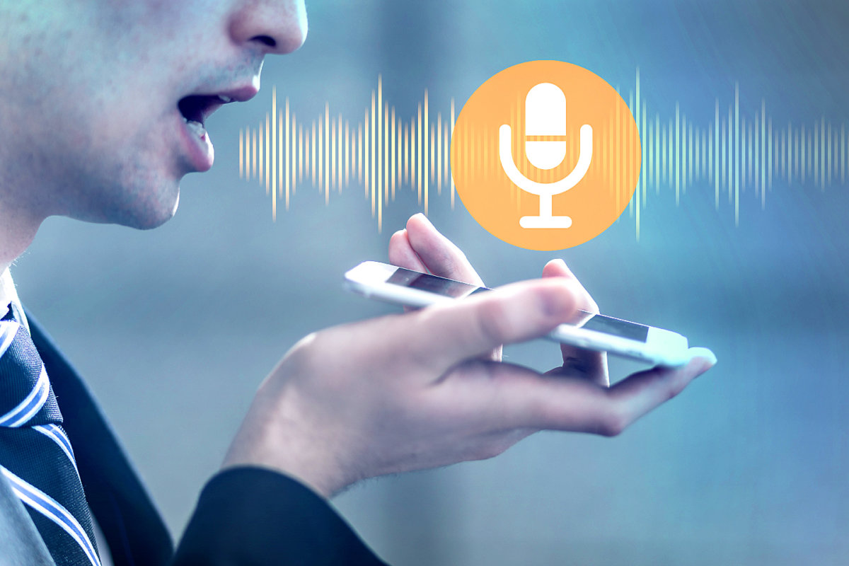
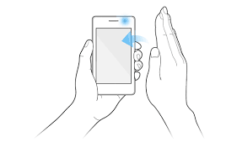
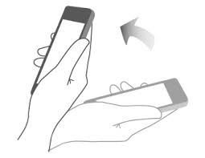

Implementation – Android and 3rd party modules
Database/Storage/Authentication
Optical Character Recognition
Voice Recognition
Gesture Recognition -Proximity & Gyroscope Sensors
Picture Credits: Google

Slide 8
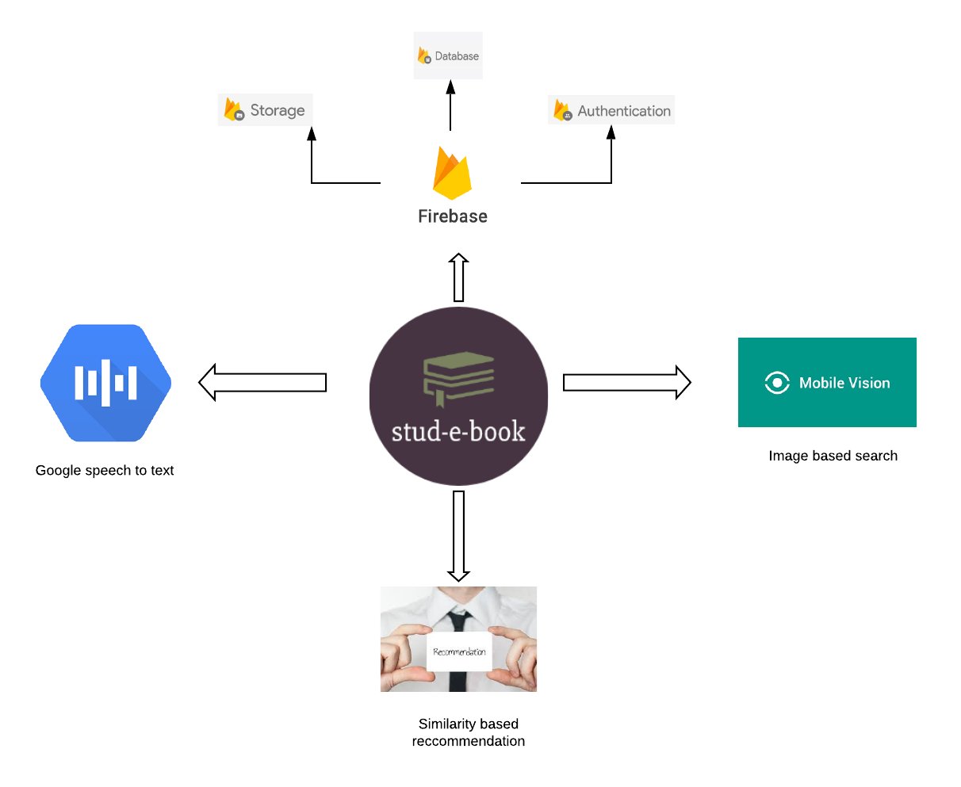
Implementation – Software Architecture

Slide 9
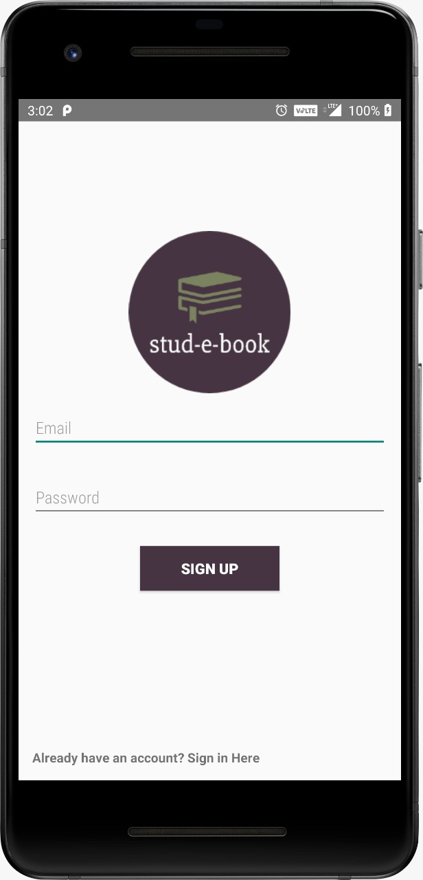
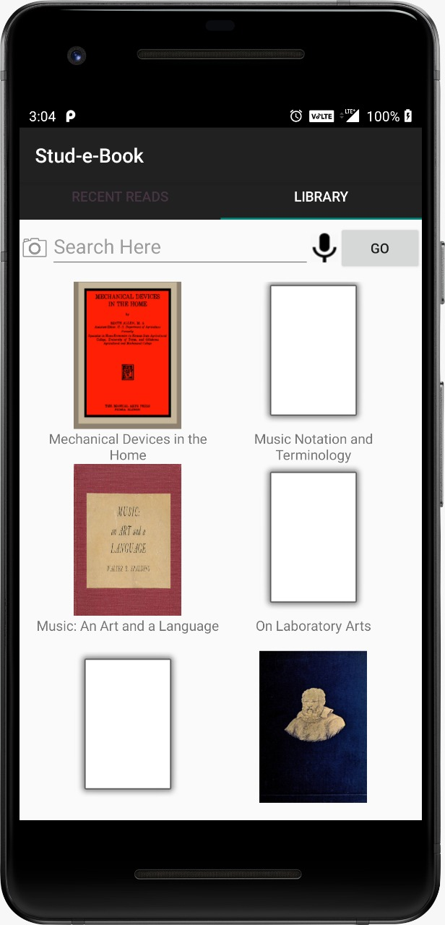
Implementation – UI Screenshots

Slide 10
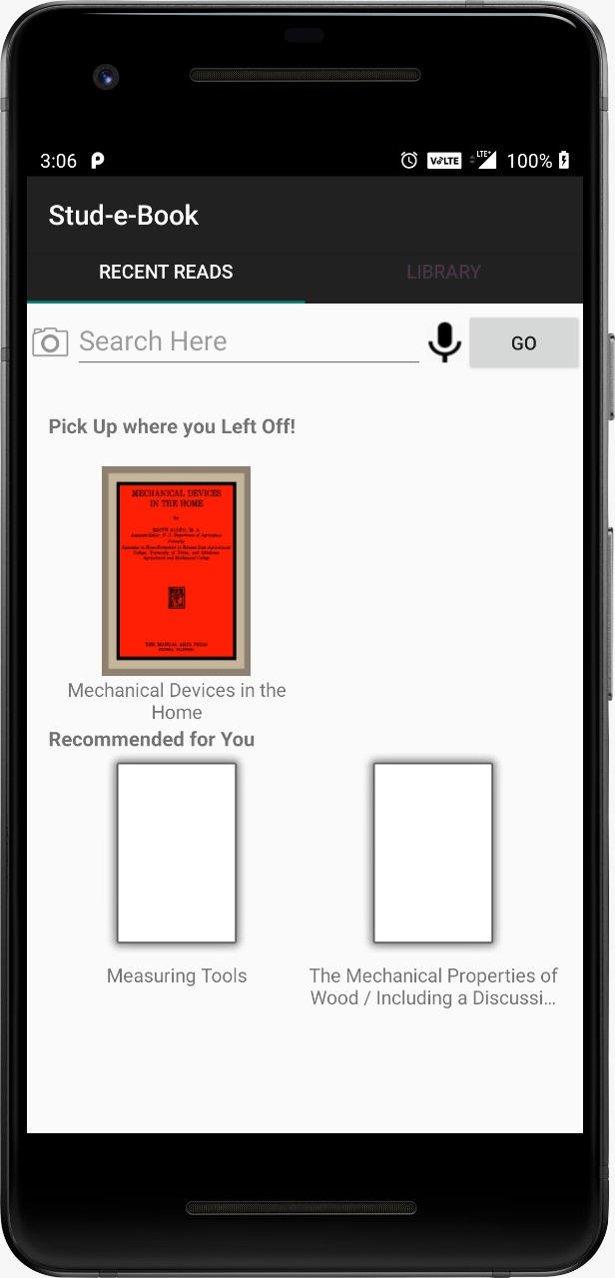
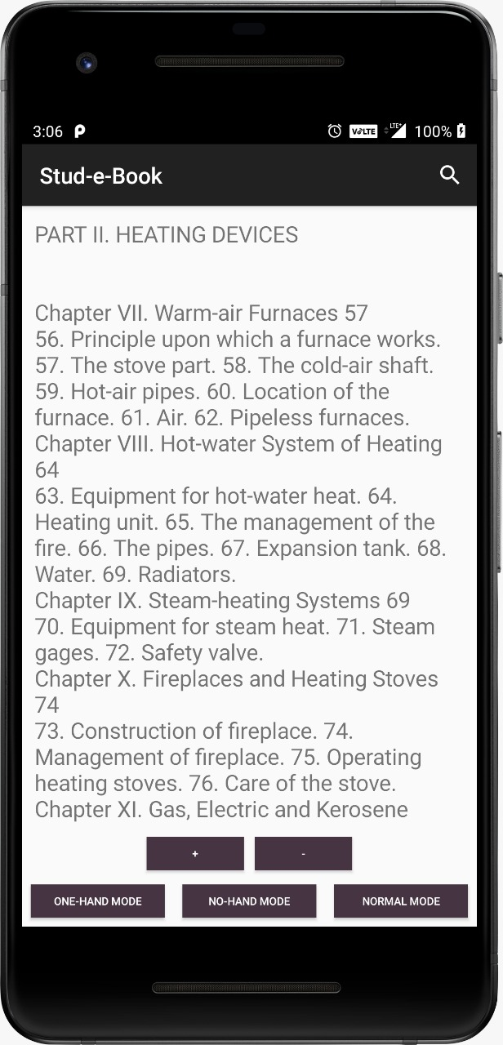
Implementation – UI Screenshots

Slide 11
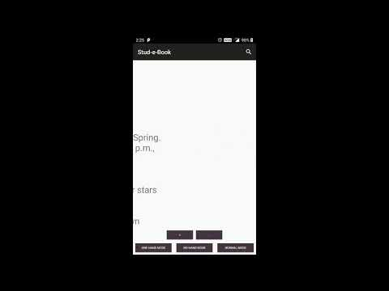
Demo

Slide 12
Results and Evaluation
Recommendation Similarity results
Mobile sensors performance evaluation on different phones
Tested and evaluated by 12 of our peers
 | Most Similar Books | Cosine Similarity
 | An Elementary Study of Insects | 0.82
An elementary study of Chemistry | The Chemistry of Hat Manufacturing | 0.46
 | The Chemistry of Food and Nutrition | 0.43

Slide 13


Evaluation feedback
Onehand mode, transitions too many pages at a time
Readjust proximity measure
Reading mode buttons too small
Customize font size
Remove text or web view
Add night/day mode
Add unit and integration tests

Slide 14
Future Scope
Epub files did not all have cover images – Fix by using other sources
Implement requested features through feedback
Increase library size and categories
Improve UI on tablet view
Highlight and lookup word meaning
Recognize boredom and push user notifications

Slide 15
References
https://developer.android.com/docs
https://firebase.google.com/docs/android/
https://developers.google.com/android/guides/overview

