Slide 1
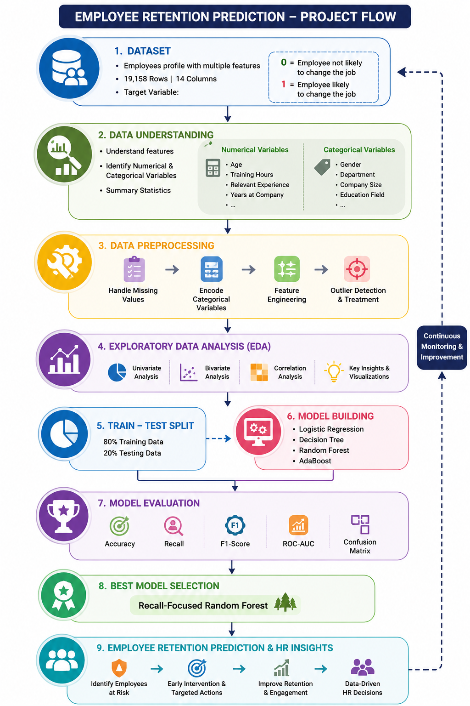
EMPLOYEE RETENTION PREDICTION

Slide 2
AGENDA:
Objective
Data Understanding
Data Preprocessing
EDA(Exploratory Data Analysis)
Model Selection
Model Evaluation
Conclusion & Recommendations

Slide 3

INTRODUCTION
FOCUS: Predict employee attrition using employee demographic, experience and training data.
Why: Reduce turnover costs and improve workforce stability.
How: Apply machine learning models to identify employees at risk of leaving.
Goal: Enable proactive HR interventions and improve employee retention.

Slide 4

Objectives:
Predict the probability of an employee seeking a job change.
Identify top factors influencing job change decisions.
Build a model with optimal accuracy and generalization.
Provide actionable insights for retention planning.

Slide 5
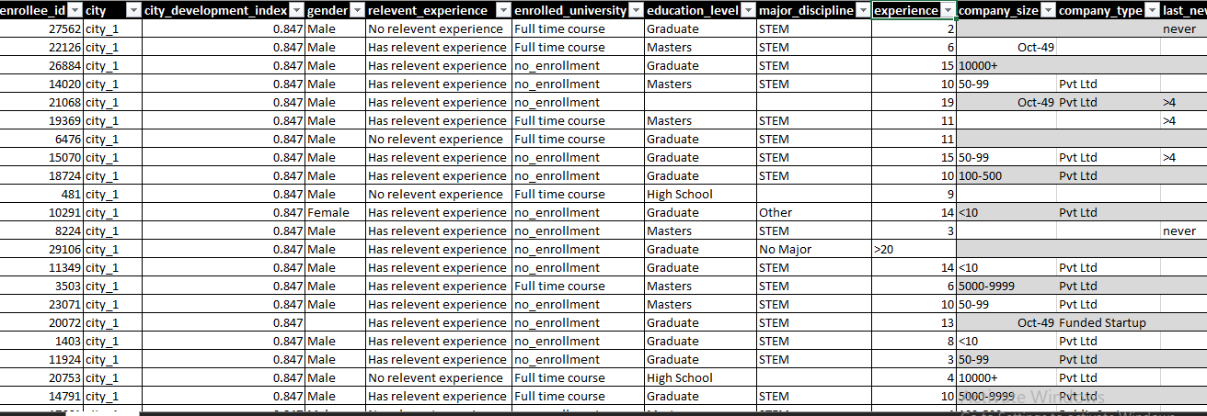
Data Acquisition
DATASET: Employees profile with multiple features.
Target variable:
0 = Employee not likely to change the job.
1 = Employee likely to change the job.
Variables: categorical variables and Numerical variables
Size : ROWS :19158
COLUMNS: 14

Slide 6
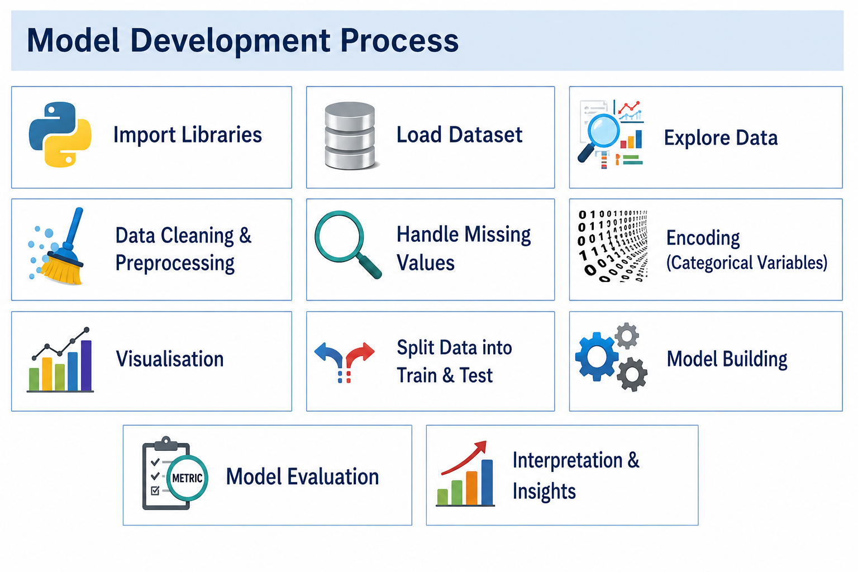

Slide 7
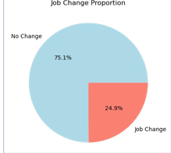

Exploratory Data Analysis(EDA)
RETENTION V/S ATTRITION
The dataset is imbalanced, with significantly more retained employees than employees likely to leave.
Approximately 75% of employees belong to the retained class (0), while 25% belong to the attrition class (1).
Since the classes are not evenly distributed, metrics such as Precision, Recall, F1-Score, and ROC-AUC are important alongside Accuracy when evaluating the model.

Slide 8
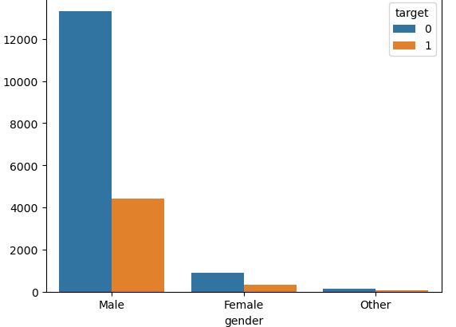
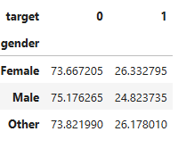
GENDER V/S TARGET Male employees have the highest retention rate at 75.18% and the lowest attrition rate at 24.82%. Female employees show a slightly higher attrition rate (26.33%) compared to males. Employees categorized as Other have an attrition rate (26.18%) similar to females. The difference in attrition rates across genders is relatively small (around 1.5 percentage points), suggesting that gender is not a major factor influencing employee retention in this dataset.

Slide 9
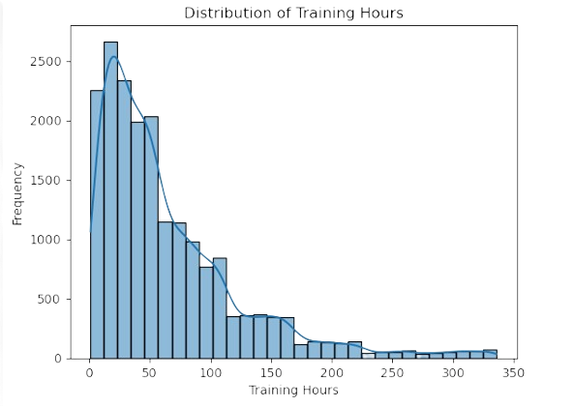
Distribution of Training Hours v/s Frequency
Training hours is positively (right) skewed .
Most employees have low training hours (roughly between 10 and 60 hours).
As training hours increase, the number of employees decreases.
Very few employees have training hours above 200.
There are some extreme values up to around 330 hours, which may be considered outliers.

Slide 10
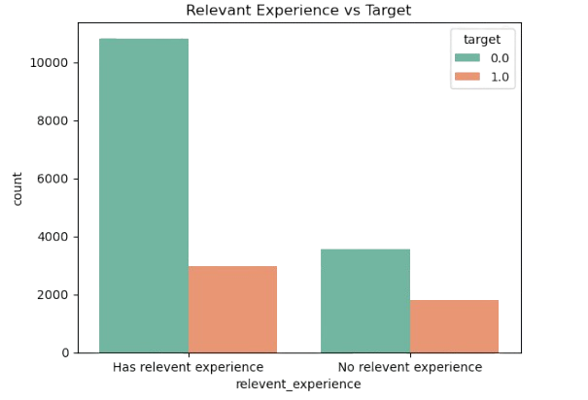
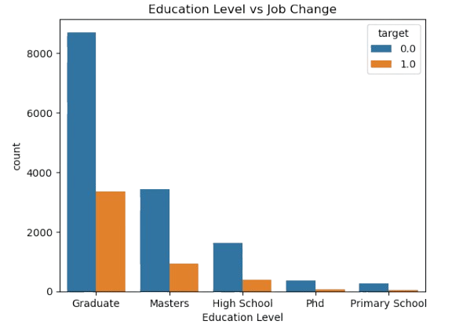
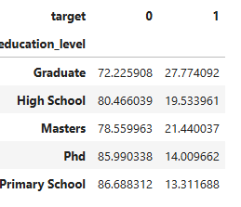
Employees with relevant experience are less likely to change a Job.
Those without relevant experience have a relatively higher proportion of job changes
Graduates form the largest group and have significant job change activity.
Higher qualifications like PhDs and Masters have lower counts overall, but still show job change cases.

Slide 11
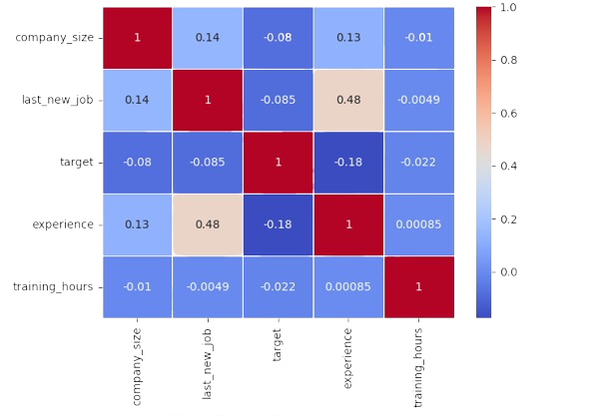
CORRELATION HEATMAP
Low correlations between most features indicate minimal multicollinearity.
Last new job moderately correlated with experience (0.48).
Target variable has weak correlation with individual features — model must learn from combinations.

Slide 12
Model Selection
I choose 4 Machine learning models for this study, each serving a different purpose:
Logistic Regression
Decision Tree
Easy to visualize and interpret. Captures non-linear relationships between features and the target. Hyperparameters tuned to improve recall while avoiding overfitting.
Predicts employee attrition probability using a sigmoid function.
Simple, fast, and highly interpretable model.
Serves as a strong baseline classification model.

Slide 13
Random Forest
Combines multiple Decision Trees for better predictions. Reduces overfitting and improves accuracy. Identifies the most important features affecting attrition.
AdaBoost
Boosting algorithm that improves weak learners sequentially. Focuses on correcting previously misclassified case Enhances overall Prediction Performance and Accuracy. The choice of these models balances interpretability (Logistic Regression) and predictive power (Random Forest) while focusing on the business requirement of high recall.

Slide 14
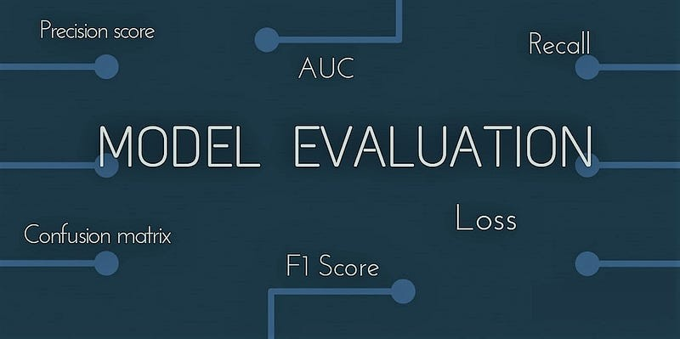
Evaluation Metrics:
Accuracy :Proportion of correct predictions among total predictions.
Precision :Out of predicted positives, how many are truly positive
Recall (Sensitivity) : Out of actual positives, how many were correctly identified.
Specificity :Out of actual negatives, how many were correctly identified.
F1 Score : Harmonic mean of Precision & Recall; balances both metrics.
ROC-AUC :Measures classification ability across thresholds; higher is better

Slide 15

Model Comparison
Model Selection
Random Forest performed well because it uses multiple decision trees, which improves prediction accuracy, reduces overfitting, and handles complex patterns in employee data more effectively than a single model.

Slide 16
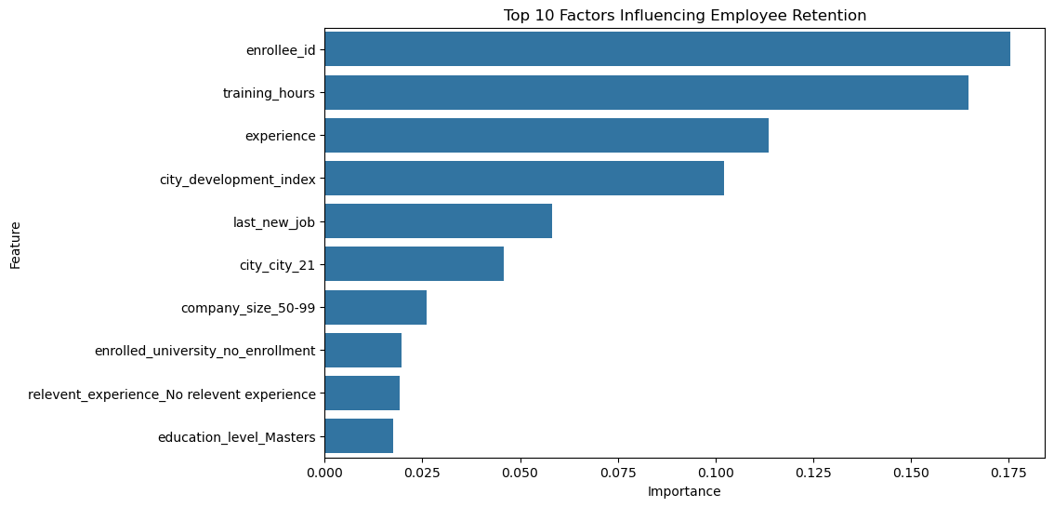
BEST MODEL FROM THE ABOVE ANALYSIS
Four machine learning models were evaluated for Employee Retention Prediction: Logistic Regression, Decision Tree, Random Forest, and AdaBoost. Although Logistic Regression achieved the highest accuracy (77.66%), Random Forest demonstrated the best overall balance between Precision and Recall, resulting in the highest F1 Score (47.46%).
Since employee retention prediction requires correctly identifying employees who are likely to leave, F1 Score was considered a key evaluation metric. Based on overall performance , Random Forest was selected as the final model for this project.

Slide 17
Conclusion
Random Forest emerged as the best-performing model for attrition prediction.
High Recall ensured better identification of employees at risk of leaving.
Important factors included training hours, experience, and company size.
Insights can support proactive HR interventions and improve retention outcomes.
The model enables informed, data-driven decision-making for workforce management.

Slide 18
Thank You!

