Slide 1

HUMAN FACE DETECTION
A Project to make lives easier

Slide 2
HUMAN FACE DETECTION
1. Introduction
2. Motivation
3. Innovation of Project
4. Scope of the Project
5. Open-CV Python
6. Face Detection
7. Haar Features System
8. Conclusion

Slide 3
Introduction
Face detection is a computer vision technology that helps to locate/visualize human faces in digital images. This technique is a specific use case of object detection technology that deals with detecting instances of semantic objects of a certain class (such as humans, buildings or cars) in digital images and videos. With the advent of technology, face detection has gained a lot of importance especially in fields like photography, security, and marketing.

Slide 4
Motivation
We developed this Face Detection Project for our Indian Army, Security CCTV Police and even Common Use of people to detect Face in single and group of peoples in Images. Today In world Security is advancing to detect the terrorist and criminals easily in crowd. This Project will easily detect faces even old\blur Images with very less time of execution. This Face Detection Code can be deployed and use in any application camera, security apps and website to found faces easily.

Slide 5
Innovation Idea of Project
1. It can Detect faces easily with less time of execution. 2. It can Detect Face in any quality of Images even blur. 3. It can Detect single, double or even multiple faces in any Image. 4. It can tell the number of Peoples/faces in Image. 5. It is fully automatic face recognition system 6. It is one of the best in today world Innovation as per less number of code use in the system. 7. It use Haar feature based Algorithm to detect which it makes very accurate and fast processing of face detection

Slide 6
Scope Of The Project
To identify and verify terrorists at airports, railway stations and malls the face recognition technology will be the best choice in India as compared with other biometric technologies since other technologies cannot be helpful in crowded places. This technology can also be used effectively in various important examinations such as SSC, HSC, Medical, Engineering, MCA, MBA, B- Pharmacy, Nursing courses etc. The examinee can be identified and verified using Face Recognition Technique. It can also be deployed in police station to identify and verify the criminals. To Identify the Number of student in classroom. It can collect in all the number of faces in less than 1 sec. Easy to take attendance

Slide 7
OpenCV-Python
OpenCV essentially stands for Open Source Computer Vision Library. Although it is written in optimized C/C++, it has interfaces for Python and Java along with C++. OpenCV boasts of an active user base all over the world with its use increasing day by day due to the surge in computer vision applications. OpenCV-Python is the python API for OpenCV. You can think of it as a python wrapper around the C++ implementation of OpenCV. OpenCV-Python is not only fast (since the background consists of code written in C/C++) but is also easy to code and deploy(due to the Python wrapper in foreground). This makes it a great choice to perform computationally intensive programs.

Slide 8
Installation
OpenCV-Python supports all the leading platforms like Mac OS, Linux, and Windows. It can be installed in either of the following ways: Packages for standard desktop environments (Windows, macOS, almost any GNU/Linux distribution) ● run pip install opencv-python if you need only main modules ● run pip install opencv-contrib-python if you need both main and contrib modules

Slide 9
Face Detection
Face detection is a technique that identifies or locates human faces in digital images. A typical example of face detection occurs when we take photographs through our smartphones, and it instantly detects faces in the picture.
Face detection is different from Face recognition. Face detection detects merely the presence of faces in an image while facial recognition involves identifying whose face it is. In this article, we shall only be dealing with the former.

Slide 10
Face Detection
Face recognition is the task of identifying an already detected object as a known or unknown face. Often the problem of face recognition is confused with the problem of face detection Face Recognition on the other hand is to decide if the "face" is someone known, or unknown, using for this purpose a database of faces in order to validate this input face

Slide 11
Face Detection Classifiers
Face detection is performed by using classifiers. A classifier is essentially an algorithm that decides whether a given image is positive(face) or negative(not a face). A classifier needs to be trained on thousands of images with and without faces. Fortunately, OpenCV already has two pre-trained face detection classifiers, which can readily be used in a program. The two classifiers are: ● Haar Classifier and ● Local Binary Pattern (LBP) For this Project, Will only discuss the Haar Classifier for Face Detection as it best method for detection.

Slide 12
Haar Feature-based Cascade Classifiers
Haar-like features are digital image features used in object recognition. They owe their name to their intuitive similarity with
Haar wavelets and were used in the first real-time face detector. Paul Viola and Michael Jones in their paper titled "Rapid
Object Detection using a Boosted Cascade of Simple Features" used the idea of Haar-feature classifier based on the Haar
wavelets.
This classifier is widely used for tasks like face detection in computer vision industry.
Haar feature-based cascade classifiers is an effectual machine learning based approach, in which a cascade function is trained
using a sample that contains a lot of positive and negative images. The outcome of AdaBoost classifier is that the strong
classifiers are divided into stages to form cascade classifiers.

Slide 13
CODE : -

Slide 14


Slide 15


Slide 16
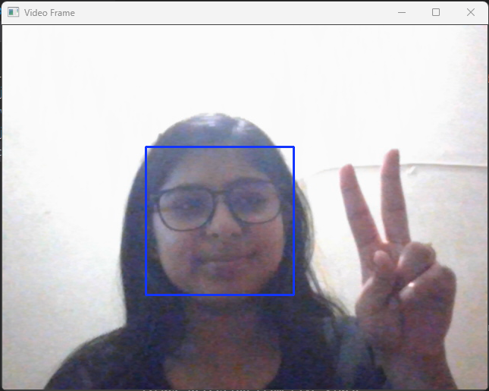
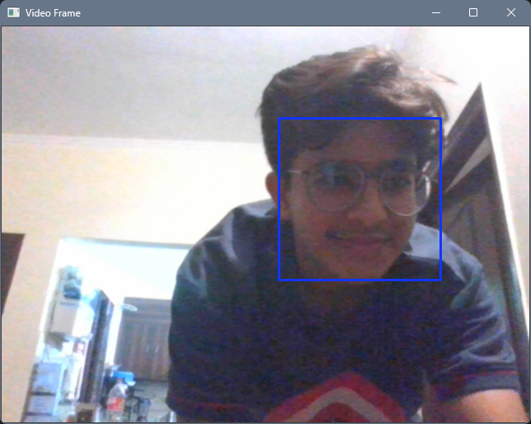
Sample Output

Slide 17
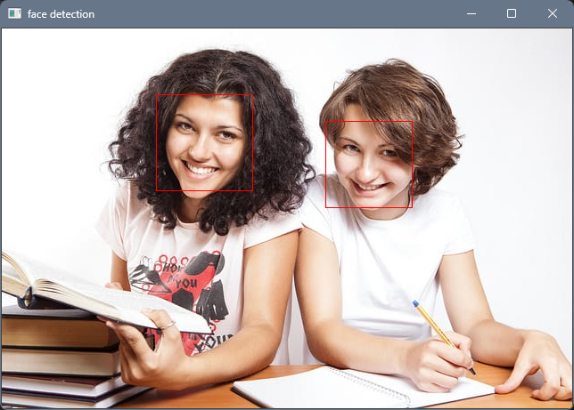
Sample Output

Slide 18
Conclusion
Face recognition technologies have been associated generally with very costly top secure applications. Today the core technologies have evolved and the cost of equipments is going down dramatically due to the integration and the increasing processing power. Certain applications of face recognition technology are now cost effective, reliable and highly accurate. As a result there are no technological or financial barriers for stepping from the pilot project to widespread deployment.
Government and NGOs should concentrate and promote applications of facial recognition system in India in various fields by giving economical support and appreciation.

Slide 19
References
1. http://umpir.ump.edu.my/id/eprint/327/3/Real%20time%20face%20detec
tion%20system%20-%20Chapter%201.pdf
2. https://www.sciencedirect.com/topics/computer-science/classifier-cascad
e
3. https://ieeexplore.ieee.org/document/6315916
4. https://link.springer.com/chapter/10.1007/978-3-642-72201-1_9
5. https://thesai.org/Downloads/Volume9No6/Paper_6-Study_of_Face_Recog
nition_Techniques.pdf
6. http://www.pace.ac.in/documents/ece/FACE%20RECOGNITION%20SYSTE
M%20WITH%20FACE%20DETECTION.pdf

