Slide 1
Capstone Project
Spring boot application
with Jwt authentication

Slide 2
Contents
Functionality of my spring boot application
Integrating and compiling my code using maven with CI/CD
Testing my code using Jacoco and SonarQube
Create and Push docker image in docker repository
Creating continuous deployment to deploy my application
on AKS(Azure Kubernetes Service)

Slide 3
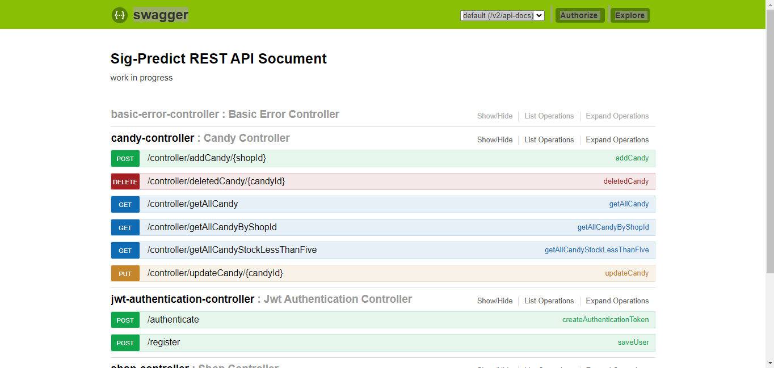
Spring boot application with Jwt authentication

Slide 4
Functionality of my spring boot application
All api’s will be secured.
function to register yourself and get authenticated.
Once authenticated perform all operation.
End-to-end documentation of application using swagger UI.
MySQL databse to keep the records

Slide 5


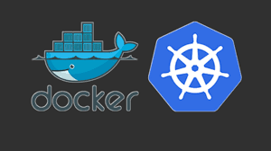
Project Workflow
Jenkins Pipeline
Pull from git
Run maven build
Checkstyle
Code coverage
Sonarqube analysis
Push jar to nexus repo
Creating docker image, aks cluster and deploy application
Git Repository
Having multiple branches (Dev, test, prod)
https://github.com/amisham96/caption-final-project.git
AKS Cluster
Fetch image from
Docker hub
Create deployment for mysql database and application

Slide 6
Points to be cover
Multi build pipeline for caption project
Add testing stage(check style reports, code coverage)
SonarQube integration and Push jar to Nexus repo.
Creating docker images and push it to docker hub.
Create Aks using terraform.
Deploy application to Aks.

Slide 7
Thankyou

