Slide 1
Параллельные вычисления Учебный год – 2020/21, весенний семестр Группа P33212 Лекция 6
Преподаватели:
Балáкшин Павел Валерьевич
(pvbalakshin@gmail.com),
Мишенёв Алексей Вадимович
(mishenevalex@gmail.com)

Slide 2
Measurement of overhead costs for thread creation in OpenMP
for (i = 1; i < 382; i++) {
omp_set_num_threads(i);
gettimeofday(&T1, NULL);
#pragma omp parallel
#pragma omp master
s++;
gettimeofday(&T2, NULL);
print_delta(T2, T1);
}
The omp_get_max_threads function allows to know the maximum number of threads (in the example this number is 381).
Notes:
Creation of new thread: request to OS, creation and start of this thread
We create 381 threads, all of them are not doing anything, master thread runs one simple command (s++) that has very small cost
We have 2 points for time measurement.
QUESTIONS: how many lines of code is running in parallel here?
ANSWER: 0, only master
381 – example of some machine. You can have different number on your machine.

Slide 3
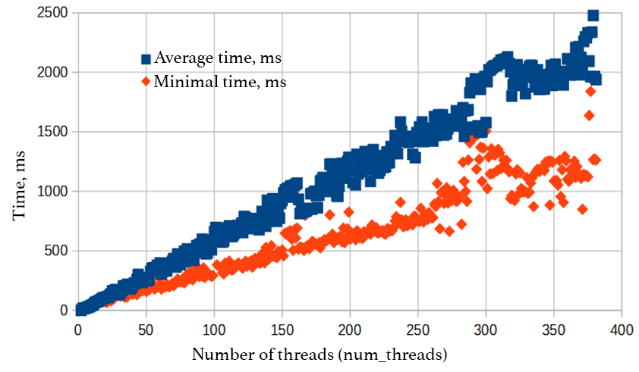
Measurement of overhead costs for thread creation in OpenMP (2)
Notes:
2 axis
There are 2 approaches (min – OS is free, average – some background tasks), but there is linear function
So, 1 thread requires about 3-5 ms.
If you program runs less that 1 second, then usage of 300 threads is a wrong approach.

Slide 4
Nested parallelism
Example 1 | Example 2
omp_set_nested(1); #pragma omp parallel num_threads(2) { putchar("!"); #pragma omp parallel num_threads(3) putchar("!"); } | omp_set_num_threads(5); #pragma omp parallel for for (i = 0; i < 10; i++) { … #pragma omp parallel for for (j = 0; j < 10; j++) { putchar("!"); } … }
Notes:
omp_set_nested(0) – no nested parallelism
omp_set_nested(1) – allow nested parallelism
Example 1:
Pragma omp parallel for will calculate the number of iterations before the code execution.
Each thread will create it’s own 3 threads.
QUESTION: how many times ‘!’ will be printed?
ANSWER: 8.
If omp_set_nested(0), or without this row – 4 “!”.
Example 2:
Without first line we would have 100 iterations total, and ‘!’ will be printed 100 times.
#pragma omp parallel for takes the following loop and split all iterations by number of existed threads. No more threads will be created!
QUESTION: how many times ‘!’ will be printed?
ANSWER: 10*10 = 100.
QUESTION: If we exclude ‘for’ from both for-s how may times ‘!’ will be printed?
ANSWER: 5*10*5*10 = 2500.

Slide 5
Nested parallelism (2)
omp_set_num_threads(5); #pragma omp parallel for collapse(2)
for (i = 0; i < 10; i++) {
…
for (j = 0; 0 < 10; j++) {
putchar("!");
printf("%d.%d\n", i, j);
}
…
}
omp_set_num_threads(5);
#pragma omp parallel for
for (int ij = 0; ij < 10*10; ++ij) {
int i = ij / 10;
int j = ij % 10;
…
putchar("!");
printf("%d.%d\n", i, j);
}
Since OpenMP 3.0 only!
Notes:
Compiler forms a single loop and then parallelizes this
Finally it allows parallelization of perfectly nested loops without using nested parallelism.
Parameter set the number of loops to be used.
If more than one loop is associated with the loop construct, then the iterations of all associated loops are collapsed into one larger iteration space.
In practical terms, it gives more consistent parallelization, if there are a lot of threads and few iterations in the outermost loop (for example, if there are 10 iterations in the outer loop and 32 processor cores in the system, then without this tricky option the loop will be parallelized to only 10 cores).
These two programs will return the same result, but the first program will give the order 0.1, 0.2, 0.3, …, however the second one will return random one: 2.0, 2.1, 2.2…

Slide 6
Sequential code inside parallel area
Example
#pragma omp parallel { parallel code; #pragma omp single sequential code (with anticipation of the others); ???? parallel code; #pragma omp master sequential code (without anticipation of the others); parallel code; }
Notes:
Both single and master forces program to run in one thread
Ex. 8 threads are running before omp single
The fastest thread start running sequential code.
Other will finish parallel code and will start waiting
It is like definite hard synchronization

Slide 7
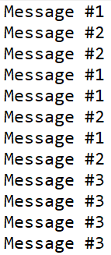
Forced synchronization of threads in parallel area
#pragma omp parallel
{
printf(“Message #1\n");
printf("Message #2\n");
#pragma omp barrier
printf("Message #3\n");
}
All threads have to complete one task prior to execute the next one.
Notes:
Assume that we have machine with 4 cores.
4 times messages 1 and 2 will be printed.
Barrier means to wait and then run tasks together on all threads.

Slide 8
Forced synchronization of threads in parallel area (2)
#pragma omp parallel
{
#pragma omp for nowait
for (i = 1; i < 100; i++)
compute_something();
#pragma omp for
for (j = 1; j < 200; j++)
more_computations();
}
Usually pragma omp for loops have hidden barrier.
Nowait allows free threads to execute next tasks.

Slide 9
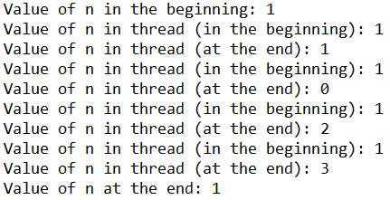
private-variables initialization
int n = 1;
printf("Value of n in the beginning: %d\n", n);
#pragma omp parallel firstprivate(n)
{
printf("Value of n in thread (in the beginning): %d\n", n);
n = omp_get_thread_num();
printf("Value of n in thread (at the end): %d\n", n);
}
printf("Value of n at the end: %d\n", n);
According to A.S. Antonov “Parallel programming with OpenMP usage”
Notes:
We have some global variable declared before the parallel region.
Thus it will be shared resource within parallel area, you can set it as private too.
For each of them new memory area allocated and we don’t know initial value of this memory area. You can also initialize it within each thread.
This is the main difference with private.
Firstprivate also allows to initialize local variables with the value of initial global variable (= from the value of variable in master thread)
This was done to support C++, where this variable can be an object.

Slide 10
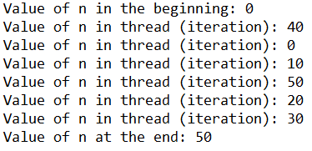
private-variables storage
int n = 0;
printf("Value of n in the beginning: %d\n", n);
#pragma omp parallel for lastprivate(n)
for (i = 0; i < 6; i++) {
n = i * 10;
printf("Value of n in thread (iteration): %d\n", n);
}
printf("Value of n at the end: %d\n", n);
lastprivate can be used in “for loops” and sections only!
According to A.S. Antonov “Parallel programming with OpenMP usage”
Notes:
The variables listed in the list are assigned the result from the last iteration of the loop
Firstprivate and last private are not good to be used together: https://www3.nd.edu/~zxu2/acms60212-40212/Lec-12-OpenMP.pdf - slides 101, 102.

Slide 11
Sequential omp for loops
What should be executed faster?
Cascade (waterfall) style | Nested style
for (i = 0; i < N; ++i) { #pragma omp parallel for reduction(+:s) for (j = 0; j < 100; ++j) s=1; #pragma omp parallel for reduction(+:s) for (j = 0; j < 100; ++j) s=1; } | for (i = 0; i < N; ++i) { #pragma omp parallel { #pragma omp for reduction(+:s) for (j = 0; j < 100; ++j) s=1; #pragma omp for reduction(+:s) for (j = 0; j < 100; ++j) s=1; } }
Notes:
When compiler see omp parallel it creates threads. But after for the end of for all threads are killed.
So it is better to reuse them.
#pragma omp for assume hidden barrier within itself.
Until all threads are not ready, next operation can not be executed. So some threads will be on idle time.

Slide 12
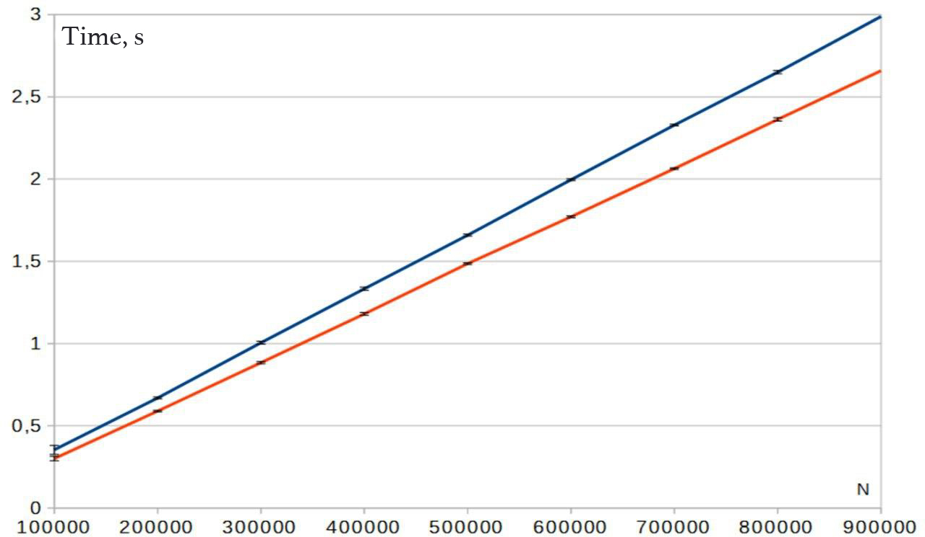
Sequential omp for loops (2)
Cascade style
Nested style
Notes:
Diff is not very big, but this is quite important.

Slide 13
‘parallel’ directive absence
INCORRECT:
#pragma omp for
for (int i = 1; i < 10; i++)
… // code
CORRECT:
#pragma omp parallel for
for (int i = 1; i < 10; i++)
… // code
CORRECT:
#pragma omp parallel
{
#pragma omp for
for (int i = 1; i < 10; i++)
… // code
}
According to A. Kolosov, A. Karpov, E. Ryzhikov “32 OpenMP traps and pitfalls when programming in C++”:
https://www.viva64.com/ru/a/0054/
Notes:
#pragma will be ignored

Slide 14
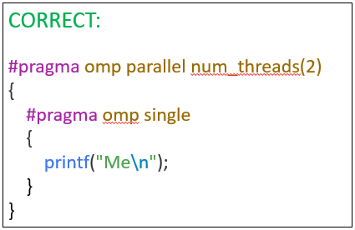
‘omp’ directive absence
INCORRECT:
#pragma omp parallel num_threads(2)
{
#pragma single
{
printf("Me\n");
}
}
According to A. Kolosov, A. Karpov, E. Ryzhikov “32 OpenMP traps and pitfalls when programming in C++”
Notes:
#pragma single will be ignored.
“Me” will be printed twice

Slide 15
‘for’ directive absence
INCORRECT:
#pragma omp parallel num_threads(2)
for (int i = 1; i < 10; i++)
… // code
CORRECT:
#pragma omp parallel for num_threads(2)
for (int i = 1; i < 10; i++)
… // code
According to A. Kolosov, A. Karpov, E. Ryzhikov “32 OpenMP traps and pitfalls when programming in C++”
Notes:
Loop will be invoked 20 times instead of required/expected 10

Slide 16
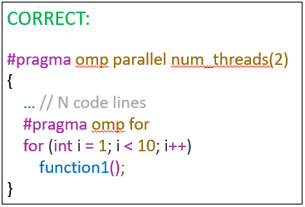
Useless parallelism
INCORRECT:
#pragma omp parallel num_threads(2)
{
… // N code lines
#pragma omp parallel for
for (int i = 1; i < 10; i++)
function1();
}
According to A. Kolosov, A. Karpov, E. Ryzhikov “32 OpenMP traps and pitfalls when programming in C++”
Notes:
Because of N code lines programmer forgot about parallelization that had been already declared.
Loop will be invoked 20 times instead of required/expected 10.
Incorrect nested parallelism.

Slide 17
Redefining the number of threads inside a parallel section
INCORRECT:
#pragma omp parallel
{
omp_set_num_threads(2);
#pragma omp for
for (int i = 0; i < 10; i++)
function1();
}
CORRECT (2 options):
#pragma omp parallel num_threads(2)
{
#pragma omp for
for (int i = 0; i < 10; i++)
function1();
}
omp_set_num_threads(2);
#pragma omp parallel
{
#pragma omp for
for (int i = 0; i < 10; i++)
function1();
}
According to A. Kolosov, A. Karpov, E. Ryzhikov “32 OpenMP traps and pitfalls when programming in C++”
Notes:
For example, we declared 8 threads as we have 8 cores.
Later we decided to create 2 more threads.
! Program will stop working with an error!
QUESTION: which correct option is better to use?
ANSWER: 1st one as 2nd one don’t have forward compatibility.

Slide 18
Undeclared local variables
INCORRECT:
int a = 0;
#pragma omp parallel private(a)
{
a++;
}
CORRECT:
int a = 0;
#pragma omp parallel private(a)
{
int a = 0;
a++;
}
According to A. Kolosov, A. Karpov, E. Ryzhikov “32 OpenMP traps and pitfalls when programming in C++”
Notes:
When entering a thread, local copies are created for variables that are parameters of private and lastprivate directives.
These copies are uninitialized by default.
Therefore, any attempt to work with them without prior initialization will cause an error during program execution.
QUESTION: How to change this code to print value of variable a after parallel section?
ANSWER: add lastprivate(a), but it is incorrect.

Slide 19
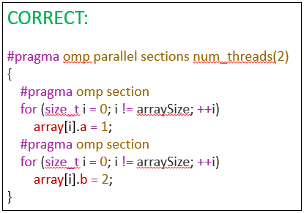
Local variables are not marked as they should
INCORRECT:
size_t i;
#pragma omp parallel sections num_threads(2)
{
#pragma omp section
for (i = 0; i != arraySize; ++i)
array[i].a = 1;
#pragma omp section
for (i = 0; i != arraySize; ++i)
array[i].b = 2;
}
According to A. Kolosov, A. Karpov, E. Ryzhikov “32 OpenMP traps and pitfalls when programming in C++”
Notes:
The error here is that the common variable i is used in the loop for the counter.
Programmer is used to have iterator variable as private by default (by compiler). But compiler do this for ‘#pragma omp parallel for’ only
But at the same time i variable is overwritten as it is the same memory area.
To fix this error, you only need to declare the counter variable as a local variable.
QUESTION: When incorrect program can be executed correctly on 2 cores machine?
ANSWER: When OS run all iterations on the 1st thread, while 2nd thread will be busy with some other task. And only after that OS start execution of tasks from 2nd thread.

Slide 20
Careless use of lastprivate
int a = 1;
#pragma omp parallel
{
#pragma omp sections lastprivate(a)
{
#pragma omp section
{
… // code1
a = 10;
}
#pragma omp section
{
… // code2
}
}
#pragma omp barrier
}
According to A. Kolosov, A. Karpov, E. Ryzhikov “32 OpenMP traps and pitfalls when programming in C++”
Notes:
The directive after a parallel section assigns a value to the variable from the lexically last section or from the last loop iteration.
Programmer can expect a value from the last section, but a is not defined there.
So if you really need a variable to be lastprivate you have to put it into the last section.

Slide 21
Simultaneous usage of shared resource
INCORRECT:
#pragma omp parallel num_threads(2)
{
printf(“Hello World!");
}
HellHell oo WorWlodrl
d
CORRECT:
#pragma omp parallel num_threads(2)
{
#pragma critical
printf(“Hello World!");
}
According to A. Kolosov, A. Karpov, E. Ryzhikov “32 OpenMP traps and pitfalls when programming in C++”
Notes:
The operation of line output is not atomic. Therefore, two threads will display their characters at the same time.

Slide 22
Unprotected access to shared memory
INCORRECT:
int a = 0;
#pragma omp parallel
{
a++;
}
CORRECT (2 options):
int a = 0;
#pragma omp parallel
{
#pragma omp atomic
a++;
}
int a = 0;
#pragma omp parallel reduction(+:a)
{
a++;
}
According to A. Kolosov, A. Karpov, E. Ryzhikov “32 OpenMP traps and pitfalls when programming in C++”
Notes:
If several threads change the variable value simultaneously, the result may be unpredictable.

