Slide 1

Understanding Test Doubles

Slide 2
What are test doubles
In automated testing it is common to use objects that look and behave like their production equivalents, but are actually simplified. This reduces complexity, allows to verify code independently from the rest of the system and sometimes it is even necessary to execute self validating tests at all. A Test Double is a generic term used for these objects.
Real life examples :
Stunt dummies used in movies.
Toy remote, toy camera

Slide 3
Why we need test doubles?
Sometimes it is just plain hard to test the system under test (SUT) because it depends on other components that cannot be used in the test environment. This could be because they aren't available, they will not return the results needed for the test or because executing them would have undesirable side effects. In other cases, our test strategy requires us to have more control or visibility of the internal behavior of the SUT.
When we are writing a test in which we cannot (or chose not to) use a real depended-on component (DOC), we can replace it with a Test Double. The Test Double doesn't have to behave exactly like the real DOC; it merely has to provide the same API as the real one so that the SUT thinks it is the real one!

Slide 4
Types of test doubles
Dummy objects are passed around but never actually used. Usually they are just used to fill parameter lists.
Fake objects actually have working implementations, but usually take some shortcut which makes them not suitable for production (an InMemoryTestDatabase is a good example).
Stubs provide canned answers to calls made during the test, usually not responding at all to anything outside what's programmed in for the test.
Spies are stubs that also record some information based on how they were called. One form of this might be an email service that records how many messages it was sent.
Mocks are pre-programmed with expectations which form a specification of the calls they are expected to receive. They can throw an exception if they receive a call they don't expect and are checked during verification to ensure they got all the calls they were expecting.

Slide 5
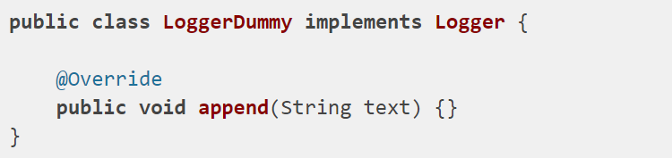
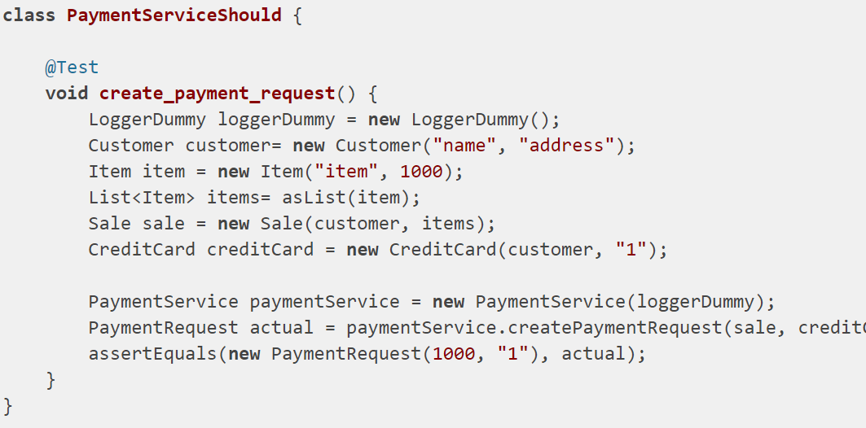
Dummy objects
The first one is the Dummy Object, it’s the simplest one, a Dummy is just an object that you pass to satisfy constructor, it will not have any method implemented and it shouldn’t.
Example. PaymentService method using Logger to log details. We don’t need to check logger functionality but payment process functionality, so We can pass dummy Log object as parameter which is not actually used by our test and does not have any contribution in our actual test.
As the name implies, a dummy is a very dumb class. It contains next to nothing, basically just enough to get your code to compile. You pass a dummy into something when you don’t care how it’s used. e.g. as part of a test, when you must pass an argument, but you don’t expect the argument to be used.

Slide 6
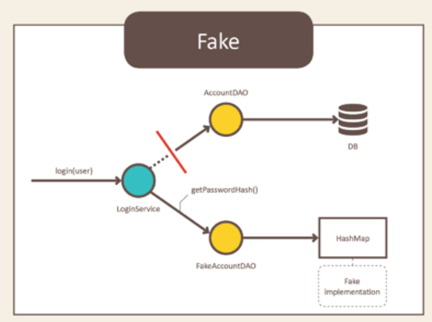
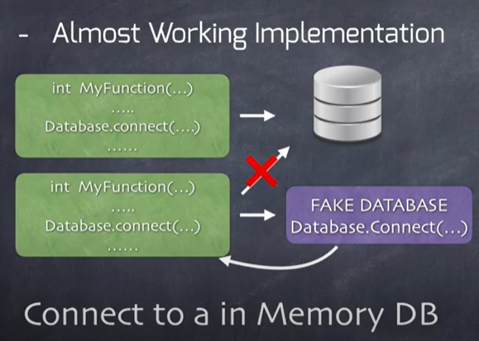
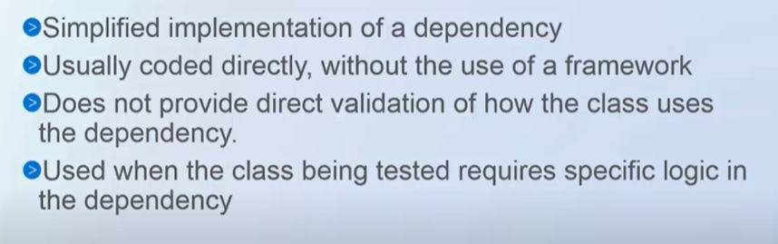
Fake Objects
We use a Fake Object to replace the functionality of a real component. Typically, it implements the same functionality as the real component but in a much simpler way
Fake Objects are simplified version of the business logic.
Fake objects actually have working implementations, but usually take some shortcut which makes them not suitable for production (an InMemoryTestDatabase is a good example).
The most common reason for using a Fake Object is that the real depended-on component is not available yet, is too slow or cannot be used in the test environment because of deleterious side effects. For example, we can encapsulate all database access behind a persistence layer interface and replace the database with in-memory hash tables and make our tests run 50 times faster.

Slide 7
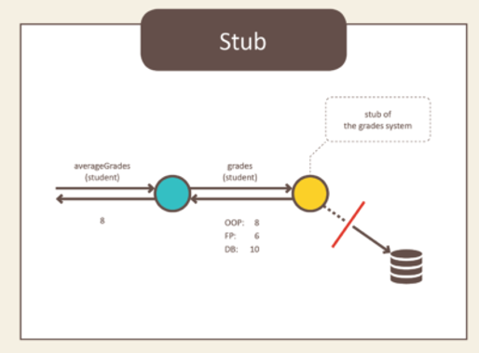
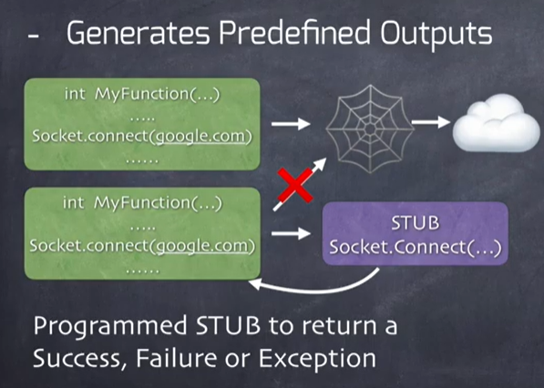
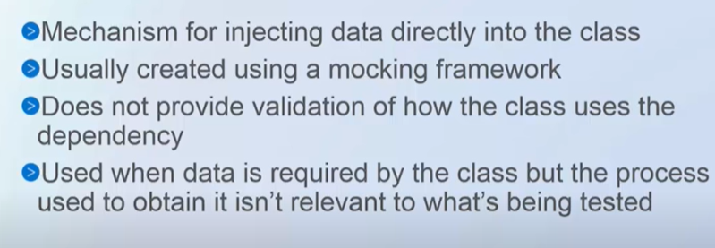
Stubs
Stubs are the objects that hold predefined data (canned answer) and uses it to give responses during tests. Stubs are used when we don't want to use objects that would give a response with real data. A stub is referred to as the lightest, and the most static version of the test doubles.
The main functions of the stubs are:
It always returns the predefined output regardless of the input.
It can be used to resemble the database objects.
Stubs are used to reduce the complexities that occur during the creation of the real objects. They are mainly used for performing state verification.
Example. If our method’s main purpose is to fetch data from db and calculate average value of that data, then stubs can be used to give some data rather than having actual db call and validation can be done in test for those values of data returned by stub.
Returns success , failure or exception (as coded). Checks the behavior of code under test in case of these return values.

Slide 8
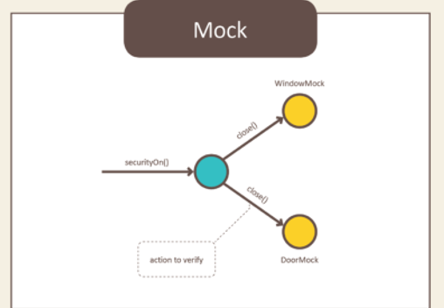
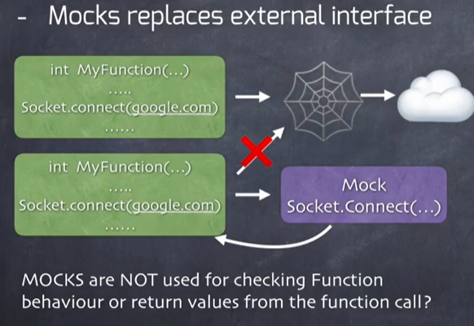
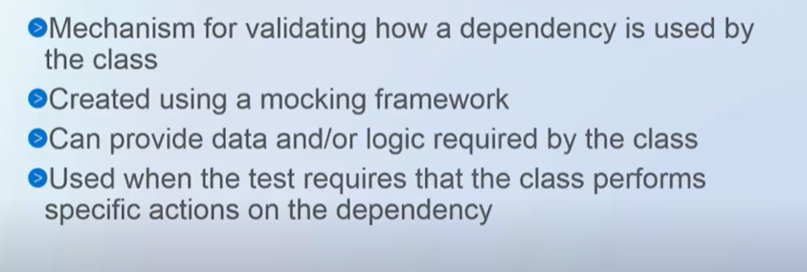
Mocks
Mocks are the objects that store method calls. It referred to as the dynamic wrappers for dependencies used in the tests. It is used to record and verify the interaction between the Java classes. A mock is known as the most powerful and flexible version of the test doubles. We use a method for mocking is called mock().
The main function of using mocks is that it gives full control over the behavior of the mocked objects. The mock objects are generally used for behavior verification. The term behavior means to check the correct methods and paths that are applied to the objects.
Mocks are mostly created by using a library or a mocking framework like Mockito, JMock, and EasyMock. It is used for testing a large suite of tests where stubs are not sufficient. One of the essential functions of mock is, we can verify how many times a given method is called, what paparmeters are passed when it was called,So to verify right calls, right number of times with right parameters.
The following code snippet shows how to use mock().
ToDoService doService = mock(ToDoService.class);

Slide 9
Spy
There are times when we would like to use most of the original object’s behavior but mock only a portion of it. This is called spying objects, also called as partial mocking.
Spies are known as partially mock objects. It means spy creates a partial object or a half dummy of the real object by stubbing or spying the real ones. In spying, the real object remains unchanged, and we just spy some specific methods of it. In other words, we take the existing (real) object and replace or spy only some of its methods.
Spies are useful when we have a huge class full of methods, and we want to mock certain methods. In this scenario, we should prefer using spies rather than mocks and stubs. It calls the real method behavior, if the methods are not stubbed.
In Mockito, spy() method is used for creating spy objects. It allows us to call the normal methods of the real object. The following code snippet shows how to use the spy() method.
List spyArrayList = spy(ArrayList.class);

Slide 10
Spy with stub sample example
//@Test
public void differenceBetweenMockingSpyingAndStubbing() {
List list = new ArrayList();
list.add("abc");
assertEquals(1, list.size());
List mockedList = spy(list);
when(mockedList.size()).thenReturn(10);
assertEquals(10, mockedList.size());
}
Here, we had initial real object list, in which we added one element and expected size to be one.
We spy real object meaning that we can instruct which method to be stubbed. So we declared that we stubbed method - size() on spy object which will return 10, no matter what is actual size.
In a nutshell, you will spy real object and stub some of the methods.

Slide 11
Difference between mock and spy
Parameters | Mock | Spy
Usage | Mocks are used to create fully mock or dummy objects. It is mainly used in large test suites. | Spies are used for creating partial or half mock objects. Like mock, spies are also used in large test suites.
Default behavior | When using mock objects, the default behavior of methods (when not stubbed) is do nothing (performs nothing.) | When using spy objects, the default behavior of the methods (when not stubbed) is the real method behavior.
 | Mock object replace mocked class entirely, returning recorded or default values. You can create mock out of "thin air". This is what is mostly used during unit testing. | When spying, you take an existing object and "replace" only some methods. This is useful when you have a huge class and only want to mock certain methods (partial mocking).
 | Mockito warns that partial mocking isn't a good practice and you should revise your Object Oriented architecture. | Spy (or partial mocking) is recommended to test legacy code.
 | When using mock objects, the default behavior of the method when not stub is do nothing. Simple means, if its a void method, then it will do nothing when you call the method or if its a method with a return then it may return null, empty or the default value. | While in spy objects, of course, since it is a real method, when you are not stubbing the method, then it will call the real method behavior. If you want to change and mock the method, then you need to stub it.

Slide 12
Difference between stub,mock and fake
Stub | Mock | Fake
an object that provides predefined answers to method calls. | an object on which you set expectations | an object with limited capabilities (for the purposes of testing), e.g. a fake web service.
you do not assert against a stub. | mocks are just like stubs, but you assert against the mock object, | Fake are close to real world implementation than a stub
Stubs provide canned answers to calls made during the test, usually not responding at all to anything outside what's programmed in for the test. Stubs may also record information about calls, such as an email gateway stub that remembers the messages it 'sent', or maybe only how many messages it 'sent'. | Mocks are what we are talking about here: objects pre-programmed with expectations which form a specification of the calls they are expected to receive. | Fake objects actually have working implementations, but usually take some shortcut which makes them not suitable for production
The purpose of a stub is to get your system under test into a specific state. For example, if you are writing a test for some code that interacts with a REST API, you could stub out the REST API with an API that always returns a canned response, or that responds to an API request with a specific error. This way you could write tests that make assertions about how the system reacts to these states; for example, testing the response your users get if the API returns a 404 error. | For example, if you are writing a test for a system that uploads files to a website, you could build a mock that accepts a file and that you can use to assert that the uploaded file was correct. Or, on a smaller scale, it's common to use a mock of an object to verify that the system under test calls specific methods of the mocked object. | Eg. In memory database.

Slide 13
Difference between stub and mock
Parameters | Stub | Mock
Data Source | The data source of stubs is hardcoded. It is usually tightly coupled to the test suite. | Data on mocks is set up by the tests.
Created by | Stubs are usually handwritten, and some are generated by tools. | Mocks are usually created by using the third-party library such as Mockito, JMock, and WireMock.
Usage | Stubs are mainly used for simple test suites. | Mocks are mainly used for large test suites.
Graphics User Interface (GUI) | Stubs do not have a GUI. | Mocks have a GUI.

