Slide 1

Unlock TEST DRIVEN DEVELOPMENT

Slide 2
Test driven development , TDD
WHAT: "Test-driven development" refers to a style of programming in which three activities are tightly interwoven: coding, testing and design.
WHY
good design
Less defects
Better test quality
Lesser time
Easy to refactor
More Focus
HOW
Red
Green
Refactor
write a "single" unit test run the test, which should fail write
"just enough" code, to make the test pass
"refactor" the code
repeat
MYTH BUSTERS
Unit testing is not TDD
TDD is not a testing practice
its to drive development
Tests to drive design
Test First is not TDD
Most common misunderstanding
But TDD is always Test First
HOW TO MATURE
TYPICAL CHALLENGE
Skill , difficult to find only < 5% developers
TDD is counter intuitive , needs practice
Advanced knowledge in on test patters
Test doubles and Mocking
TDD strategies
Refactoring
Test Last
Test First
Test Driven

Slide 3
Test last ,test first and test driven
Test Last
Test First
TDD
Automated Test
Automated test
Test First
TDD
Test First is not as same as TDD

Slide 4
Traditional Development vs. TDD
Traditional Development Process
3-36 months
1-24 months
1-3 months
3 – 36 months
1 – 24 months
1 – 3 months
Design
Code
Test

Slide 5
Traditional Development vs. TDD
TDD Process
< 10 min.
3-36 months
< 10 min.
1-24 months
< 10 min.
1-3 months
Test
Code
Design

Slide 6
Traditional Development vs. TDD
TDD Process
< 10 min.
< 10 min.
< 10 min.
3 – 36 months
1 – 24 months
1 – 3 months
Test
Code
Design
Rinse and Repeat
Refactor

Slide 7
Red-Green-Refactor Cycle
1: Write a new test
2: Make test compile
Red
3: Run test, ensure it fails
4: Write code to make test pass (all tests must pass)
Green
5: Refactor the code
Refactor
6: Go To “1”

Slide 8
Why TDD?
Good design
Enabler for Refactoring
Guarantees Coverage
Drives development
Reduces Development time
Its Fun and Feels happier (red to green)
Testability is high
Aids in emergent design
Less Time spent debugging
Quality of test is high

Slide 9
LEGACY AND TDD

Slide 10
LEGACY CODE AND TDD
First things first… what is legacy code?
“Code without tests.” – Michael Feathers, Working Effectively with Legacy Code
Thoughts on approaches?
Mocking?
Maybe more harm than good
Useful approaches:
Divide and Conquer – Brute force (or bulldozer) approach, relying on the test you have to test sub-part in isolation. Slowly add new tests to speed up the feedback loop – repeat until happy
Software Seams – Several ways to inject new functionality into existing code base. Most common: object seams(polymorphism), others: file linking seams, pre-processing seams (facilitates unit testing)
Strangler – Develop new functionality aside and revert to the old functionality when the new functionality fails. Keep updating new functionality till the old functionality is irrelevant
Sprout functions: encapsulate new functionality you need to make into a new method and only test that new method
Sprout classes: like functions, but the new logic is encapsulated within a new class
Parallel run – Add a new service that runs parallel to the existing (similar to strangler but not quite). With parallel run, you’re leveraging production output logs to ensure both services are computing the same thing
Notes:
Adding artificial mocking into a meaningless design could create brittle and unmanageable tests – maybe more harm than good

Slide 11
LEGACY CODE AND TDD
When refactoring, consider the following
Test cases should be written for all non-private methods. This includes:
Public scoped methods
Protected scoped methods
/* Default */ scoped methods
You should not create test for “Private” methods BUT….
If you must, updated the access to “Protected”
When in doubt, remember F.I.R.S.T TDD
Fast: you want to run them frequently
Independent: should not depend on each other
Repeatable: in any environment, in your laptop, without network…
Self-validating: should have a Boolean output… not a log that you have to read to know the result.
Timely: Write them before the code is in a production state – it will be more difficult if you wait
11

Slide 12
TEST Doubles
Stub Provides hard coded values to calls made during the test; usually does not respond to anything outside what is programmed in for the test
Spy Stubs that also record information based on what they are called (for e.g. an email service that tracks how many messages were sent).
Fake Objects that have working implementations but take a shortcut which makes them unsuitable for production (for e.g. an in memory test database).
Dummy Objects that are passed around but never used. They exist to fill parameter lists.
Mock Simulates the behavior of real objects in controlled ways. Mock objects register calls they receive so we can verify that all expected actions were performed. It’s created using a mocking library: EasyMock, jMock, Mockito, etc.
12

Slide 13
TEST DOUBLES

Slide 14
WHY DO WE NEED TEST DOUBLES?
What if that method depends on other things?
The real object:
Has non-deterministic behavior, e.g. random, unpredictable
Is slow and difficult to set up
Has behavior that is hard to trigger (a network error)
Has (or is) a user interface
Does not exist (a common problem with interfacing with other teams or new hardware systems)
Common Mock Frameworks jMock – Java Mockito – Java EasyMock – Java/.NET Jasmie – Javascript Moq - .NET
14

Slide 15
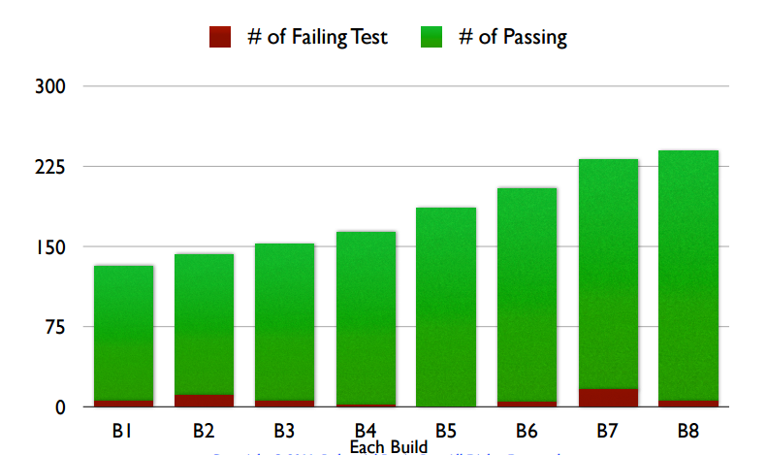
Metrics - Test Run Trend
Test Run Trend with every CI Build

Slide 16
METRICS

Slide 17
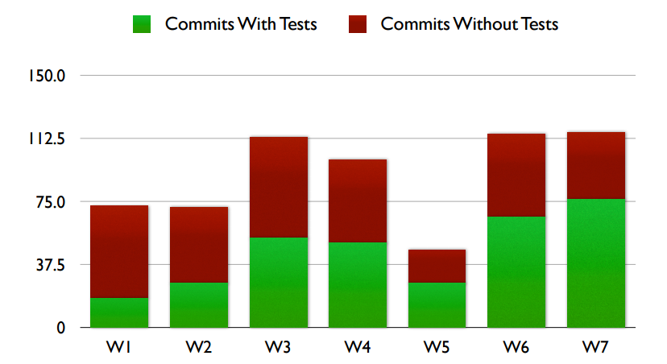
Metrics - Test Balance
Number of commits that include Tests over time (weekly)

Slide 18
THANK YOU

