Slide 1


Team Raptors
Ryan Byrne, Ross Davenport, Rachel Brinkley

Slide 2
Border Crossing
Data:
Population data for surrounding cities
Questions:
What modes of transportation are the most utilized?
Congestion at different entry points? (How long it takes to get through, population of travel?)
Proximity of cities within 50 miles?
If we were going to add an entry point where would add?
Notes:
Define the core message or hypothesis of your project.
Describe the questions you asked, and why you asked them
Describe whether you were able to answer these questions to your satisfaction, and briefly summarize your findings
Elaborate on the questions you asked, describing what kinds of data you needed to answer them, and where you found it

Slide 3
Finding the data
Notes:
Describe the exploration and cleanup process.
Discuss insights you had while exploring the data that you didn't anticipat.
Discuss any problems that arose after exploring the data, and how you resolved them Present and discuss interesting figures developed during exploration, ideally with the help of Jupyter Notebook

Slide 4
We found the data, Now what?
Notes:
Discuss the steps you took to analyze the data and answer each question you asked in your proposal Present and discuss interesting figures developed during analysis, ideally with the help of Jupyter Notebook

Slide 5
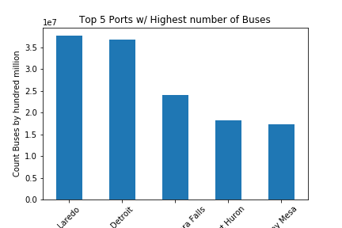
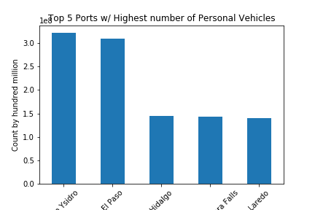

Notes:
Discuss your findings. Did you find what you expected to find? If not, why not? What inferences or general conclusions can you draw from your analysis?

Slide 6
What we learned from this project
Merging issues
Bad formatting for CSV files
Notes:
Discuss any difficulties that arose, and how you dealt with them.
Discuss any additional questions that came up, but which you didn't have time to answer: What would you research next, if you had two more weeks?

Slide 7


Any questions?
This Photo by Unknown Author is licensed under CC BY-SA

