Slide 1

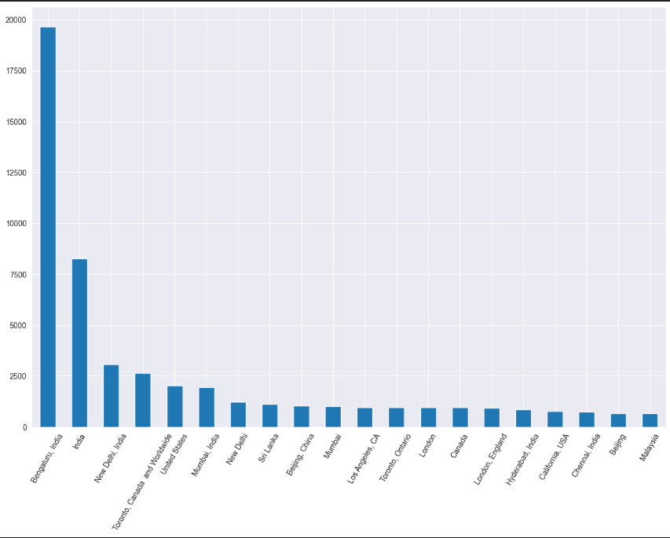
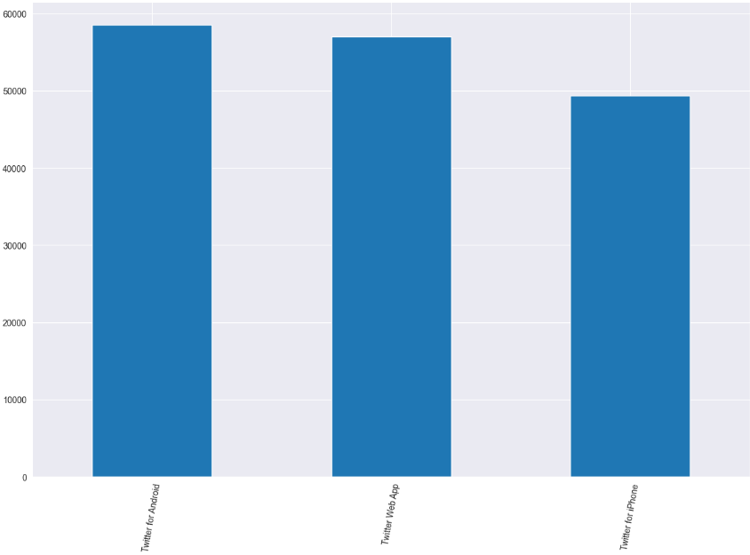
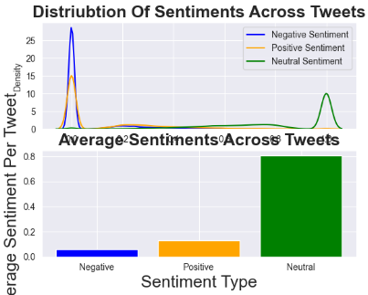
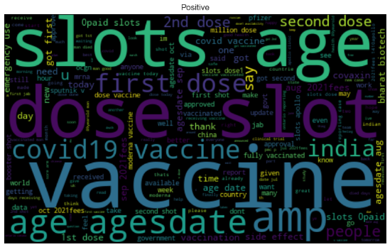
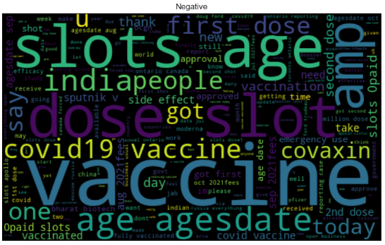
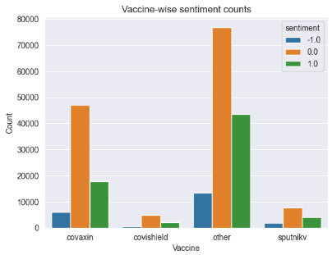
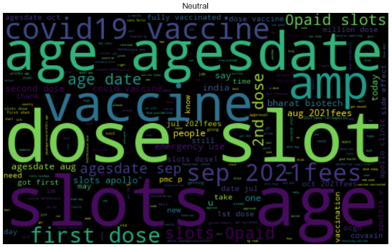
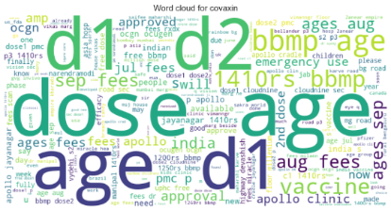
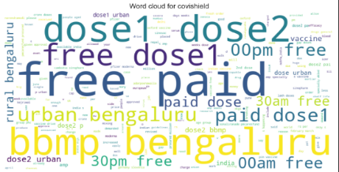
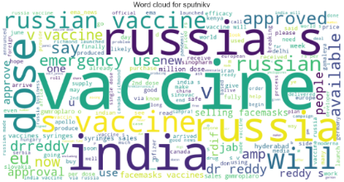
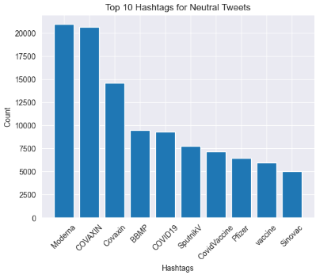
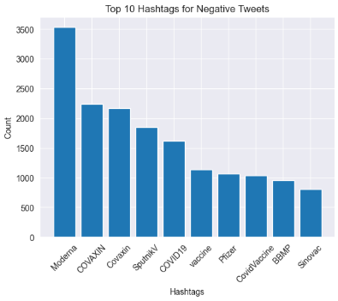
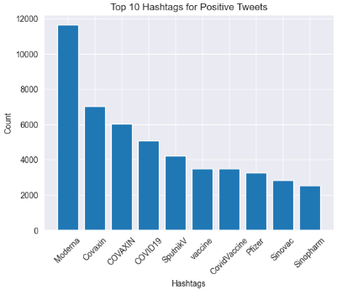
Sentiment Analysis on COVID-19 Vaccine Tweets
Amish Raj, Boomika Karuppaiah
Computer Science Department, School of Engineering and Science
Abstract
Methodology
Results
Conclusion
The project aims to perform sentiment analysis on COVID-19 vaccine-related tweets using natural language processing techniques and supervised learning algorithms. The project classifies tweets into three categories: good, negative, and neutral using a sizable dataset of tweets gathered via the Twitter API. Three methods—TextBlob, VADER, and BERT models—were used to do the sentiment analysis. Data pre-processing, feature engineering, and data visualization were also used in this research to create word clouds and find the most prevalent phrases linked to certain emotions. The investigation also looked into the relationships between sentiment ratings and other characteristics including user location, tweet platform, word count, and average word length. The project's findings shed important light on the public's perception of the COVID-19 vaccine that can be used to shape public health policies and communication tactics.
Imported necessary libraries and datasets, data preprocessing, and two approaches to sentiment analysis: TextBlob and VADER
Imported required modules, including os, numpy, pandas, re, matplotlib.pyplot, plotly, string, seaborn, nbformat, nltk, wordcloud, collections, and neattext.
Imported 'vaccination_all_tweets.csv' and 'vaccination_tweets_trained.csv' datasets.
Data preprocessing involved examining the dataset by displaying the head, tail, shape, and info of the 'vaccination_all_tweets.csv' dataset.
Visually represented the dataset for analysis, displaying a geographical and platform-wise distribution of tweets.
neattext library is used to clean the data.
Removed hashtags, user handles, Punctuation marks , URLs, emojis, and special characters from the tweet.
Stop words are removed from the cleaned data.
Generated a word count to get the most common words in the dataset for different sentiments.
The same data preprocessing steps are applied to the 'vaccination_tweets_trained.csv' dataset.
Sentiment analysis step involves two approaches: TextBlob and VADER.
TextBlob approach involves training the TextBlob model on the pre-labeled dataset from 'vaccination_tweets_trained.csv' using NaiveBayesClassifier.
Trained model is then applied to the cleaned data in the 'vaccination_all_tweets.csv' dataset using the blob function to assign polarity and subjectivity to each tweet.
Results are stored in a new 'results' column, and the tweets are separated into three categories based on sentiment: positive, negative, and neutral.
Word clouds and bar graphs are generated for each sentiment category.
VADER approach involves evaluating the accuracy of the VADER model on the pre-labeled dataset from 'vaccination_tweets_trained.csv'.
The model is then applied to the un-labeled dataset from 'vaccination_tweets_unlabeled.csv' to predict the sentiment of each tweet.
Results are stored in a new 'VADER_sentiment' column in the 'vaccination_tweets_unlabeled.csv' file.
Overall, this methodology involves a structured approach to sentiment analysis on COVID-19 vaccine-related tweets, including data preprocessing, two approaches to sentiment analysis, and data visualization to gain insights into public opinion and inform public health policies and communication strategies.
The project utilized data collected from Twitter API by Kaggle, which consisted of tweets related to COVID-19 vaccines. The data were pre-processed and different supervised models were applied to analyze the sentiments expressed in the tweets. The findings were presented through a visualization shown below, which illustrates the distribution and average of sentiments across all the tweets in the dataset. The results provide insights into the general sentiment of the public towards COVID-19 vaccines on Twitter.
On the pre-labeled dataset, the TextBlob model provides an accuracy of 72.91% while the VADER model has an accuracy of 47.61%. Due to this we consider TextBlob while performing the basic sentiment analysis. It returns us polarity, subjectivity and sentiment for the tweets.
Analysis was then conducted involving extracting data from vaccine-related tweets and analyzing the sentiment associated with each vaccine. The sentiment analysis involved grouping tweets by vaccine and assigning numeric values to sentiment values before generating a bar plot for the sentiment counts of each vaccine. The below figure provides a visual representation of the sentiment counts for each vaccine.
Additionally, word clouds were generated for each vaccine to visualize the most frequently occurring words. The figure below provides insights into the most frequent words used in tweets related to the most popular vaccines.
Covaxin Covishield Sputnik
Finally, hashtag analysis was performed based on the sentiments. The resulting plot found that Moderna was the hashtag used most for all sentiments.
Neutral Negative Positive
Overall, the analysis provides insights into the public sentiment toward COVID-19 vaccines. The analysis found that the sentiment towards the top vaccine for COVID-19 was mostly neutral, with the remaining majority of tweets being positive.
Our project's sentiment analysis code for Twitter data provides a powerful tool to monitor public opinion on any topic. The analysis indicates that most tweets related to COVID-19 vaccines are neutral, with a majority being positive and a smaller percentage being negative. The code is customizable for specific needs, such as analyzing sentiment on a particular brand or product. The generated visualizations and word clouds offer valuable insights into the most commonly associated sentiments and words with the topic of interest. This code is a valuable resource for businesses, policymakers, and researchers looking to track public opinion on social media.
Future scope of project:
Expand the analysis to include other social media platforms such as Facebook and Instagram to gain a comprehensive understanding of public opinion.
Extend the analysis to include other healthcare-related topics and gain insights into public opinion on healthcare policies, treatment options, and disease prevention strategies.
Use the sentiment analysis results to identify areas of misinformation and develop targeted communication strategies to combat them.
Introduction
References
The COVID-19 pandemic has brought significant disruption to the lives of millions of people worldwide, causing unprecedented changes in daily routines and social interactions. To curb the spread of the virus, governments and health organizations worldwide have launched vaccination campaigns. In this context, social media platforms, particularly Twitter, have emerged as crucial spaces for sharing opinions and discussing COVID-19 vaccines.
Analyzing the sentiment of tweets related to COVID-19 vaccines can offer valuable insights into public opinion, guide public health policies, and support effective communication strategies. Sentiment analysis on Twitter data has become an increasingly relevant research area, providing a comprehensive view of the public's perception of a particular topic. Sentiment analysis involves identifying the underlying sentiment or emotion in a piece of text.
In this project, we developed a sentiment analysis model to classify tweets related to COVID-19 vaccines into positive, negative, and neutral categories. Our goal is to develop a machine learning model trained on a vast dataset of COVID-19 vaccine-related tweets collected via the Twitter API. We employed advanced natural language processing (NLP) techniques and supervised learning algorithms to train the model. Additionally, we performed data preprocessing, feature engineering, and data visualization techniques to generate word clouds and identify the most common phrases associated with each sentiment category. The results of this study provided valuable insights into the public's perception of COVID-19 vaccines, inform public health policies and communication strategies, and facilitate effective vaccination campaigns.
The results of this study provided valuable insights into the public's perception of COVID-19 vaccines, inform public health policies and communication strategies, and facilitate effective vaccination campaigns. By analyzing the sentiment of tweets related to COVID-19 vaccines, we can better understand public opinion and identify potential challenges in vaccine adoption. The outcomes of this project can help public health officials and policymakers create targeted strategies to promote vaccination and address vaccine hesitancy.
Qorib, M., Oladunni, T., Denis, M., Ososanya, E., & Cotae, P. (2023). Covid-19 vaccine hesitancy: Text mining, sentiment analysis and machine learning on COVID-19 vaccination Twitter dataset. Science Direct, 212(118715). doi:https://doi.org/10.1016/j.eswa.2022.118715.
Liu, S., & Liu, J. (2021). Public attitudes toward COVID-19 vaccines on English-language Twitter: A sentiment analysis. Science Direct, 39(39), 5499–5505. doi:https://doi.org/10.1016/j.vaccine.2021.08.058.
Shamrat, F. M. J. M., Chakraborty, S., Imran, M., Muna4, J. N., Billah, M. M., Das, P., & Rahman, M. O. (2021). Sentiment analysis on twitter tweets about COVID-19 vaccines using NLP and supervised KNN classification algorithm. Indonesian Journal of Electrical Engineering and Computer Science, 23(1), 463–470. doi:http://doi.org/10.11591/ijeecs.v23.i1.pp463-470.
Gabriel Preda. (2021). <i>COVID-19 All Vaccines Tweets</i> [Data set]. Kaggle. https://doi.org/10.34740/KAGGLE/DSV/2845240
Hassanhshah. (2021, October 17). COVID vaccine sentiment and time series analysis. Kaggle. Retrieved April 7, 2023, from https://www.kaggle.com/code/hassanhshah/covid-vaccine-sentiment-and-time-series-analysis
Amartyanambiar. (2021, September 11). Covid-19 vaccine sentitmental analysis. Kaggle. Retrieved May 7, 2023, from https://www.kaggle.com/code/amartyanambiar/covid-19-vaccine-sentitmental-analysis/notebook
Gpreda. (2021, March 20). Explore vaccines tweets. Kaggle. Retrieved May 7, 2023, from https://www.kaggle.com/code/gpreda/explore-vaccines-tweets

