Slide 1
Mining and summarizing customer reviews
Minqing Hu & Bing Liu
Amish Gala – Nov 2014
COMP 6751 – Dr. Sabine Bergler

Slide 2



Product Reviews: Unstructured Data
Online retailers often request customer feedback; massive amount of data collected
How best to leverage existing NL tools to mine and summarize this data?
137 M Weekly Customers
60 M Unique Monthly Visitors
170 M Reviews / Opinions

Slide 3
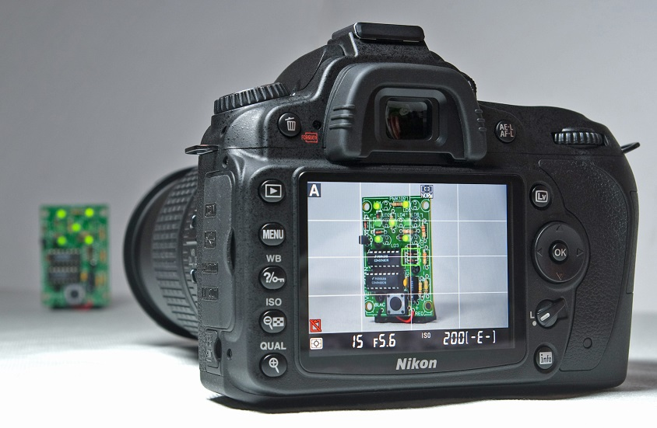
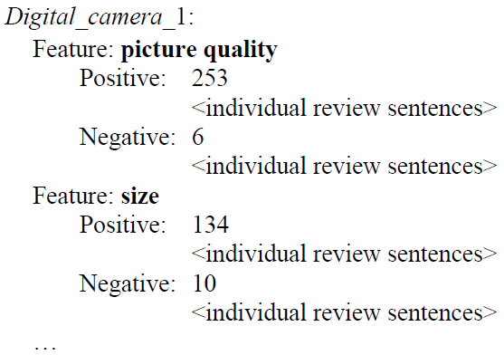
Paper Facts
Published in 2004 (10 years old)
Investigated the possibility of automating the identification of “features” for a given product
Goal was to create a summary for customers/retailers highlighting the sentiment (positive or negative) for each “feature”
Example sentences for each feature
Looked at electronics sold online (two digital cameras, a cell phone, an MP3 player, and a DVD player
Notes:
Since then, retailers have taken a much more active role in mining consumer data and presenting them in ways that are helpful. E.g. you can filter the reviews based on stars and only read those marked as a certain star rating. Additionally, many retailers offer a helpful hint “verified buyer” to give validtity to the review.
Features can differ per product: camera can have weight, size,

Slide 4
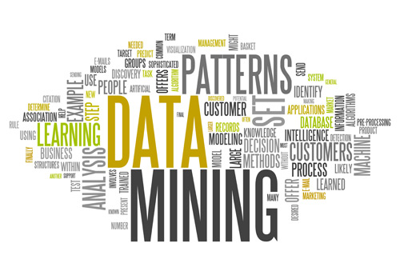
Authors’ Strategy
Mining product reviews
Used data mining and NLP techniques
Identifying “Opinion” Sentences
Authors targeted sentences which contained both a “feature” and an “opinion” word
Identified opinion words, and used WordNet to determine their “semantic orientation”
Propose a robust-ish algorithm
Summarizing
Aggregate results (putting it all together)
Notes:
More on the algorithm later

Slide 5
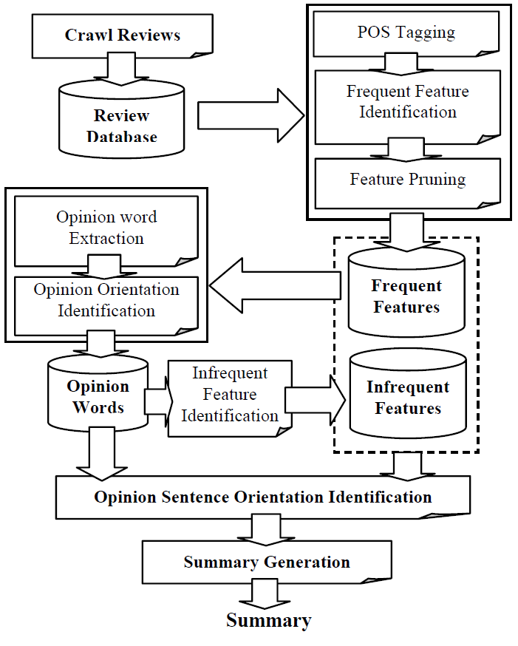
Authors’ Strategy (cont’d)
Retrieve information*
Part 1
POS Tagging
(Frequent) Feature ID
Part 2:
Opinion Words and Orientation
(Infrequent) Feature ID
Sentence Orientation
Part 3:
Summary
Notes:
Visualize the pipeline
Retrieve the data. Authors built some code to crawl reviews of Amazon and C|Net
Authors tagged each word, and used techniques to extract features
Orientation
Summary

Slide 6
Part 1: POS Tagging and Feature Identification
Used NLProcess Linguistic Processor (link)
Split into sentences, tagged words (noun, verb..)
Extracted per-sentence noun and noun-phrases*
Frequent Feature Identification
Authors focused on explicitly defined features, and stayed away from the anaphoric / implicit
“While light, it will not easily fit in pockets”
Used Apriori Association Mining (CBA) to identify frequent features
Notes:
N + NPs according to the authors are the likeliest places for product features to be identified.
Did some pre-processing (removed stop words, stemming and fuzzy matching)
Stemming: Stemming is the term used in linguistic morphology and information retrieval to describe the process for reducing inflected (or sometimes derived) words to their word stem, base or root form—generally a written word form.
Apriori – best way to explain it is with an example of grocery shopping receipts. Each receipt is a row containing each item (bread milk eggs in row 1, bread eggs and sour cream in the next). run the Ran association miner CBA [26], which is based on the Apriori algorithm in [1] on the transaction set of noun/noun phrases produced in the previous step. Each resulting frequent itemset is a possible feature. In our work, we define an itemset as frequent if it appears in more than 1% (minimum support) of the review sentences
Minimum threshold of 1% (think of shopping lists – people who bought milk and eggs also bought flour)

Slide 7
Feature Identification (cont’d)
Authors optimized association mining by leveraging syntactic features:
Compactness pruning: only retain words phrases appearing next to each other in a specific order which are meaningful
Redundancy pruning: remove single word features when they are part of a superset in multiple occurrences
Prune “life”; keep “battery life”

Slide 8
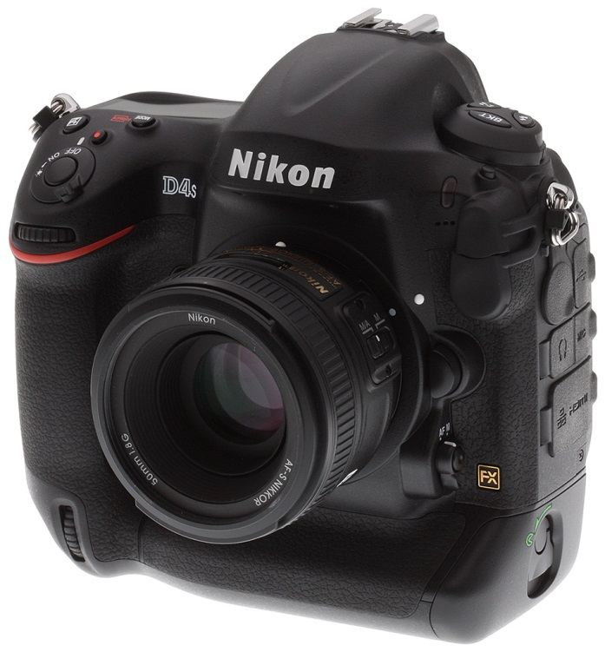
Example
Input sentences (Nikon Camera review):
The flash is slow to recharge.
The battery life is disappointing
The zoom lens feels sturdy
… and hundreds more
Using CBA, extracted the following features:
Flash
Battery Life
Zoom lens

Slide 9
Part 2: Opinion Words / Orientation
Leveraged previous studies that show subjectivity correlates highly with the presence of adjectives
Sentences with both “features” + opinion words
Chose opinion words “nearby” (good practice)
Semantic orientation similar to what we’ve see using AFINN
Certain words have positive orientation, others have negative
Not all words (at the time of the study) had an established orientation; however, word synsets were well described in WordNet
Notes:
Output from previous step is a database of all “frequent features”, and the sentences in which they appear.
the nearby adjective is recorded as its effective opinion. /* A nearby adjective refers to the adjacent adjective that modifies the noun/noun phrase that is a frequent feature. */
In metadata a synonym ring or synset, is a group of data elements that are considered semantically equivalent for the purposes of information retrieval.

Slide 10
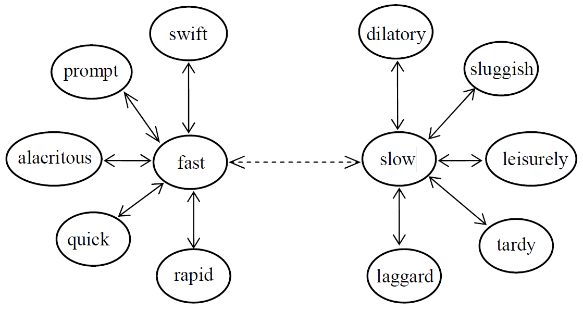
Orientation (cont’d)
Authors proposed a simple approach for orientation prediction:
Manually identified 30 very common seed adjectives
Determined orientation by finding the closest sibling in WordNet
The battery charges quickly!
Notes:
Morphology / reduce inflected or derived forms.
Fast has a positive orientations; thus quick also has a positive orientation
In WordNet, adjectives are organized into bipolar clusters, as illustrated in Figure 4. The cluster for fast/slow, consists of two half clusters, one for senses of fast and one for senses of slow. Each half cluster is headed by a head synset, in this case fast and its antonym slow. Following the head synset is the satellite synsets, which represent senses that are similar to the sense of the head adjective.
Leverage the linguistic feature that adjectives share the same semantic orientation as their synonyms!
Built algorithm to determine orientation of all adjectives in list.
All adjectives NOT in wordNet were discarded!

Slide 11
Infrequent Features
Linguistic treatment (post-processing)
For each sentence that has one or more opinion words (adjectives), but zero “frequent” features
Search for the closest N or NP, and store it in the “infrequent features” set.
“The spare battery holder was a nice surprise”
This was sometimes problematic due to the nature of online reviews (often reviewers told unrelated stories)
Overall these accounted for around 15-20%

Slide 12
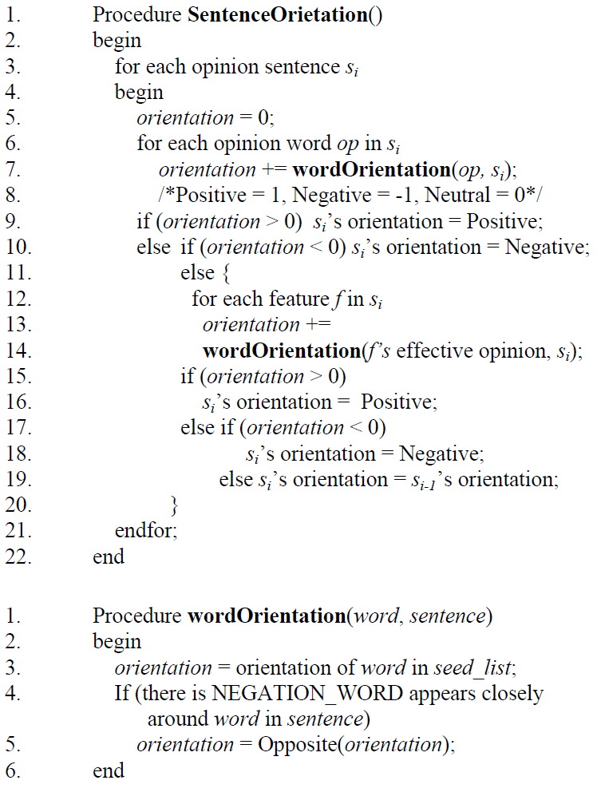
Overall Sentence Orientation (cont’d)
For each sentence, calculate the overall orientation
If overall is positive, set positive
If overall is negative, set negative
Otherwise, calculate the effective feature orientation within the sentence
If this again is 0, use previous
Handling of negation words appearing closely
Notes:
Use the dominant orientation of all opinion words found in the sentence
Majority positive words → positive orientation
Majority negative words → negative orientation
If equal use the orientation of the closest opinion word to the feature (effective orientation)
In some cases, the previous sentence’s orientation was taken (heuristic)
By closely we mean that the word distance between a negation word and the opinion word should not exceed a threshold (in our experiment, we set it to 5). This simple method deals with the sentences like “the camera is not easy to use”, and “it would be nicer not to see little zoom sign on the side”. This method is quite effective in most cases.

Slide 13
Part 3: Summary Generation
Once orientations are determined for each sentence, summary generation prepared:
For each discovered feature, count and provide opinion sentences for both positive and negative orientation
Rank features according to frequency

Slide 14
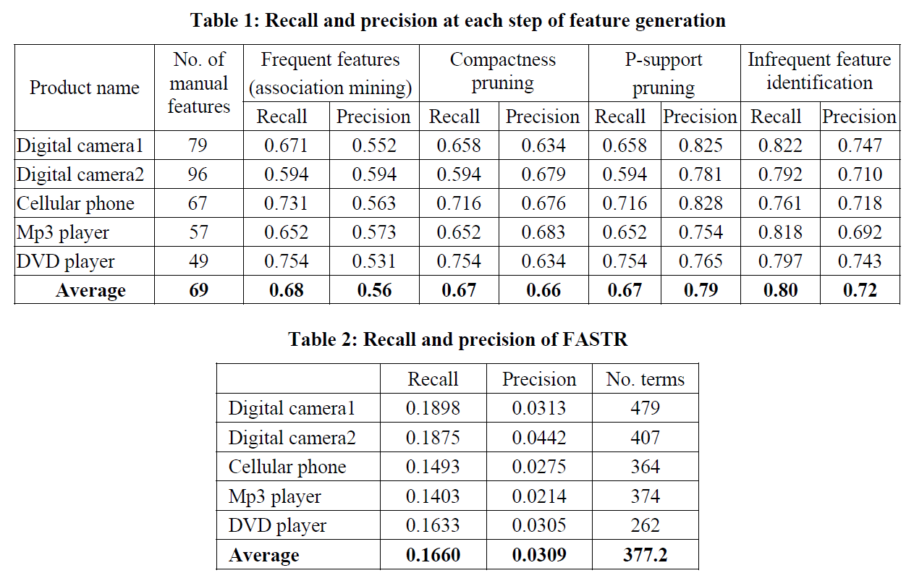
Experimental Results
Notes:
Authors manually read all the reviews. For each sentence, if the user expresses an opinion, all features are tagged
Orientation is also identified. If no opinion was given, then the sentence was not tagged
Manual features identified for each product
Next two columns show feature identification using association mining. Overall, precision was quite low (~ half of those identified by AM were not in the gold list)
After applying compactness pruning (check multi-word features and remove those which are likely to be meaningless), precision improved; recall stayed largely the same
After applying p-support (redundancy) pruning (check for features which are a subset), precision again improved greatly; recall stayed largely the same
Approach for identifying infrequent features yielded good results – high recall and decent precision
Compared to publicly available term extraction / indexing system, this approach was very good. Some reasons: FASTR produced too many terms, and skips single word noun phrases.

Slide 15
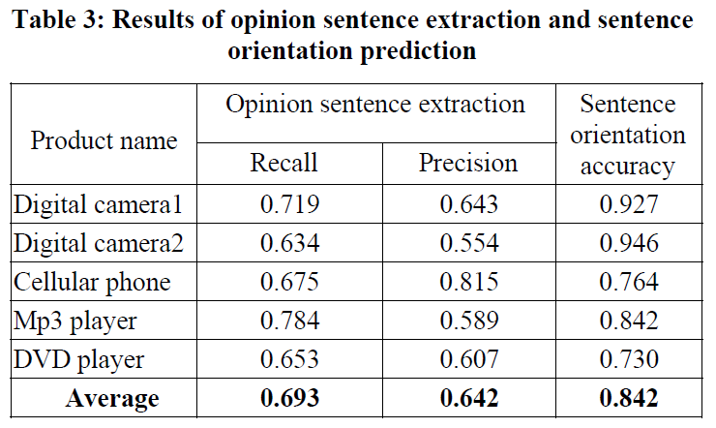
Experimental Results (cont’d)
Notes:
The previous table showed the effectiveness at identifying the features, the follow will explain how well the semantics were predicted:
- Once again, gold list was manually determined
This table shows a few thing:
The effectiveness of the automated opinion sentence extraction
The orientation accuracy (for the opinion sentences identified, was the orientation correct?)
Difficulties due to determining whether the sentence is providing an opinion (objective vs. subjective)
Also, reviews tend to have lively descriptions “it was a beautiful Sunday morning when I decided to try to use the camera’s zoom”
Not really an opinion sentence, but tagged as one by the algorithm
Using WordNet was quite effective as orientation accuracy indicates

Slide 16
Discussion: Cool Tools!
Interesting Linguistic-y things:
Authors used synonym sets and antonym sets interestingly
Extraction of features similar to what we saw in Santini slides involving aspects
Extract feature scaffolding to then hang semantics off of (in this case, orientation)
Authors optimized association mining by pruning which correlates well with NL (context aware?)
Calculation of orientation, considered proximity of opinion words to feature words which also interesting
Pipeline approach – can modify modules and see impact
Notes:
AFINN anyone?

Slide 17
Discussion: Areas of Improvement
Threats to validity
Analysis only done on a small set of products (100 reviews each)
Authors did not consider pronoun / anaphora resolution
Authors limited to identifying NPs and ADJP; what about VPs?
Often the presence of AUX verbs can lead to speculative phrases (“some users may enjoy a larger screen”) and thus not opinion
Reviews of electronics are usually done by a certain demographic (cannot generalize)
Are the proposed techniques extendable to, for example literary reviews, hotel reviews etc.
Since parser only did POS tagging (removed stop words etc.), approach doesn’t satisfy “selectivity” aspect
Using a grammar may be a way to improve and filter out problematic sentences (often offer little to potential readers)

Slide 18
Summary
Authors proposed a simple and effective way of mining a set of electronic product reviews
They were able to show that “features” were able to be detected from the N/NPs with a respectable precision / recall
Furthermore, the approach predicted the semantic orientation of opinion sentences with high precision (~84%)
Easy to read / understand / implement – recommended!

Slide 19
Reference
Minqing Hu and Bing Liu. 2004. Mining and summarizing customer reviews. In Proceedings of the tenth ACM SIGKDD international conference on Knowledge discovery and data mining (KDD '04). ACM, New York, NY, USA, 168-177. DOI=10.1145/1014052.1014073
Link: http://dl.acm.org/citation.cfm?id=1014073

