Slide 1
Advanced SQL (part 1)
CS263 Lecture 7

Slide 2
Processing Multiple Tables – Joins
The real power of the relational model derives from its storage of data in many related entities
Taking advantage of this approach to data storage requires establishing the relationships and constructing queries that use data from multiple tables
The relationships between tables are established by including a common column (or columns) in each table.
Often this is accomplished by setting up a primary key-foreign key relationship, where the foreign key in one table references the primary key in another, and the values in both come from a common domain
We can use these columns to establish the link between two tables by finding common values in the columns

Slide 3
Joins
In SQL the WHERE clause of the SELECT command can be used for multiple table operations. In fact SELECT can include references to 2, 3 or more tables in the same command
SQL has 2 ways to use SELECT for combining data from related tables
Most frequently used is called a Join
SQL implicitly specified a join by referring in a WHERE clause to the matching of common columns over which tables are joined
The result of the join operation is a single tableSelected columns from all the tables are included
Join = a relational operation that causes two or more tables with a common domain to be combined into a single table or view

Slide 4
Joins
Each row returned contains data from rows in the different input tables where values for the common columns match
An important rule of thumb: there should be one condition within the WHERE clause for each pair of tables being joined. If two tables are combined, one condition would be necessary, but if three tables (A, B, C) are to be combined, then two conditions would be necessary because there are two pairs of tables (A-B and B-C)
There are several types of joins, the most commonly used are the following 4:

Slide 5
Equi-join
Equi-join – a join in which the joining condition is based on equality between values in the common columns; common columns appear redundantly in the result table
e.g. if we want to know the names of customers who have placed orders, that information is kept in 2 tables CUSTOMER_T and ORDER_T. If we want to find the names of customers who have placed orders:
SELECT CUSTOMER_T.CUSTOMER_ID, ORDER_T.CUSTOMER_ID, CUSTOMER_NAME, ORDER_ID
FROM CUSTOMER_T, ORDER_T
WHERE CUSTOMER_T.CUSTOMER_ID = ORDER_T.CUSTOMER_ID;

Slide 6
Natural join
Is an equi-join in which one of the duplicate columns is eliminated in the result table (most commonly used form of join operation)
From the previous example, one CUSTOMER_ID would be left out
Notice that CUSTOMER_ID must still be qualified as it exists in both CUSTOMER_T and ORDER_T
e.g. for each customer who placed an order, what is the customer’s name and order number?
SELECT CUSTOMER_T.CUSTOMER_ID, CUSTOMER_NAME, ORDER_ID
FROM CUSTOMER_T, ORDER_T
WHERE CUSTOMER_T.CUSTOMER_ID = ORDER_T.CUSTOMER_ID

Slide 7
Outer join
Often in joining two tables we find that a row in one table does not have a matching row in the other table
e.g., several CUSTOMER_ID numbers may not appear in the ORDER_T table (maybe they have not ordered for a long time)
As a result, the equi-join and natural join do not include all of the customers in CUSTOMER_T
Using an outer join rows that do not have matching values in common columns are also included in the result table. Null values appear in columns where there is not a match between the tables
(as opposed to inner join, in which rows must have matching values in order to appear in the result table)

Slide 8
Outer join
e.g. List the customer name, ID number, and order number for all customers. Include customer information even for customers that do have an order
SELECT CUSTOMER_T.CUSTOMER_ID, CUSTOMER_NAME, ORDER_ID
FROM CUSTOMER_T, LEFT OUTER JOIN ORDER_T
WHERE CUSTOMER_T.CUSTOMER_ID = ORDER_T.CUSTOMER_ID
The syntax LEFT OUTER JOIN was selected because the CUSTOMER_T table was named first, and it is the table from which we wish all rows returned (regardless of whether there is a matching order in the ORDER_T table)

Slide 9
Outer join
Has we reversed the order in which the tables were listed, the same results could be obtained using a RIGHT OUTER JOIN
It is also possible to request a FULL OUTER JOIN, in that case all rows would be matched and returned, including any rows that do not have a match in the other table

Slide 10
Union join
Includes all columns from each table in the join, and an instance for each row of each table, i.e. the result of a union join is a table that includes all of the data from each table that is joined
So a union join of the CUSTOMER_T table (15 customers and 6 attributes) and the ORDER_T table (10 orders and 3 attributes) will return a results table of 25 rows and 9 columns
Assuming that each original table contained no nulls, each customer row in the results table will contain 3 attributes with assigned null values and each order row will contain 6 attributes with assigned null values
Do not confuse this command with the UNION command for joining select STATEMENTS (discussed later)

Slide 11
Sample multiple join with 4 tables
This query on the next page produces a result table that includes all the information needed to create an invoice for order no. 1006.
We want the customer information, the order information, the order line information and the product information (4 tables)
Since the join involves 4 tables, there will be 3 column join conditions
Each pair of tables requires an equality-check condition in the WHERE clause, matching primary keys against foreign keys
Joining useful when data from several relations are to be retrieved, and the relationships are not necessarily nested

Slide 12
4 table join
SELECT CUSTOMER_T.CUSTOMER_ID, CUSTOMER_NAME, CUSTOMER_ADDRESS, CITY, SATE, POSTAL_CODE, ORDER_T.ORDER_ID, ORDER_DATE, QUANTITY, PRODUCT_NAME, UNIT_PRICE, (QUANTITY * UNIT_PRICE)
FROM CUSTOMER_T, ORDER_T, ORDER_LINE_T, PRODUCT_T
WHERE CUSTOMER_T.CUSTOMER_ID = ORDER_LINE.CUSTOMER_ID AND ORDER_T.ORDER_ID = ORDER_LINE_T.ORDER_ID
  AND ORDER_LINE_T.PROUCT_ID = PRODUCT_PRODUCT_ID
  AND ORDER_T.ORDER_ID = 1006;

Slide 13
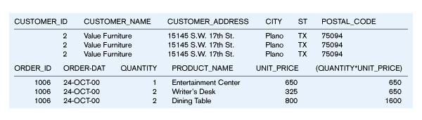
Results from a four-table join
From CUSTOMER_T table
From ORDER_T table
From PRODUCT_T table

Slide 14
Subqueries (nested subqueries)
Placing an inner query (SELECT, FROM, WHERE) within a WHERE or HAVING clause of another (outer) query
The inner query provides values for the search condition of the outer query
There can be multiple levels of nesting
Useful alternative to joining when there is nesting of relationships
The following queries both answer the question ‘what is the name and address of the customer who placed order number 1008?’
The second version uses the subquery technique

Slide 15
Subqueries
SELECT CUSTOMER_NAME, CUSTOMER_ADDRESS, CITY, STATE, POSTAL_CODE
FROM CUSTOMER_T, ORDER_T
WHERE CUSTOMER_T.CUSTOMER_ID = ORDER_T.CUSTOMER_ID AND ORDER_ID = 1008;
------------------------------------------------------------------------

Slide 16
Subqueries
SELECT CUSTOMER_NAME, CUSTOMER_ADDRESS, CITY, STATE, POSTAL_CODE
FROM CUSTOMER_T
WHERE CUSTOMER_T.CUSTOMER_ID =
(SELECT ORDER_T.CUSTOMER_ID
FROM ORDER_T WHERE ORDER_ID = 1008);

Slide 17
Subqueries
The subquery approach may be used for this query because we only need to display data from the table in the outer query
The value for ORDER_ID does not appear in the query result - it is used as a selection criterion in the outer query
To include data from the subquery in the result, we should use a join technique (since data from a subquery cannot be included in the final results)

Slide 18
Subqueries
Another example - ‘which customers have placed orders’
The IN operator will test to see if the CUSTOMER_ID value of a row is included in the list returned from the subquery
Subquery is embedded in parentheses. In this case it returns a list that will be used in the WHERE clause of the outer query. DISTINCT is used because we do not care how many orders a customer has placed as long as they have placed an order
SELECT CUSTOMER_NAME FROM CUSTOMER_T
WHERE CUSTOMER_ID IN
  (SELECT DISTINCT CUSTOMER_ID FROM ORDER_T);

Slide 19
Subqueries
Following example shows use of NOT and demonstrates using a join in an inner query
‘Which customers have not placed any orders for computer desks?’
SELECT CUSTOMER_NAME FROM CUSTOMER_T
WHERE CUSTOMER_ID NOT IN
(SELECT CUSTOMER_ID FROM ORDER_T, ORDER_LINE_T, PRODUCT_T
WHERE ORDER_T.ORDER_ID = ORDER_LINE_T.ORDER_ID AND ORDER_LINE_T.PRODUCT_ID = PRODUCT_T.PRODUCT_ID AND PRODUCT_NAME = ‘Computer Desk’);

Slide 20
Subqueries
So here the inner query returned a list of all customers who had ordered computer desks
The outer query listed the names of those customers who were not in the list returned by the inner query
EXISTS and NOT EXISTS can be used in the same location where IN would be (just prior to the beginning of the subquery)
EXISTS will take a value of ‘true’ if the subquery returns an intermediate results table which contains one or more values, and ‘false’ if no rows are returned (the opposite for NOT EXISTS)

Slide 21
Subqueries
e.g. ‘what are the order numbers for all orders that have included furniture finished in natural ash?’
SELECT DISTINCT ORDER_ID FROM ORDER_LINE_T
WHERE EXISTS
(SELECT * FROM PRODUCT_T
WHERE PRODUCT_ID = ORDER_LINE_T.PRODUCT_ID
AND PRODUCT_FINISH = ‘Natural Ash’);

Slide 22
Subqueries
Here the subquery checks to see if the finish for a product on an order line is natural ash
The main query picks out the order numbers for all orders that have included the ‘Natural Ash’ finish
Where EXISTS or NOT exists are used in a subquery, select will usually select all the columns (SELECT*) as a placeholder (because it doesn’t matter which columns are returned - the purpose of the subquery is testing to see if any rows fit the condition, not to return values from particular columns)
The columns that are to be displayed will be determined by the outer query

Slide 23
Subqueries
In summary - use the subquery approach when qualifications are nested or more easily understood in a nested way
Such subqueries are processed ‘inside out’, whilst another type of subquery, the correlated subquery, is processed ‘outside in’

Slide 24
Correlated vs. noncorrelated subqueries
Non-correlated subqueries:
  Do not depend on data from the outer query
  Execute only once for all the rows processed in the entire outer query

Slide 25
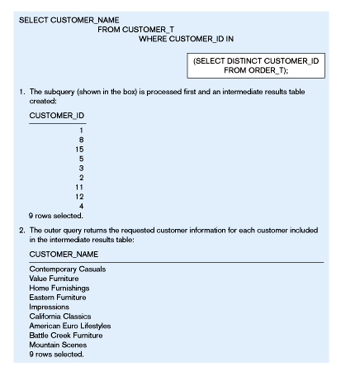
Processing a noncorrelated subquery
No reference to data in outer query, so subquery executes once only

Slide 26
Correlated vs. noncorrelated subqueries
Correlated subqueries
Make use of the result of the outer query to determine the processing of the inner query
The inner query is different for each row referenced in the outer query – i.e. executes once for each row of the outer query
e.g. – list all the details about the product with the highest unit price
Here we compare a table to itself and we do this by giving the table two aliases, PA and PB
Firstly, PRODUCT_ID 1 (the end table) will be considered
When the subquery is executed, it will return the prices of every product except the one being considered in the outer query

Slide 27
Correlated vs. noncorrelated subqueries
Then the outer query will check to see if the unit price for the product being considered is greater than all of the unit prices returned by the subquery
If it is, it will be returned as the result, if not the next value in the outer query will be considered, and the inner query will return a list of all the unit prices for the other products
The list returned by the inner query changes as each product in the outer query changes, this makes it a correlated subquery
SELECT PRODUCT_NAME, PRODUCT_FINISH, UNIT_PRICE FROM PRODUCT_T PA
WHERE UNIT_PRICE > ALL
(SELECT UNIT_PRICE FROM PRODUCT_T PB WHERE PB.PRODUCT_ID != PA.PRODUCT_ID);

Slide 28
Correlated subquery example
The EXISTS operator will return a TRUE value if the subquery resulted in a non-empty set, otherwise it returns a FALSE
e.g. show all orders that include furniture finished in natural ash
SELECT DISTINCT ORDER_ID FROM ORDER_LINE_T
WHERE EXISTS
  (SELECT * FROM PRODUCT_T
  WHERE PRODUCT_ID = ORDER_LINE_T.PRODUCT_ID
  AND PRODUCT_FINISH = ‘Natural ash’);
  See following Fig.

Slide 29
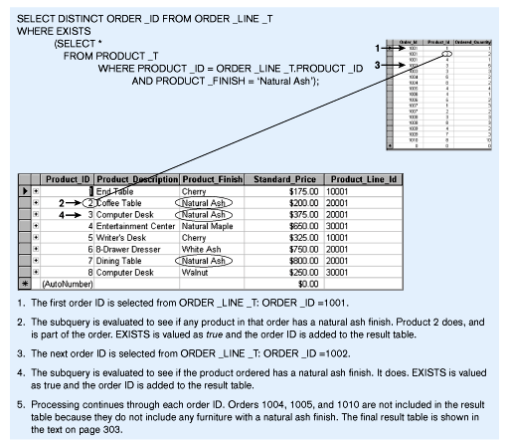
Processing a correlated subquery
Subquery refers to outer-query data, so executes once for each row of outer query

Slide 30
Using derived tables
Subqueries are not limited to inclusion in the WHERE clause, they may also be used in the FROM clause
Here they create a temporary derived table that is used in the query
Creating a derived table that has an aggregate value in it (such as MAX or AVG) allows the aggregate to be used in the WHERE clause
e.g. which products have a standard price that is higher than the average standard price?
One column of the subquery is an aggregate function that has an alias name. That alias can then be referred to in the outer query

Slide 31
Using derived tables
Subquery forms the derived table used in the FROM clause of the outer query
SELECT PRODUCT_DESCRIPTION, STANDARD_PRICE, AVGPRICE
FROM
    (SELECT AVG(STANDARD_PRICE) AVGPRICE FROM PRODUCT_T),
    PRODUCT_T
    WHERE STANDARD_PRICE > AVG_PRICE;
The WHERE clause normally cannot include aggregate functions, but because the aggregate is performed in the subquery its result can be used in the outer query’s WHERE clause

Slide 32
Combining queries
The UNION clause is used to combine the output from multiple queries together into a single result table
To use UNION, each query must output the same number of rows
They must also be union-compatible, i.e. the output from each query for each column should be of Compatible datatypes (compatibility varies among products)
Can use the CAST command to control datatype conversion
e.g., the DATE datatype in ORDER_T may need to converted to a text datatype:
SELECT CAST(ORDER_DATE AS CHAR) FROM ORDER_T

Slide 33
Combining queries
Following query (over 2 pages) determines the customer(s) who have purchased the largest and smallest quantities of any product, and returns the results in one table
Notice that the expression QUANTITY is created in which the strings ‘Smallest Quantity’ and ‘Largest Quantity’ have been inserted for readability. The ORDER BY clause has been used to organise the order in which the rows of output are listed

Slide 34
Combining queries
SELECT C1.CUTOMER_ID, CUSTOMER_NAME, ORDERED_QUANTITY,’LARGEST QUANTITY’ QUANTITY
FROM CUSTOMER_T C1, ORDER_T O1, ORDER_LINE_T Q1
WHERE C1.CUSTOMER_ID = O1.CUSTOMER_ID
AND O1.ORDER_ID = Q1.ORDER_ID
AND ORDERED_QUANTITY =
(SELECT MAX(ORDERED_QUANTITY) FROM ORDER_LINE_T)
UNION {query on next page}

Slide 35
Combining queries
SELECT C1.CUSTOMER_ID, CUSTOMER_NAME, ORDERED_QUANTITY, ‘SMALLEST QUANTITY’
FROM CUSTOMER_T C1, ORDER_T O1, ORDER_LINE_T Q1
WHERE C1.CUSTOMER_ID = O1.CUSTOMER_ID
AND O1.ORDER_ID = Q1.ORDER_ID
AND ORDERED_QUANTITY =
(SELECT MIN(ORDERED_QUANTITY) FROM ORDER_LINE_T)
ORDER_BY ORDERED_QUANTITY

Slide 36
Ensuring transaction integrity
Transaction = discrete unit of work that must be completely processed (or not processed at all)
May involve multiple updates
If any update fails, then all other updates must be cancelled
BEGIN TRANSACTION/END TRANSACTION - marks boundaries of a transaction
BEGIN TRANSACTION creates a log file and starts recording all changes (insertions, deletions and updates) to the database in this file
END TRANSACTION (or COMMIT WORK) takes the contents of the log file and applies them to the database (making them permanent) and then empties the log file

Slide 37
Ensuring transaction integrity
ROLLBACK WORK- cancels updates since the last COMMIT WORK and empties the log file
There is also an AUTOCOMMIT (ON/OFF) command in some RDBMS which specifies whether changes are made permanent after each data modification command or only when work is explicitly made permanent by the COMMIT WORK command
An example of these commands is shown in the following Fig.

Slide 38
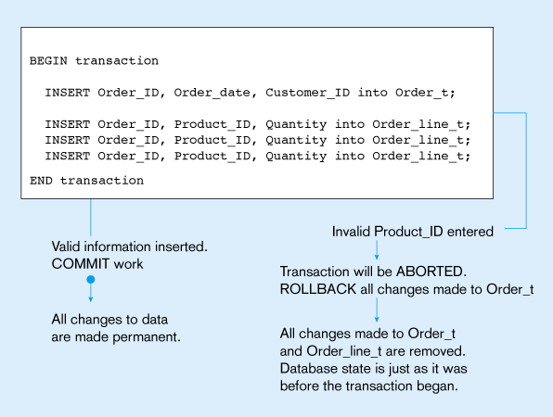
An SQL Transaction sequence (in pseudocode)

