Slide 1
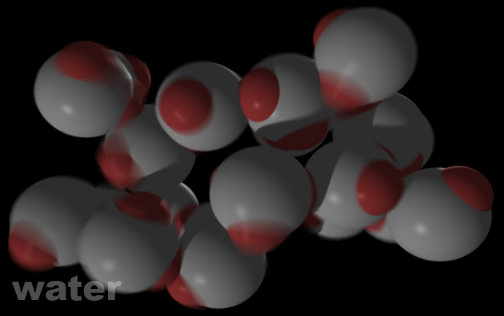
Water
Building an Accessible Tool from a Complex Simulation

Slide 2
Overview
Water is a software package for simulating molecular H₂O.
Designed to be useable by high school through graduate level students.

Slide 3
Work History
6 years experience developing interactive simulations for research & education at Boston University primarily in Java using Swing.
Designed/Implemented Network Visualization, Molecular Dynamics, Neural Net, Dynamical Systems, & Machine Learning software.
Started working at a principle level straight out of high school; will be completing a B.A. in Math next week.

Slide 4
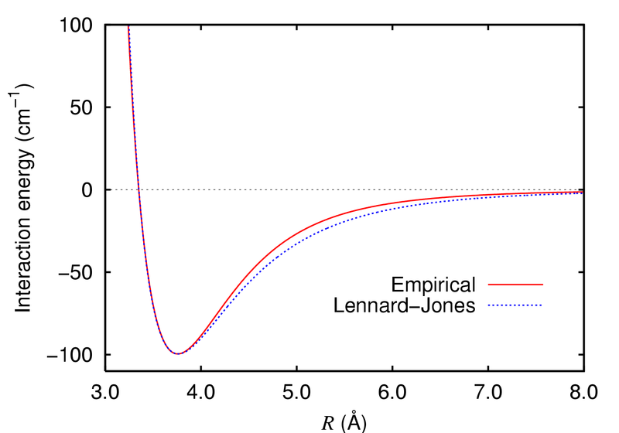
Molecular Dynamics
Celestial Mechanics using an intermolecular instead of gravitational potential.
Uses
  Explain Basic Chemistry
  Developing Nanotechnology
  Determine Structure of Proteins

Slide 5
BCP
A Typical Research Simulation

Slide 6
BCP
Strengths
Easy to develop
Works well with existing tools
Excellent performance
Good for internal use
Weaknesses
Requires extensive scientific and technical background to use
Even for an expert, difficult to visualize results
Not useable by students.

Slide 7
Software Demo

Slide 8
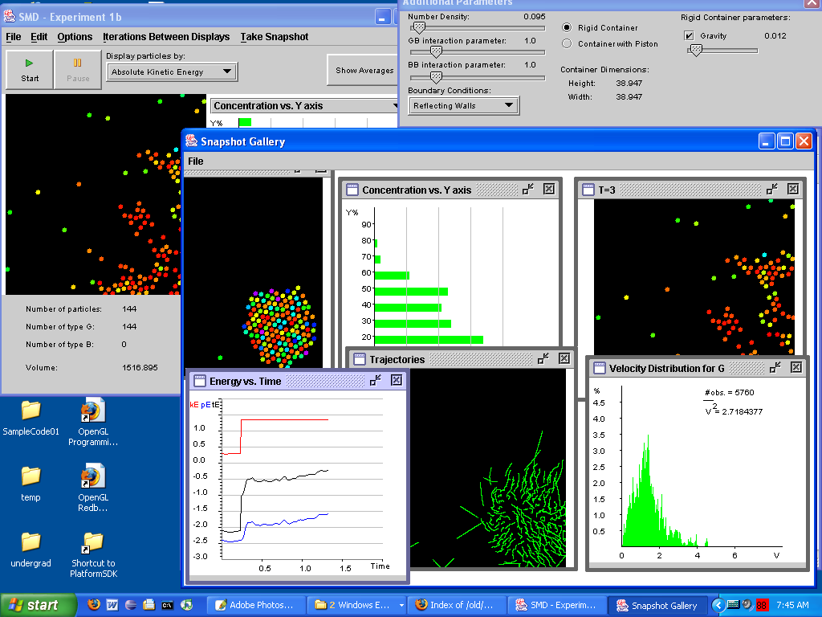

Slide 9
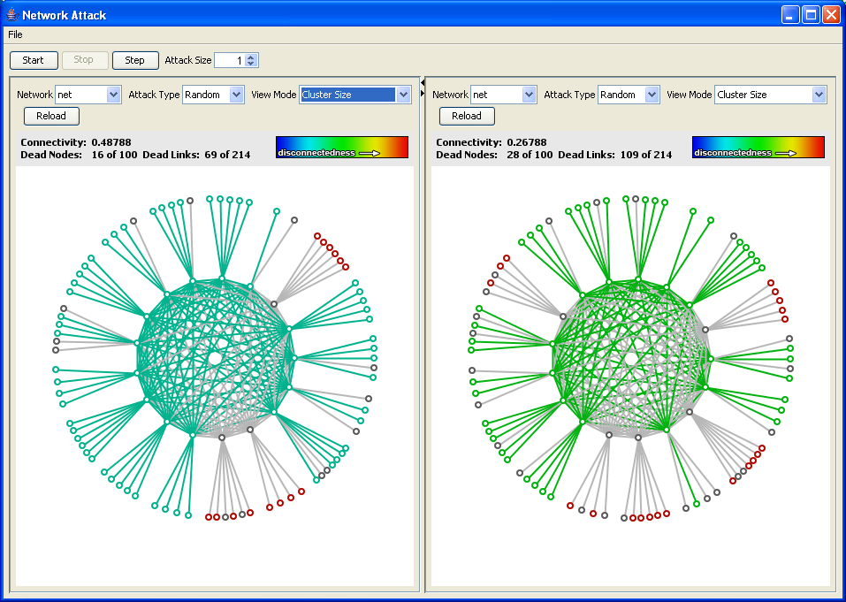

Slide 10
Principles
User centric design
  Don’t build the GUI from the programmer’s perspective
  Aesthetically pleasing but not flashy
  Know application domain & platform, think like user
  Don’t listen, watch
Paradigms
  Modeless
  Dense Panels
  Snapshot Chooser
Libraries
  Water developed in a few months including extensive testing & prototyping
  High Level GUI ‘Look,’ Widgets, Charting, Snapshots, as well as low level: event handling, concurrency, data binding represent years of evolution.
  Essential for efficient development, available tools are not sufficient

Slide 11
