Slide 1
Predictive Analysis of LT Wheel & Rail Degradation
YZ Bay Billet Charging EOT Crane — A Business Analytics Approach
Prem Kumar Thauvan | Crane Maintenance Department

Slide 2
Objective & Business Problem
▶ Goal — Forecast LT wheel failures and rail degradation before they cause unplanned crane downtime.
▶ Why it matters — Unplanned wheel/rail failures halt billet charging operations and raise maintenance cost.
▶ Approach — Use historical maintenance data + predictive analytics to plan proactively.
Expected Outcomes
▶ Forecast failures — 3 / 6 / 12 months ahead
▶ Rank rail risk zones — Critical / High / Medium / Normal
▶ Actionable recommendations — Reduce downtime & optimize replacement schedule

Slide 3
End-to-End Workflow
Step 1
Step 2
Step 3
Step 4
Step 5
Step 6
Load
Data
Clean &
Structure
Explore
(KPIs+Charts)
Preprocess
& Classify
Predictive
Modeling
Forecast &
Recommend
➜
➜
➜
➜
➜
A repeatable pipeline: every time new maintenance data arrives, the model can be retrained to keep forecasts current.

Slide 4
Data Sources
Three sheets from the maintenance Excel workbook
Wheel Replacement
Rail Hardness
Rail Replacement
Date, crane (East/West),
wheel position (SW/SE/NE/NW),
remarks for each failure
Hardness readings (HB) for
North & South rails across
12 track sections
Job logs: pieces replaced,
column sections, reason
(welding / replacement)
Users can upload their own workbook or use the default file — the pipeline adapts automatically.

Slide 5
Data Cleaning & Structuring
Turning messy records into reliable, analysis-ready tables
▶ Normalize crane names — Any spelling of East/West unified into LT EAST / LT WEST
▶ Extract wheel position — Detect SW, SE, NE, NW from text descriptions
▶ Parse dates — Convert all records to real, sortable dates
▶ Read rail hardness layout — Pull North/South readings per section into a clean table
▶ Mine job descriptions — Extract pieces replaced, sections, and reason from free text
▶ Handle missing values — Fill blanks and flag gaps so counts stay accurate

Slide 6
Key Performance Indicators
Actual figures from the current dataset
15
14 / 1
354 / 348
466
18
Total Wheel
Replacements
West / East
Failures
Avg Hardness
N / S (HB)
Max Hardness
(HB)
Rail Pieces
Replaced
9 North and 9 South sections exceed the 300 HB danger threshold — average track hardness is 351 HB.

Slide 7
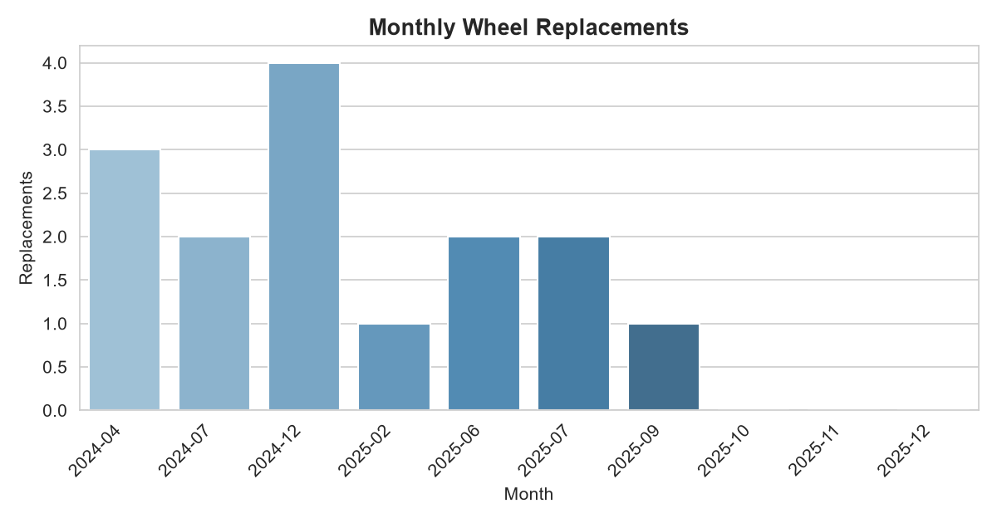
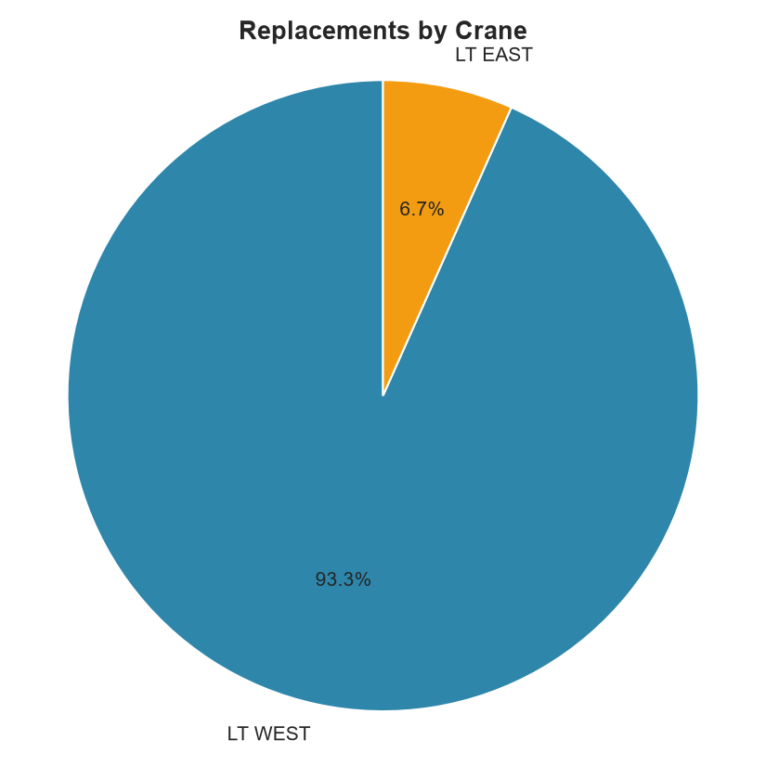
Failure Trends
Monthly volume and crane distribution
West crane accounts for 14 of 15 failures — the clear priority for intervention.

Slide 8
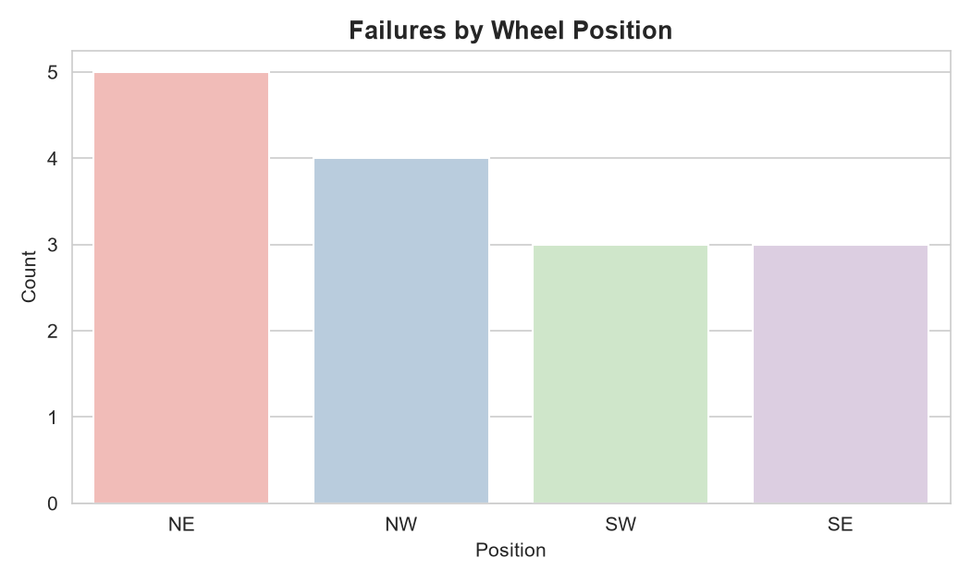
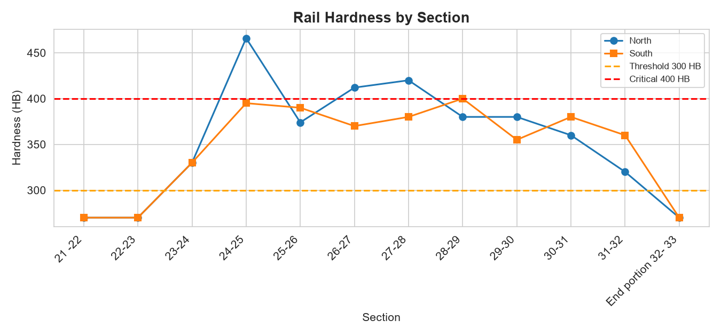
Weak Spots & Rail Condition
Failure position and hardness danger zones
Max hardness reaches 466 HB — well above the 400 HB critical line, accelerating wheel wear in those sections.

Slide 9
Rail Hardness Risk Classification
Turning numbers into action
Risk Level
Hardness
Recommended Action
Critical
> 400 HB
Immediate replacement
High
> 350 HB
Schedule replacement
Medium
> 300 HB
Monitor monthly
Normal
≤ 300 HB
Normal operation

Slide 10
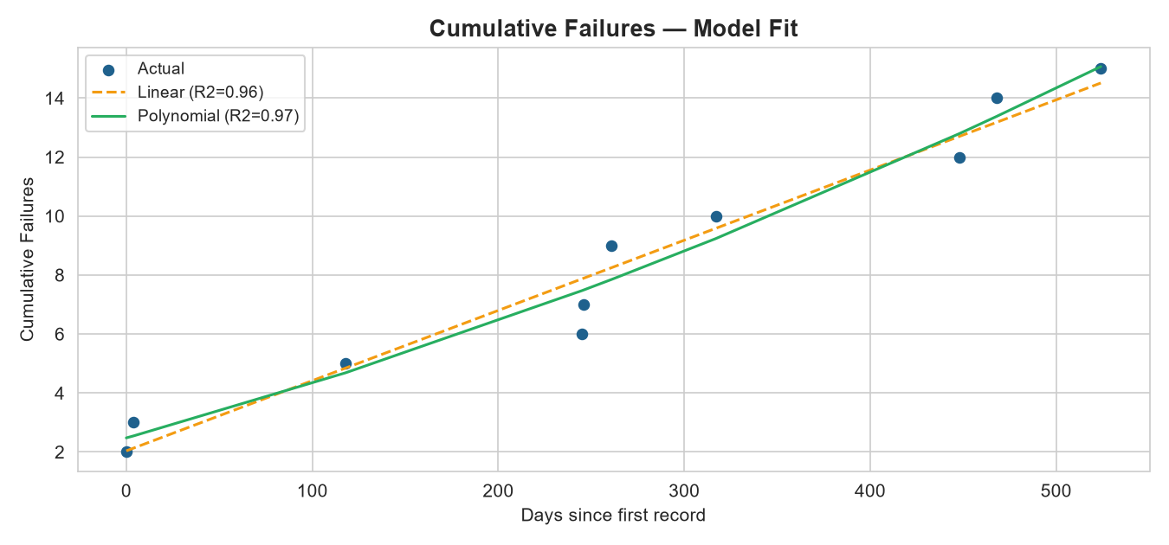
Predictive Modeling
Linear vs Polynomial — model fit on actual data
Model Scores
▶ Linear R² = 0.960 — MAE 0.7, RMSE 0.85
▶ Polynomial R² = 0.967 — MAE 0.66, RMSE 0.77
▶ Selected: Polynomial — highest R² = best fit
Both models score highly; the better fit is selected automatically and used for the forecast.

Slide 11
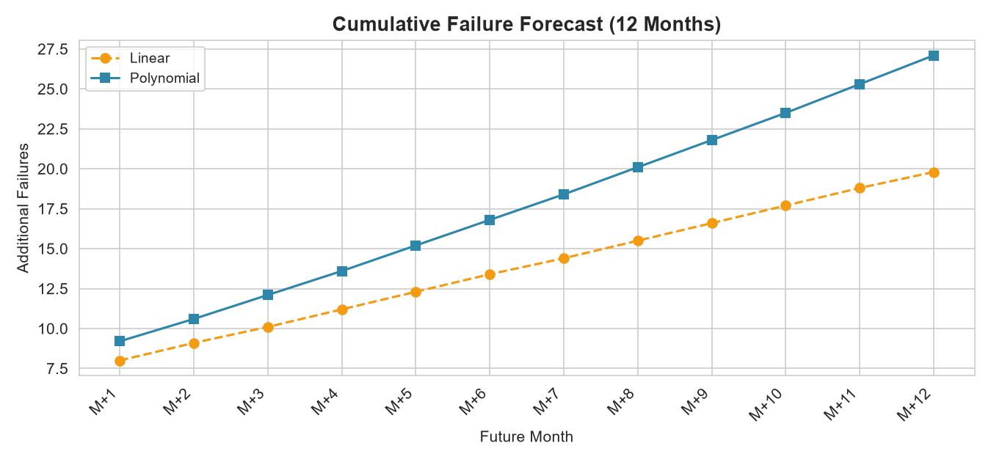
Forecast & Risk Adjustment
Risk-adjusted outlook for the next 12 months
+12
Next 3 Months
+16
Next 6 Months
2.3
Avg / Month
Average hardness 351 HB applies a +51% risk boost. Recommendation: HIGH PRIORITY: Schedule comprehensive rail replacement program

Slide 12
Recommendations
Data-driven maintenance actions
▶ Prioritize critical rail sections — Sections above 400 HB (max 466 HB) replaced first
▶ Schedule wheel replacements proactively — ~12 expected in 3 months, 16 in 6
▶ Focus on the West crane — 14 of 15 failures occur there
▶ Monitor medium-risk sections monthly — Prevent escalation to critical
▶ Retrain model with new data — Keep forecasts accurate over time

Slide 13


THANK YOU

