Slide 1

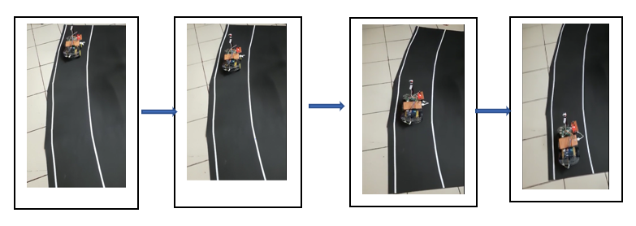
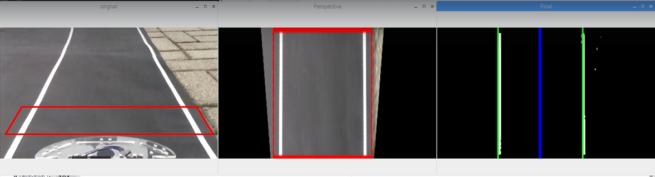
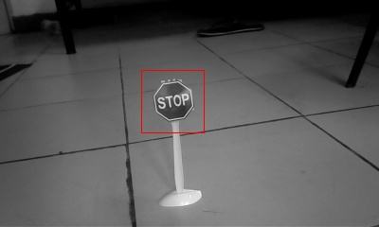
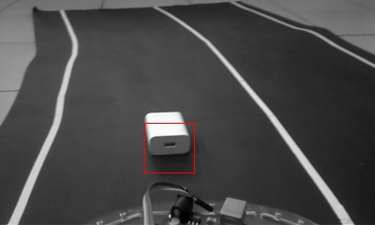
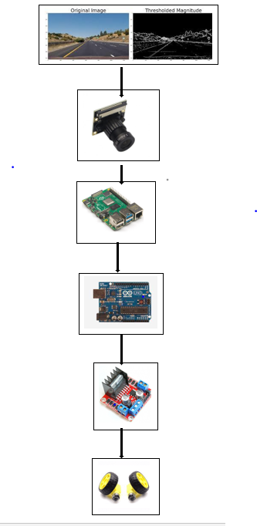
Self Driving Car
Amit Chaudhary| Prof. Archana T | School of computer science and Engineering
Introduction
Results
Automation-driving vehicles developed by different companies such as Google, Tesla, Nissan, Audi etc., uses Artificial Intelligence techniques as a key feature to achieve autonomous capabilities under dynamic environmental conditions. It is assumed that there will be around 21 million self-driving vehicles in the United States and 27 million in Europe by 2030. The idea of driverless cars or autonomous cars originates by observing accidents due to careless driving of people which could sometimes become extremely harmfulSelf driving cars is autonomous cars that includes drives by itself and have navigational skills. It works on four basis components like Observe ( Camera, Sonar, LIDAR and Radar), Process (CPU, GPU and FPGAs), Decide (Artificial Intelligence) and Execute ( Drive by wire). For observe purpose, OpenCV is used, for process purpose raspberry pi is used and for decide purpose artificial intelligence is used.
In this prototype, we have done lane detection using OpenCV and stop sign detection, obstacle detection and traffic light detection using artificial intelligence. For the detection of stop sign, obstacle and traffic light we have created positive and negative samples and train it using cascade trainer gui software which use HAAR cascade model.
fig: Track images.
fig: Lane detection
fig: stop sign detection fig: obstacle detection
Motivation
The main motivation was that humans are bad drivers and not good at boring and repetitive tasks. Every day 360 + people die in accidents in India. Self driving cars feels no tiredness and provide super quick response and being awareness around surrounding every time.
SCOPE of the Project
Automation Vehicles scope to reduce the number of crashes on roads and remove the driver error like laziness, alcoholic. It helps in better traffic management and efficiency to reduce the traffic gams. It provide the better access and mode of transportation. It provides the societal cost-savings by reducing accident, better fuel savings and driverless. It can be easily tracked and find the better short path of destination by utilize GPS. Here we are using different technique like OpenCV for image processing to extract more feature of image and artificial intelligence to process and analysis those real-time video to predicted turns, different traffic signs and signals.
Methodology
Initially, tracks are deployed on surface to gather data through video streaming using webcam with help of OpenCV which is open-source computer vision library. After the collection of data, deployment of image processing such thresholding, Hough Line transformation to find the Centre point and frame point. With help of these Centre and frame point, we are able to find the curve/turn value of car and traffic sign to distinguish different classes i.e. right, left, forward and stop.
After this, we are able to collect the dataset for our model to make self-automation vehicle. Dataset contain the image and csv file which contain image location and curve value of turn. These datasets are collected manually which leads to innovate the model according to environment we provide to the car. After collection of data, OS operation are performed to extract the data and label it from location then image processing technique are applied to get better feature result from image and such technique may be augmentation, thresholding, Hough line detection and some preprocessing like gaussian blur and resizing the image were required to remove noise and equal size dimension. Thereafter, we were ready make HAAR cascade model using cascade trainer gui which performance is better on image or video.
Conclusion
In project, a chassis car has been used for making a blueprint of driverless car. The basic concept behind a automation-driving car is to sense its environment and take actions respectively. The steering angle of the car was measured using a value difference between frame center and lane center. Movement in the wheel affect a value difference between frame center and lane center based on value difference turning take place. The motors are used to drive the car which is controlled by using an H-bridge motor driver. The signal to the motor driver shield was given through the Arduino board using PWM. The Arduino board gets the signal from a Raspberry Pi which runs the computer vision algorithm to navigate the car. Cascade trainer gui which uses HAAR cascade model has been used to train data to move the car chassis on pre-defined paths. HAAR cascade model is implemented along with the powerful computer vision techniques to enable the car to navigate autonomously.
In this prototype, we can do various change using sensors and camera to get better performance. There should be utilization anti-light resolution camera to get clear raw data for processing and predicting. Here, better hardware should be utilized to get for fast communication and response.
References
[1] “Definition of self driving car” http://www.techopedia.com
[2] “H-Bridge” www.modularcircuits.com/blog/articles/h-bridge-secrets/h-bridges-thebasics
[3] “The Full Arduino Pin out Guide” https://www.circuito.io/blog/arduino-uno-pinout
[4] “Self-driving course” https://www.udemy.com/applied-deep-learningtm-thecomplete-self-driving-car-course/
Data Collection
Classification
Finding lanes using OpenCV
Real time data
HAAR cascade model
Serial Communication
Arduino
Motors
H-bridge
Motors rotation with different speeds

