Slide 1
Watermark Lab
Statistical signals in AI writing
Insertion, detection and survival
under recursive paraphrasing
A pattern in token choices
Completed local study
23 October 2026
Research prototype and completed benchmark
01
Notes:
Watermark Lab studies whether a signal inserted into the token choices of a language model remains detectable when its text is rewritten. We control generation and test with the same secret key. We have completed a real local comparison of three method settings across twenty explanatory topics, three seeds and a separate length sweep. The saved run contains 210 cells and 1,050 measurements. Our strongest engineering outcome is the complete insertion, inspection and recovery workflow. The main research finding is that original detection works in this study while recursive paraphrasing leaves very little recoverable signal. The following slides distinguish implementation, measured evidence and proposed work. Full depth appears in the speaker notes, and the accompanying guide contains the longer technical reference.
Sources
Local run research-20261021-115335-998767, completed 22 October 2026. Measurement snapshot: output/documentation/research-evidence-20261022.json. Full guide: WATERMARK_LAB_COMPLETE_GUIDE.md.

Slide 2
The problem and the reason for this study
Can a deliberate signal survive
when the wording changes?
01
02
03
Insertion
Rewriting
Detection
The generator favors a secret
set of token choices.
The attacker changes
wording without our
processor.
The detector reconstructs the
pattern with the same key.
Baseline rationale: no retraining, explicit detection and measurable parameter tradeoffs
02
Notes:
Text often leaves the system that generated it. Copying removes surrounding metadata, and rewriting changes wording. Our question is whether a deliberately embedded keyed pattern can supply evidence of origin after those transformations. This differs from trying to classify every unknown paragraph as human or AI. We chose a green-list baseline because it changes sampling without retraining, provides an explicit detector and exposes a strength-versus-quality tradeoff. This was an engineering starting point, not evidence that it was the most robust available construction. The current threat model gives an attacker the marked passage and a paraphraser without our insertion processor. The detector then searches the transformed text for the original pattern. Useful success means quality-preserving transformed detection at a declared accidental-trigger rate. A negative result can still establish a reproducible failure condition and motivate a better construction.
Sources
Kirchenbauer et al. A Watermark for Large Language Models. ICML 2023. https://proceedings.mlr.press/v202/kirchenbauer23a.html
Sadasivan et al. Can AI-Generated Text be Reliably Detected? TMLR, preprint revised 2025. https://arxiv.org/abs/2303.11156

Slide 3
The watermark changes next-token sampling
Key + previous token
HMAC-SHA256 seeds a deterministic
vocabulary partition through PCG64.
Approximately 25% favored
Add delta to green logits.
The model still samples among
alternatives.
Eligible next-token vocabulary
Same key and tokenizer reconstruct the favored choices during detection
03
Notes:
A token is a vocabulary unit rather than necessarily a whole word. The model produces logits for possible next tokens. Our scheme combines the secret key with the preceding token ID using HMAC-SHA256, then seeds PCG64 to create a deterministic permutation of the eligible vocabulary. Roughly one quarter is green. The actual fraction accounts for rounding the partition size. The logits processor adds delta to every green choice and leaves other candidates available. The marked sample uses delta 2 in the baseline and delta 3 in the stronger setting. The ordinary control receives no processor. The fixed condition uses one constant partition and a different distinct-token scoring unit. Generation uses the same paired seeds, but differing early choices change subsequent model contexts. HMAC use does not prove security of the whole construction: PCG64 is not a cryptographic PRNG. All diagram values illustrate the mechanism rather than a measured next-token probability distribution.
Sources
Kirchenbauer et al. A Watermark for Large Language Models. ICML 2023. https://proceedings.mlr.press/v202/kirchenbauer23a.html
Local run research-20261021-115335-998767, completed 22 October 2026. Measurement snapshot: output/documentation/research-evidence-20261022.json. Full guide: WATERMARK_LAB_COMPLETE_GUIDE.md.
Source: watermark.py, generate.py and research.py.

Slide 4
The score measures excess favored choices
z = (G − gamma × T) / √[T × gamma × (1 − gamma)]
G = favored choices T = checked evidence units
Marked original
116 / 195
11.12
First rewrite
48 / 194
−0.08
Cutoff = 4. Below cutoff means insufficient evidence for this pattern.
04
Notes:
The baseline detector counts distinct eligible adjacent token pairs. T is that evidence count, G is the count whose current token falls in the keyed green set, and gamma is the actual green fraction. It computes z=(G-gamma*T)/sqrt(T*gamma*(1-gamma)). The first completion token, special-token boundaries and repeated pairs do not contribute. The screenshot example has 116 green pairs out of 195, compared with an expectation around 48.75. That gives z approximately 11.12. The first rewrite has 48 green pairs out of 194, almost exactly the expectation of 48.5, producing z approximately -0.083. Its evidence count barely changes, so length alone does not explain the drop. Four is an experimental cutoff. A z-score is not an AI probability, and the normal tail is only an approximate null calculation. Dependence and domain effects require empirical calibration. The fixed method instead counts distinct eligible token IDs and intentionally exports no approximate p-value.
Sources
detect.py, research.py fixed_score. Historical saved chain: .runtime/ui-jobs/d4bb09fa5a361a1d/output.json.

Slide 5
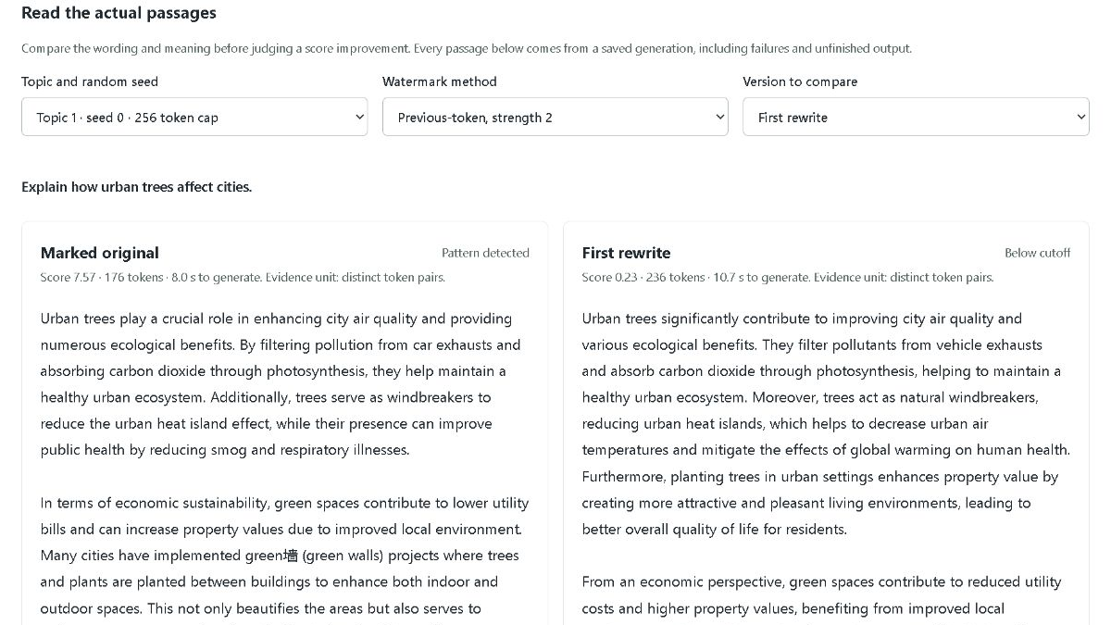
The app connects writing to the evidence
01
Generate & compare
Ordinary and marked passages
02
Check a passage
Rebuild the keyed pattern
03
Try rewriting
Three recursive paraphrases
04
Research bench
Rates, reviews and checkpoints
Actual saved paragraph-comparison layout
Single-passage lab: localhost:8765 Research bench: localhost:8766
05
Notes:
The app runs locally with a plain HTML/CSS/JavaScript frontend and Python HTTP servers. The single-passage lab on port 8765 provides Generate and compare, Check a passage, Try rewriting, Batch experiment and Saved experiments. Generation displays the complete decoded prose before optional token highlights. Handoff buttons carry the key and configuration to the next task. Checking needs the tokenizer and key, not the generation weights. Recursive rewriting transforms the previous output three times without watermark bias. The research bench on port 8766 adds live progress, three-method comparisons, full saved passages, length diagnostics, reviews, checkpoints and CSV/JSON exports. Main-UI generated samples primarily show raw-ID scores with a separate text score, while the research benchmark scores visible text after re-tokenization. A numeric untrained fixture exists for mechanics, but cannot produce paragraphs or validate semantic robustness. The screenshot shows actual saved app layout from an earlier verification session, not the final results table. The servers are running for the presentation.
Sources
ui/index.html, ui/app.js, ui_worker.py, ui/research.html, ui/research.js and research_server.py. Screenshot: output/research-passages.jpg.

Slide 6
The controlled local experiment
20 topics × 3 seeds × 3 methods
180 main cells, each with five scored conditions
Method | Partition | Bias
Baseline | Previous token | delta 2
Stronger bias | Previous token | delta 3
Fixed vocabulary | Constant partition | delta 3
Length sweep: 30 more cells at caps 128 and 512
210 completed cells and 1,050 rows. Ordinary control text is shared across methods.
06
Notes:
The completed run uses Qwen2.5-0.5B-Instruct, temperature 0.8, top-p 0.95, base seed 1234 and main cutoff 4. Main generation prompts ask for two complete paragraphs around 120 words with a 256-token ceiling. The main design contains twenty manual explanatory topics, three seed indices and three method settings. Each cell has an ordinary control, marked original and three recursive paraphrases, giving 180 cells and 900 rows. A separate sweep adds caps 128 and 512 on the first five topics at seed index zero, giving thirty cells and 150 rows. Total: 210 cells and 1,050 scored rows. Controls are generated once for each topic/seed/cap and scored across methods, so those rows are not independent negative texts. The full plan represents 910 generation calls absent discarded attempts. Seed zero is development, seed one controls set a provisional cutoff of at least four, and seed two provides an exploratory held-out view. One key, one model and the same model for paraphrasing limit generalization. Translation and semantic methods are outside this completed run.
Sources
Local run research-20261021-115335-998767, completed 22 October 2026. Measurement snapshot: output/documentation/research-evidence-20261022.json. Full guide: WATERMARK_LAB_COMPLETE_GUIDE.md.
Protocol: research.py, RESEARCH.md and prompts.json.

Slide 7
Rewriting removes most detectable evidence
Method | After 1 | After 3
Baseline | 2/60 | 0/60
Stronger bias | 5/60 | 0/60
Fixed vocabulary | 2/60 | 1/60
Baseline
Stronger bias
Fixed vocabulary
Originals: 60/60 per method. Controls: 0/60 triggers. Human false-positive rate remains unmeasured.
07
Notes:
Every main-stage original crosses the cutoff: sixty out of sixty per method. After the first rewrite, baseline detection is two of sixty (3.3%), stronger bias five of sixty (8.3%), and fixed vocabulary two of sixty (3.3%). After the second rewrite, all three have zero detections. After the third rewrite, baseline and stronger bias remain zero, while the fixed variant detects one of sixty (1.7%). Ordinary controls trigger zero of sixty for each detector, but the text is shared and these are AI-generated negatives, not a human corpus. The chart shows detection proportions rather than average z-scores. A non-monotonic individual chain or aggregate rate can occur because a later rewrite can retain or accidentally recover favored evidence. All three methods detect original insertion reliably in this measured setup. Stronger first-round survival is a small exploratory difference, not a validated robust winner, and requires paired analysis, quality review and independent confirmation. Topic correlation and limited sample size constrain uncertainty.
Sources
Local run research-20261021-115335-998767, completed 22 October 2026. Measurement snapshot: output/documentation/research-evidence-20261022.json. Full guide: WATERMARK_LAB_COMPLETE_GUIDE.md.

Slide 8
Research foundations and alternative methods
Green-list insertion
Semantic context
Kirchenbauer et al. / ICML 2023
Liu et al. / ICLR 2024
Soft promotion and independent detection
SIR embedding and trained transformation
Retention after editing
Distortion-free sampling
Kirchenbauer et al. / ICLR 2024
Kuditipudi et al. / TMLR 2024
Residual fragments and observed text length
Keyed sequence alignment for detection
Recursive paraphrase attacks
Production evaluation
Sadasivan et al. / TMLR
Dathathri et al. / Nature 2024
Stress tests and spoofing concerns
SynthID-Text quality and efficiency
Fixed vocabulary grouping
Joint quality and detection
Zhao et al. / ICLR 2024
Tu et al. / ACL 2024
Unigram-Watermark and conditional guarantees
WaterBench comparison protocol
Full primary-source citations in speaker notes. Published findings and our measurements have separate scopes.
08
Notes:
Kirchenbauer et al. ICML 2023 supply the green-list insertion and independent statistical-detection foundation. Their reliability follow-up studies retained n-grams after human/model edits and the value of sufficient observed text and span-sensitive detection. Sadasivan et al. stress-test detector families using recursive paraphrasing and spoofing. Different methods, lengths and attack conditions explain why studies can report useful retention or strong failures. Zhao et al. propose Unigram-Watermark with a fixed grouping strategy and conditional theoretical guarantees. Our fixed variant uses project-specific keying and unique-token scoring, so it is not an exact reproduction and does not inherit the theorem. Liu et al. use semantic context representations and a trained watermark transformation in SIR. It needs dedicated assets and is pending here. Kuditipudi et al. couple sampling to a keyed random sequence and align text for detection, with distribution-preservation properties under their construction. SynthID-Text studies tournament sampling, quality and serving efficiency at scale. WaterBench motivates joint quality and detection evaluation under fairer comparisons. None of those alternative papers has been fully reproduced in this app. The full titles and primary source links follow.
Sources
Kirchenbauer et al. A Watermark for Large Language Models. ICML 2023. https://proceedings.mlr.press/v202/kirchenbauer23a.html
Kirchenbauer et al. On the Reliability of Watermarks for Large Language Models. ICLR 2024. https://arxiv.org/abs/2306.04634
Sadasivan et al. Can AI-Generated Text be Reliably Detected? TMLR, preprint revised 2025. https://arxiv.org/abs/2303.11156
Zhao et al. Provable Robust Watermarking for AI-Generated Text. ICLR 2024. https://arxiv.org/abs/2306.17439
Liu et al. A Semantic Invariant Robust Watermark for Large Language Models. ICLR 2024. https://arxiv.org/abs/2310.06356
Kuditipudi et al. Robust Distortion-free Watermarks for Language Models. TMLR 2024. https://arxiv.org/abs/2307.15593
Dathathri et al. Scalable watermarking for identifying large language model outputs. Nature 2024. https://doi.org/10.1038/s41586-024-08025-4
Tu et al. WaterBench: Towards Holistic Evaluation of Watermarks for Large Language Models. ACL 2024. https://aclanthology.org/2024.acl-long.83/

Slide 9
The quality and validation gaps
Originals reaching the token cap
Review still required
Method | Cap flags
Baseline | 9/60
Stronger bias | 25/60
Fixed vocabulary | 35/60
Meaning and claims
preservation
Human false-positive
calibration
Independent paraphrasers and
keys
Faithful semantic comparison
No validated robust winner yet
Cap flags do not equal quality ratings. Current human-review count: 0.
09
Notes:
Original detector scores rise with stronger bias, but completeness diagnostics show a cost that needs investigation. Original cap flags in the main stage are 9/60 for the baseline, 25/60 for stronger bias and 35/60 for fixed vocabulary. A cap flag means the generation reached its configured maximum without a final EOS token. It is a completion diagnostic, not a fluent-writing grade. All current human-review counts are zero. Meaning, claims and fluency have therefore not received a systematic review. Zero observed ordinary-control triggers does not establish a zero error rate, and these controls do not estimate human false-positive rates. The same small model generates originals and paraphrases, and the current run uses one key. Exact-token dependence makes the baseline fragile to replacing a token and its next-token context. Fixed partitioning removes that context dependence but a paraphraser can still replace the token itself. We need fair comparison at controlled empirical errors and acceptable quality before selecting a method. Translation code exists, but no translation or semantic-watermark comparison is included in the completed run.
Sources
Local run research-20261021-115335-998767, completed 22 October 2026. Measurement snapshot: output/documentation/research-evidence-20261022.json. Full guide: WATERMARK_LAB_COMPLETE_GUIDE.md.
Tu et al. WaterBench: Towards Holistic Evaluation of Watermarks for Large Language Models. ACL 2024. https://aclanthology.org/2024.acl-long.83/

Slide 10
The next milestone is a fair robustness gain
More faithful rewrites detected,
at a controlled error rate
01
02
03
Quality and calibration
Faithful alternative
Independent
confirmation
Review saved passages and
collect human negatives.
Integrate the semantic encoder
and reference method.
Test new attacks, keys and
models on fresh cases.
Completed: insertion, inspection and local benchmark. Next: quality-aware comparison.
10
Notes:
The end goal is a watermark that retains useful detection after meaning-preserving transformations while keeping accidental detections and writing degradation low. Step one is to freeze this completed baseline, review passage fidelity and completeness, and calibrate against a documented human-authored negative corpus with a separate confirmation split. Step two is to reproduce a faithful reference candidate such as SIR, including its semantic encoder and trained transformation assets. An embedding similarity score alone would only assess fidelity and would not implement semantic watermarking. Step three is to compare the candidate on independent paraphrasers, new keys and models, and a fresh test set at matched empirical false-positive rates and comparable quality. Actual translation is another distinct attack to add when models are available. Report raw denominators, paired successes/failures, uncertainty, cap limits, quality ratings and runtime. The desired outcome is a reproducible useful operating range, with an improvement claimed only when independent measurements support it. The current testbed and completed baseline make that next comparison possible.
Sources
Local run research-20261021-115335-998767, completed 22 October 2026. Measurement snapshot: output/documentation/research-evidence-20261022.json. Full guide: WATERMARK_LAB_COMPLETE_GUIDE.md.
Liu et al. A Semantic Invariant Robust Watermark for Large Language Models. ICLR 2024. https://arxiv.org/abs/2310.06356
Tu et al. WaterBench: Towards Holistic Evaluation of Watermarks for Large Language Models. ACL 2024. https://aclanthology.org/2024.acl-long.83/

