Slide 1
Roameo, your travel partner
A web app dedicated to give user amazing
Travel Experiences.

Slide 2
IDEAS

Slide 3
Neighbourhood awareness
Fetch the current location of user to enable him get the places worth visiting nearby.
App would recommend the hotels nearby in order of their popularity.
User can get the historic information of the place as well as the knowledge of nearby places.
What If you are travelling alone and prefer a company of someone.

Slide 4
Suppose you are new to a place and want someone so
that you both of you can share the travel costs and save some money
App would give a platform to link unknown travellers in a nearby radius.
Two persons going to the same place can accompany each other in the journey.

Slide 5
Interest Based destination
User can always add or remove his choices of places such
as adventurous places to visit this weekend or a nice family picnic spot or some hill station.
App would recommend users places to visit according to their interests as well history of their travels.
Aim is to get a categorised classification of all places and let the user choose categories of his or her choice.

Slide 6
Network of travellers
A social platform to share your travel experiences or photos among your co-traveller's network
A reputation system which will reward points based on the upvotes done to your experiences by your co-travellers.
The reputation system would give proper discounts on future travels based on current points of the traveller.
A traveller can recommend his visited place to others in his network.
The points earned from personal fulfilled recomendation would be larger than the earned from upvotes.

Slide 7
Technology Stack
Google app engine:
  The app is deployed on cloud thats gives automatic scalability in response to the amount of traffic it receives
  App engine provides us with Nosql datastores, memcache and a user authentication API
  Jinja framework is used to integate python variables inside HTML structure
  The live link for our app is mojoroameo.appspot.com
  Python is used as programming platform

Slide 8
Google Maps and places APIs
The google place api is used to query certain places of interest such as temples, historiacal monuments, malls etc. considering the current location of the user.
Recommending these places to user automatically would improve its user experience and would help someone going to an unknown place to find his places of interest.
Google maps api is also used to get the travellers in the neighbourhood that could be recommended so as to accompany them.
For current location we would recommend certain places to visit and any travellers nearby.

Slide 9
Interest based recommendation engine
Not fully implemented in this prototype
A functional features has been shown that how a user can add or remove his places of interest baed on categories like adventures, water sports, family picnic etc.
Recommendation would be provided to users based on his interest as well as past history of travels.

Slide 10
Co-travellers network
Using a adjacency list of co-travellers for each user in the database schema.
Whenever this user shares something it would appear in the feed of all his co-travellers.
The places to recommend the user also depends on the places of interest or past travels of his co-travellers.
The current prototype contains the functionality to add friends or co-travellers, sharing platfrom would be provided in future versions.

Slide 11
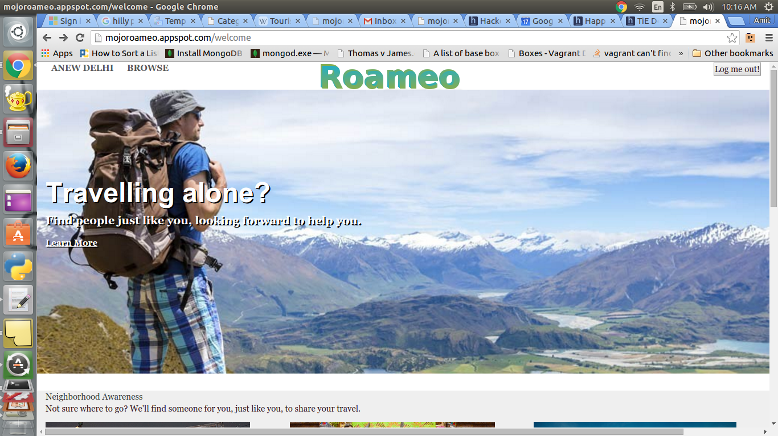
Snapshots

Slide 12
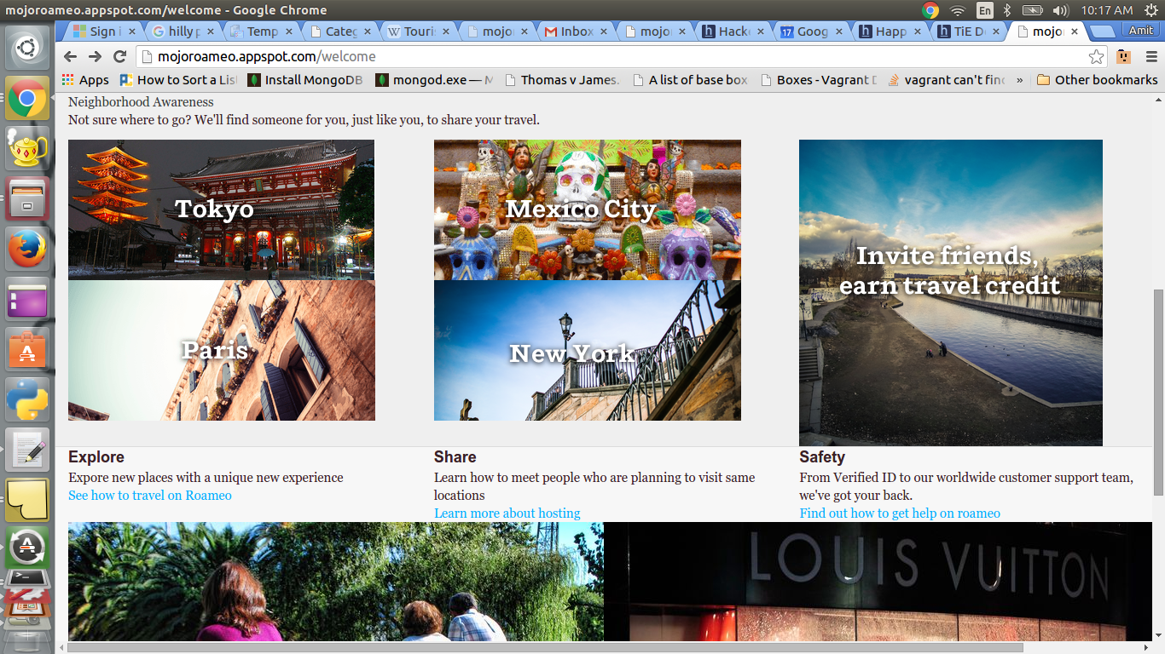

Slide 13
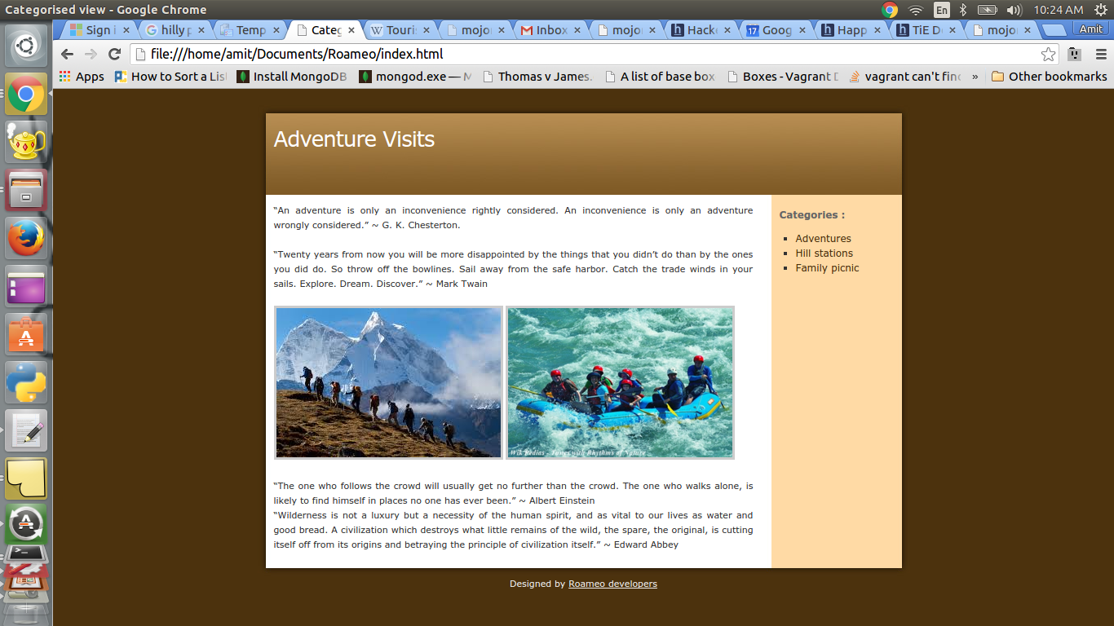
Categorized places

Slide 14
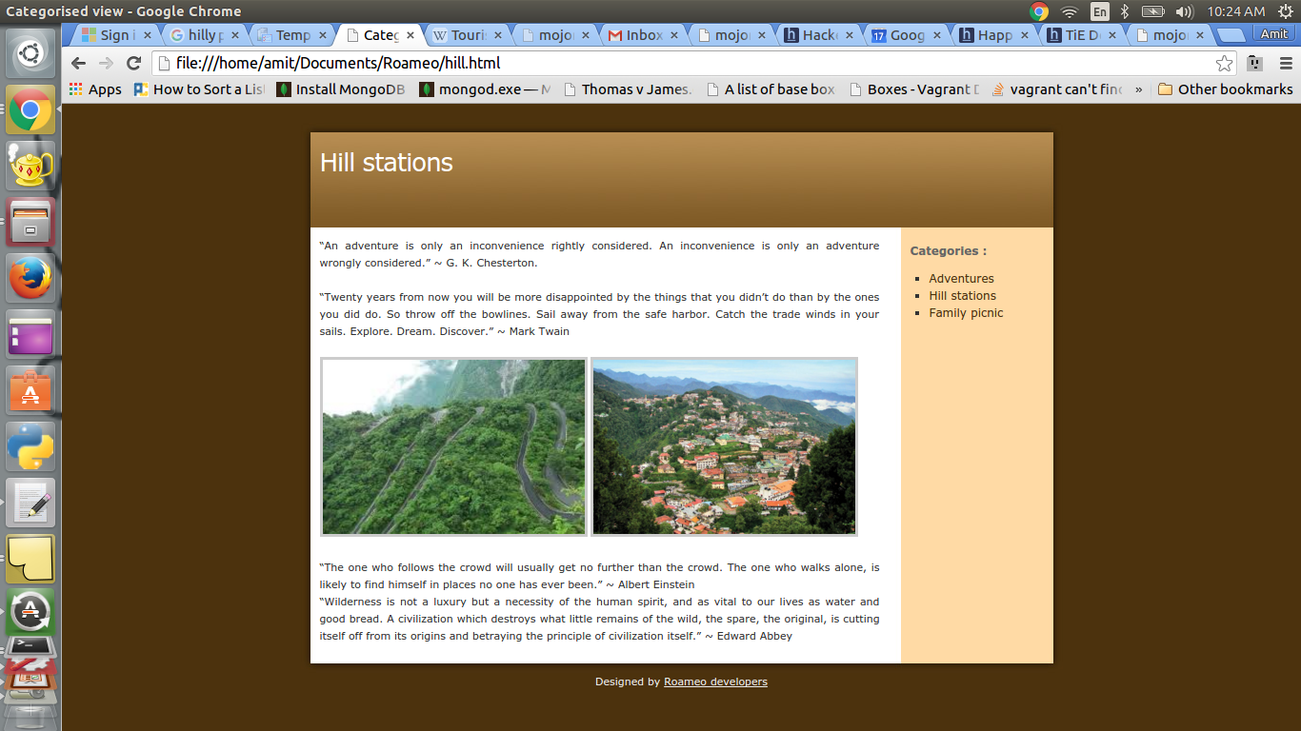

Slide 15
The home page would display the nearby places such as hotels, resturants or historical places
Nearby users would be shown existing within a specified radius.
Users can explore various categorised places and then add to their interests

Slide 16
Thanks

