Slide 1
Data Science in Context
Deep Learning Setup on AWS
Amit Kapoor

Slide 2
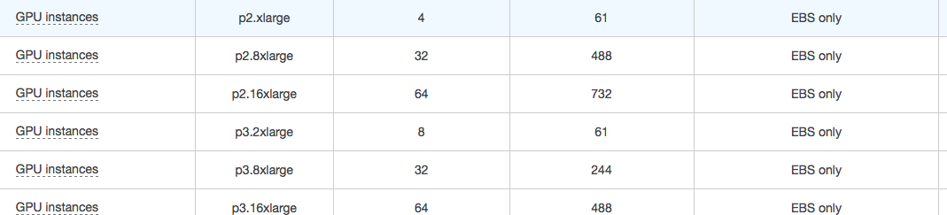
EC2 instances for Deep Learning
For most deep learning projects, the recommended AWS instance is a GPU instance. Training deep learning models will be faster on a GPU instance than a CPU instance.
P3 Instances (up to 8 NVIDIA Tesla V100 GPUs)
P2 Instances (up to 16 NVIDIA NVIDIA K80 GPUs)
G3 Instances (up to 4 NVIDIA Tesla M60 GPUs)

Slide 3
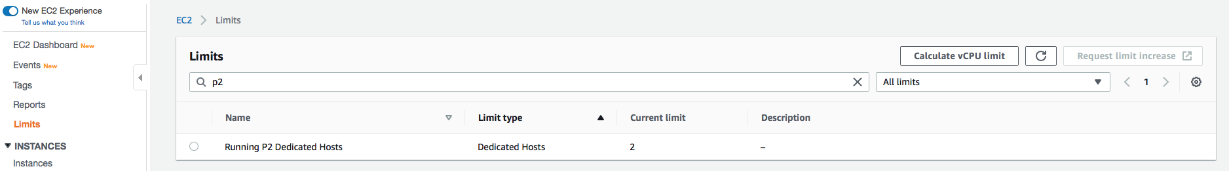
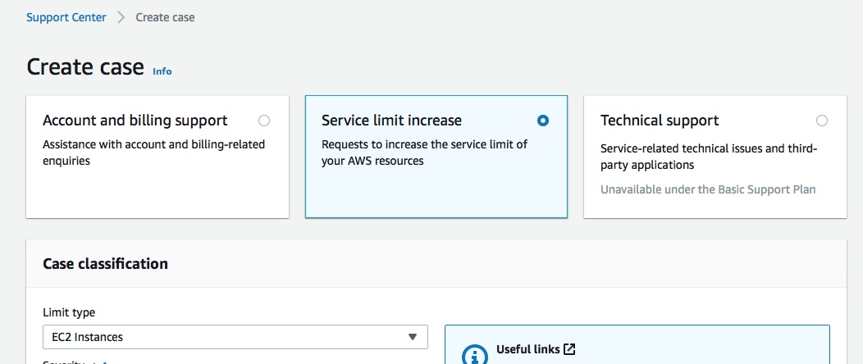
EC2 instances limit
AWS doesn’t allow first time users to launch a ‘P’ or ‘G’ instance so the user should first check the Limits section to review the limits on types of instances and if needed request to increase the limit of instance type needed.
If user requires limit increase for a instance type, a service limit request can be made which requires 24/48 hrs of processing time.

Slide 4
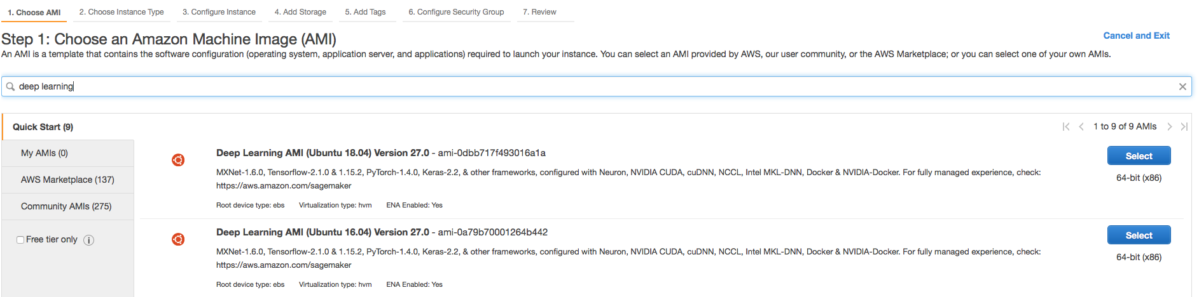
Spinning up EC2 Instance
To set up an EC2 instance, search for deep learning AMI and select one that matches with the requirements.
In the next screen, select the Instance type. Based on CPU, memory, storage, and networking capacity requirements user can select here P2, P3, G3 or G4 instances.

Slide 5
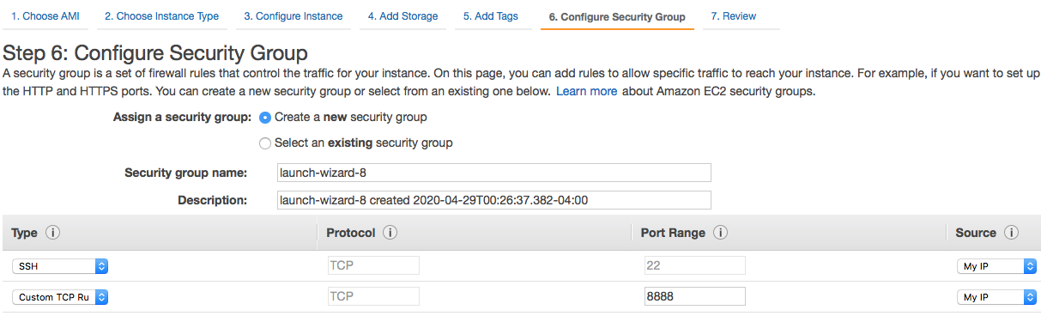
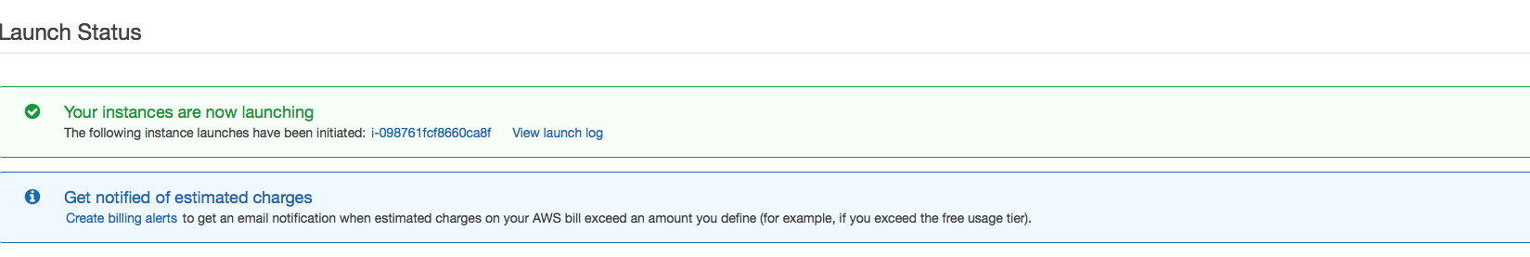
Spinning up EC2 Instance (Contd..)
The next important step in setup process is selecting security group. A security group acts as a virtual firewall to control inbound and outbound traffic. Here port 8888 is for jupyter notebook.
After performing all configuration setup steps, ec2 instance will be up and running.

Slide 6
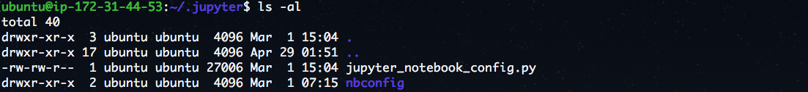
Setup environment on EC2 instance
In the ~/.jupyter directory, edit the notebook config file jupyter_notebook_config.py. By default, the notebook config file has all fields commented out. Lets have below set of configuration options to be uncommented in jupyter_notebook_config.py. The location of this file is ~/.jupyter
c = get_config()
# Run on all IP addresses of your instance
c.NotebookApp.ip = '*'
# Don't open browser by default
c.NotebookApp.open_browser = False
# Fix port to 8888
c.NotebookApp.port = 8888

Slide 7
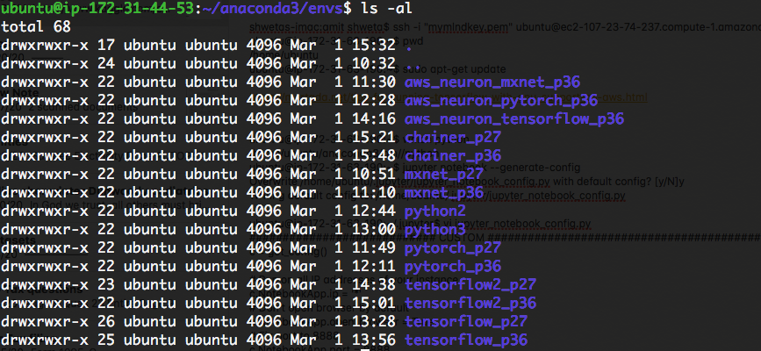
Setup environment on EC2 instance(Contd..)
Now to run jupyter notebook, select any of available environment.
Activate the environment and run ‘jupyter notebook’ command. In this case I selected tensorflow_p36.

Slide 8
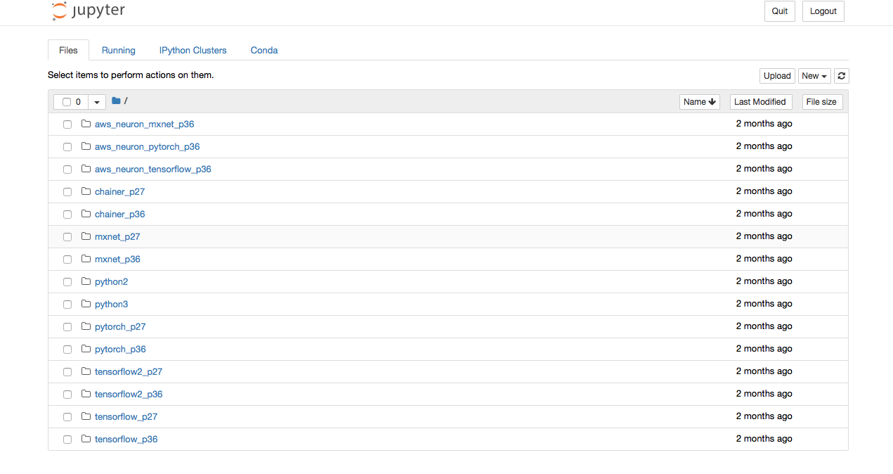
Setup environment on EC2 instance(Contd..)
If all goes well so far Jupyter notebook should run.
To deactivate source, here is the command.

Slide 9
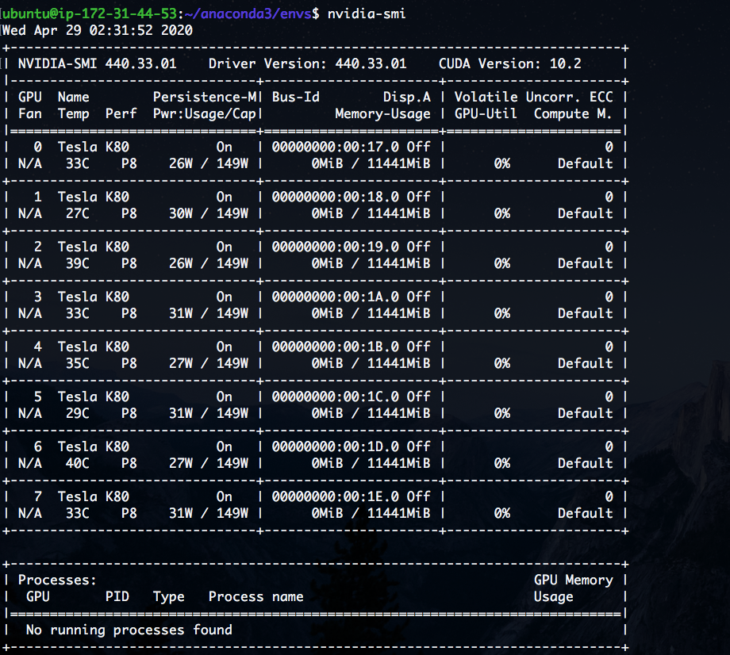
Optimizing GPU settings
The NVIDIA System Management Interface (nvidia-smi) is a command line utility for management and monitoring of NVIDIA GPU devices.

Slide 10
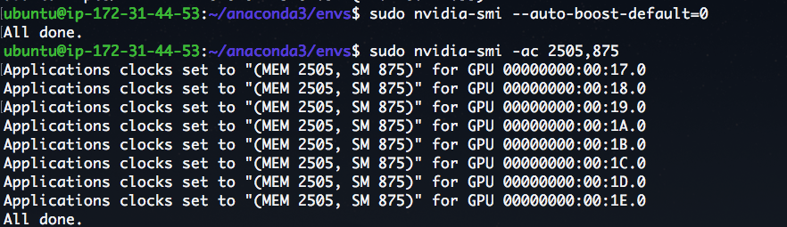
Optimizing GPU settings (Few Quirks)
There are several GPU setting optimizations that can be performed to get the best performance on ‘G’ and ‘P’ instances. By default, the NVIDIA driver uses an autoboost feature that varies the GPU clock speeds. By disabling the autoboost feature and setting the GPU clock speeds to their maximum frequency, we can consistently achieve the maximum performance with GPU instances.
1. Configure the GPU settings to be persistent.
2. Disable the autoboost feature for all GPUs on the instance and set all GPU clock speeds to their maximum frequency. The clock speeds differ based on instance types. For P2, P3, G3 and G4 are (2505,875), (877,1530), (2505,1177) and (5001,1590) resp. Below example is for our p2 instance.

Slide 11
References
https://developer.nvidia.com/nvidia-system-management-interface
https://mortada.net/tips-for-running-tensorflow-with-gpu-support-on-aws.html
https://docs.aws.amazon.com/AWSEC2/latest/UserGuide/optimize_gpu.html

Slide 12
Thanks!

