Slide 1
Category review: Chips
September 2020
Retail Analytics
Presented by Amit Mittal
Brand note: If client logo is not required, use alternate title page layout right click slide thumbnail > Layout > Title

Slide 2
Notes:
To view Privacy video explaining how important data privacy is to Quantium, please click here: https://www.youtube.com/watch?v=Zq1QDAkoRzU
or here Q:\Company Reference\Brand & Design\Brand videos\Q Privacy.mp4
At Quantium, we believe that data is the behavioural footprint of humanity and that it has to be treated with the utmost care and responsibility.
Histories, attitudes, indeed lives are stored within it in ways that aren’t always apparent – and that’s what makes its potential so powerful.
To work with it responsibly, sensitively, we set ourselves the highest data privacy protection and governance standards.
We have spent 17 years perfecting privacy-by-design and secure-by-design principles. Central to this is not holding any personally identifiable information about people –
we neither receive it, and put the necessary protections in place to be unable to decipher it.
Every aspect of handling data is safeguarded: from its de-identification, to its encryption – data security is paramount and of the highest grade.
We pride ourselves on gaining the trust of iconic organisations around the world through years of securely working with their data,
and in turn the trust that builds with their stakeholders.

Slide 3
Executive summary
01
Task 1
Data Preparation and Customer Analytics
After analysing customer purchasing behaviour, we found three customer segments which we should target in order to increase the sales.
Budget – Older Families
Mainstream – Young Singles/Couples
Mainstream – Retirees
We should increase the visibility of Woolworths 190gm and Twisties 250gm & 270gm chips at stores, in order to increase the sales.
02
Task 2
Experimentation and Uplift Testing
After evaluating the performance of a store trial which was performed in stores 77, 86 and 88. We found the store trial was successful in significantly increasing the sales.
We also observed, significant increase in number of customers during the trial period i.e. from February 2019 to April 2019.
We can roll out the new store layout to other stores as well to increase the sales.

Slide 4
01
Category
Budget – Older Families, Mainstream – Young Singles/Couples, and Mainstream – Retirees contributes most to the sales.
Older Families purchases more chips per customer than all other segments.
Mainstream – Midage and Young Singles/Couples are willing to pay more price per packet of chips

Slide 5
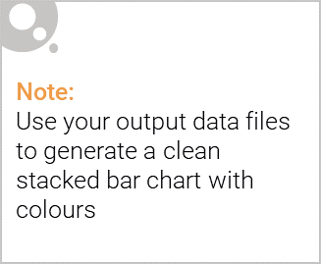
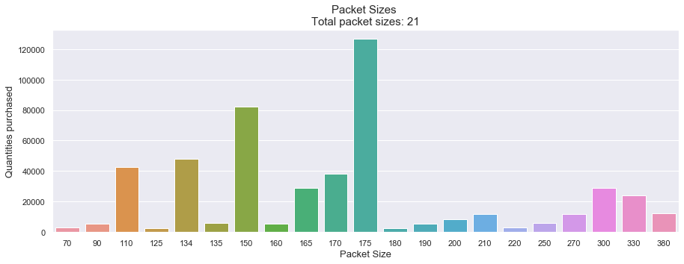
Editable (delete this)
Some useful Insights
Mostly customers prefer to purchase 175gm and 150gm packs across all segments.
These packs are popular among customers because most of the customer prefers to buy medium size packs and many produces such packs.
39% and 19% of the brands produces 175gm and 150gm packs respectively.
We can see less quantity purchased for many pack sizes, this is because they are being produced by certain brands only and have their separate customer base.

Slide 6
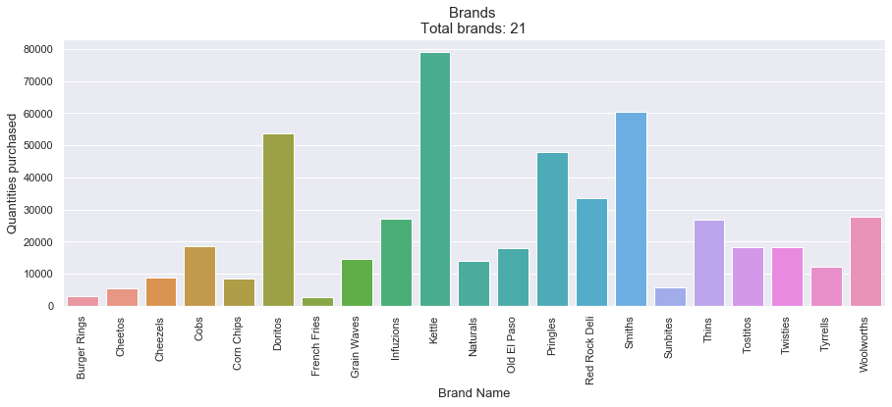
Editable (delete this)
Some useful Insights
Mostly customers prefer to purchase chips from Kettle brand across all segments.
One possible reason is Kettle also produces 175gm and 150gm packs.
Pringles only sell 134gm packs and they were sold most.

Slide 7
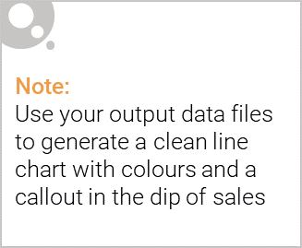
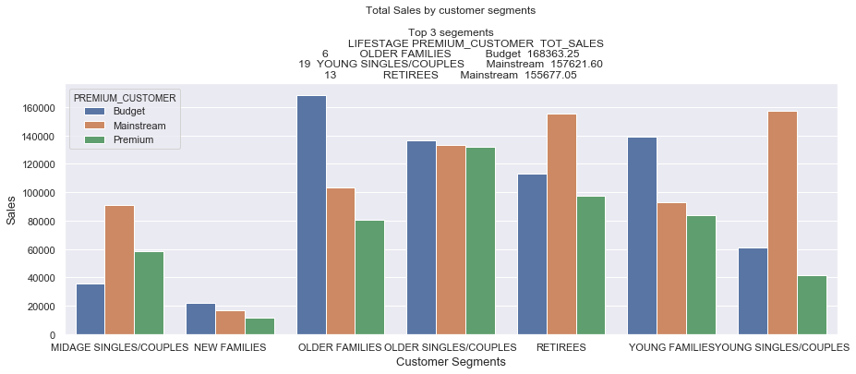
Target Segments
It will be good to focus on segments which are contributing most to the sales, and we can see that Budget – Older Families, Mainstream – Young Singles/Couples, and Mainstream – Retirees are those segments.
It will be good to understand their purchasing behaviour to target them accordingly.

Slide 8
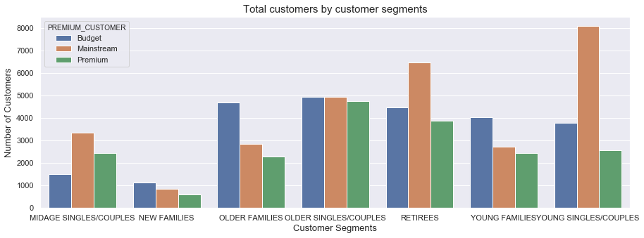
Proportion of customers
We can see that high sales in Mainstream – Young Singles/Couples, and Mainstream – Retirees is due to high number of customers in these segments.
However, this does not seems to be fair reason for Budget – Older Families.

Slide 9
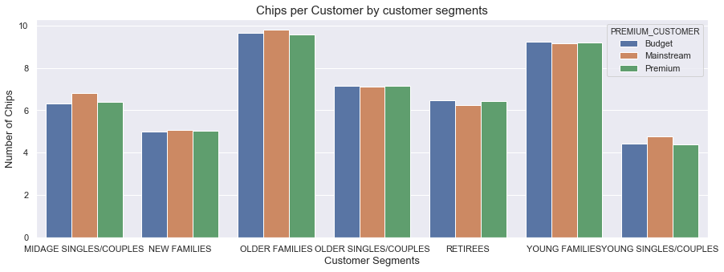
Chips per customer
We can see that Older Families are purchasing more chips per customer than any other segment, this is the reason they are contributing most to the sales.
In fact New Families purchasing more chips per customer than Young Singles/Couples beside contributing least to the overall sales.
In general, families are purchasing more chips per customer than any other segments, probably because families have more members and children.

Slide 10
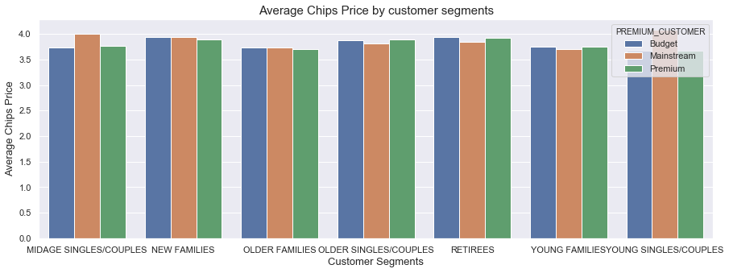
Price per packet of chips
When checking price per packet of chips, we can see that all segments are spending similar amount only.
But Mainstream – Midage and Young Singles/Couples are willing to pay more price per packet of chips compared to their budget and premium counterparts.
This may be due to premium customers being more likely to buy healthy snacks and when they buy chips, this is mainly for entertainment purposes rather than their own consumption.

Slide 11
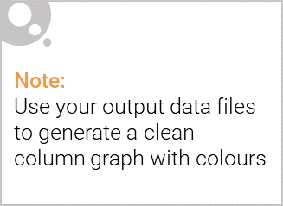
Observations and Recommendation
We should increase the stock of 175gm and 150gm packs at the stores, as they are purchased most across all segments
We should increase the stock of Pringles and Kettle chips at all stores, because these are favorite brands among all segments.
We found that Budget – Older Families are 18% more likely to purchase from Woolworths chips and 22% more likely to purchase 190gm packs than the rest of the population
Mainstream – Young Singles/Couples are 23% more likely to purchase Twisties chips and 28% more likely to purchase 270 grams packs than the rest of the population
Mainstream – Retirees are 5% more likely to purchase Twisties chips and 14% more likely to purchase 250 grams packs than the rest of the population
Therefore, we should increase the visibility of these chips at the stores, so that they are more likely to be purchased and resulting in more sales.

Slide 12
02
Trial Store Performance
Overall trial store performance boosted in the trial period. We saw significant increase in overall sales in trial period as compared to pre-trial period.
Trial store 77 and 88 showed significant increase in sales and number of customers in trial period vs. pre-trial period.
For trial store 86 there was no significant difference in sales, but there was significant increase in number of customers in trial period.

Slide 13
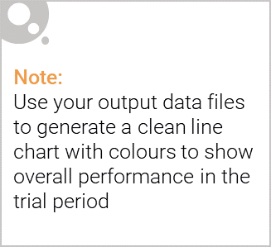
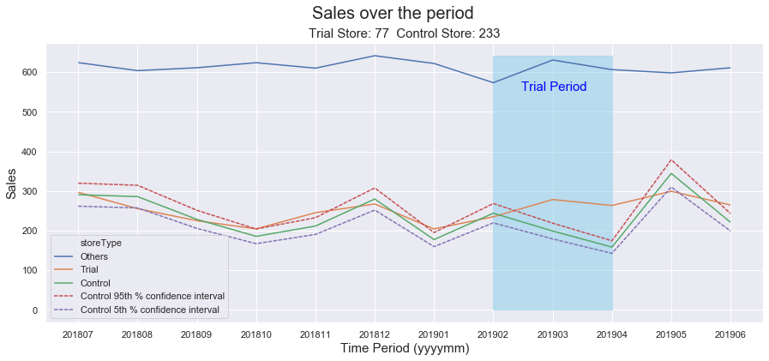
Performance of Trial Stores
For trial store 77 control store was 233.
We can see that the trial store performance was different in pre-trial and trial period.
In pre-trial period (Jul 2018 – Jan 2019), trial store performance was similar to control store.
However, in trial period (Feb 2019 – April 2019) trial store’s sales increased significantly for two out of three trial months.

Slide 14
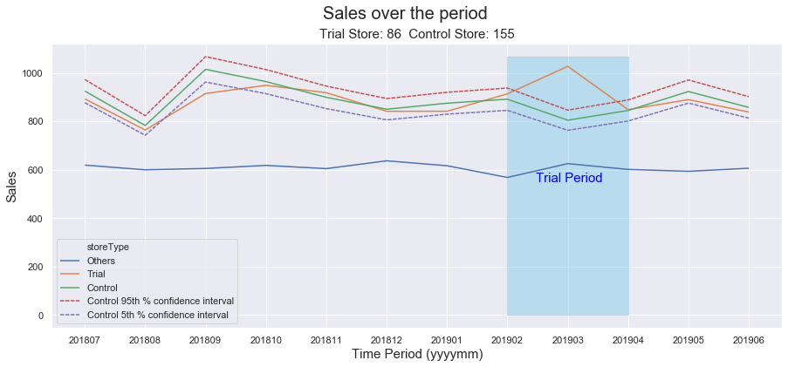
Performance of Trial Stores
For trial store 86 control store was 155.
We can see that there was no difference in trial store’s performance in pre-trial and trial period.
In pre-trial period (Jul 2018 – Jan 2019), trial store’s sales was similar to control store’s sales.
In trial period (Feb 2019 – April 2019) trial store’s sales was similar to control store’s sales in two out of three trial months.

Slide 15
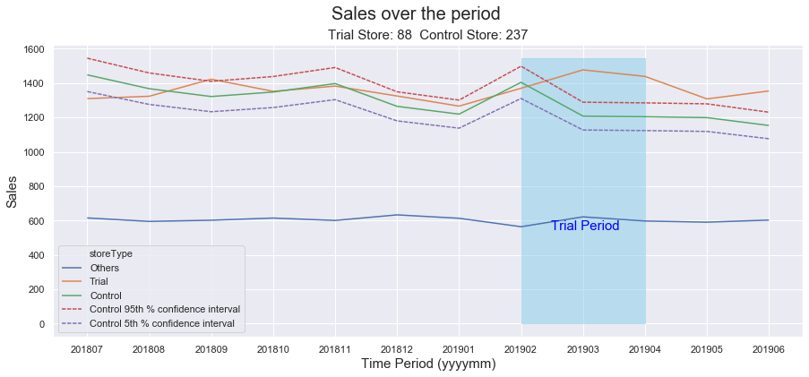
Performance of Trial Stores
For trial store 88 control store was 237.
We can see that the trial store performance was different in pre-trial and trial period.
In pre-trial period (Jul 2018 – Jan 2019), trial store’s sales was similar to control store’s sale.
However, in trial period (Feb 2019 – April 2019) trial store’s sales increased significantly in two out of three trial months.

Slide 16
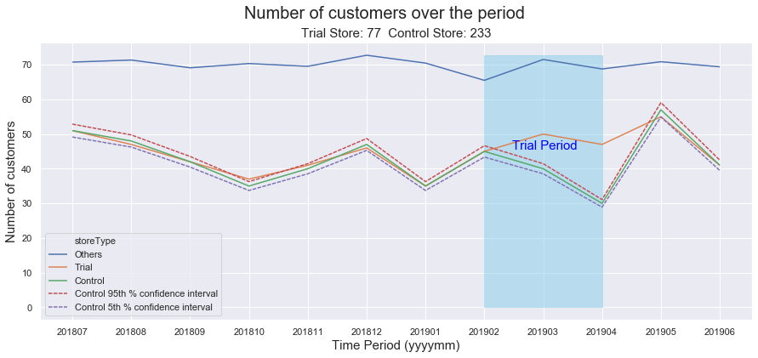
Call out of the performance in the Trial Store
We can observe that in trial store (77) number of customers increased significantly during the trial period, resulting in increased sales.
Number of customers increased significantly in two out of three trial months.
This shows, the new trial layout was successful in increasing the footfall and sales for the store.

Slide 17
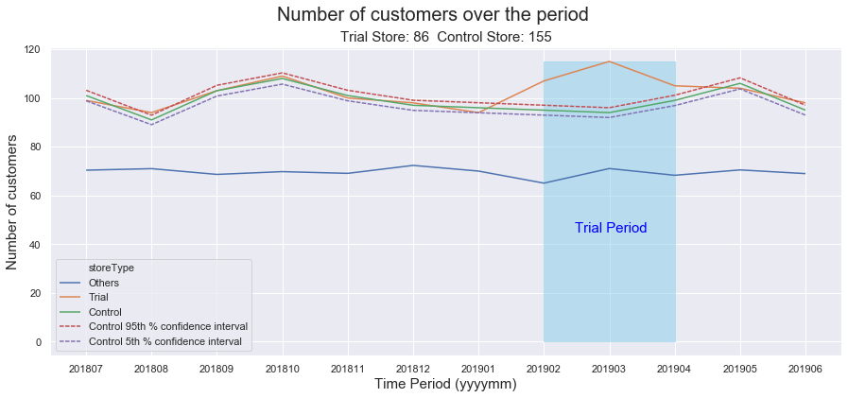
Call out of the performance in the Trial Store
We can observe that in trial store (86) number of customers increased significantly during the trial period, resulting in increased sales.
Number of customers increased significantly in all three trial months.
This shows, the new trial layout was successful in increasing the footfall for the store.

Slide 18
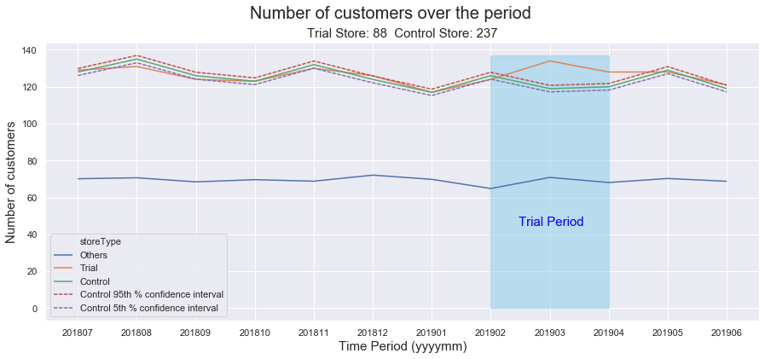
Call out of the performance in the Trial Store
We can observe that in trial store (88) number of customers increased significantly during the trial period, resulting in increased sales.
Number of customers increased significantly in two out of three trial months.
This shows, the new trial layout was successful in increasing the footfall and sales for the store.

Slide 19
Observations and Recommendation
Overall, store trail was successful in increasing the sales
We can roll out the trail layout in all stores in order to increase the sales and monitor store performance afterwards
We need to check with the Category Manager, if some different strategy was implemented in trial store 86, because in this store number of customers increased significantly however sales did not.

