Slide 1

HR Analytics Dashboard
Employee attrition analysis built in Power BI
Notes:
Introduce the project: an HR Analytics dashboard in Power BI focused on employee attrition. Add your name and course/company on this slide if needed.

Slide 2


Project overview
Objective
Who is leaving?
Age group, gender, education field
Analyse employee attrition in an HR dataset and present the results in an interactive Power BI dashboard, so HR can see who is leaving, where it is concentrated and what may be driving it.
Where is it concentrated?
Job role and years at company
What may be driving it?
Salary slab and job satisfaction
Notes:
Explain the business problem: attrition is costly, and HR needs to know which employees leave and why.

Slide 3





Key metrics tracked
Employees
Attrition
Attrition rate
1,480
238
16.1%
Distinct employees
Employees who left
Attrition / headcount
Average age
Average salary
Average tenure
37
6.5K
7.0
Mean age in years
Mean monthly income
Mean years at company
Notes:
Values are taken from the dashboard cards: 1,480 employees, 238 exits, 16.1% attrition rate, average age 37, average monthly income 6.5K, average tenure 7.0 years.

Slide 4
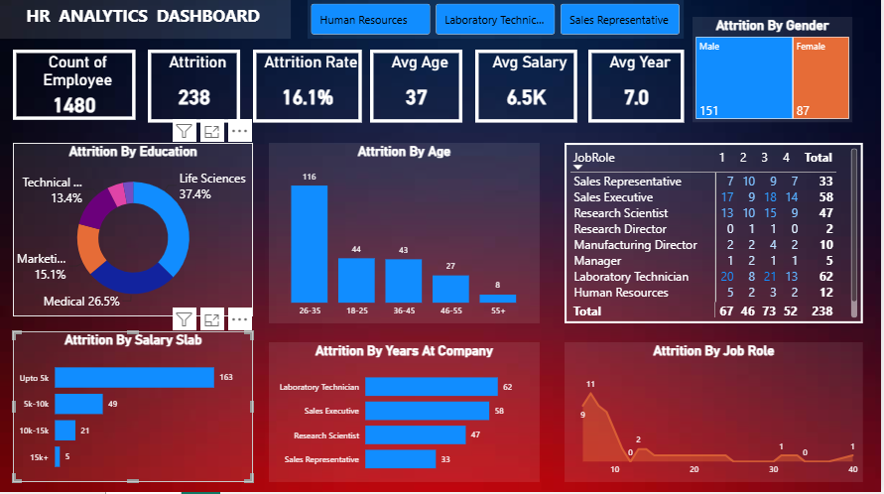
Dashboard at a glance
Attrition by age group
Attrition by gender
Attrition by education field
Attrition by job role
Attrition by salary slab
Attrition by years at company
Job role vs job satisfaction
Notes:
Interactive Power BI report. A job role slicer at the top filters every visual. The next slides rebuild the main charts from the dashboard values.

Slide 5
Who leaves: age and gender
Attrition by age group
Attrition by gender
Ages 26-35 account for 116 of 238 exits (49%)
Men account for 151 exits (63%), women for 87 (37%)
Notes:
Age: 18-25 = 44, 26-35 = 116, 36-45 = 43, 46-55 = 27, 55+ = 8. Gender: Male 151, Female 87. Both totals add up to 238.

Slide 6
Where it happens: education and role
Attrition by education field
Attrition by job role
Life Sciences and Medical make up 64% of exits
Three roles account for 167 of 238 exits (70%)
Notes:
Education shares are read from the donut: Life Sciences 37.4%, Medical 26.5%, Marketing 15.1%, Technical 13.4% (label cut off in the screenshot, assumed Technical Degree). The remaining 7.6% is grouped as Other fields. Job roles come from the matrix on the dashboard. The matrix lists eight roles that add up to 229 of 238 exits; the other 9 exits belong to a role that is scrolled out of view in the screenshot, so it is not charted.

Slide 7
What drives it: pay and satisfaction
Attrition by salary slab
Attrition by job satisfaction
163 of 238 exits (68%) earned up to 5K a month
Satisfaction levels 1 and 2 hold 113 exits (47%)
Notes:
Salary slabs: up to 5K = 163, 5K-10K = 49, 10K-15K = 21, 15K+ = 5. Satisfaction totals come from the Total row of the job role matrix: 67, 46, 73, 52 for levels 1-4. Note that level 3 has the single highest count (73), so satisfaction alone does not explain exits.

Slide 8


Key insights
Age profile
Ages 26-35 account for 116 of 238 exits (49%)
Pay
68% of exits earned up to 5K a month
Roles
Laboratory Technician, Sales Executive and Research Scientist make up 70% of exits
Satisfaction
47% of exits rated satisfaction 1 or 2
Notes:
Percentages are shares of the 238 employees who left.

Slide 9
Suggested retention actions
Review pay
Retain ages 26-35
Act on satisfaction
Most exits earn up to 5K a month, so benchmark pay in that slab.
Half of all exits are in this group. Add career paths and growth plans.
Run focused surveys and manager reviews in the three high-exit roles.
Notes:
These actions follow from the dashboard patterns. They are suggestions to discuss, not proven causes of attrition.

Slide 10

Conclusion
238 of 1,480 employees left, an attrition rate of 16.1%
Exits cluster in ages 26-35, pay up to 5K and three job roles
Next step: act on pay and satisfaction, then track the rate over time
Thank you
Notes:
Close with the one number to remember: 16.1% attrition, 238 exits.

