Slide 1
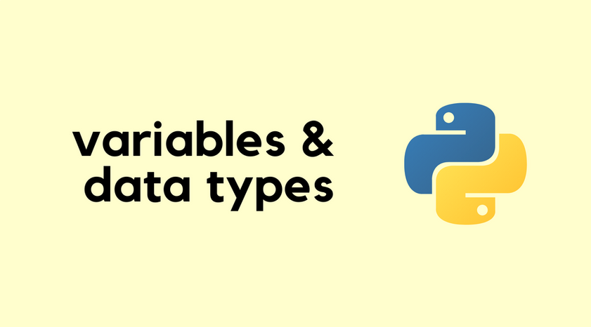

Slide 2
What is a variable?
Variable is like a container that holds data.Creating a variable is like creating a placeholder in memory and assigning it some value.
An assignment in Python is the process of assigning a value to a variable. This is typically done using the assignment operator "=", like this:
a = 1
b = True
c = "Harry"
d = None
These are four variables of different data types.
What is a Data Type?
Data type specifies the type of value a variable holds.
In python, we can print the type of any operator using type function:
a = 1
print(type(a))
b = "1"
print(type(b))

Slide 3
By default, python provides the following built-in data types:
1. Numeric data: int, float, complex
int: 3, -8, 0
float: 7.349, -9.0, 0.0000001
complex: 6 + 2i
2. Text data: str
code:
a = “Hello World”
print(a)
3. Boolean data:
Boolean data consists of values True or False.
code:
a = True
b = False
print(a)
print(b)

Slide 4
4. Sequenced data: list, tuple
List:
list1 = [8, 2.3, [-4, 5], ["apple", "banana"]]
print(list1)
Output:
[8, 2.3, [-4, 5], ['apple', 'banana']]
Tuple:
tuple1 = (("parrot", "sparrow"), ("Lion", "Tiger"))
print(tuple1)
Output:
(('parrot', 'sparrow'), ('Lion', 'Tiger'))
5. Mapped data: dict
dict1 = {"name":"Sakshi", "age":20, "canVote":True}
print(dict1)
Output:
{'name': 'Sakshi', 'age': 20, 'canVote': True}

Slide 5
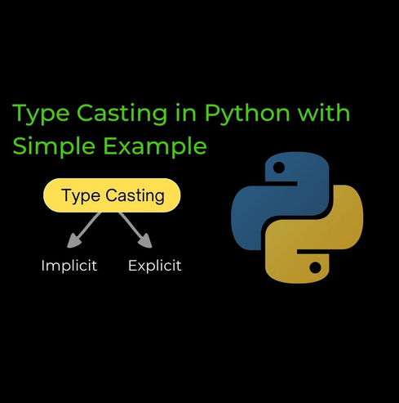

Slide 6
Typecasting in python
The conversion of one data type into the other data type is known as type casting in python or type conversion in python.
Python supports a wide variety of functions or methods like: int(), float(), str(), ord(), hex(), oct(), tuple(), set(), list(), dict(), etc. for the type casting in python.
Two Types of Typecasting:
Explicit Conversion (Explicit type casting in python)
Implicit Conversion (Implicit type casting in python).
Explicit typecasting:
The conversion of one data type into another data type, done via developer or programmer's intervention or manually as per the requirement, is known as explicit type conversion.
It can be achieved with the help of Python’s built-in type conversion functions such as int(), float(), hex(), oct(), str(), etc .

Slide 7
Example of explicit typecasting:
string = "15"
number = 7
string_number = int(string) #throws an error if the string is not a valid integer
sum= number + string_number
print("The Sum of both the numbers is: ", sum)
Output:
The Sum of both the numbers is 22
Implicit typecasting
Implicit typecasting in Python automatically converts lower data types to higher ones during operations to prevent data loss.

Slide 8
Example of implicit type casting:
# Python automatically converts
# a to int
a = 7
print(type(a))
# Python automatically converts b to float
b = 3.0
print(type(b))
# Python automatically converts c to float as it is a float addition
c = a + b
print(c)
print(type(c))
Ouput:
<class 'int'>
<class 'float'>
10.0
<class 'float'>

Slide 9


Slide 10
What are strings?
In python, anything that you enclose between single or double quotation marks is considered a string. A string is essentially a sequence or array of textual data. Strings are used when working with Unicode characters.
Example
name = "Harry"
print("Hello, " + name)
Output
Hello, Harry
Accessing Characters of a String
In Python, string is like an array of characters. We can access parts of string by using its index which starts from 0.
Square brackets can be used to access elements of the string.
print(name[0])
print(name[1])

Slide 11
String Slicing & Operations on String
Length of a String:
We can find the length of a string using len() function.
Example:
fruit = "Mango"
len1 = len(fruit)
print("Mango is a", len1, "letter word.")
Output:
Mango is a 5 letter word.

Slide 12
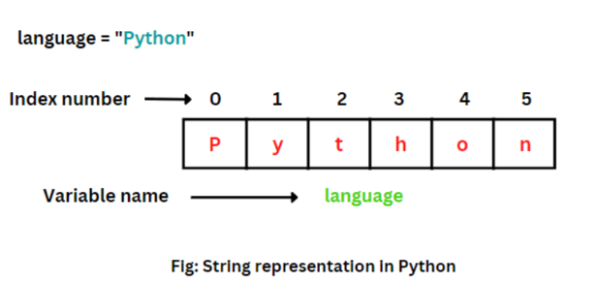
String as an array
A string is essentially a sequence of characters also called an array. Thus we can access the elements of this array.
Example:
pie = "ApplePie"
print(pie[:5])
print(pie[6]) #returns character at specified index
Output:
Apple
i
Slicing Example:
pie = "ApplePie"
print(pie[:5]) #Slicing from Start
print(pie[5:]) #Slicing till End
print(pie[2:6]) #Slicing in between
print(pie[-8:]) #Slicing using negative index
Output:
Apple
Pie
pleP
ApplePie

Slide 13
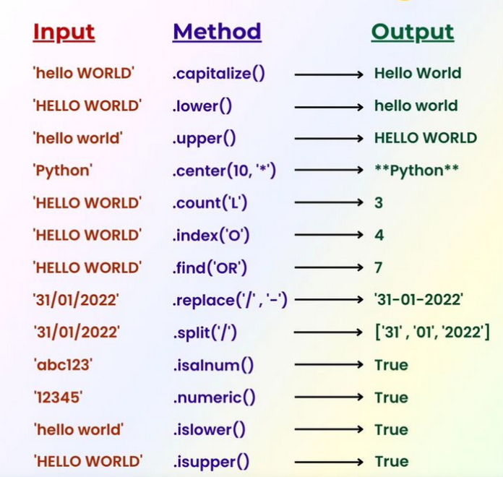
String Methods in Python

Slide 14


