Slide 1
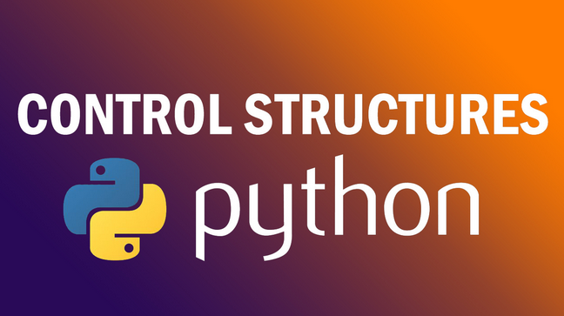

Slide 2
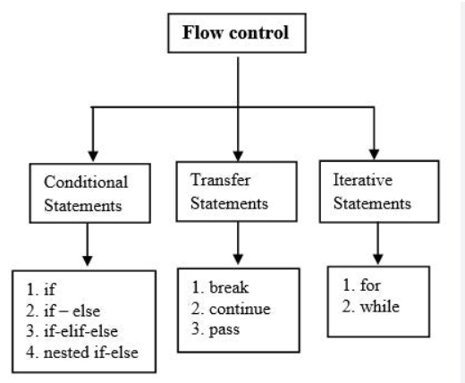

Slide 3
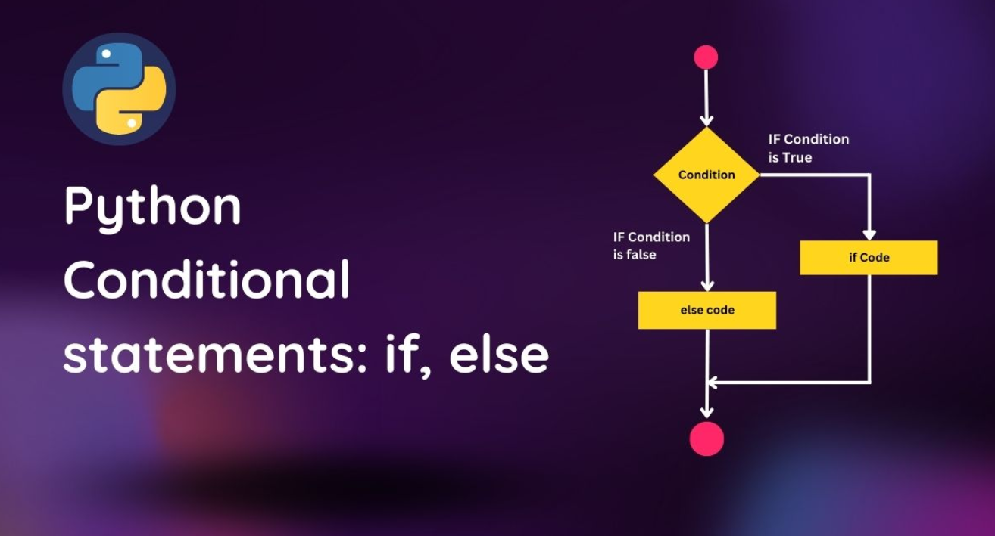

Slide 4
if-else Statements
Sometimes the programmer needs to check the evaluation of certain expression(s), whether the expression(s) evaluate to True or False. If the expression evaluates to False, then the program execution follows a different path than it would have if the expression had evaluated to True.
Based on this, the conditional statements are further classified into following types:
if
if-else
if-else-elif
nested if-else-elif.
An if……else statement evaluates like this:
if the expression evaluates True:
Execute the block of code inside if statement. After execution return to the code out of the if……else block.\
if the expression evaluates False:
Execute the block of code inside else statement. After execution return to the code out of the if……else block.

Slide 5
Example:
applePrice = 210
budget = 200
if (applePrice <= budget):
print("Alexa, add 1 kg Apples to the cart.")
else:
print("Alexa, do not add Apples to the cart.")
Output:
Alexa, do not add Apples to the cart.

Slide 6
elif Statements
Sometimes, the programmer may want to evaluate more than one condition, this can be done using an elif statement.
Working of an elif statement.
Example:
num = 0
if (num < 0):
print("Number is negative.")
elif (num == 0):
print("Number is Zero.")
else:
print("Number is positive.")
Output:
Number is Zero.

Slide 7
Nested if statements
We can use if, if-else, elif statements inside other if statements as well.
Example:
num = 18
if (num < 0):
print("Number is negative.")
elif (num > 0):
if (num <= 10):
print("Number is between 1-10")
elif (num > 10 and num <= 20):
print("Number is between 11-20")
else:
print("Number is greater than 20")
else:
print("Number is zero")
Output:
Number is between 11-20

Slide 8
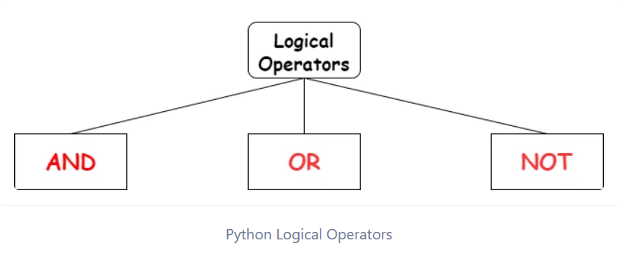

Slide 9
Logical operators in Python
Logical operators in Python are used to combine conditional statements. Here are the logical operators along with examples:
1. AND (and): Returns True if both statements are true.
x = 5
print(x > 3 and x < 10) # Output: True
2. OR (or): Returns True if one of the statements is true.
x = 5
print(x > 3 or x < 4) # Output: True
3. NOT (not): Returns True if the statement is false.
x = 5
print(not(x > 3 and x < 10)) # Output: False
These operators can be used in conditional statements, loops, and other control flow structures to control the flow of execution based on conditions.

Slide 10
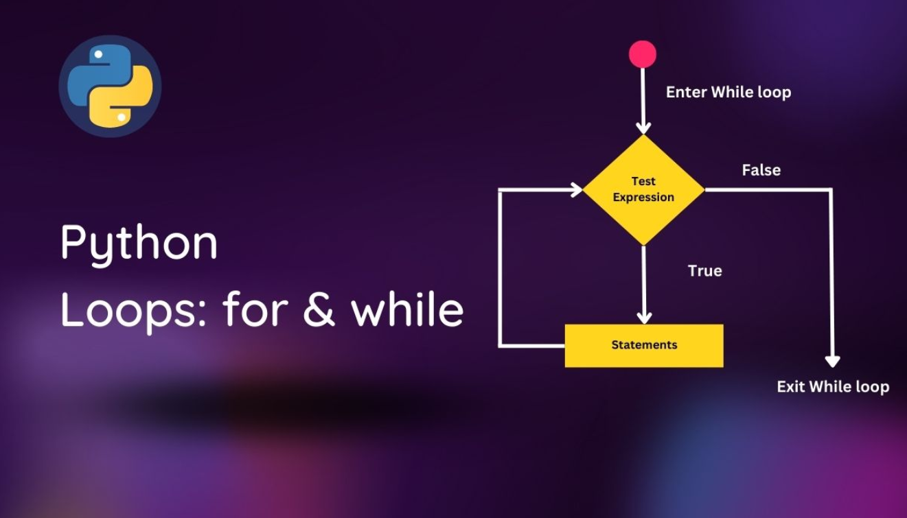

Slide 11
Introduction to Loops
Sometimes a programmer wants to execute a group of statements a certain number of times. This can be done using loops. Based on this loops are further classified into following main types;
for loop
while loop
The for Loop
for loops can iterate over a sequence of iterable objects in python. Iterating over a sequence is nothing but iterating over strings, lists, tuples, sets and dictionaries.
Example: iterating over a string:
name = 'Abhishek'
for i in name:
print(i, end=", ")
Output:
A, b, h, i, s, h, e, k,

Slide 12
Example: iterating over a list:
colors = ["Red", "Green", "Blue", "Yellow"]
for x in colors:
print(x)
Output:
Red
Green
Blue
Yellow
Similarly, we can use loops for lists, sets and dictionaries.
range():
What if we do not want to iterate over a sequence? What if we want to use for loop for a specific number of times?
Example:
for k in range(5):
print(k)

Slide 13
Python while Loop
As the name suggests, while loops execute statements while the condition is True. As soon as the condition becomes False, the interpreter comes out of the while loop.
Example:
count = 5
while (count > 0):
print(count)
count = count - 1
Output:
5
4
3
2
1
Here, the count variable is set to 5 which decrements after each iteration. Depending upon the while loop condition, we need to either increment or decrement the counter variable (the variable count, in our case) or the loop will continue forever.

Slide 14
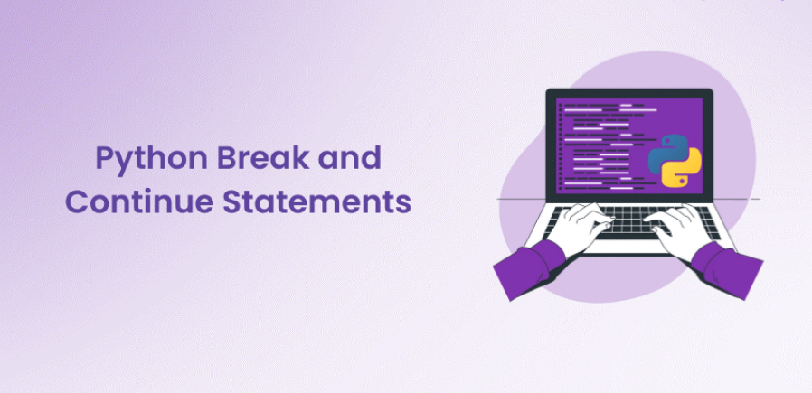

Slide 15
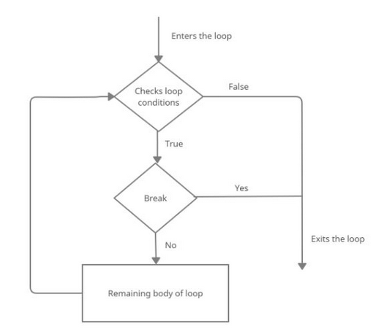
break statement
The break statement enables a program to skip over a part of the code. A break statement terminates the very loop it lies within.
example:
for i in range(1,101,1):
print(i ,end=" ")
if(i==50):
break
else:
print("Mississippi")
print("Thank you")
output
1 Mississippi
2 Mississippi
3 Mississippi
4 Mississippi
5 Mississippi
.
.
.
50 Mississippi

Slide 16
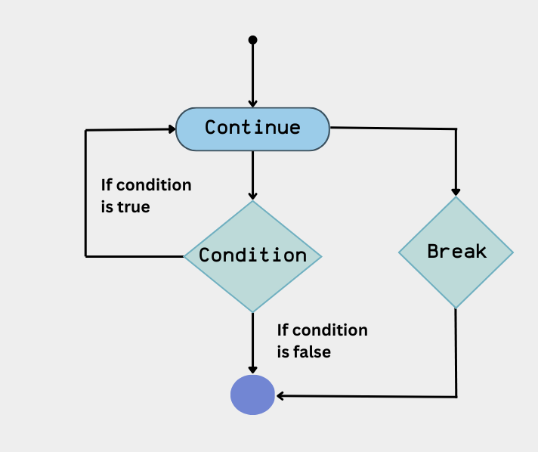
Continue Statement
The continue statement skips the rest of the loop statements and causes the next iteration to occur.
Example:
for i in [2,3,4,6,8,0]:
if (i%2!=0):
continue
print(i)
output
2
4
6
8
0

Slide 17


