Slide 1
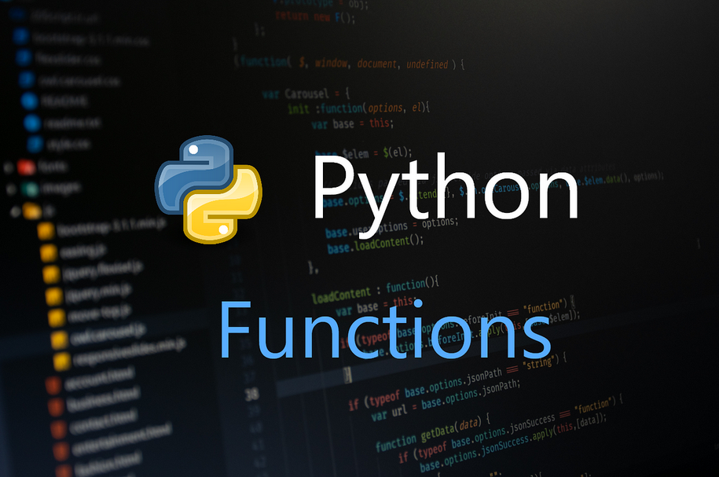

Slide 2
Python Functions
A function is a block of code that performs a specific task whenever it is called. In bigger programs, where we have large amounts of code, it is advisable to create or use existing functions that make the program flow organized and neat.
There are two types of functions:
Built-in functions
User-defined functions
Built-in functions:
These functions are defined and pre-coded in python. Some examples of built-in functions are as follows:
min(), max(), len(), sum(), type(), range(), dict(), list(), tuple(), set(), print(), etc.
User-defined functions:
We can create functions to perform specific tasks as per our needs. Such functions are called user-defined functions.
Syntax:
def function_name(parameters):
pass
# Code and Statements

Slide 3
Create a function using the def keyword, followed by a function name, followed by a paranthesis (()) and a colon(:).
Any parameters and arguments should be placed within the parentheses.
Rules to naming function are similar to that of naming variables.
Any statements and other code within the function should be indented.
Calling a function:
We call a function by giving the function name, followed by parameters (if any) in the parenthesis.
Example:
def name(fname, lname):
print("Hello,", fname, lname)
name("Sam", "Wilson")
Output:
Hello, Sam Wilson

Slide 4
Function Arguments and return statement
There are four types of arguments that we can provide in a function:
Default Arguments
Keyword Arguments
Variable length Arguments
Required Arguments
Default arguments:
We can provide a default value while creating a function. This way the function assumes a default value even if a value is not provided in the function call for that argument.
Example:
def name(fname, mname = "Jhon", lname = "Whatson"):
print("Hello,", fname, mname, lname)
name("Amy")
Output:
Hello, Amy Jhon Whatson

Slide 5
Keyword arguments:
We can provide arguments with key = value, this way the interpreter recognizes the arguments by the parameter name. Hence, the the order in which the arguments are passed does not matter.
Example:
def name(fname, mname, lname):
print("Hello,", fname, mname, lname)
name(mname = "Peter", lname = "Wesker", fname = "Jade")
Output:
Hello, Jade Peter Wesker
Required arguments:
In case we don’t pass the arguments with a key = value syntax, then it is necessary to pass the arguments in the correct positional order and the number of arguments passed should match with actual function definition.
Example : when number of arguments passed does not match to the actual function definition.
def name(fname, mname, lname):
print("Hello,", fname, mname, lname)
name("Peter", "Quill")
Output:
name("Peter", "Quill")\
TypeError: name() missing 1 required positional argument: 'lname'

Slide 6
Variable-length arguments:
Sometimes we may need to pass more arguments than those defined in the actual function. This can be done using variable-length arguments.
There are two ways to achieve this:
I. Arbitrary Arguments:
While creating a function, pass a * before the parameter name while defining the function. The function accesses the arguments by processing them in the form of tuple.
Example:
def name(*name):
print("Hello,", name[0], name[1], name[2])
name("James", "Buchanan", "Barnes")
Output:
Hello, James Buchanan Barnes
II. Keyword Arbitrary Arguments:
While creating a function, pass a * before the parameter name while defining the function. The function accesses the arguments by processing them in the form of dictionary.
Example:
def name(**name):
print("Hello,", name["fname"], name["mname"], name["lname"])
name(mname = "Buchanan", lname = "Barnes", fname = "James")
Output:
Hello, James Buchanan Barnes

Slide 7
return Statement
The return statement is used to return the value of the expression back to the calling function.
Example:
def name(fname, mname, lname):
return "Hello, " + fname + " " + mname + " " + lname
print(name("James", "Buchanan", "Barnes"))
Output:
Hello, James Buchanan Barnes

Slide 8
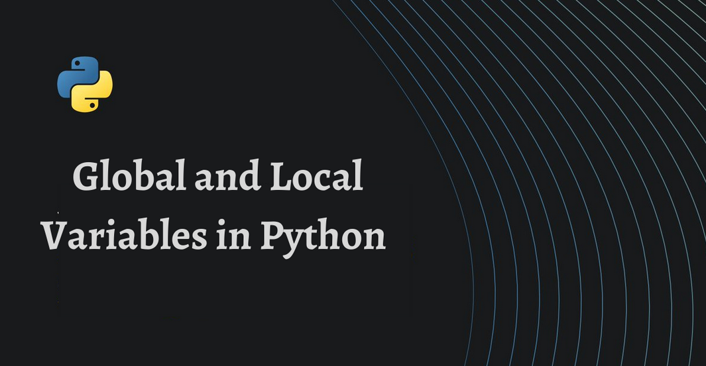

Slide 9
local and global variables
Before we dive into the differences between local and global variables, let's first recall what a variable is in Python.
A variable is a named location in memory that stores a value. In Python, we can assign values to variables using the assignment operator =. For example:
x = 5
y = "Hello, World!"
Now, let's talk about local and global variables.
A local variable is a variable that is defined within a function and is only accessible within that function. It is created when the function is called and is destroyed when the function returns.
On the other hand, a global variable is a variable that is defined outside of a function and is accessible from within any function in your code.
Here's an example to help clarify the difference:

Slide 10
x = 10 # global variable
def my_function():
y = 5 # local variable
print(y)
my_function()
print(x)
print(y) # this will cause an error because y is a local variable and is not accessible outside of the function
In this example, we have a global variable x and a local variable y. We can access the value of the global variable x from within the function, but we cannot access the value of the local variable y outside of the function.

Slide 11
The global keyword
Now, what if we want to modify a global variable from within a function? This is where the global keyword comes in.
The global keyword is used to declare that a variable is a global variable and should be accessed from the global scope. Here's an example:
x = 10 # global variable
def my_function():
global x
x = 5 # this will change the value of the global variable x
y = 5 # local variable
my_function()
print(x) # prints 5
print(y) # this will cause an error because y is a local variable and is not accessible outside of the function
In this example, we used the global keyword to declare that we want to modify the global variable x from within the function. As a result, the value of x is changed to 5.
I hope this tutorial has helped clarify the differences between local and global variables and how to use the global keyword in Python. Thank you for watching!

Slide 13


