Slide 1
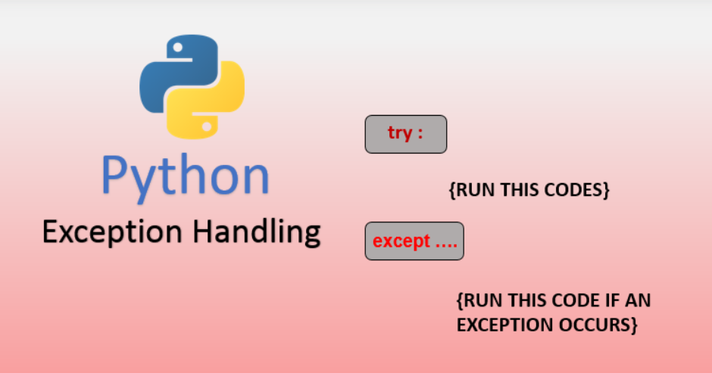

Slide 2
Errors and Exceptions in python
Errors: Errors in Python are typically categorized as syntax errors or runtime errors.
Syntax Errors: Syntax errors occur when the Python parser encounters code that violates the language syntax rules. These errors are detected during the parsing stage before the code is executed. Common examples include missing parentheses, incorrect indentation, or misspelled keywords.
Example of a syntax error:
print("Hello world" # Missing closing parenthesis
Runtime Errors (Exceptions): Runtime errors, also known as exceptions, occur during the execution of a program. These errors interrupt the normal flow of the program. Runtime errors can be caused by various factors, such as invalid input, division by zero, or accessing an index out of range. Python provides mechanisms to handle exceptions gracefully using try, except, else, and finally blocks.
Example
result = 10 / 0 # ZeroDivisionError: division by zero

Slide 3
Built-in exceptions
Built-in exceptions that represent various types of errors or exceptional conditions that may occur during the execution of a program. Here are some commonly used built-in exceptions in Python:

Slide 4
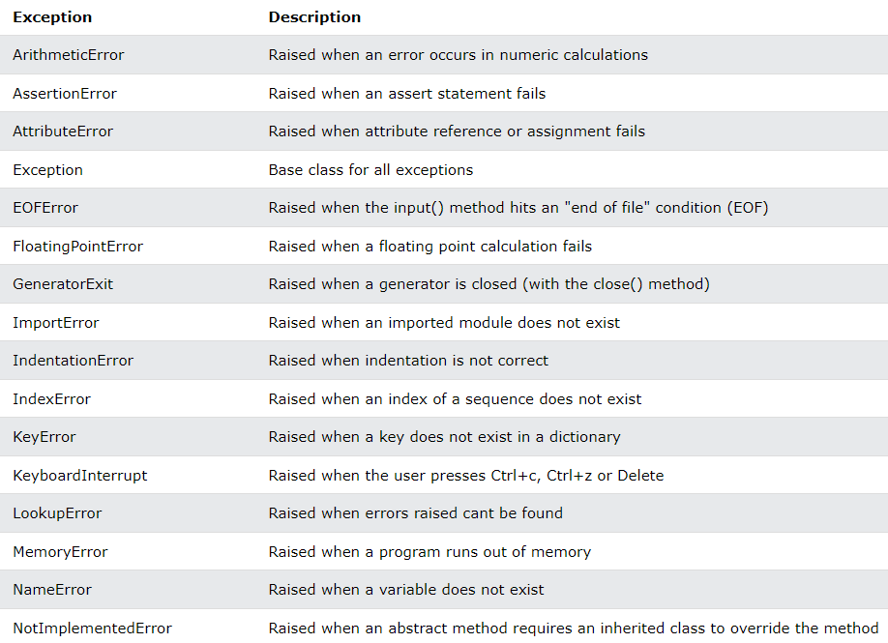

Slide 5
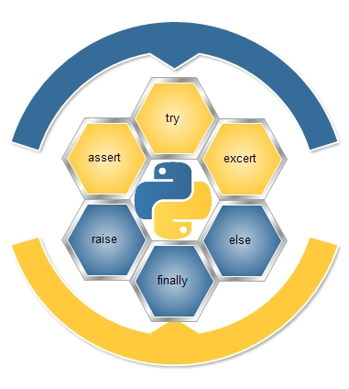

Slide 6
Exception Handling
Exception handling is the process of responding to unwanted or unexpected events when a computer program runs. Exception handling deals with these events to avoid the program or system crashing, and without this process, exceptions would disrupt the normal operation of a program.
Exceptions in Python
Python has many built-in exceptions that are raised when your program encounters an error (something in the program goes wrong).
When these exceptions occur, the Python interpreter stops the current process and passes it to the calling process until it is handled. If not handled, the program will crash.
Python try...except
try….. except blocks are used in python to handle errors and exceptions. The code in try block runs when there is no error. If the try block catches the error, then the except block is executed.
Syntax:
try:
#statements which could generate
#exception
except:
#Soloution of generated exception

Slide 7
Example:
try:
num = int(input("Enter an integer: "))
except ValueError:
print("Number entered is not an integer.")
Output:
Enter an integer: 6.022
Number entered is not an integer.

Slide 8
Finally Clause
The finally code block is also a part of exception handling. When we handle exception using the try and except block, we can include a finally block at the end. The finally block is always executed, so it is generally used for doing the concluding tasks like closing file resources or closing database connection or may be ending the program execution with a delightful message.
Syntax:
try:
#statements which could generate
#exception
except:
#solution of generated exception
finally:
#block of code which is going to
#execute in any situation
The finally block is executed irrespective of the outcome of try……except…..else blocks
One of the important use cases of finally block is in a function which returns a value.

Slide 9
Example:
try:
num = int(input("Enter an integer: "))
except ValueError:
print("Number entered is not an integer.")
else:
print("Integer Accepted.")
finally:
print("This block is always executed.")
Output 1:
Enter an integer: 19
Integer Accepted.
This block is always executed.
Output 2:
Enter an integer: 3.142
Number entered is not an integer.
This block is always executed.

Slide 10
This function divides 10 by a user-provided number, handling potential exceptions such as zero division or invalid input.
def divide_numbers():
try:
# Code that may raise an exception
x = int(input("Enter a number: "))
result = 10 / x
print("Result:", result)
except ZeroDivisionError:
print("Cannot divide by zero!")
except ValueError:
print("Invalid input! Please enter a valid number.")
else:
print("No exceptions occurred.")
finally:
print("Exiting function.")
divide_numbers()
Enter a number: a
Invalid input! Please enter a valid number.
Exiting function.

Slide 11
Here's a summarized flow:
The code inside the try block is executed.
If an exception occurs during the execution of the try block:
Python searches for a matching except block.
If found, the code inside that except block is executed.
If no exceptions occur during the execution of the try block:
The code inside the else block (if present) is executed.
Regardless of whether an exception occurs or not: The code inside the finally block (if present) is executed.

Slide 12


Slide 13
Difference between the raise and assert statements in Python.
raise is a general-purpose statement used to raise exceptions programmatically. It allows you to raise any exception at any point in your code.
assert, on the other hand, is primarily used for debugging purposes to check the correctness of conditions that are expected to be true. It's typically used during development and testing.
if x < 0:
raise ValueError("x cannot be negative")
assert x >= 0, "x cannot be negative"
In this example, if x is negative, a ValueError exception is raised with the specified error message.
Here, if x is negative, an AssertionError is raised with the specified error message. Unlike raise, assert is typically disabled in optimized Python code.
So, while both can be used to handle error conditions, raise is more general-purpose and is used to raise exceptions explicitly, while assert is more for debugging and verifying conditions during development.

Slide 14


