Slide 1


Slide 2
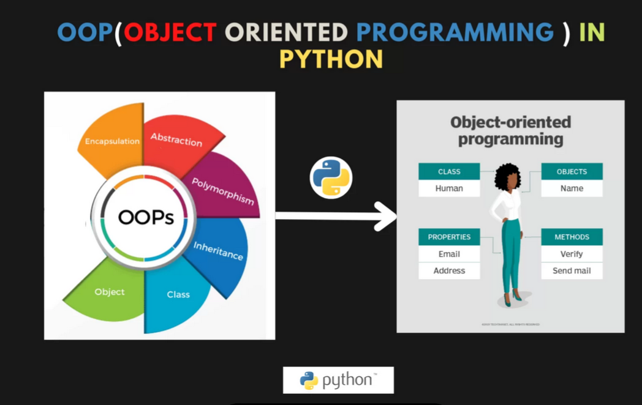

Slide 3
Introduction to Object-oriented programming
Introduction to Object-Oriented Programming in Python: In programming languages, mainly there are two approaches that are used to write program or code.
1). Procedural Programming
2). Object-Oriented Programming
The procedure we are following till now is the “Procedural Programming” approach. So, in this session, we will learn about Object Oriented Programming (OOP). The basic idea of object-oriented programming (OOP) in Python is to use classes and objects to represent real-world concepts and entities.
A class is a blueprint or template for creating objects. It defines the properties and methods that an object of that class will have. Properties are the data or state of an object, and methods are the actions or behaviors that an object can perform.
An object is an instance of a class, and it contains its own data and methods. For example, you could create a class called "Person" that has properties such as name and age, and methods such as speak() and walk().
Each instance of the Person class would be a unique object with its own name and age, but they would all have the same methods to speak and walk.

Slide 4
Key Features of OOP
One of the key features of OOP in Python is encapsulation, which means that the internal state of an object is hidden and can only be accessed or modified through the object's methods. This helps to protect the object's data and prevent it from being modified in unexpected ways.
Another key feature of OOP in Python is inheritance, which allows new classes to be created that inherit the properties and methods of an existing class. This allows for code reuse and makes it easy to create new classes that have similar functionality to existing classes.
Polymorphism is also supported in Python, which means that objects of different classes can be treated as if they were objects of a common class. This allows for greater flexibility in code and makes it easier to write code that can work with multiple types of objects.
In summary, OOP in Python allows developers to model real-world concepts and entities using classes and objects, encapsulate data, reuse code through inheritance, and write more flexible code through polymorphism.

Slide 5
Python Class and Objects
A class is a blueprint or a template for creating objects, providing initial values for state (member variables or attributes), and implementations of behavior (member functions or methods). The user-defined objects are created using the class keyword.
Creating a Class:
Let us now create a class using the class keyword.
class Details:
name = "Rohan"
age = 20
Creating an Object:
Object is the instance of the class used to access the properties of the class Now lets create an object of the class.
Example:
obj1 = Details()

Slide 6
Now we can print values:
Example:
class Details:
name = "Rohan"
age = 20
obj1 = Details()
print(obj1.name)
print(obj1.age)
Output:
Rohan
20

Slide 7
self parameter
The self parameter is a reference to the current instance of the class, and is used to access variables that belongs to the class.
It must be provided as the extra parameter inside the method definition.
Example:
class Details:
name = "Rohan"
age = 20
def desc(self):
print("My name is", self.name, "and I'm", self.age, "years old.")
obj1 = Details()
obj1.desc()
Output:
My name is Rohan and I'm 20 years old.

Slide 8
Constructors
A constructor is a special method in a class used to create and initialize an object of a class. There are different types of constructors. Constructor is invoked automatically when an object of a class is created.
A constructor is a unique function that gets called automatically when an object is created of a class. The main purpose of a constructor is to initialize or assign values to the data members of that class. It cannot return any value other than None.
Syntax of Python Constructor
def __init__(self):
# initializations
init is one of the reserved functions in Python. In Object Oriented Programming, it is known as a constructor.
Types of Constructors in Python
1. Parameterized Constructor
2. Default Constructor

Slide 9
1. Parameterized Constructor in Python
When the constructor accepts arguments along with self, it is known as parameterized constructor.
These arguments can be used inside the class to assign the values to the data members.
Example:
class Details:
def __init__(self, animal, group):
self.animal = animal
self.group = group
obj1 = Details("Crab", "Crustaceans")
print(obj1.animal, "belongs to the", obj1.group, "group.")
Output:
Crab belongs to the Crustaceans group.

Slide 10
2. Default Constructor in Python
When the constructor doesn't accept any arguments from the object and has only one argument, self, in the constructor, it is known as a Default constructor.
Example:
class Details:
def __init__(self):
print("animal Crab belongs to Crustaceans group")
obj1=Details()
Output:
animal Crab belongs to Crustaceans group

Slide 11
Inheritance in python
When a class derives from another class. The child class will inherit all the public and protected properties and methods from the parent class. In addition, it can have its own properties and methods,this is called as inheritance.
Python Inheritance Syntax:
class BaseClass:
Body of base class
class DerivedClass(BaseClass):
Body of derived class
Derived class inherits features from the base class where new features can be added to it. This results in re-usability of code.
Types of inheritance:
Single inheritance
Multiple inheritance
Multilevel inheritance
Hierarchical Inheritance
Hybrid Inheritance

Slide 12
Single Inheritance:
Single inheritance enables a derived class to inherit properties from a single parent class, thus enabling code reusability and the addition of new features to existing code.
Example:
class Parent:
def func1(self):
print("This function is in parent class.")
class Child(Parent):
def func2(self):
print("This function is in child class.")
object = Child()
object.func1()
object.func2()
Output:
This function is in parent class.
This function is in child class.

Slide 13
When a class can be derived from more than one base class this type of inheritance is called multiple inheritances.
Example:
class Mother:
mothername = ""
def mother(self):
print(self.mothername)
class Father:
fathername = ""
def father(self):
print(self.fathername)
class Son(Mother, Father):
def parents(self):
print("Father name is :", self.fathername)
print("Mother :", self.mothername)
s1 = Son()
s1.fathername = "Mommy"
s1.mothername = "Daddy"
s1.parents()
Multiple Inheritance:
Output:
Father name is : Mommy
Mother name is : Daddy

Slide 14
Polymorphism in Python allows objects of different data types to be treated as objects of a common interface. One common way to achieve polymorphism in Python is through method overriding in inheritance.
Code:
class Animal:
def speak(self):
pass
class Dog(Animal):
def speak(self):
return "Woof!"
class Cat(Animal):
def speak(self):
return "Meow!"
# Polymorphic function
def animal_says(animal):
return animal.speak()
dog = Dog()
cat = Cat()
print(animal_says(dog)) # Output: Woof!
print(animal_says(cat)) # Output: Meow!
Here, both the Dog and Cat classes have a speak() method, but they implement it differently. The animal_says() function can accept any object that has a speak() method, demonstrating polymorphism.

Slide 15


