Slide 1
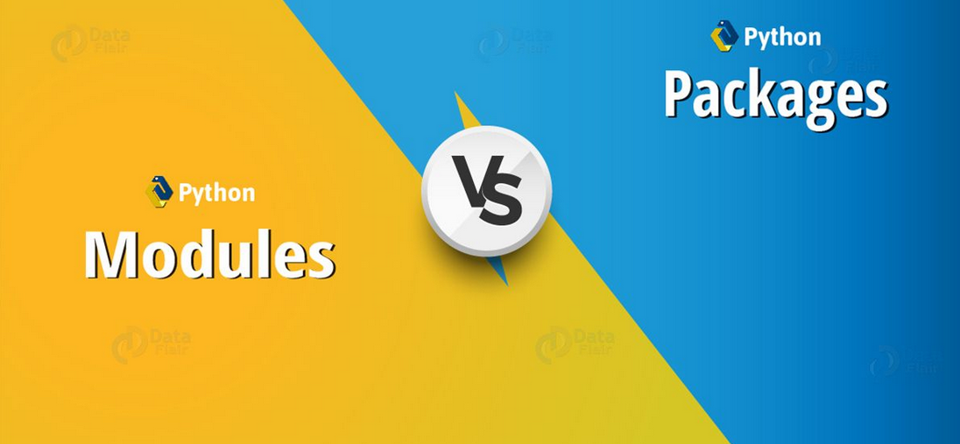

Slide 2
Modules and pip in Python!
Module is like a code library which can be used to borrow code written by somebody else in our python program. There are two types of modules in python:
Built in Modules - These modules are ready to import and use and ships with the python interpreter. there is no need to install such modules explicitly.
External Modules - These modules are imported from a third party file or can be installed using a package manager like pip or conda. Since this code is written by someone else, we can install different versions of a same module with time.
The pip command
It can be used as a package manager pip to install a python module. Lets install a module called pandas using the following command
pip install pandas

Slide 3
Using a module in Python (Usage)
We use the import syntax to import a module in Python. Here is an example code:
import pandas
# Read and work with a file named 'words.csv'
df = pandas.read_csv('words.csv')
print(df) # This will display first few rows from the words.csv file
Similarly we can install other modules and look into their documentations for usage instructions.
We will find ourselved doing this often in the later part of this course

Slide 4
Packages in Python
In Python, a package is a way of organizing related modules. A package can contain multiple modules (Python files) and sub-packages (subdirectories containing their own modules and sub-packages). Packages are used to structure larger Python projects and to avoid naming conflicts between modules.
To create a package, you simply create a directory with an __init__.py file inside it. This __init__.py file can be empty or can contain initialization code for the package.
Here's a basic example of how you might structure a Python package:
code:
my_package/
__init__.py
module1.py
module2.py
subpackage/
__init__.py
submodule1.py
submodule2.py
To use modules and sub-packages from a package in your Python code, you can import them using dot notation. For example:
import my_package.module1
from my_package.subpackage import submodule1

Slide 5
Alternatively, you can use relative imports within the package itself:
from . import module1
from .subpackage import submodule1
Python's packaging ecosystem also provides tools like setuptools and pip to help you create, distribute, and install packages. These tools allow you to specify dependencies, versioning, and other metadata for your packages.

Slide 6
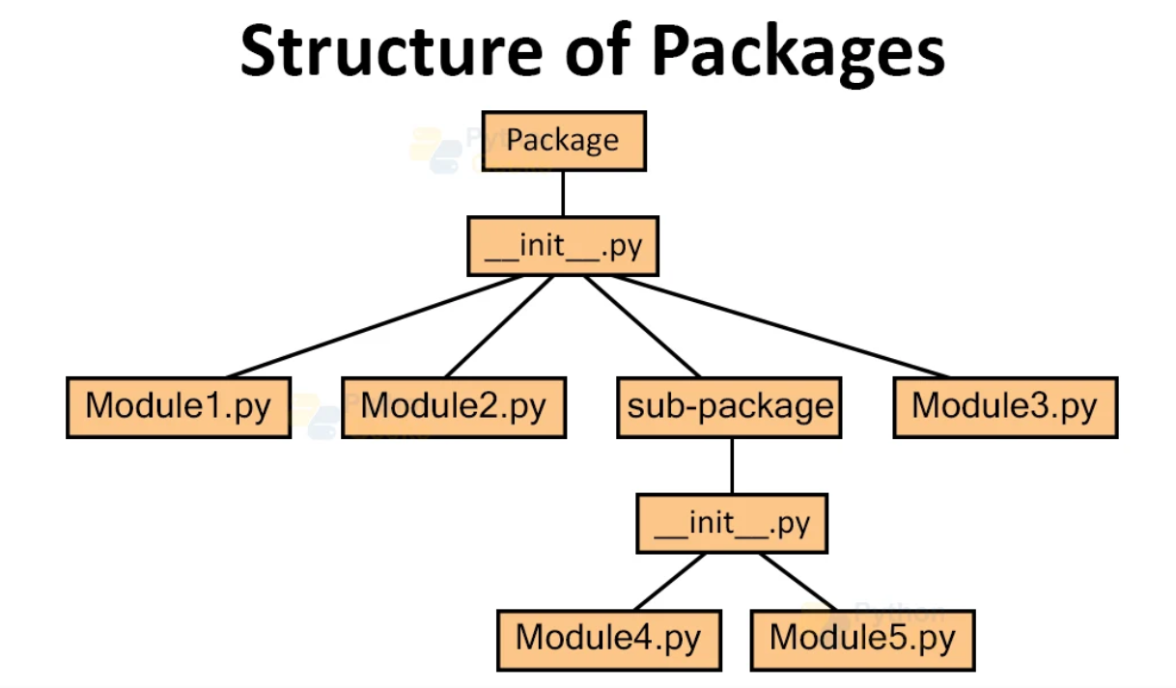

Slide 7
How importing in python works
Importing in Python is the process of loading code from a Python module into the current script. This allows you to use the functions and variables defined in the module in your current script, as well as any additional modules that the imported module may depend on.
To import a module in Python, you use the import statement followed by the name of the module. For example, to import the math module, which contains a variety of mathematical functions, you would use the following statement:
import math
Once a module is imported, you can use any of the functions and variables defined in the module by using the dot notation. For example, to use the sqrt function from the math module, you would write:
import math
result = math.sqrt(9)
print(result) # Output: 3.0

Slide 8
from keyword
You can also import specific functions or variables from a module using the from keyword. For example, to import only the sqrt function from the math module, you would write:
from math import sqrt
result = sqrt(9)
print(result) # Output: 3.0
You can also import multiple functions or variables at once by separating them with a comma:
from math import sqrt, pi
result = sqrt(9)
print(result) # Output: 3.0
print(pi) # Output: 3.141592653589793

Slide 9
importing everything
It's also possible to import all functions and variables from a module using the * wildcard. However, this is generally not recommended as it can lead to confusion and make it harder to understand where specific functions and variables are coming from.
from math import *
result = sqrt(9)
print(result) # Output: 3.0
print(pi) # Output: 3.141592653589793
Python also allows you to rename imported modules using the as keyword. This can be useful if you want to use a shorter or more descriptive name for a module, or if you want to avoid naming conflicts with other modules or variables in your code.
The "as" keyword
import math as m
result = m.sqrt(9)
print(result) # Output: 3.0
print(m.pi) # Output: 3.141592653589793

Slide 10
The dir function
Finally, Python has a built-in function called dir that you can use to view the names of all the functions and variables defined in a module. This can be helpful for exploring and understanding the contents of a new module.
import math
print(dir(math))
This will output a list of all the names defined in the math module, including functions like sqrt and pi, as well as other variables and constants.
In summary, the import statement in Python allows you to access the functions and variables defined in a module from within your current script. You can import the entire module, specific functions or variables, or use the * wildcard to import everything. You can also use the as keyword to rename a module, and the dir function to view the contents of a module.

Slide 11


