Slide 1

INDUSTRY INTERNSHIP
Mid-Term Presentation
Role: Data Science Mentor & AI Creative Production Intern
B.Sc. Data Science & AI (2023–2026) | AAFT, Noida
Submitted by: Amit Sharma | Supervisor: Mr. Gaurav Kumar
Asian Academy of Film & Television · School of Data Science & AI

Slide 2






Overview
TuteDude
Experience
GravEiens
Experience
Tools &
Technologies
AI & LLM
Projects
Proof of
Work
Skills
Developed
Conclusion

Slide 3

Introduction
My Roles
Key Expertise
Data Science Mentor
Mentoring & student evaluation
Full-Time | TuteDude
AI-based content creation & animation
AI Creative Production Intern
Python, SQL & Machine Learning
Full-Time | GravEiens
Data Science & Generative AI workflows
AI animation for educational content
Prompt Engineering & LLM tools

Slide 4
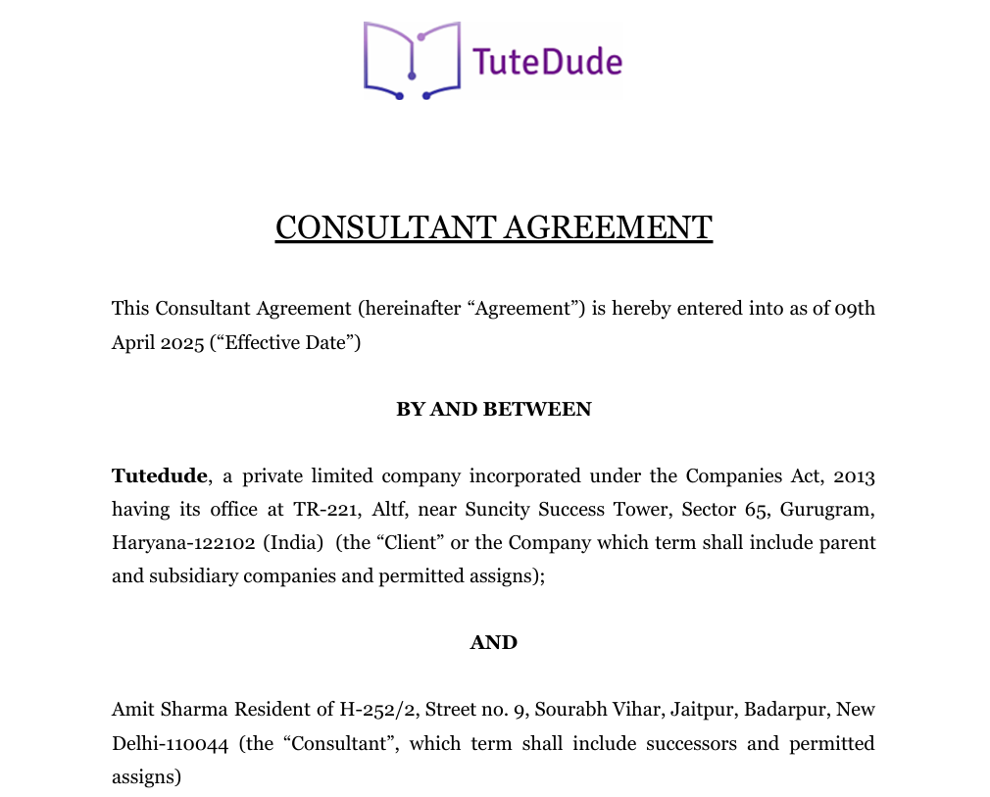
TuteDude Experience
Key Responsibilities & Impact
Evaluated assignments
Python, SQL, ML, NLP, Power BI, Tableau
1:1 Mentorship
Personalized guidance & project support
Data Science Mentor
Real-world projects
Apr 2025 – Present | Full-Time | 1+ Year
Guided students on industry-level use-cases
Consultant Agreement
Structured feedback
Improved student comprehension & outcomes

Slide 5
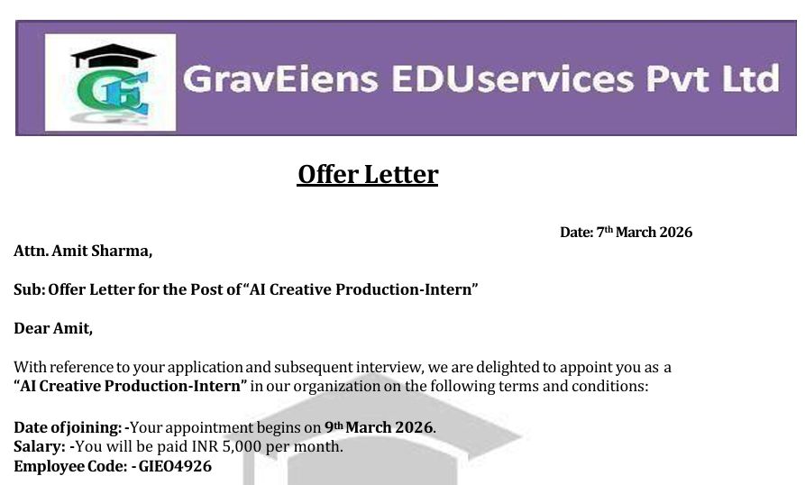
GravEiens Experience
Responsibilities & Workflow
AI Educational Video Content
Created animated videos for S. Chand
AI Animation & VFX Pipelines
End-to-end production workflows
AI Creative Production-Intern
S. Chand Book Animation
Mar 2026 – Present | Full-Time
Animated content from curriculum textbooks
15+ Videos Produced in 1 Month
Generative AI Tools
Higgsfield, Gemini, Kling AI, Seedance, WAN
Script → Prompt Engineering → AI Generation → Editing → Final Output

Slide 6
Tools & Technologies
Data Science Stack
AI Animation & Production
Python
SQL
Higgsfield AI
Google Gemini
Power BI
Tableau
Meta AI
Kling AI
Machine Learning
Deep Learning
Seedance
WAN Models
NLP
Wondershare Filmora

Slide 7
AI Projects
PDF Summarizer
YouTube Transcriber
Extracts key insights and summaries from large documents using AI, enabling quick comprehension of lengthy PDFs.
Converts YouTube video content into structured text transcripts, enabling searchable and analyzable content.
GitHub Repository: https://github.com/amit-sharma-ds

Slide 8
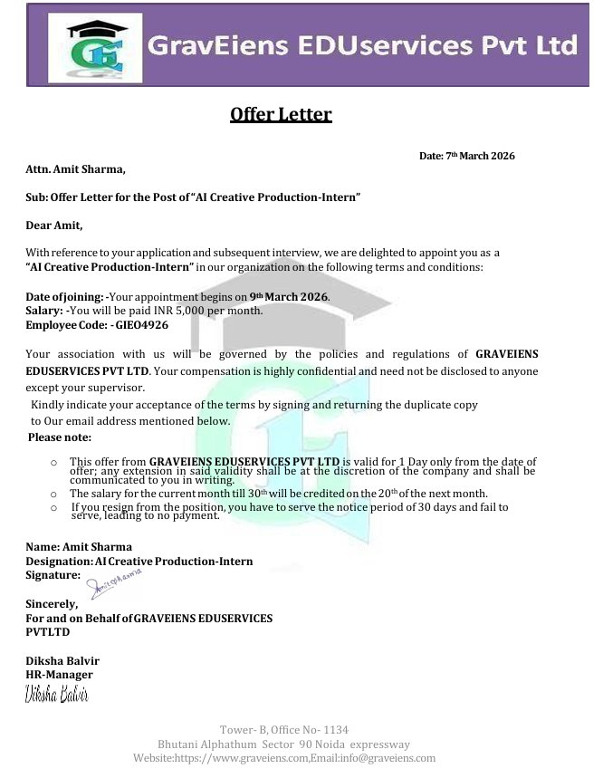
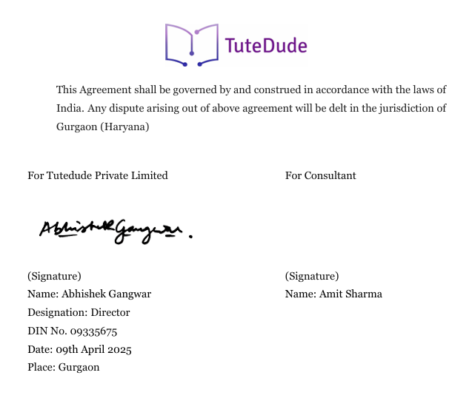
Proof of Work
Official Documentation
GravEiens Offer Letter
TuteDude Consultant Agreement

Slide 9
Skills Developed
Technical Skills
AI Skills
Soft Skills
✓ Data Science & Analytics
✓ Generative AI Workflows
✓ Student Mentorship
✓ Machine Learning & Deep Learning
✓ Prompt Engineering
✓ Communication
✓ NLP & Text Processing
✓ AI Animation & VFX
✓ Project Management
✓ Power BI & Tableau
✓ LLM Tools & APIs
✓ Industry Exposure

Slide 10
Conclusion
✓ Strong experience in Data Science & AI production
✓ Hands-on mentoring & AI creative workflows
✓ Real-world exposure to industry AI pipelines
✓ Continuous learning in AI, ML & Generative AI
✓ Aspiring to build impactful AI-driven solutions

Slide 11
Thank You!
Amit Sharma | B.Sc. Data Science & AI | AAFT Noida
TuteDude • GravEiens EDUservices
📩 amsharma2607@gmail.com | github.com/amit-sharma-ds

