Slide 1
Updater

Slide 2
Story Background & Problems
A developer or a small company develops a software.
They will most likely need to distribute a version update for that software, at some point.
They:
might not have the time or resources to program such a feature that enables them to distribute a version update efficiently and securely.
will want to minimize the cost of the updating server, which will distribute the update to the clients.
will want a scalable solution that can handle a growing number of clients.

Slide 3
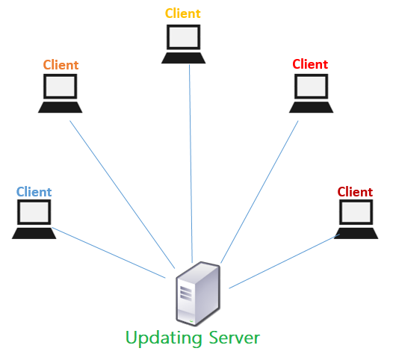
Problem #1 Efficiency
Sending the update to each client individually might take a long time and a large network resources.

Slide 4
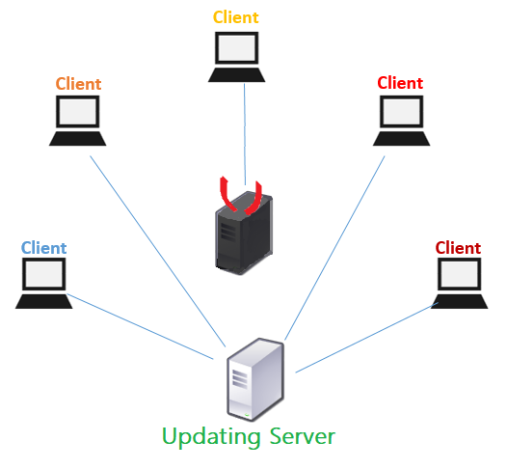

Problem #2 Security
The update process must be secure to prevent an attacker from uploading a virus or a backdoor.

Slide 5
Problem #3 Scalability
The solution needs to support scaling.

Slide 6
Solution - Updater
Notes:
Echo Server

Slide 7
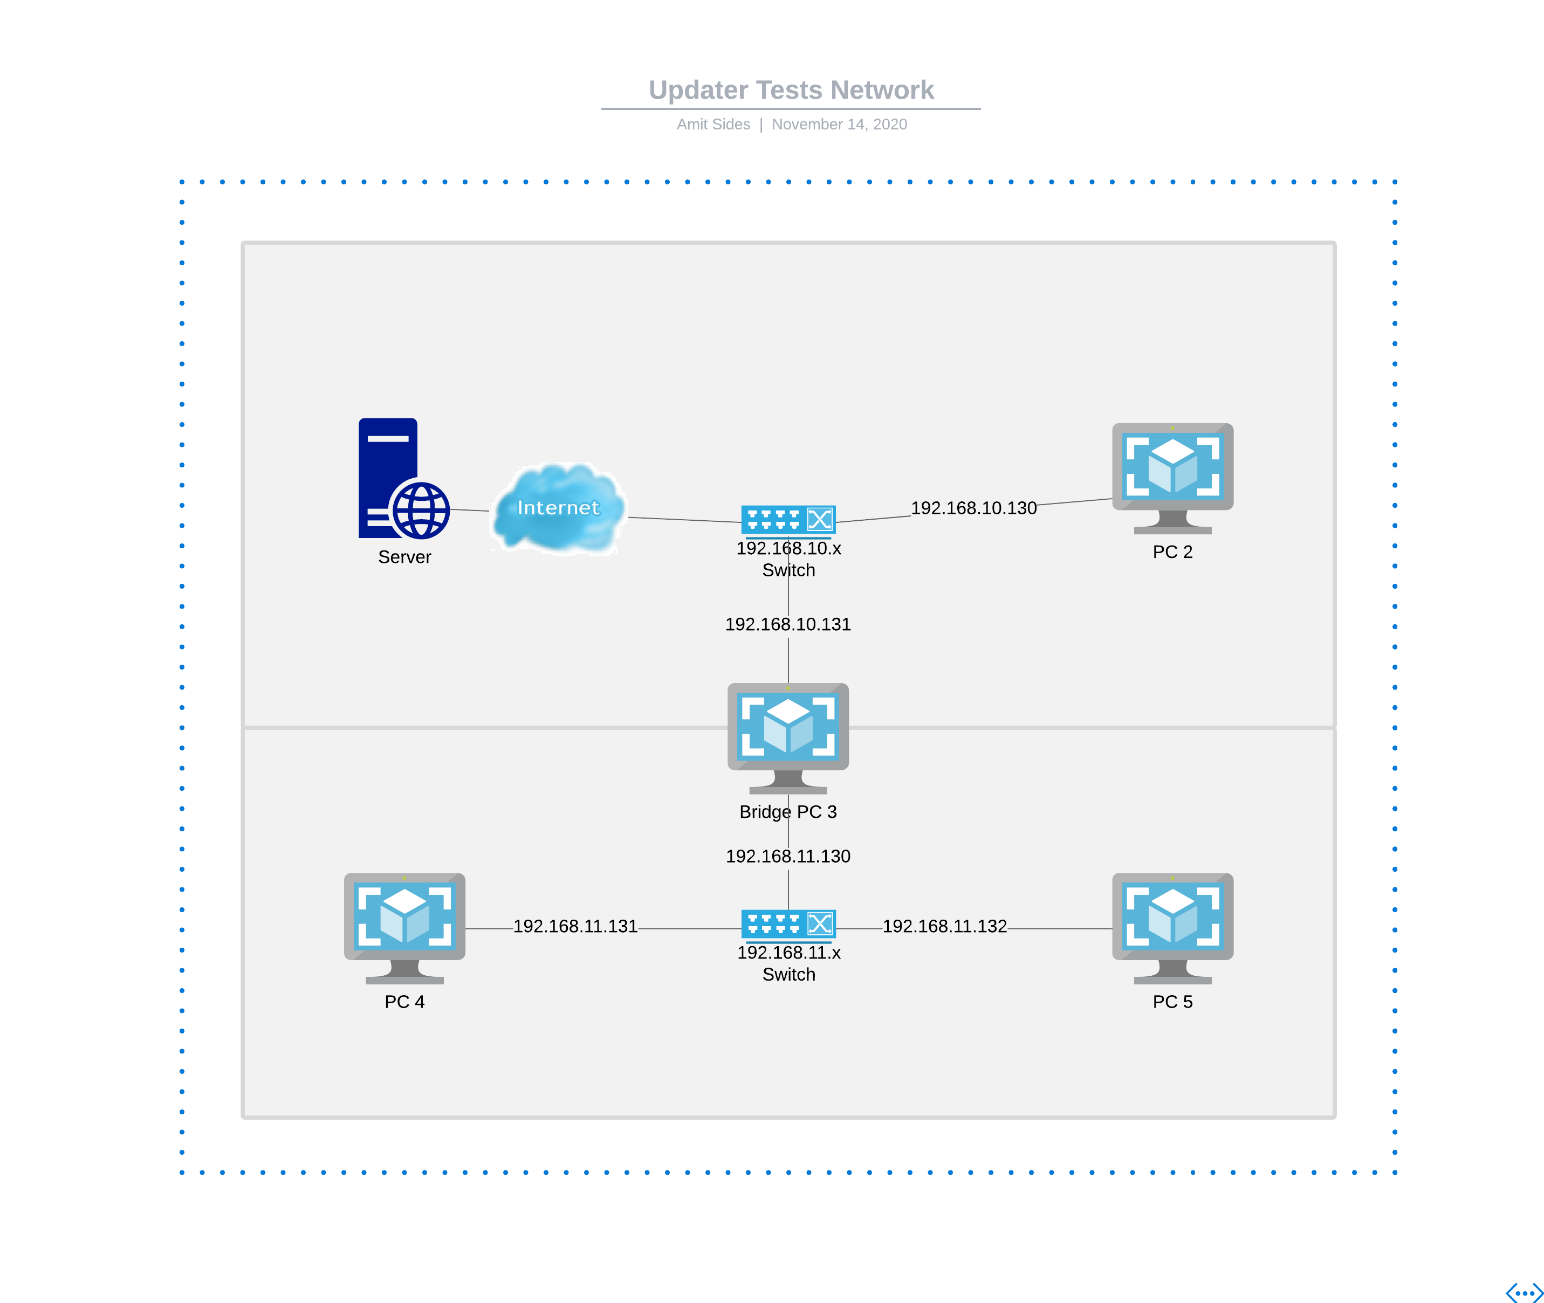
Updater
One prime server that distributes updates.
Efficiency: Clients can spread updates as well using broadcasts.
Security: Every update is cryptographically signed.
Scalability: Multiple servers can be connected to the main server and distribute updates as well.

Slide 8
Updater
The server distributes an update to reachable clients.
Version Update
Version Update
Version Update

Slide 9
Updater
The server distributes an update to reachable clients.
Request Version
Request Version
Request Version

Slide 10
Updater
The server distributes an update to reachable clients.
Clients download the update.
Update file
Update file
Update file

Slide 11
Updater
The server distributes an update to reachable clients.
Clients download the update.
Clients spreads the update to other clients.
Version Update
Version Update
Version Update
Version Update
Version Update

Slide 12
Updater
The server distributes an update to reachable clients.
Clients download the update.
Clients spreads the update to other clients.
Request Version
Request Version
Request Version
Request Version

Slide 13
Updater
The server distributes an update to reachable clients.
Clients download the update.
Clients spreads the update to other clients.
Clients download the update from other clients, and so on…
Update file
Update file
Update file

Slide 14
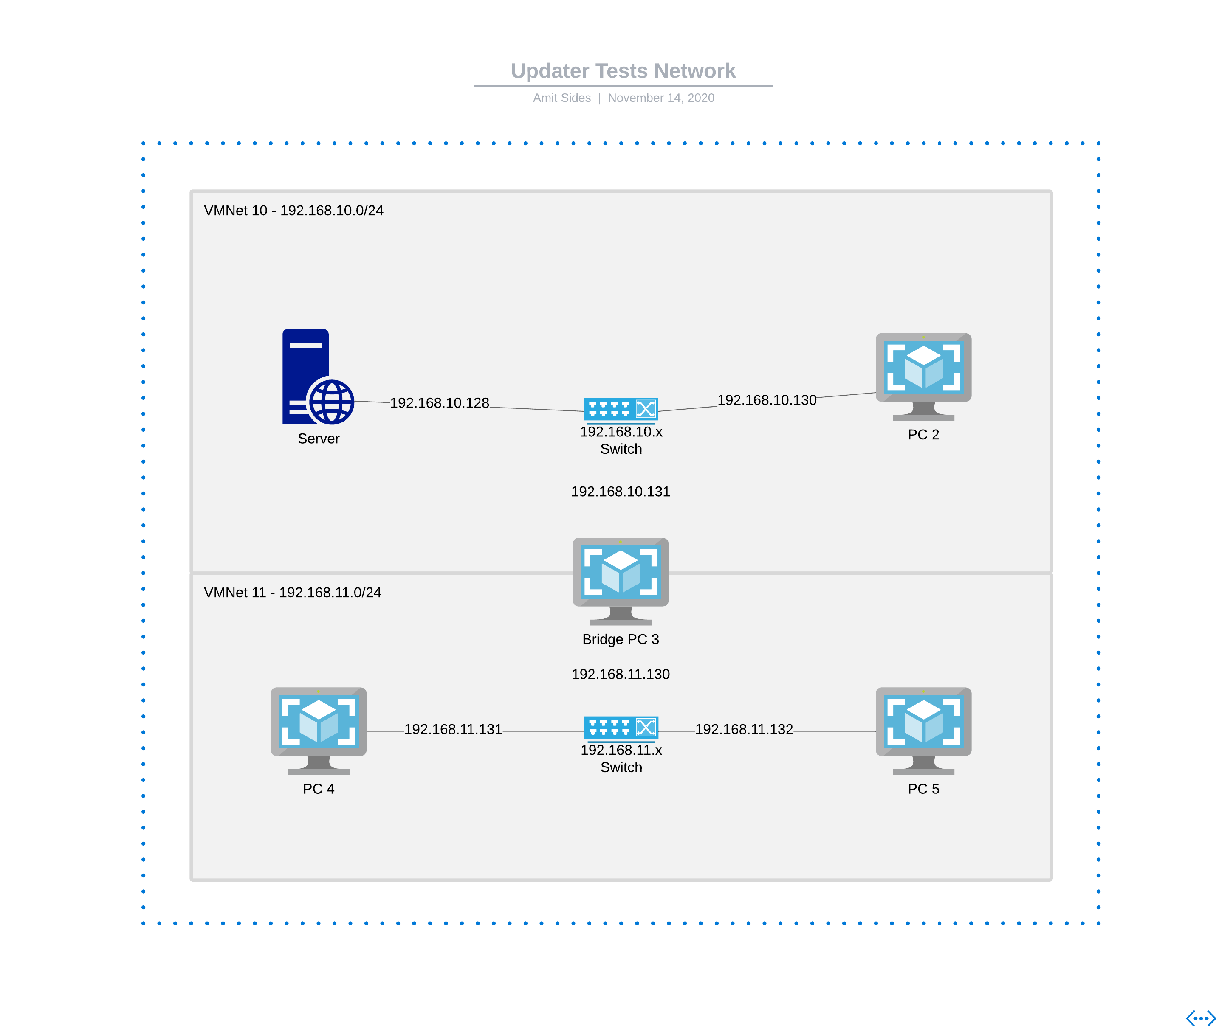
Testing Network
1 Server connected to VMNet 10.
2 Clients connected to VMNet 10.
One of them, PC 3, connected to VMNet 11 as well.
2 Other clients connected to VMNet 11.

Slide 15
Demonstration

Slide 16
Links
OVFs on OneDrive
VMs On OneDrive
https://github.com/amit-sides/Updater
The VMs/OVFs take a lot of time to download though….

