Slide 1
Updater

Slide 2
Story Background & Problems
A developer or a small company develops a software.
They will most likely need to distribute a version update for that software, at some point.
They:
might not have the time or resources to program such a feature that enables them to distribute a version update efficiently and securely.
will want to minimize the cost of the updating server, which will distribute the update to the clients.
will want a scalable solution that can handle a growing number of clients.

Slide 3
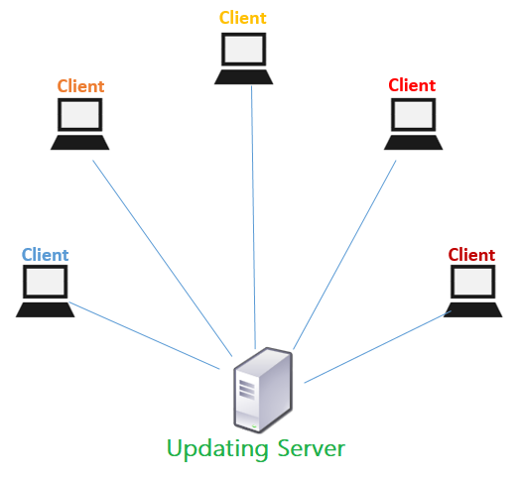
Problem #1 Efficiency
Sending the update to each client individually might take a long time and a large network resources.

Slide 4
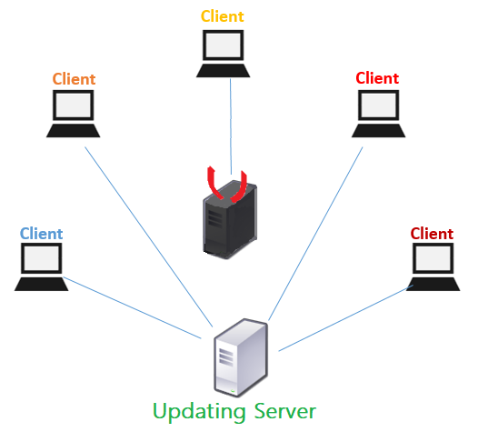

Problem #2 Security
The update process must be secure to prevent an attacker from uploading a virus or a backdoor.

Slide 5
Problem #3 Scalability
The solution needs to support scaling.

Slide 6
Solution - Updater
Notes:
Echo Server

Slide 7
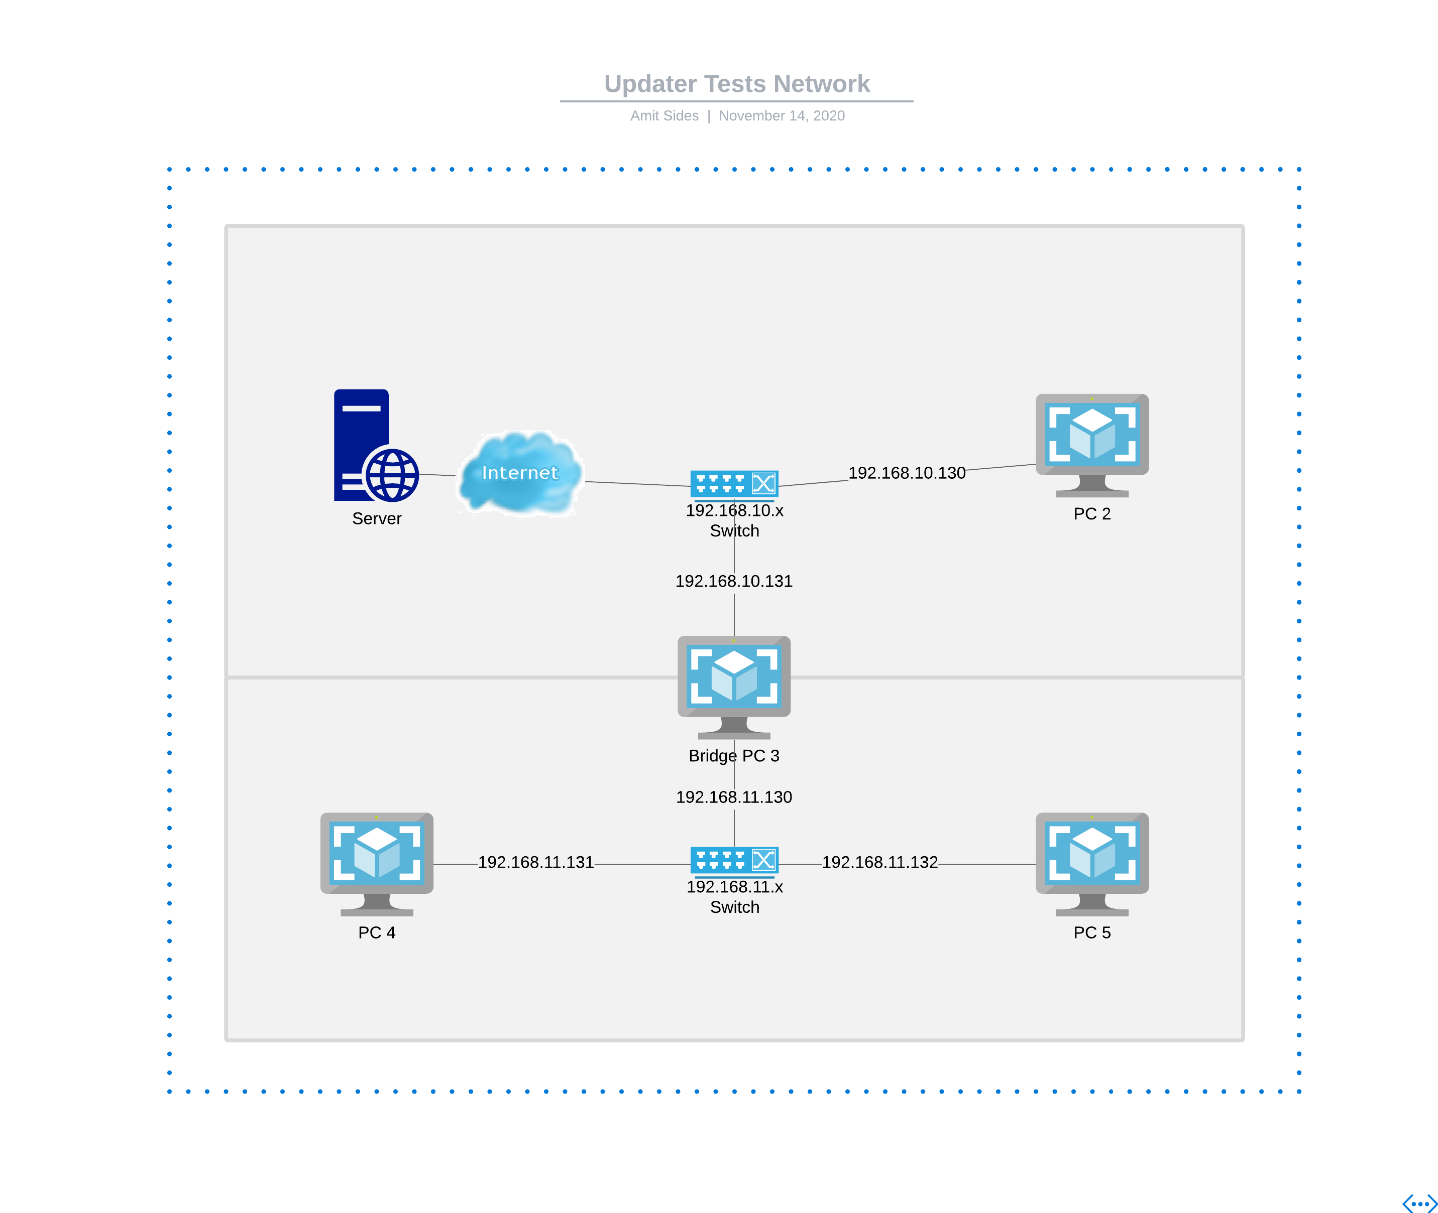
Updater
One prime server that distributes updates.
Efficiency: Clients can spread updates as well using broadcasts.
Security: Every update is cryptographically signed.
Scalability: Multiple servers can be connected to the main server and distribute updates as well.

Slide 8
Solution #1 - Threads

Slide 9


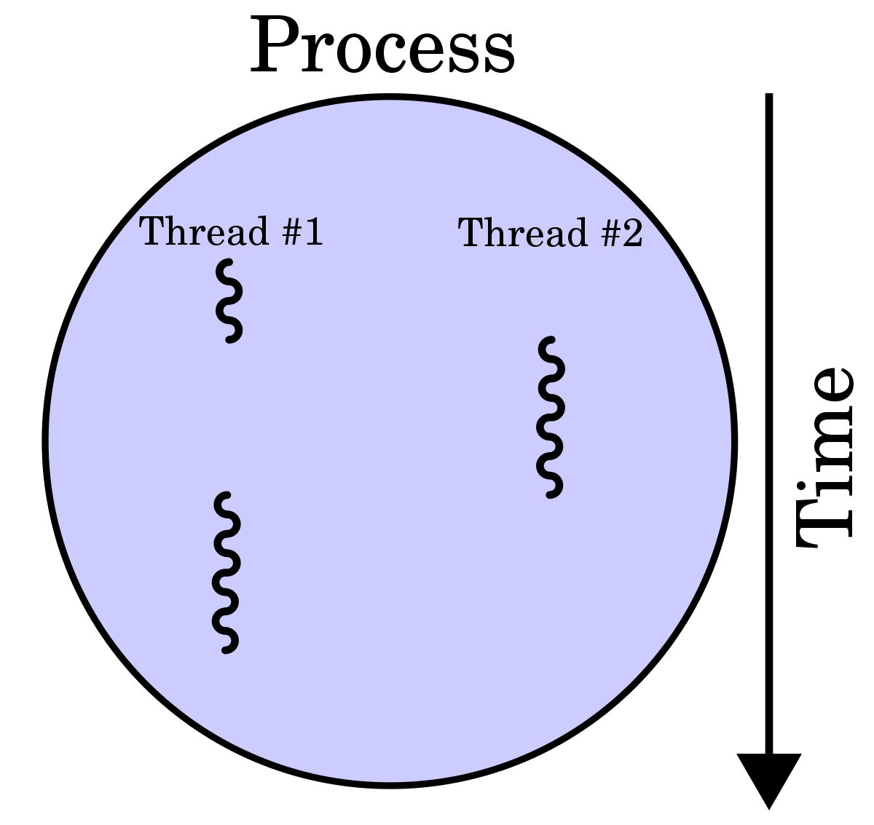
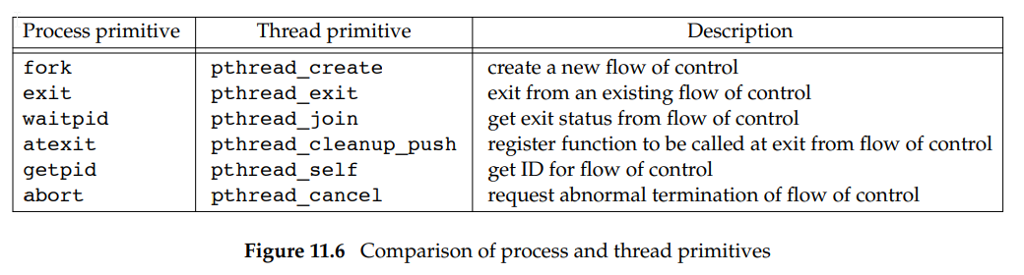
Threads
pthread library
int pthread_create(pthread_t *thread, const pthread_attr_t *thread_attributes, void *(*start_routine) (void *), void *arg);
int pthread_join(pthread_t thread, void **retval);
From Advanced Programming in the UNIX ® Environment
Notes:
thread – The thread ID (mostly an int, but could be struct)
Thread_attributes – Some attributes of the thread
start_routine – The function to run on start
arg – The argument passed to start_routine

Slide 10
Threads - Demonstration
Notes:
Threads

Slide 11
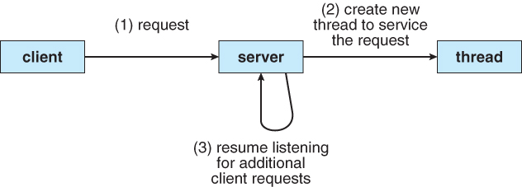
Threads
Each client get it’s own thread.
The main thread listens for incoming client requests.
Notes:
Show “Echo Server”

Slide 12
Threads - Demonstration
Notes:
Threaded Echo Server

Slide 13
Solution #2 - Select

Slide 14
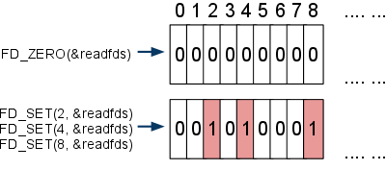
Select
int select(int nfds, fd_set *readfds, fd_set *writefds, fd_set *exceptfds, struct timeval *timeout);
void FD_CLR(int fd, fd_set *set);
int FD_ISSET(int fd, fd_set *set);
void FD_SET(int fd, fd_set *set);
void FD_ZERO(fd_set *set);
Notes:
nfds = maximum fd number + 1 (not count!)
Return value of select: number of fd’s waiting for IO
fd sets bits are updated according to the fds that are waiting for action.

Slide 15
Select - Demonstration
Notes:
select

Slide 16
Solution #3 - Poll

Slide 17
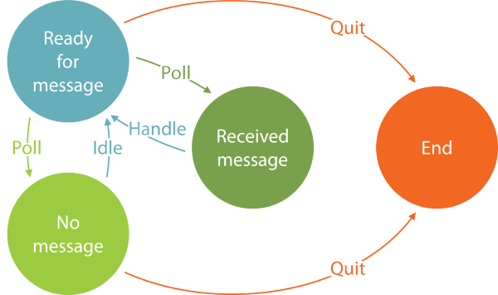
Poll
int poll(struct pollfd *fds, nfds_t nfds, int timeout);
struct pollfd {
int fd; /* file descriptor */
short events; /* requested events */
short revents; /* returned events */
};
POLLIN, POLLOUT, POLLHUP, …
POLLRDHUP – since Linux 2.6.17
Notes:
nfds = number of elements in fds array
Return value of poll: number of fd’s waiting for IO
Revents is updated according to the fds that are waiting for action.

Slide 18
Poll - Demonstration
Notes:
poll

Slide 19
Tips & Tricks
epoll function – wait for event, not IO.
ppoll, pselect functions – wait for either a fd or a signal.
Avoids deadlock by atomic operations, see ‘man pselect’.
select in python is FUN!

Slide 20
Broadcast

Slide 21
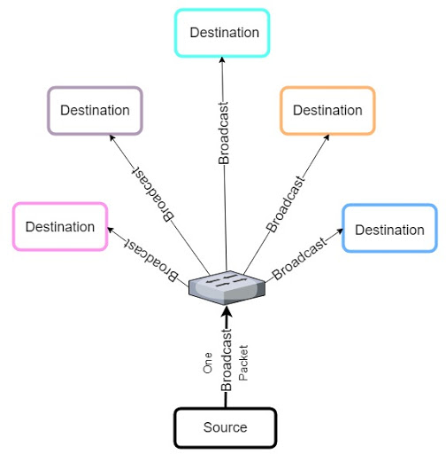
Broadcast
Sending a message to all network stations.
Allows clients to find servers, or server to identify themselves in the network.
Usually, routers are configured to not forward a broadcast beyond the LAN.
Overloading the network with broadcasts can slow network communication.
This is called a broadcast storm.
Use with cautious!

Slide 22
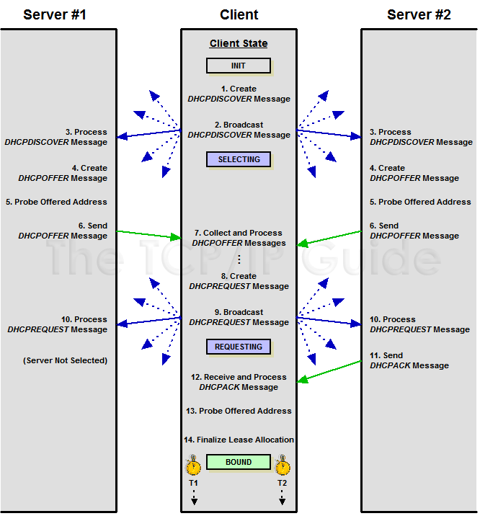
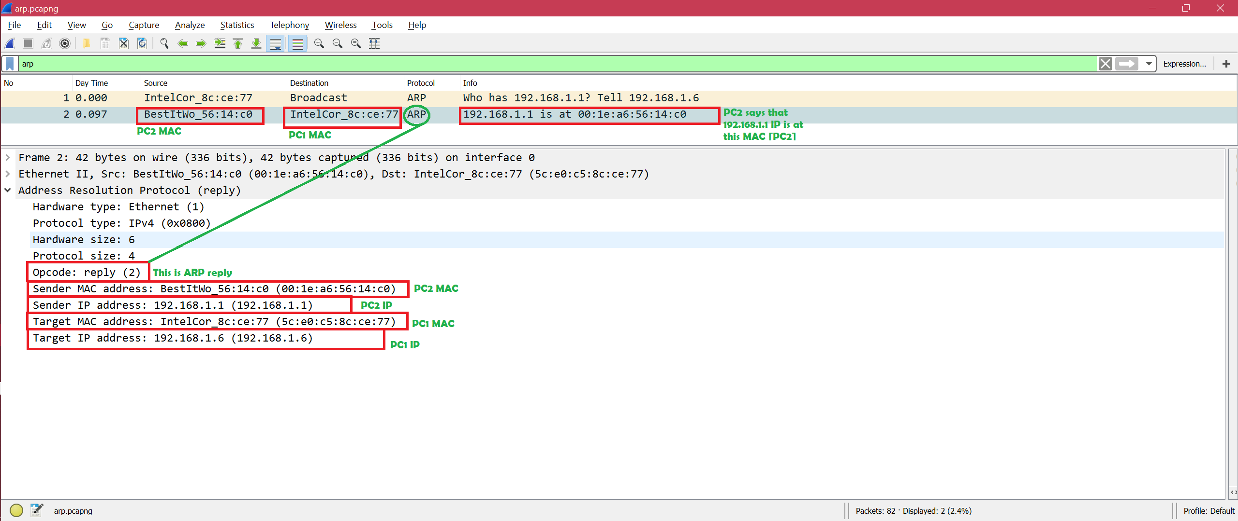
Broadcast Examples
DHCP
Discover
Discover
ARP
Offer
Offer
Request
Request
Ack
Another Examples: NetBIOS, WOL

Slide 23
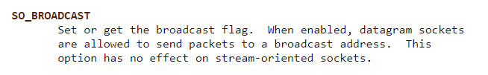
Broadcast
To send a UDP broadcast:
int enabled = 1;
setsockopt(socket_fd, SOL_SOCKET, SO_BROADCAST, &enabled, sizeof(enabled));
To send lower layered broadcast (ARP):
Use raw sockets.
Notes:
SO_BROADCAST flag
SOL_SOCKET – Changing an option for the socket

Slide 24
Broadcast - Demonstration
Notes:
broadcast

Slide 25
Sources
Beej's Guide to Network Programming
Advanced Programming in the UNIX ® Environment
https://github.com/amit-sides/MultithreadedServers
?

