Slide 1
Alec .. did this automatically
04-06-2025: Weekly Update

Slide 2
Summary: Lab IT Status
Main | Progress | Details | Last-Updated
Hardware
Sav02 Fan | LESS PROGRESS | Waiting on fan
Software
Drexel credentials for servers | LESS PROGRESS | Waiting on Chris

Slide 3
Summary: Alec Research Status
Main | Progress | Details | Target Paper | Last-Updated
UMBC Collab
Priority-based Routing | DONE | Submitted
ARL
Security Partitioning | PROGRESS | Coding simulation framework
ARL Test Chip | LESS PROGRESS | Waiting on standard cells
Writing/Review
Book | LESS PROGRESS |  | Springer
Candidacy | PROGRESS | Outlining papers | Candidacy
EDA-schema
Schema v1: eda-datagen | LESS PROGRESS | Helping where I can
Schema v2: image-gen | NO PROGRESS
Schema v3: 3D-datagen | NO PROGRESS | Compile SKL Papers
eda-learn | PROGRESS | OpenROAD GPL code and plotting variables
s

Slide 4
UMBC Collab

Slide 5

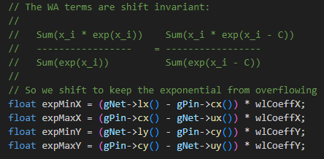

Slide 6
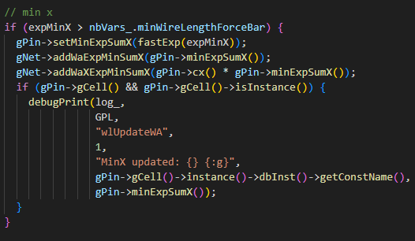

Slide 8
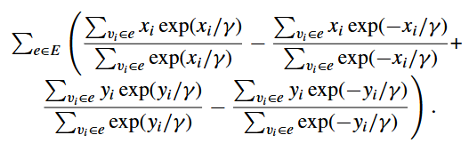

Slide 9
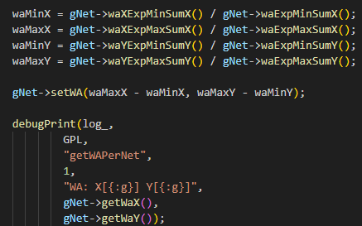

Slide 11


Slide 12


Slide 13
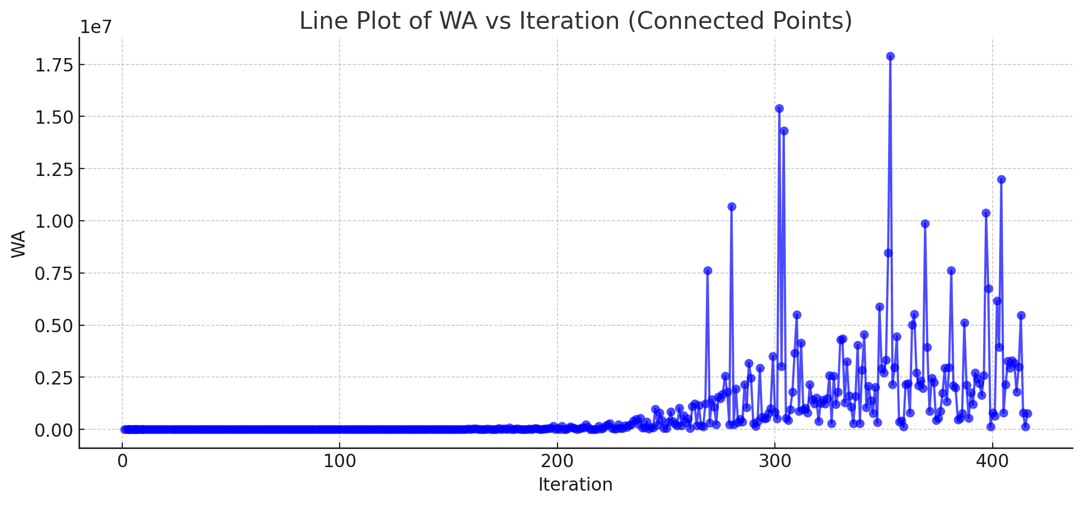
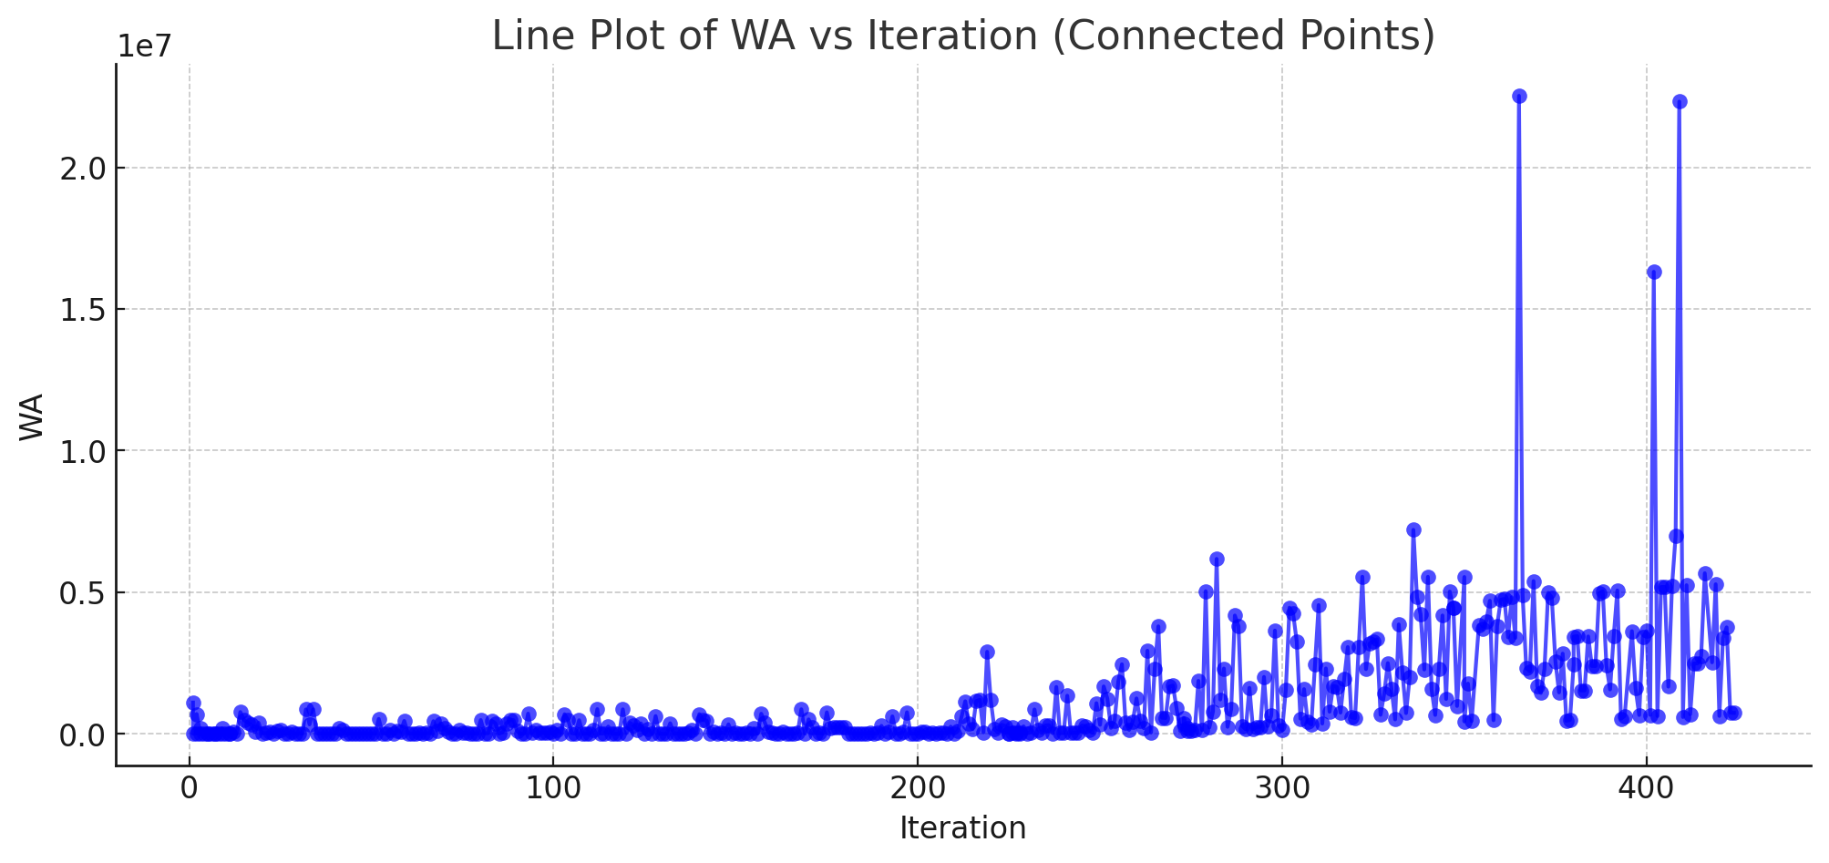
WA

Slide 14
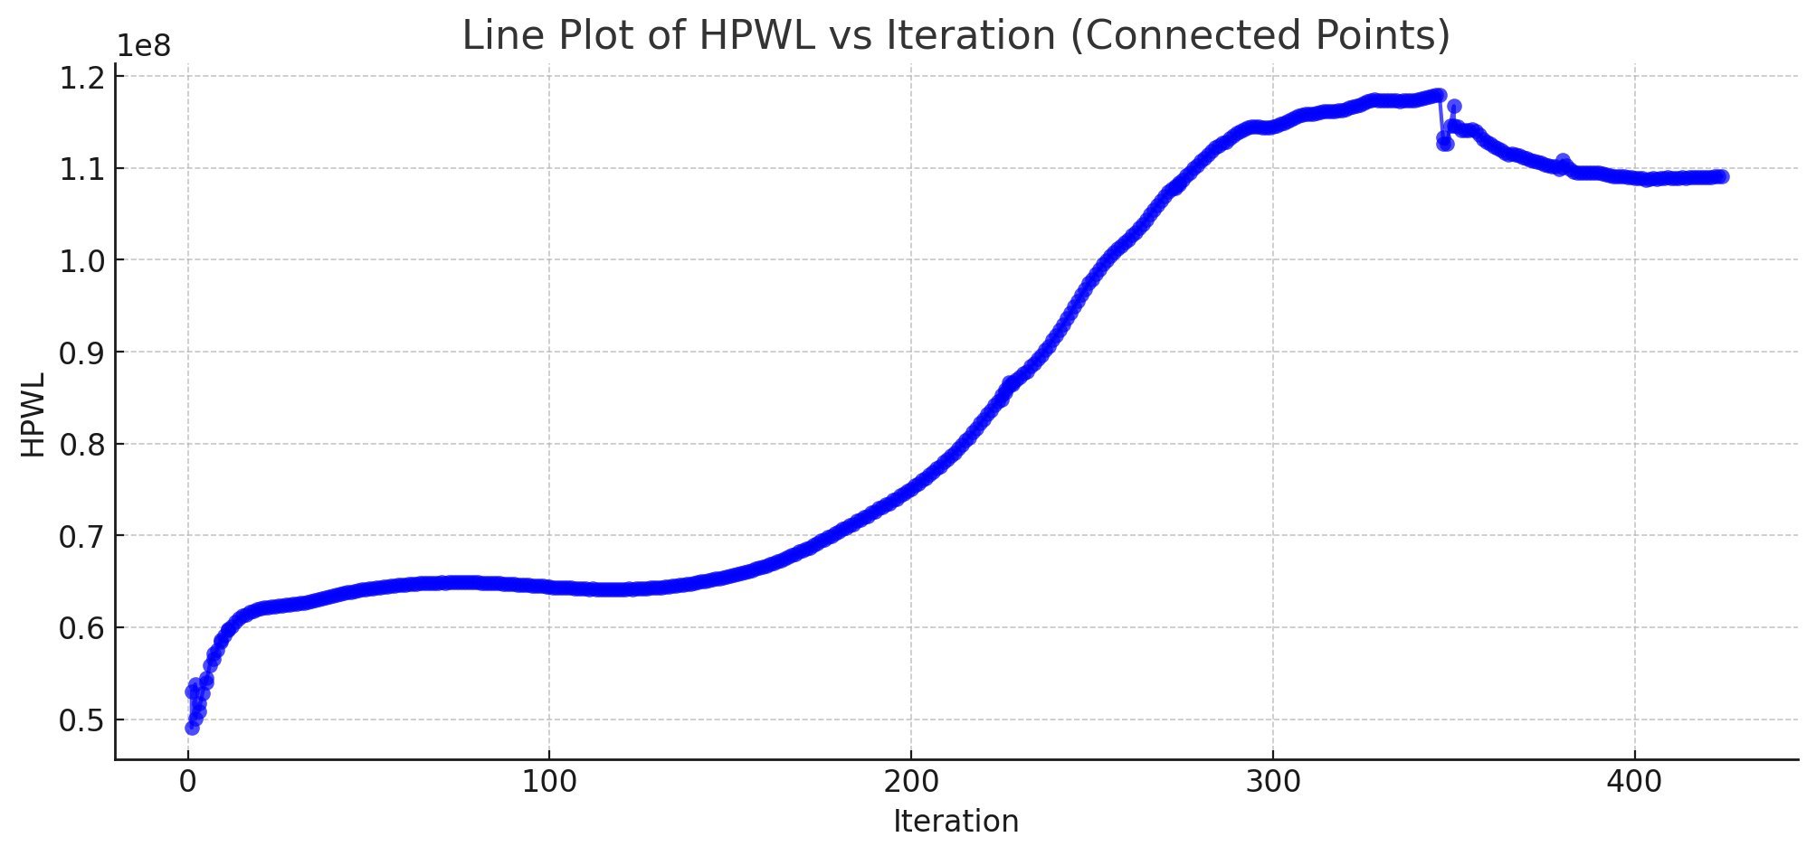
HPWL

Slide 15
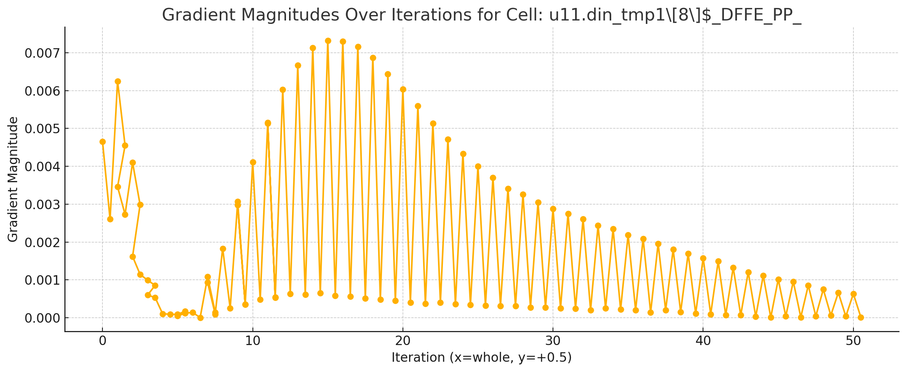
Grad (Single Cell)

Slide 16
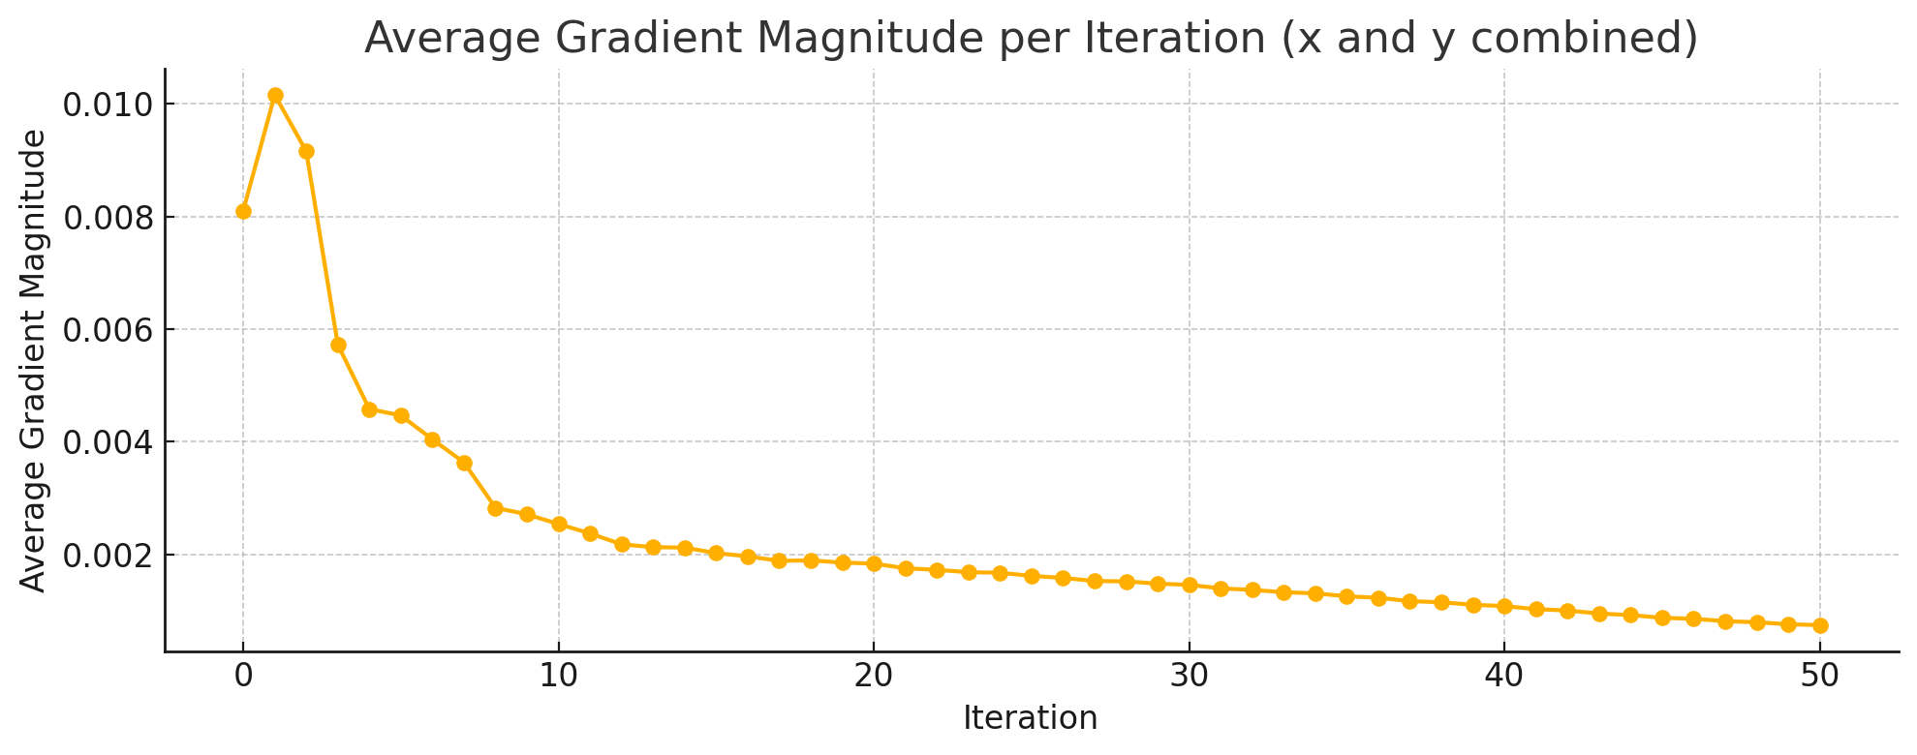
Grad (Total)

Slide 17
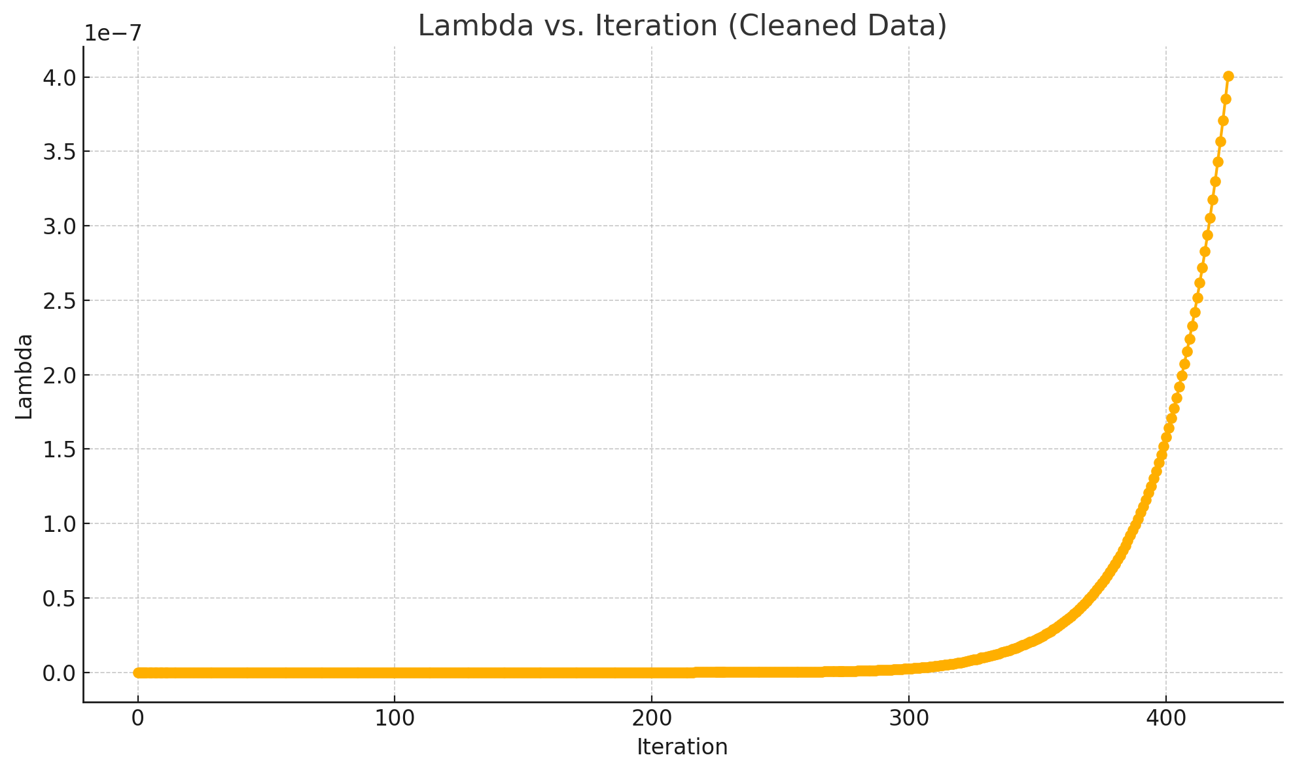
Lambda (Density Penalty)

Slide 18
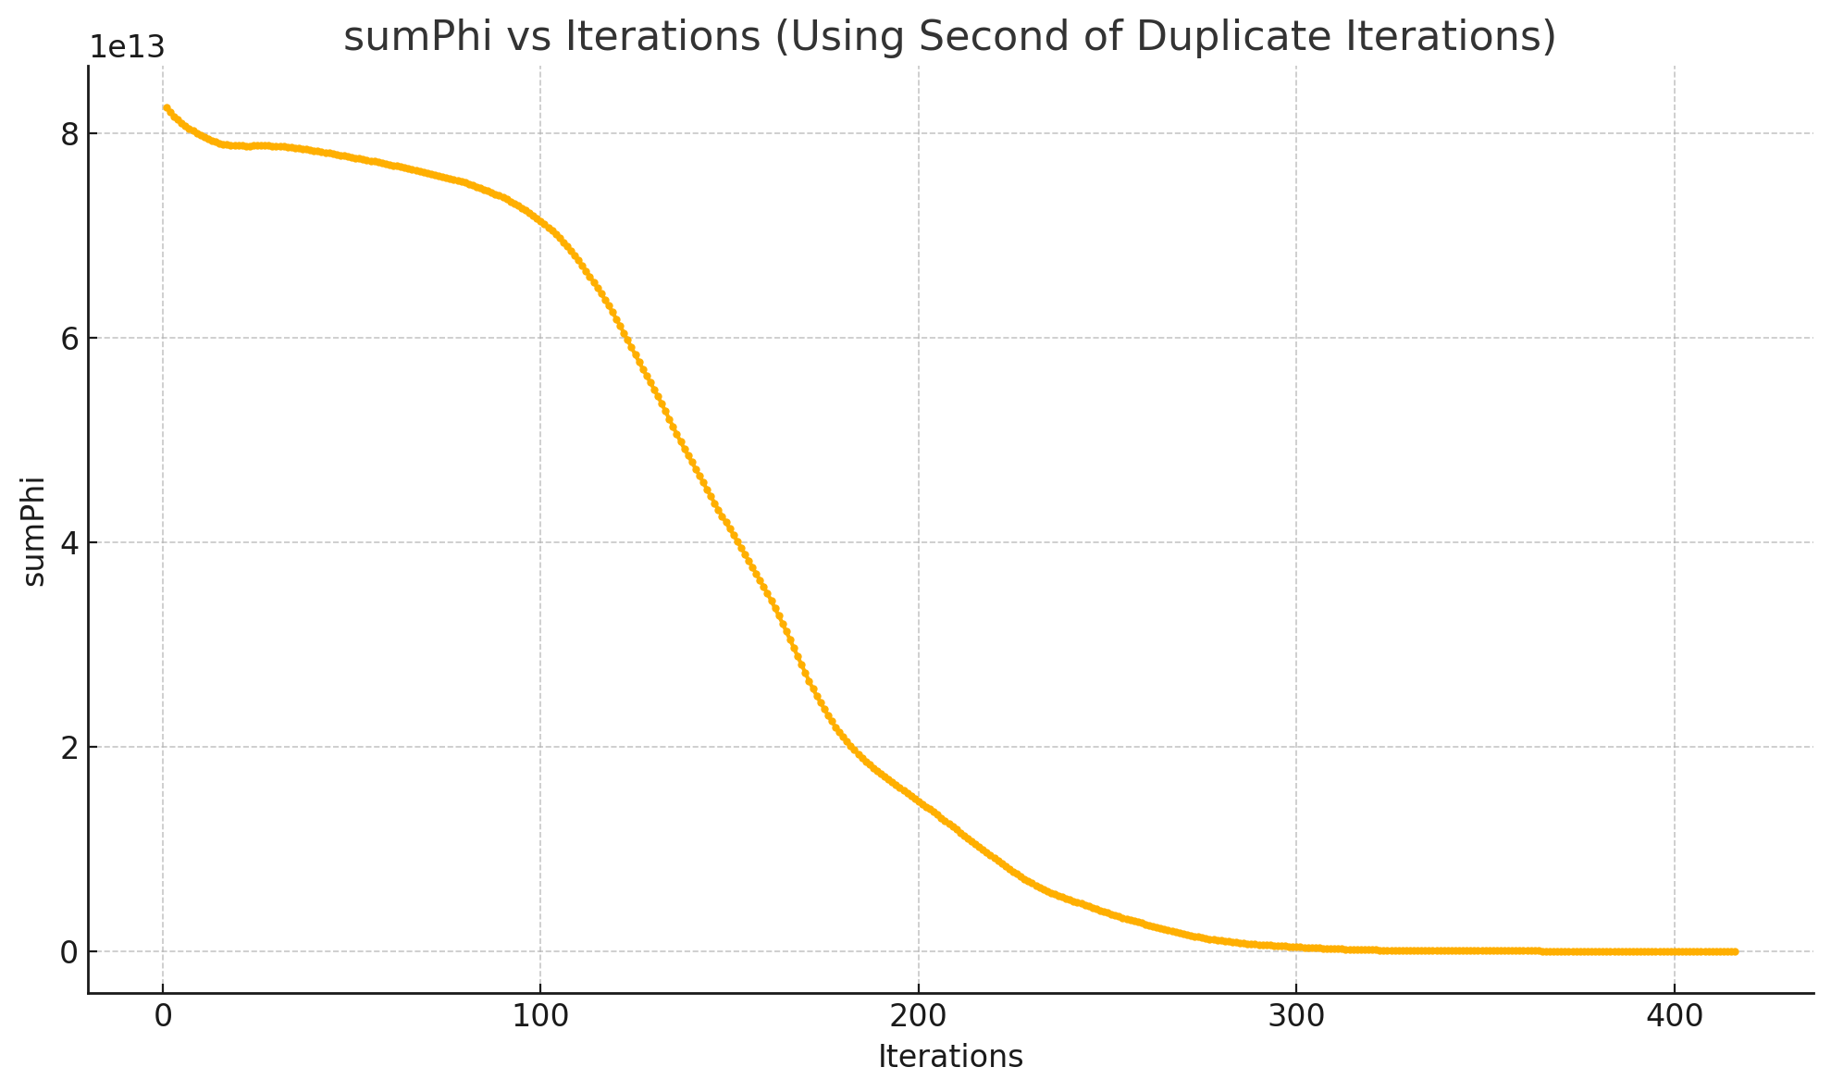
sumPhi (Density Constraint)

Slide 19
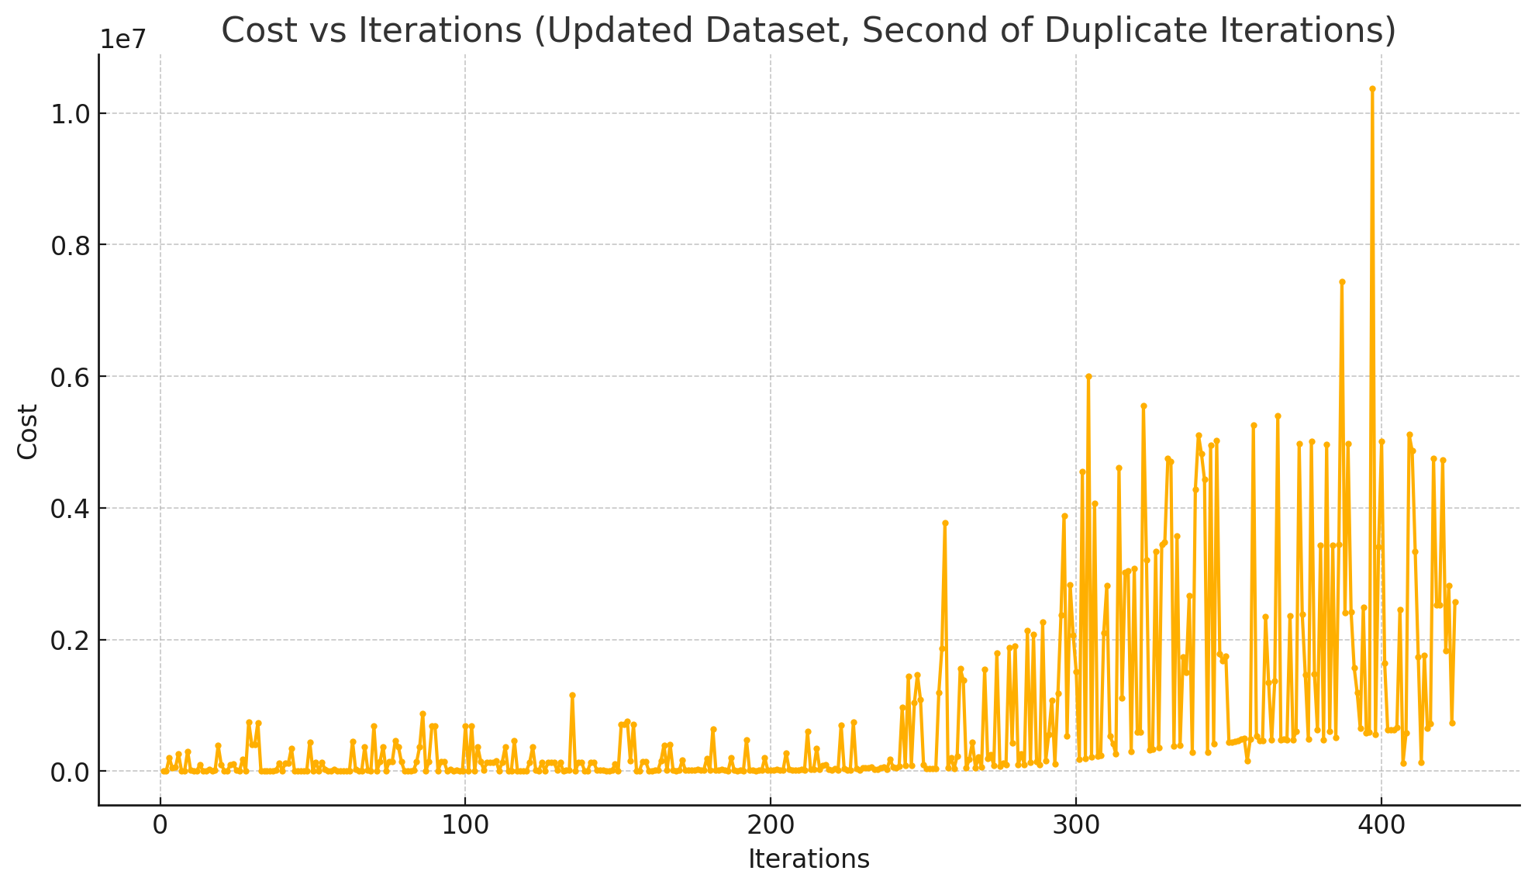
Cost (Objective Function)

Slide 20
Cost (Objective Function)
+
x
=

Slide 21
ARL Research Update
03-27-2025

Slide 22
Research Objectives
FP-ASIC obfuscation and partitioning
Study and develop partitioning algorithms for secure partitioning between FP and ASIC layers
In Progress: Implement “Controllability” and “Observability” for security-aware partitioning
In Progress: Implement per-wire simulation
In Progress: Calculate Controllability and Observability and use as weights
In Progress: Considering “ePlace-3D” for analytical placement
3-D FPGA Design and Implementation
OpenFPGA Investigation
TODO: examine capabilities

Slide 23
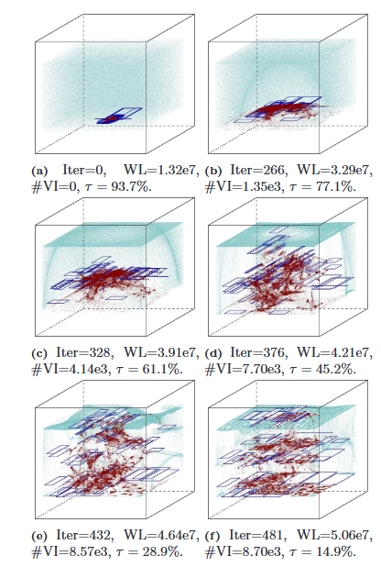
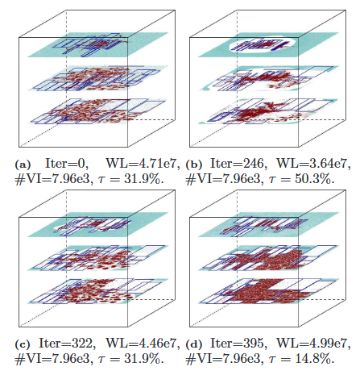
ePlace-3D

Slide 24
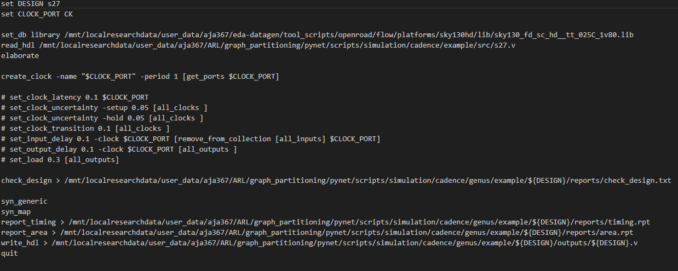
Logical Synth & Testbench Gen.

Slide 25
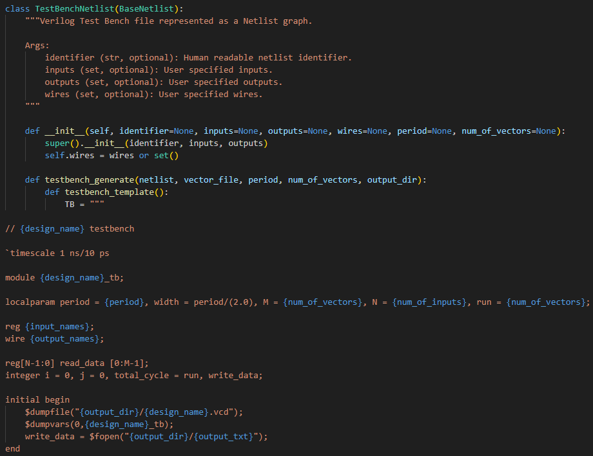
Logical Synth & Testbench Gen.

Slide 26
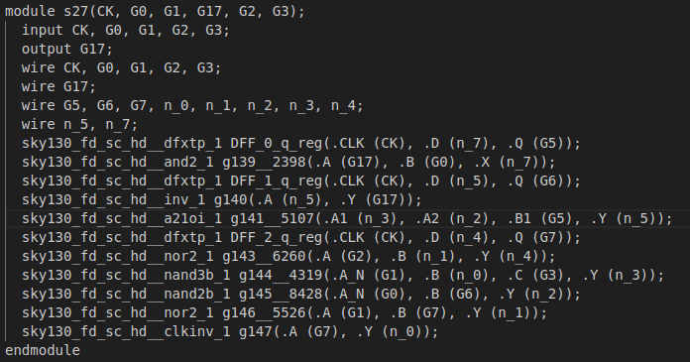
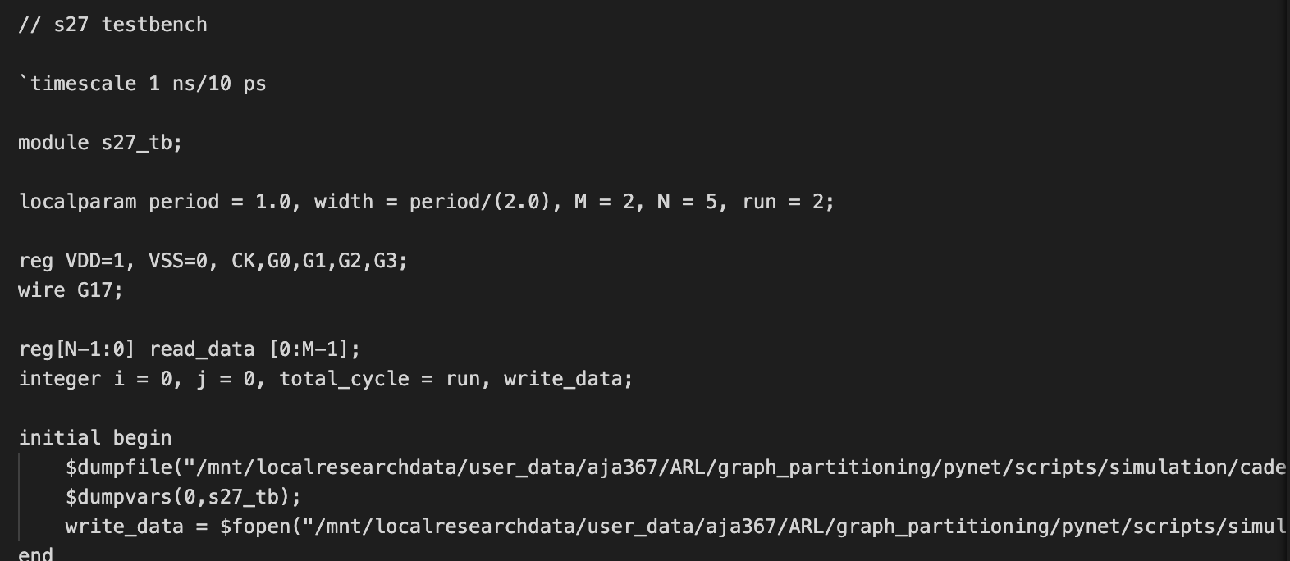

Slide 27
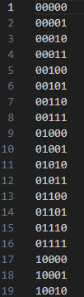
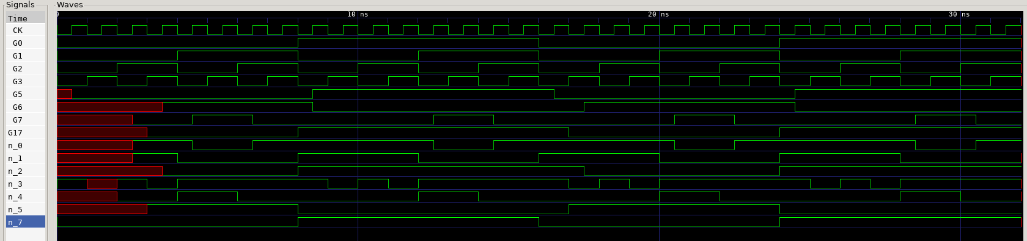
Simulation

Slide 28
EDA-schema

Slide 29
Schema v1: eda-datagen
Moot slide

