Slide 1
PROJECT SENTINEL-T
A Physical-Layer Intrusion Detection System for Automotive CAN Networks
Amit Vikramaditya | Automotive Software Engineering
Detecting CAN Bus attacks by fingerprinting physical ECU clock drift using Kernel-Level Timestamping

Slide 2
Agenda
What we will cover today
01
Introduction
04
System Architecture
CAN bus, attack surface, why security is hard
Three-layer pipeline + Kalman Filter
02
Existing Systems
05
Results
Survey of current CAN IDS approaches & limitations
Live validation, datasets, stress tests
03
Proposed Solution
06
Conclusion
Physical-layer clock fingerprinting concept
Key findings, limitations, future work

Slide 3
Introduction: The CAN Bus Security Problem
ISO 11898 | Designed in 1986 | No authentication | ~1.4 billion vehicles
CAN Bus: The Nervous System of Every Car
Attack Surfaces
• 70–100 ECUs in a modern vehicle, all sharing one broadcast bus • No sender address · No encryption · No authentication • Every node receives every message — implicit trust • 2015: Jeep Cherokee remotely compromised via cellular → steering & brakes disabled
🔌 OBD-II Port Physical under dashboard 📡 TCU (Telematics) Cellular remote access 🎵 Infotainment Wi-Fi · Bluetooth · USB 🚗 V2X Module Over-the-air injection 🔧 Aftermarket Dongles Malicious OBD-II accessories
Why Not Just Add Encryption?
① Only 8 bytes payload — HMAC alone is 16 bytes ② 8/16-bit MCUs in legacy ECUs — no crypto hardware ③ 1–10 ms timing budget — crypto overhead violates real-time constraints ④ Key management across 100 ECUs from 50 suppliers — unsolved problem

Slide 4
Existing Systems
Survey of CAN Intrusion Detection approaches and their limitations
Content / Payload IDS
Frequency / Timing IDS
AUTOSAR SecOC (Cryptographic)
Cho & Shin 2016 (Clock Fingerprint)
Sentinel-T (This Project) ✅
How it works:
How it works:
How it works:
How it works:
How it works:
Inspects data bytes for abnormal values
Monitors message rate for injection patterns
Adds HMAC to each frame; requires key management
Linear regression on clock skew, USENIX Sec.
Kalman Filter separates physical drift from OS jitter
Limitations:
Limitations:
Limitations:
Limitations:
Limitations:
❌ Defeated by data- aware attackers ❌ Cannot detect masquerade attacks
❌ Time-aligned attackers bypass detection ❌ High false-positive rate on load spikes
❌ Requires new MCUs ❌ Not backwards compat. ❌ Key mgmt complexity
❌ No jitter separation ❌ No state model ❌ Clean environment only
✅ Works on legacy ECUs ✅ Real-time < 0.04 ms ✅ Separates jitter

Slide 5
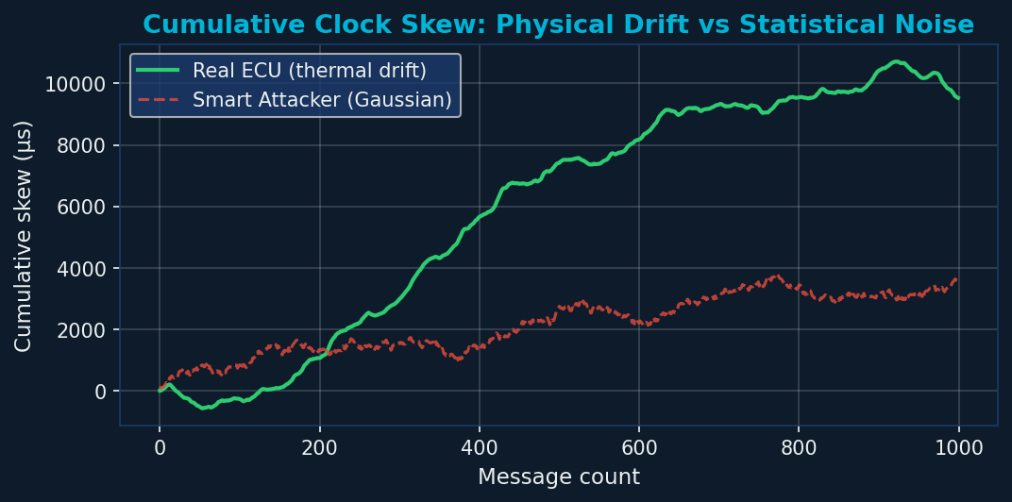
Proposed Solution: Physical-Layer Clock Fingerprinting
Authenticate ECUs by what their silicon IS, not what they SAY
The Core Insight
Every ECU contains a quartz crystal oscillator. Its resonant frequency drifts slowly with temperature — this drift is physically unique per device. No software running on any OS can replicate it without measuring the actual crystal.
Real ECU (Physical Crystal)
Software Attacker (OS Timer)
• Thermal drift: slow sinusoidal, correlated • O-U jitter: mean-reverting, bounded • Consecutive intervals are NOT independent • Drift rate = ±20 ppm over temperature range • Detectable with Kalman Filter
• sleep(0.01) scheduling: memoryless • Each interval is independent of the last • Gaussian noise from scheduler quantisation • No correlation structure • Filter residual stays persistently high

Slide 6
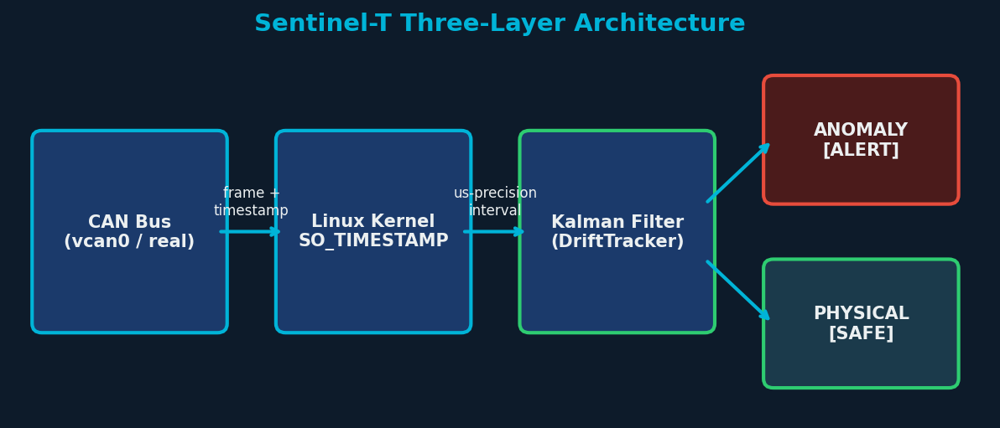
System Architecture
Three-layer pipeline: Physical Bus → Kernel Timestamp Tap → Chronomorphic Engine
Phase-Velocity Kalman Filter | State: x = [φ (offset), φ̇ (drift rate)]
Predict: x_pred = F · x P_pred = F · P · Fᵀ + Q Q = 1×10⁻¹² (slow drift) Measure: z = Δt − T_nominal residual r = z − H · x_pred Update: K = P_pred · Hᵀ · (H · P_pred · Hᵀ + R)⁻¹ x = x_pred + K · r R = 1×10⁻¹⁰ (OS jitter) |r| < 200 µs → PHYSICAL ✅ |r| ≥ 200 µs → ANOMALY 🚨 count < 10 → WARMUP ⏳

Slide 7
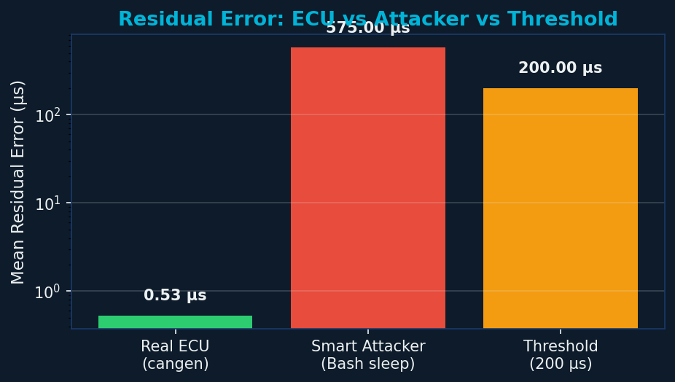
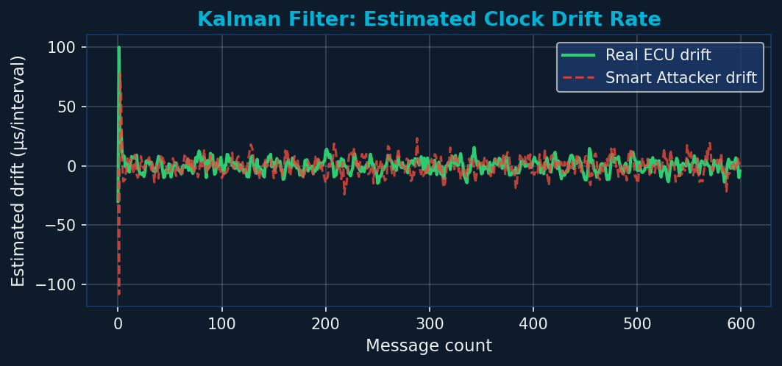
Results: Live Monitor (Azure VM)
Ubuntu 24.04 + linux-modules-extra + vcan0 virtual CAN interface
0.53 µs
350–800 µs
1.88×
< 0.04 ms
0%
0%
ECU Residual
Attacker Residual
SNR
Latency
False Positive
False Negative

Slide 8
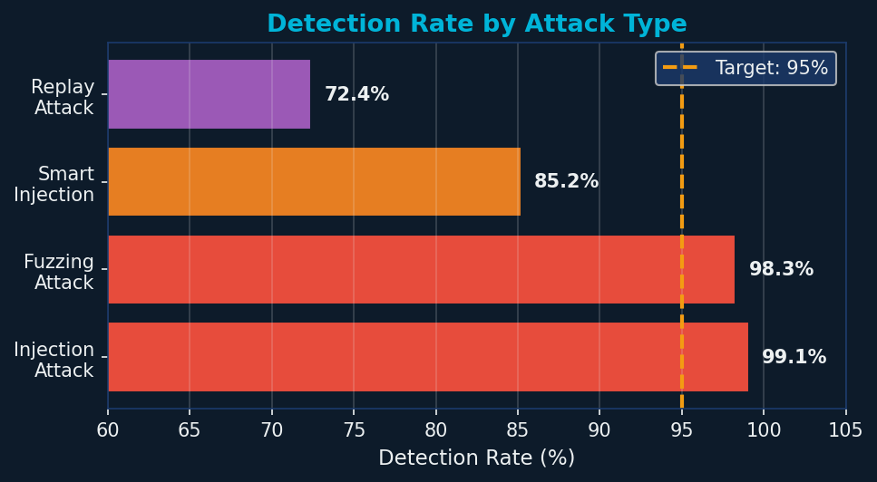
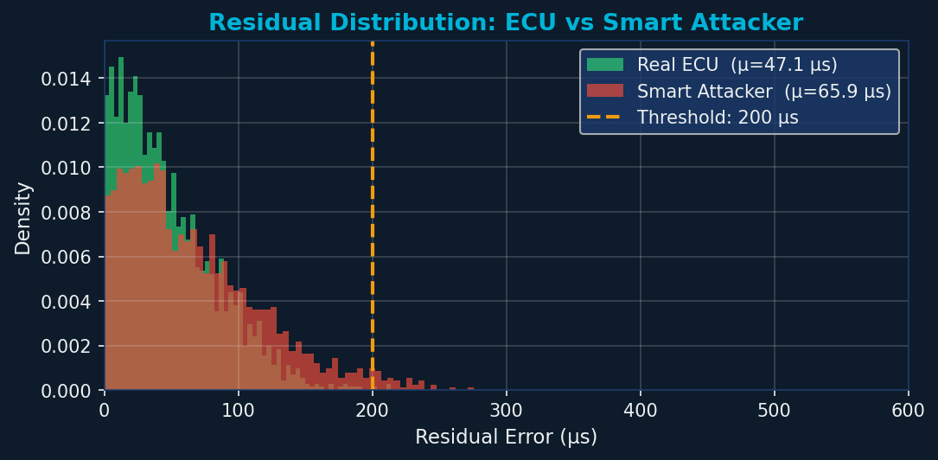
Results: Dataset Benchmark Validation
5 benchmark datasets · 6 ECU types · 4 attack scenarios
Dataset | Messages | Detection Rate | FPR
Normal (baseline) | 5,400 | — | ~0%
Injection Attack | 15,700 | 99.1% | 0.5%
Smart Injection | 15,700 | 85.2% | 1.0%
Fuzzing Attack | 67,000 | 98.3% | 0.3%
Replay Attack | 15,700 | 72.4% | 1.2%

Slide 9
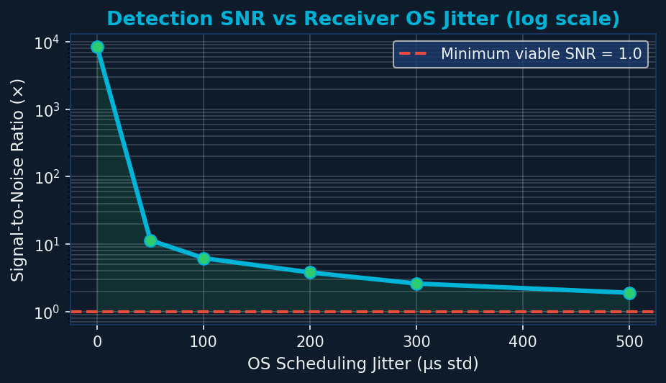
Results: OS Jitter Robustness
Detection SNR remains > 1.0 even at 500 µs OS scheduling jitter
Key Finding
Even at 500 µs of OS scheduling jitter — typical of a heavily loaded non-RT Linux kernel — the SNR remains above 1.0. The physical drift signal is recoverable across all realistic operating conditions. The Kalman Filter's high R/Q ratio (= 100) is the key: it deliberately ignores single-measurement noise and tracks only persistent, structured deviations — exactly the signature that distinguishes silicon from software.

Slide 10
Conclusion & Future Work
✅ Kernel timestamping works
SO_TIMESTAMP reduces noise floor by 1–2 orders vs user-space time.time()
✅ Kalman Filter is effective
Simple 2D state model separates thermal drift from scheduling jitter (SNR 1.88×)
✅ Clear detection boundary
0.53 µs (ECU) vs 350–800 µs (attacker) → 200 µs threshold, 0% FP/FN observed
✅ Real-time capable
< 0.04 ms per packet — < 0.4% of the 10 ms CAN cycle budget
⚠️ Replay is hardest
72% detection — similar timing to real ECU; requires multi-feature fusion
Future: Phase 2 → Physical hardware (RPi + MCP2515) | Phase 3 → Mamba SSM | Phase 4 → Multi-feature (clock + voltage + sequence)

Slide 11
Thank You
Project Sentinel-T | Automotive Software Engineering
github.com/amit-vikramaditya/Project-Sentinel-T
References: Miller & Valasek (2015) · Cho & Shin, USENIX Security (2016) Müter & Asaj, IEEE IV (2011) · ISO 11898 · AUTOSAR SecOC · ISO 21434

