Slide 1
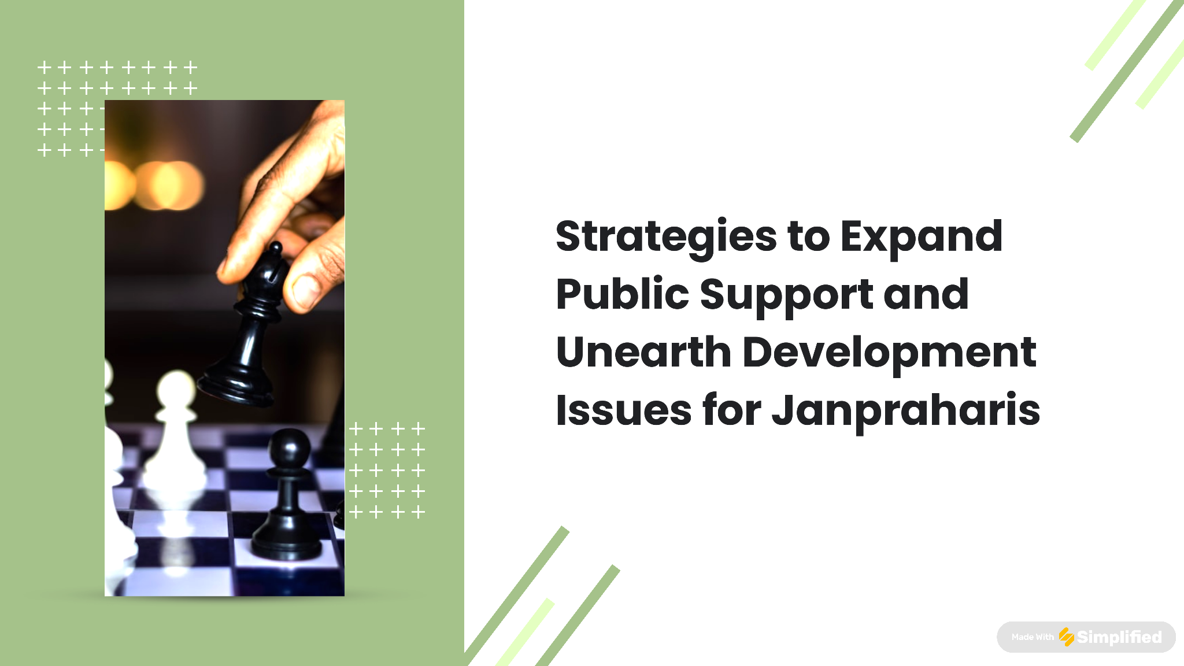

Slide 2
Intro
Janpraharis: Fostering Public Support for Development
Mission:
Expand public support and address development issues through strategic initiatives.
Commitment:
Dedicated to garnering public backing and tackling pressing development concerns.
Public Involvement:
Striving to engage the public in co-creating sustainable solutions for a brighter future.
Key Strategies:
1. Targeted Outreach Programs:
- Reach diverse demographics through tailored campaigns.
- Increase awareness and engagement at the grassroots level.
2. Community Partnerships:
- Cultivate relationships with local leaders and organizations.
- Collaborate to amplify impact and address specific needs.
Values:
1. Transparency:
- Open communication channels for clear updates and information.
- Build trust through honest and accountable practices.
2. Inclusivity:
- Encourage participation from all segments of society.
- Ensure diverse voices contribute to shaping solutions.

Slide 3
Importance: Janpraharis
Janpraharis: Driving Positive Change in Development
Mission:
Addressing crucial development issues and expanding public support
Importance:
Understanding the pivotal role Janpraharis plays in driving positive change
Public Involvement:
Ensuring a brighter future for all by involving the public in shaping sustainable solutions.
Strategic Initiatives:
1. Collaboration with Community Leaders:
- Forge partnerships to amplify impact.
- Leverage local insights for effective solutions.
2. Targeted Outreach Programs:
- Engage diverse communities through tailored campaigns.
- Increase awareness and participation.
3. Transparency Prioritization:
- Emphasize open communication for trust-building.
- Implement accountable practices for credibility.

Slide 4
Importance: Public Support
Janpraharis: Driving Positive Change in Development
Importance:
Public Backing is Vital for:
- Success in addressing development issues.
- Generating greater awareness and mobilizing resources.
Benefits of Public Support:
1. Resource Mobilization:
- Leverage support for increased resources.
- Implement sustainable solutions at scale.
2. Community Collaboration:
- Actively involve the public in initiatives.
- Foster a sense of ownership and collaboration
Strategies for Public Involvement:
1. Transparency:
- Communicate openly about initiatives and impact.
- Build trust through transparent practices.
2. Active Engagement:
- Encourage public participation in decision-making.
- Align efforts with community needs and aspirations.
Janpraharis Ensures:
- Sustainable efforts that align with community needs.
- A collaborative approach for a prosperous future.

Slide 5
Expansion Strategies
Expanding Public Support: Education and Awareness
Approach:
Educate the Public About:
- Janpraharis' Mission
- Development Issues Addressed
Content Types:
1. Infographics:
- Visualize impact and key messages.
- Enhance understanding with graphics.
2. Videos:
- Showcase work and success stories.
- Convey importance through storytelling.
Platforms:
Social Media: | - Reach a broad audience. | - Spark conversations and engagement.
Presentations: | - Communicate key messages effectively. | - Tailor content for various audiences.
Workshops: | - Provide interactive learning experiences. | - Foster direct engagement and understanding.
Partnerships: | - Collaborate with local schools and universities. | - Integrate educational programs.

Slide 6
Expansion Strategies
Organisational Structure- JanPraharis
Media Head
Social Media
Print Media
Speaker (Pravakta)
Speaker Media
Vice Chairman
Chairman
Vice President
Executive wing- different section (By profession, advocacy, NGOs
Unit wings
Unit wings
President
Specialist wings
General Secretary
Secretary
Panchayat Heads
President
Yuva wing
Cluster Heads (Legislative wing)
Vice President
Farmers wing
Secretary
Yuva wing
Media Incharge
Women wing
Treasurer

Slide 7
Expansion Strategies
Engaging Local Communities for Effective Impact
Strategies for Community Engagement:
1. Community Events:
- Organize gatherings to foster community spirit.
- Create platforms for open interaction and participation.
2. Surveys:
- Conduct comprehensive surveys to understand local needs.
- Gather insights directly from community members.
3. Town Hall Meetings:
- Hold regular town hall meetings for open dialogue.
- Actively involve community members in decision-making.
Impact:
Creating a Sense of Ownership:
- Actively involving communities creates a sense of ownership.
- Empower community members in decision-making processes.
Building Strong Relationships:
- Forge connections with local leaders and influencers.
- Collaborate with local organizations to amplify impact.
Fostering Collaboration:
- Collaboration with local entities amplifies the impact of initiatives.
- Strengthens relationships and garners broader support.

Slide 8
Expansion Process
Information Campaigns
- Execute campaigns to raise awareness about government initiatives.
- Empower constituencies with knowledge about available resources.
- Promote transparency and accessibility in governance.
Town Hall Meetings
- Conduct regular town hall meetings for direct engagement.
- Provide a platform for open dialogue and issue resolution.
- Demonstrate accessibility and a commitment to diverse voices.
04
Public Support
____________
Bottom-Up Process
01
03
Public Service Initiatives
-Public Service Initiatives
- Launch health camps, educational workshops, and skill development.
- Demonstrate commitment to community well-being and progress.
Community Outreach
- Organize events, rallies, and gatherings for community unity.
- Showcase leadership presence and engagement with local concerns.
02

Slide 9
Expansion Strategies
Strategic Collaboration for Amplified Impact
Collaborative Approach:
Working Together:
- Collaborate with influential stakeholders.
Resource Sharing:
- Pool resources for collective impact.
Expertise Leveraging:
- Utilize each other's expertise for effective solutions
Benefits:
- Sustainable Change:
- Collective effort for long-lasting impact.
- Greater Public Support:
- Garner increased support through collaborative initiatives.
Key Stakeholders:
- Government Officials
- NGOs
- Businesses

Slide 10
Expansion Strategies
Harnessing the Power of Social Media
Amplifying Impact Through Awareness Campaigns
Organizing Events:
- Workshops, Seminars, Rallies:
- Direct opportunities for community engagement.
Objectives:
- Community Education:
- Informing the community about Janpraharis' cause.
- Unity and Purpose:
- Creating a sense of unity and shared purpose.
Benefits:
- Engagement Opportunities:
- Directly engage with the community.
- Mission Amplification:
- Amplify the impact of Janpraharis' mission
Platforms:
- Facebook
- Twitter
- Instagram
Strategies:
- Raise Awareness:
- Utilize social media for broader reach.
- Community Engagement:
- Foster engagement and dialogue.
- Success Stories:
- Share impactful success stories.
Content Creation:
- Compelling Content:
- Create engaging and informative content.
- Hashtags:
- Use relevant hashtags for visibility.
- User-Generated Content:
- Encourage community participation.
Benefits:
- Community Building:
- Foster a sense of community.
- Public Support:
- Encourage support for Janpraharis' cause.

Slide 11
Issues Finding Process
Local Needs Assessment
- Conduct surveys to identify key development issues.
- Engage with local stakeholders and experts.
- Emphasize grassroots insights for shaping priorities.
Data Analysis and Prioritization
- Analyze data to prioritize urgent and impactful issues.
- Develop action plans tailored to local needs.
- Illustrate commitment to evidence-based decision-making.
04
Unearthing Development Issues
____________
Bottom-Up Process
01
03
Community Consultations
- Organize discussions to gather firsthand insights.
- Encourage open dialogue to uncover specific concerns.
- Highlight participatory approaches in identifying needs.
Infrastructure Inspections
- Regularly inspect local infrastructure and service points.
- Identify areas requiring immediate attention.
- Demonstrate commitment to proactive governance.
02

Slide 12

Conclusion
Maximizing Impact:
Strategy Evaluation & Adjustment
Continuous Improvement Through Evaluation
Regular Evaluation:
- Monitor outcomes of awareness campaigns and events.
Feedback Analysis:
- Analyze community feedback for insights.
Stay Informed:
- Remain updated on development issues.

