Slide 1
How the Internet works
related sections to read
in Networked Life:
10.1-10.2
13.1
14.1
15.1-15.2
17.1

Slide 2
Take a moment to think about how amazing the Internet is:
  It’s always on
  It is “free”
  It’s (almost) never noticeably congested (though individual sites or access points might be)
  you can get messages to anywhere in the world instantaneously
  you can communicate for free, including voice and video conferencing
  you can stream music and movies
  it is uncensored (in most places) (of course, this can be viewed as good or bad)

Slide 3
This talk focuses on the question of how the Internet can be so robust
  Is there an “Achilles’ heel”? a single point of failure that can be attacked?
  How does the network autonomously adapt to congestion?
To answer these questions, we will discuss some of the underlying technologies that contribute to the robustness of the Internet
  packet switching
  Ethernet
  TCP/IP
  routing protocols

Slide 4
Evolution of the technologies underlying the Internet
  the Internet was not designed top-down by a single company or government organization
  it evolved
    many alternative technologies/protocols were proposed and tried out
    eventually, the best were identified and adopted (in a “democratic” way)
    when new people joined, they had to use whatever protocols everybody was using, until it grew into a standard
  it is decentralized – no one owns it or controls it

Slide 5
Compare with the old-style telephone networks
  designed top-down by companies like AT&T, who built the network of telephone lines, and wanted (and had) complete control over their use
  good aspect of design:
    old handsets did not need electrical power
    energy for dial-tone and speakers came from phone line
    phones would work even if power knocked out in electrical strorm
  con: they were circuit-switched (a dedicated path between caller and receiver had to be established, and most of that bandwidth was wasted)
In contrast, given how the Internet “grew”, it is amazing it works at all (!)

Slide 6
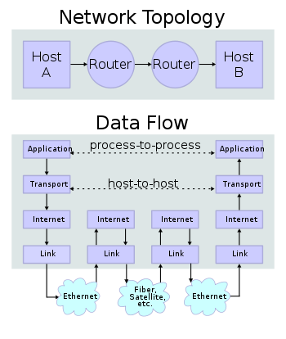
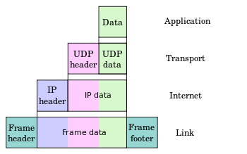
protocol stacks
layered architecture
each layer is an abstraction that assumes the functionality of the layer underneath
files
unencrypted
streams
buffers
packets
frames
bytes
bits
drivers,
network card

Slide 7
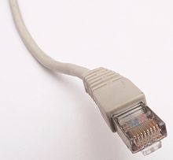
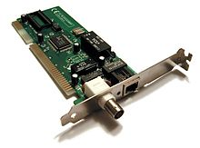
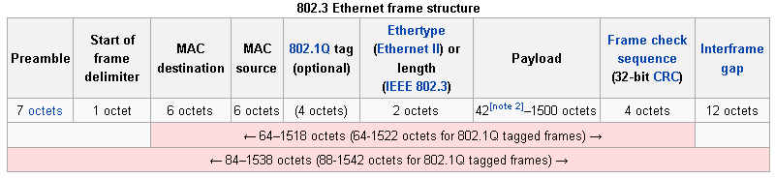
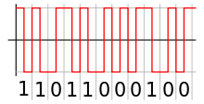


Ethernet
local machines on common wire hear all transmissions
in cases of packet collisions, use a “back-off” algorithm
each machine waits a random time (gauged by the amount of congestion) to re-transmit

Slide 8
IP addresses
[0-255].[0-255].[0-255].[0.255]
128.194.139.1 (associated with a specific MAC)
<domain>.<domain>.<subnet>.<host>
IPv4 (current standard, 4 billion IP addresses)
IPv6 (extended address space: 2¹²⁸=10³⁹ devices)
128.194.139.1 = sun.cs.tamu.edu
DNS – domain name server
  distributed network of servers that translate hostnames to IP addresses
  TAMU campus has several DNS servers that communicate with others worldwide
  nslookup: www.google.com = 74.125.227.145

Slide 9
TCP-IP
transport layer
built on top of IP
  assumes can send datagrams to IP addresses
UDP: User Datagram Protocol
  simple, fast, checksums, no guarantee of delivery
TCP-IP: Transmission Control Protocol
  connection-oriented: hand-shaking, requires message acknowledgements (ACK)
  guarantees all packets delivered uncorrupted in order

Slide 10
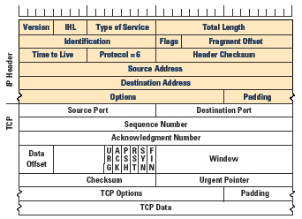
TCP-IP packets
a file or message is divide up into packets
information:
source IP address
destination IP address
mesg sequence number
(for acknowledgement)
payload size
checksum
payload (e.g. 512 bytes)
Geoff Huston, www.potaroo.net/ispcol

Slide 11
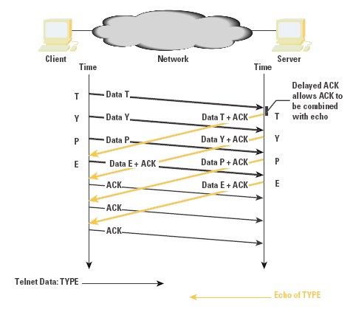
Congestion Control
TCP/IP senders track the response time of ACK messages
separate latency (roundtrip) from throughput (bandwidth)
adaptively adjust transmission frequency
Geoff Huston, www.potaroo.net/ispcol

Slide 12
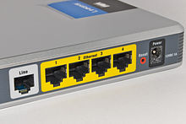
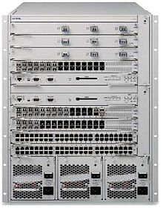
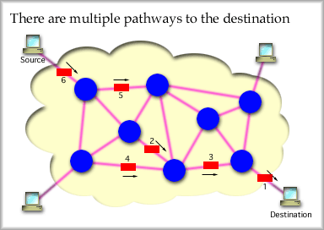
routers and routing
each router switches packets among its local connections
there are many paths from source to destination
ideally, what we want is to identify the shortest path (Bellman-Ford algorithm)
each router maintains a router table of IP addresses sent on out-going links (plus congestion information)
http://int.fhsu.edu/kevin/courses/datacom1VC/html/chapter_10.html

Slide 13
port 2:
addresses
128.1.1.1 to
132.255.255.255
Router table
port 1
TCP/IP
packet,
dest =
128.19.32.3
port | IP address range
1 | 001.*.*.* to 127.*.*.*
2 | 128.1.1.1 to 132.255.255.255
3 | 133.1.1.1 to 191.255.255.255
4 | 192.1.1.1 to 253.*.*.*
5 | 254.1.1.1 255.255.255.255
router
port 5
port 3
port 4
Essentially what routers do is receive packets, extract destination IP,and switch them to an out-going port.
Each router has a limited capacity (throughput or bandwidth, e.g. 10 GB/s).

Slide 14
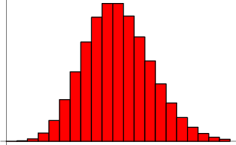
Robustness of the Internet
does the Internet have an “Achilles’ heel”?
is there a single point of failure (that could be attacked)?
or is it designed to be fault tolerant?
it is hard to know the overall topology
does the connectivity follow a Poisson distribution?
  is there an “average” number
  of connections, some with more,
  some with less?

Slide 15
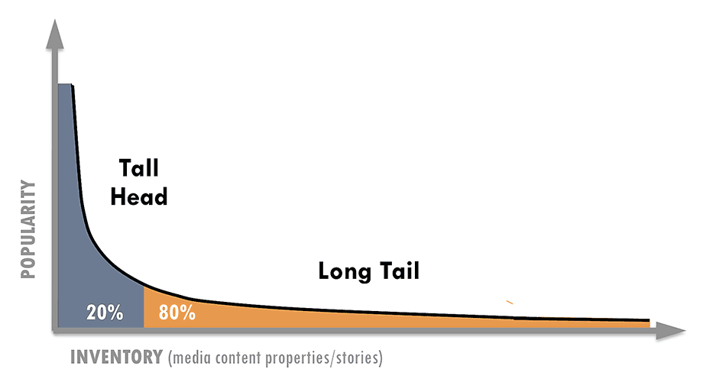
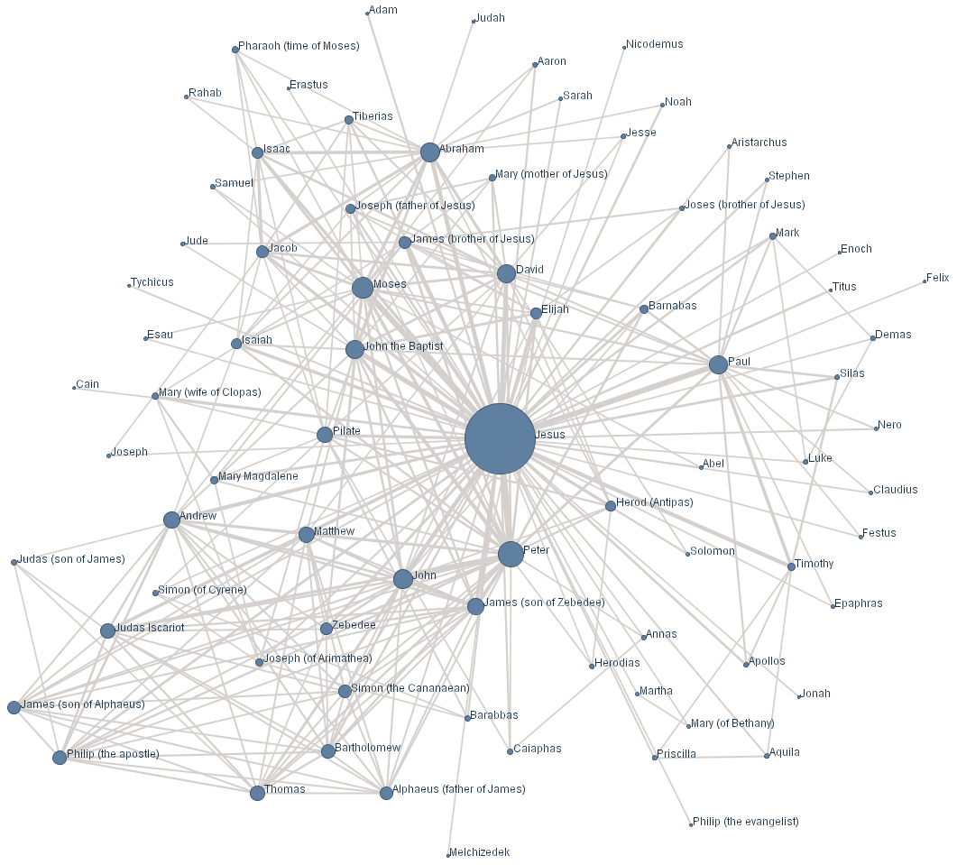
Modeling the Internet’s Topology
The connectivity profile likely follows a Power Law (or Zipf) distribution
  many nodes have few connections (on the edge?)
  few nodes have many connections (in the core?)
  if d is the degree of a node (# connections), then p(d>x) ≈ kx^{-α} (“scale-free” networks)
  however, this does not necessarily imply that there are a few highly connected nodes in the core of the Internet which would become “choke points”
proportion of nodes
number of connections per node
www.crossway.org

Slide 16
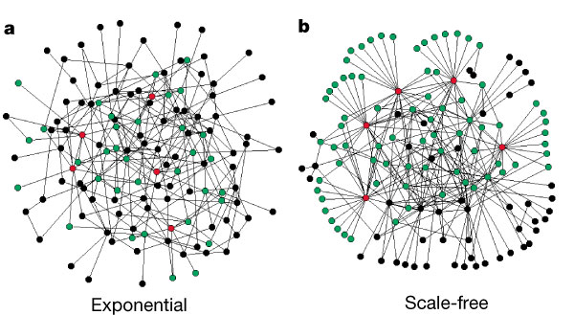
Modeling the Internet with Random Networks
Preferential Attachment (PA) model
  new nodes probabilistically connect to popular nodes
Constrained Optimization (CO) model
  when a cable/router reaches capacity, add another
both of these generate “scale-free” topologies
however, CO has much better performance
http://www.nature.com/
nature/journal/v406/n6794

Slide 17
“The Net routes around damage”
x
the adjacent nodes just
update their router tables

Slide 18
What about Internet Congestion?
the packet-switched design solves this
packets can take multiple paths to destination and get re-assembled
if one router gets overloaded, buffer overflow messages tell neighbors to route around it
also TCP/IP “back-off” algorithm
  monitors throughput of connections and adjusts transmission frequency adaptively
thus the Internet is amazingly robust, adaptive, and fault tolerant by design

Slide 19
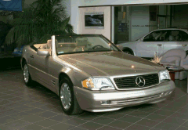
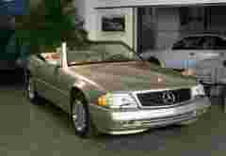
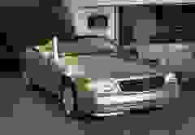
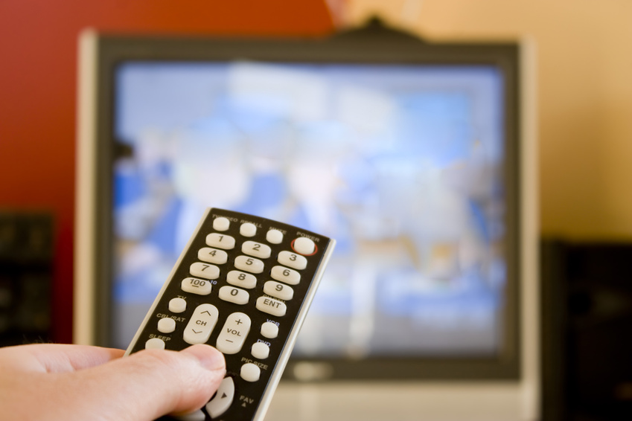
Streaming
Netflix, Pandora
VOIP (voice-over-IP, Skype)
video-conferencing
multi-casting (Olympics)
dither and jitter
use lossy compression to adjust stream to end-to-end bandwidth
use buffering to smooth out arrival of packets delayed and out-of-order
intermediate servers staged for local distribution (e.g. Akamai)
quality-of-service guarantees (QoS)
images from: pagetutor.com/
imagecompression
even
play-
back
buffer
uneven arrival of packets

Slide 20
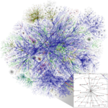
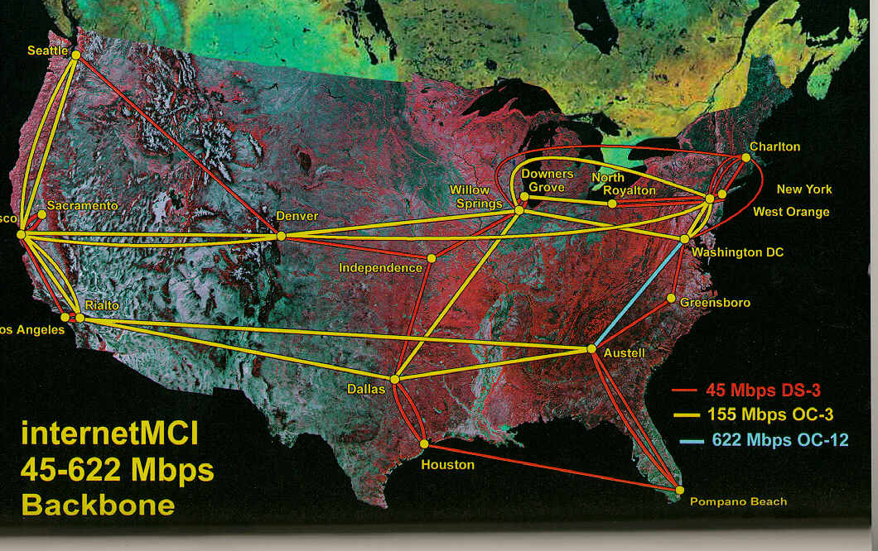
Access speed is determined by service provider (bandwidth of connection, e.g. dialup to T1)
Internet backbone
  who owns it?
  who controls it? can you tell somebody to stop streaming or hogging all the bandwidth? (the cable and phone companies would like to!)
Net Neutrality
  public policy issue; major economic impact
  service providers cannot discriminate based on user, content, packet type or destination, similar to highways

Slide 21
Wireless/Mobile
replace Ethernet (IEEE 802.3) with 802.11
transport protocol (TCP/IP) and higher layers in stack remain the same
issues
  dynamic IP address assignment (DHCP)
    ask router for temporary unique IP address
  new nodes may join or leave anytime
  roaming – device might change from one receiver/cell to another, take IP with it? causes changes in routing tables?
  security – encrypt packets sent over the air

