Slide 1

CODEBASICS RESUME CHALLENGE 8
BY
Amit Patil

Slide 2
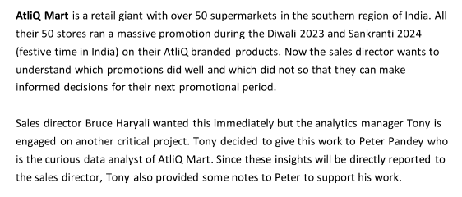
PROBLEM STATEMENT

Slide 3
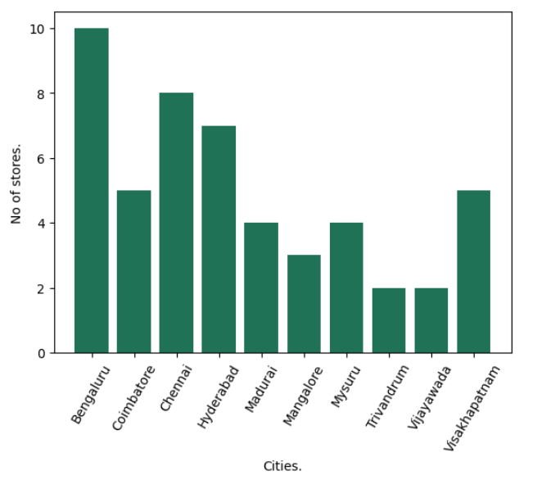
No of Stores in Each City
The number of stores varies considerably between the nine cities.
Bengaluru has the most stores, with 10, while Mangalore and Trivandrum have the fewest, with 2 each.
This may be due to factors such as the size of the city, the population density, and the level of economic activity.

Slide 4
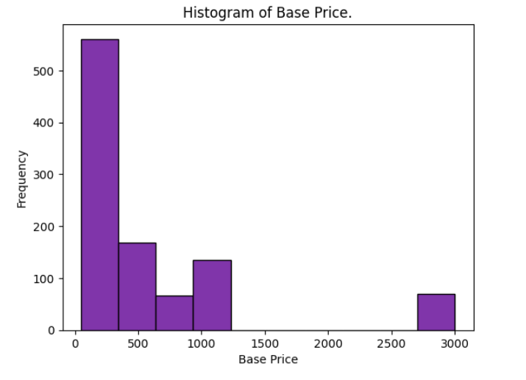
Base Price of Different Products.
The majority of products fall within the 0 to 250 price range.
There are fewer products priced at the extremes of the range.i.e. (2750 to 3000).

Slide 5
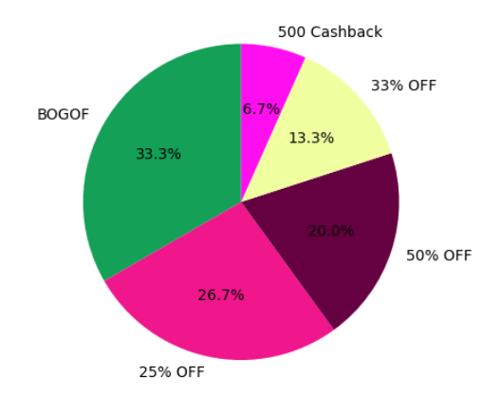
Promo Types Distribution.
This pie chart tells that offer BOGOF has highest share i.e. 33.3%
500 Cashback is the lowest share among promo.

Slide 6
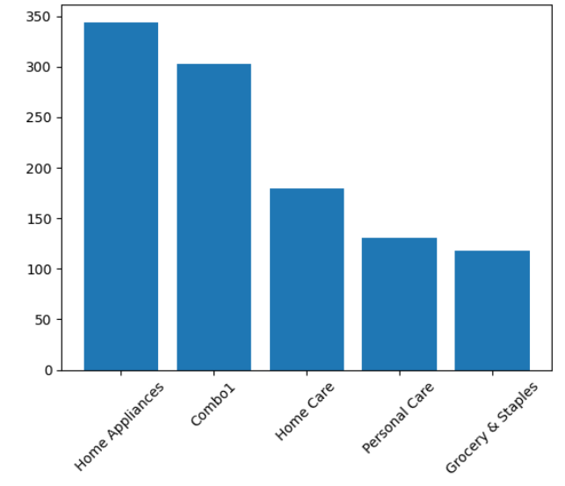
Product Categories.
Bar chart shows that category ‘Home Appliances’ has highest no of products.
While ‘Grocery and Staples’ category has least no of products.

Slide 7
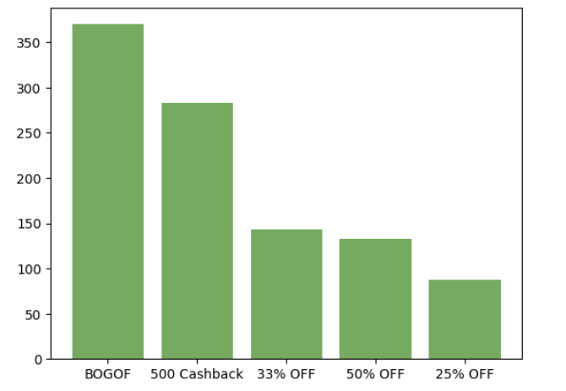
Promotional offer vs growth in sales.
‘’BOGOF promotional offer has highest growth in sales around 350%.
’25% OFF’ promotional offer has least growth in sales.

Slide 8
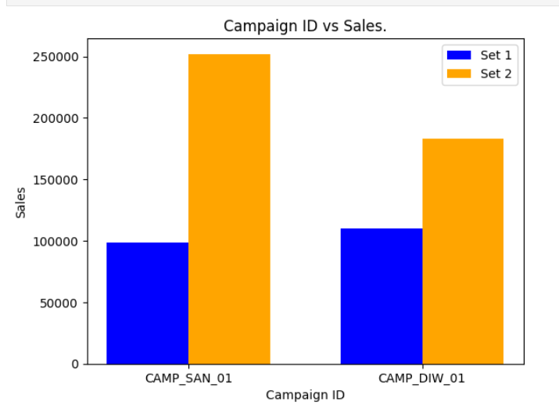
Campaign ID vs Sales.
SANKRANTI campaign has seen more growth in sales than DIWALI sales campaign.
There was almost 2.5 times increase in sales in Sankranti campaign.
Where as almost 1.8 times increase in sales in Diwali campaign.

Slide 9

List of products with price>500 and featured in promo type of 'BOGOF’

Slide 10
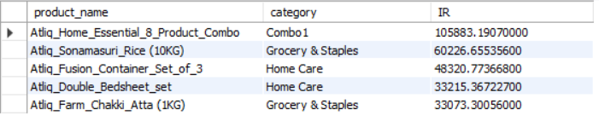
Top 5 products, ranked by Incremental Revenue Percentage(IR%), across all campaigns.

Slide 11

No of products in each campaign.

Slide 12
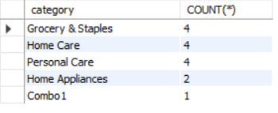
What are different categories and their product count.

Slide 13
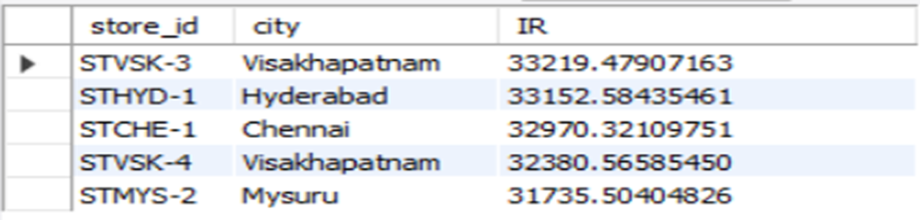
Top 5 Stores who got highest revenue.

Slide 14
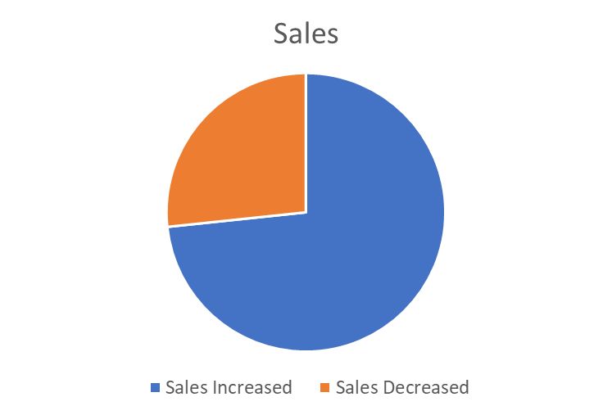
No of events in which sales Dropped/Increased.
In around 1100 events we see increase in sales.
Where as in 400 events we see decrease in sales.

