Slide 1
ROBUST AUTONOMOUS DRIVING
Evaluating Vision Robustness Under
Real-World Image Distortions
Lane Detection • Feature Matching • Vehicle Detection
Amit Ashkenazi
amit17ashkenazi@gmail.com
Alon Kenan
alon.kenan.ee@gmail.com

Slide 2
PROJECT OVERVIEW
Why Robustness Matters
Classical computer-vision and deep-learning methods used in autonomous driving are normally evaluated on clean images. On the road, cameras see low light, motion blur, and rain every day.
1
Measure degradation
Sweep 3 realistic distortions across 9 severity levels, scored vs. achieved SNR.
This project measures how much performance each method loses as distortion severity increases — and how much of it can be recovered.
2
Enhancement recovery
Restore the image first (denoise / deblur / de-rain), then re-run the same method.
3
Fine-tuning recovery
Adapt the model itself to distorted inputs, using real ground truth.
Robust Autonomous Driving Under Image Distortions
2

Slide 3
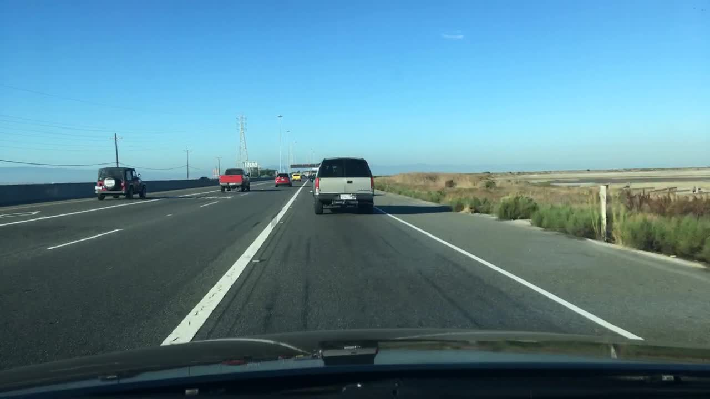
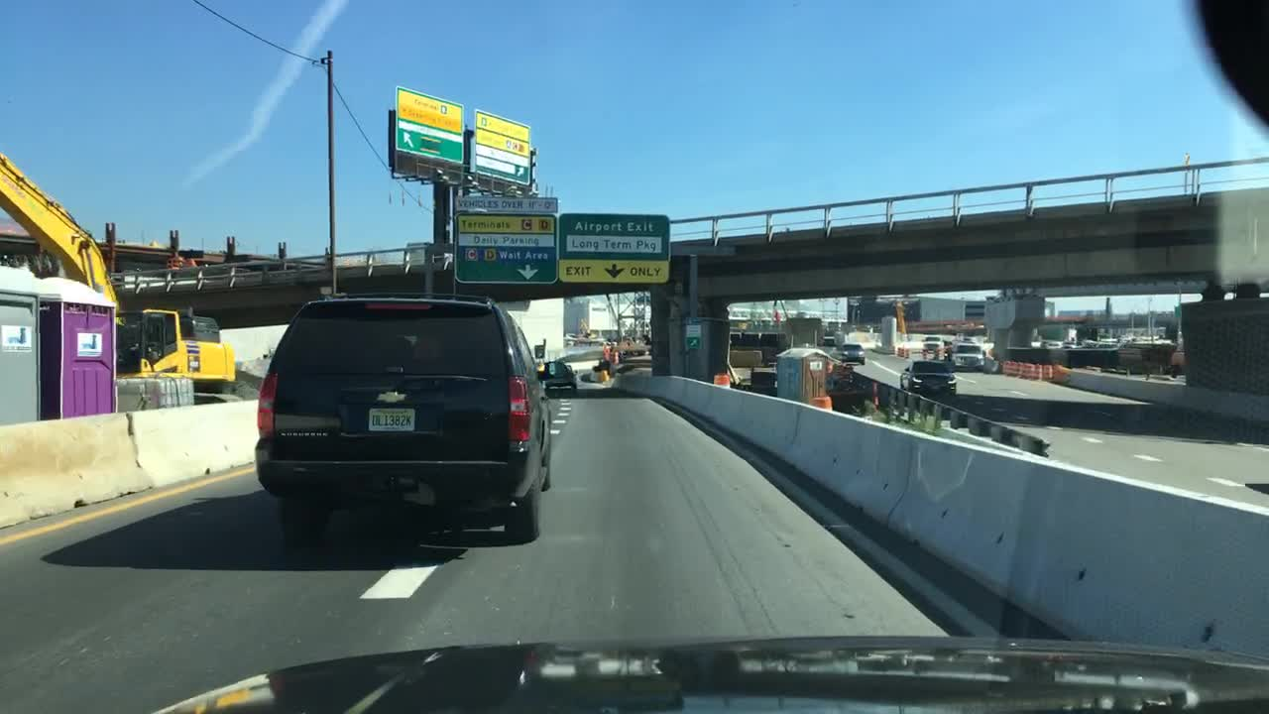
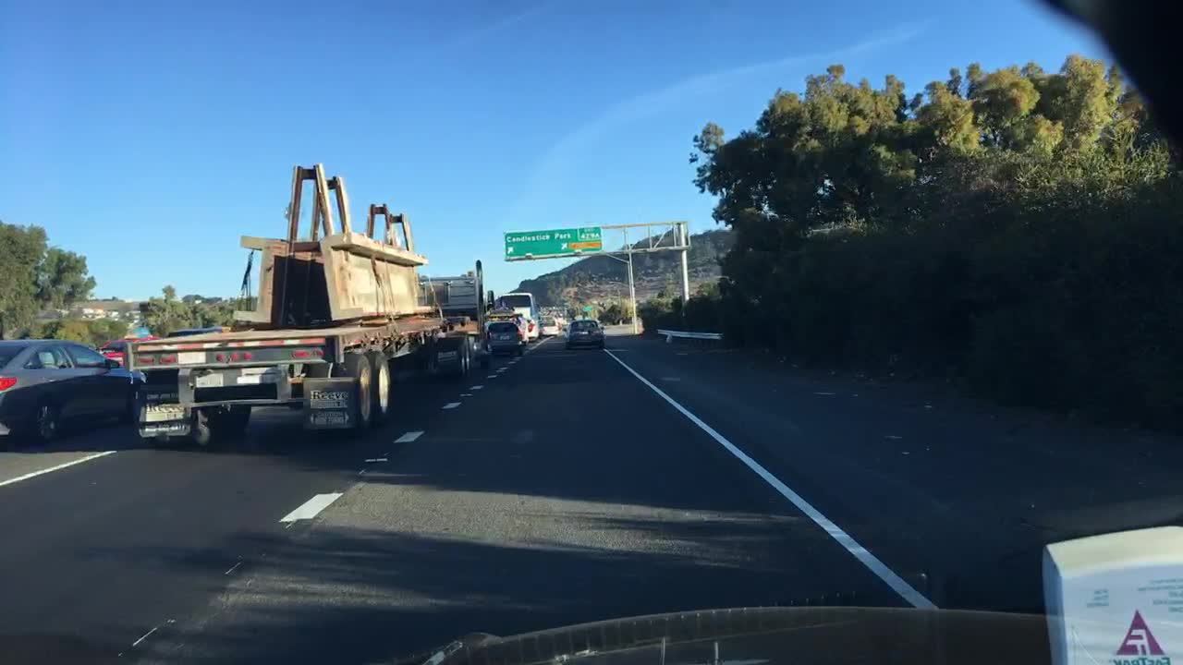
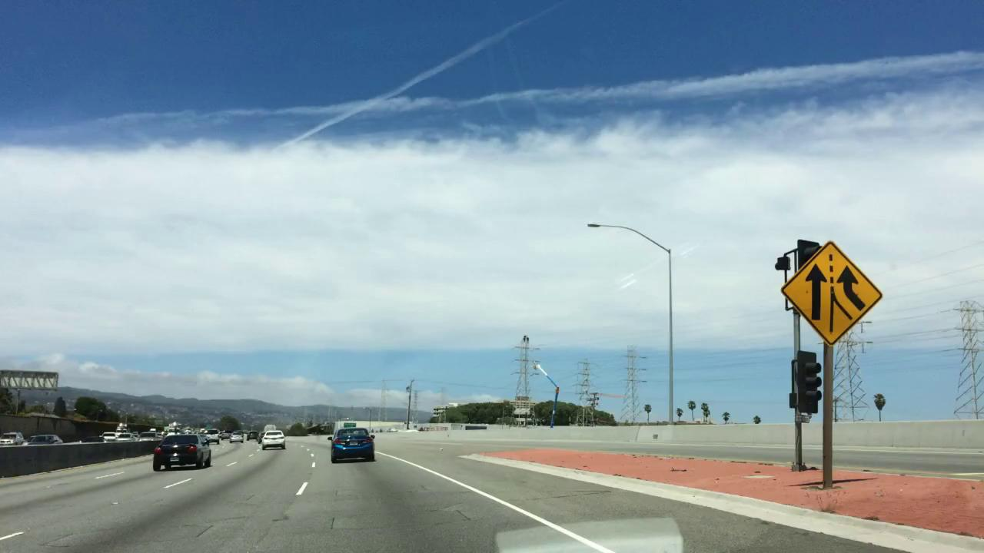
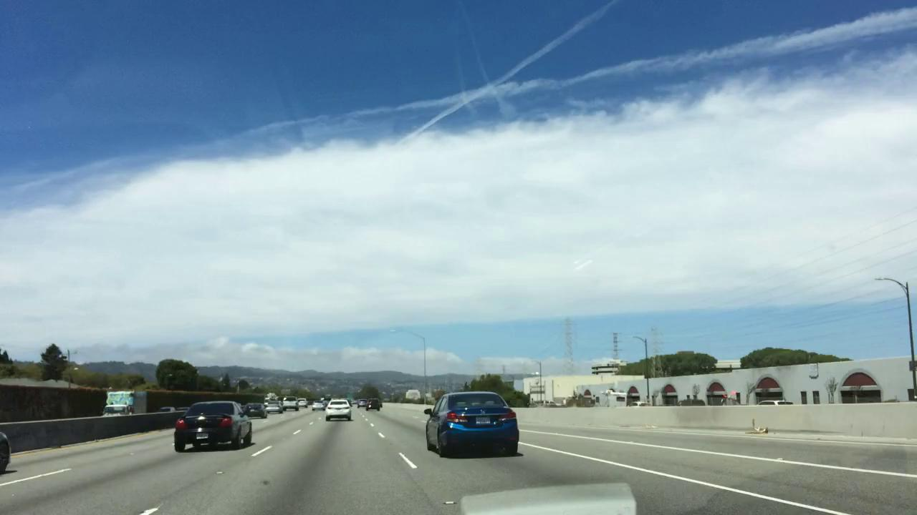
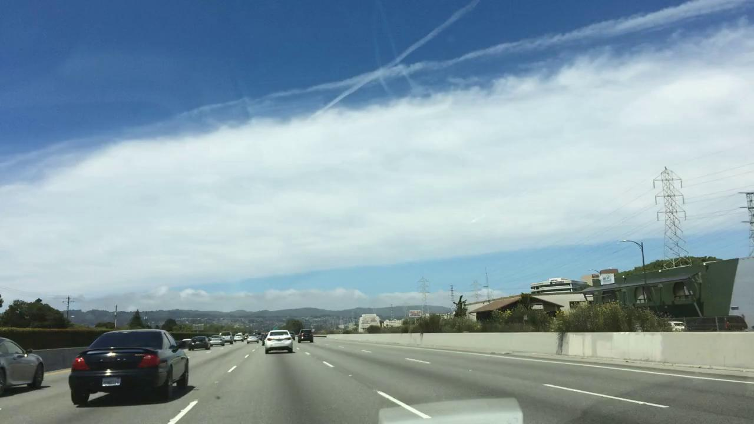
THE DATASET
BDD100K — Real Driving Scenes
Berkeley DeepDrive: large-scale, diverse road-scene images/video with object, lane, and drivable-area annotations — the source for all three tasks.
Dataset 1 — 300 images → Task 1 (Lane Detection) & Task 3 (Vehicle Detection)
Dataset 2 — 178 consecutive-frame pairs from one driving video → Task 2 (Feature Matching)
Robust Autonomous Driving Under Image Distortions
3

Slide 4
THREE TASKS, THREE LEVELS OF VISION
One Pipeline, Three Perception Methods
Task 1
Lane Detection
Canny + Hough Transform
Classical — Low Level
Task 2
Feature Matching
ORB + BFMatcher + RANSAC
Classical — High Level
Task 3
Vehicle Detection
YOLOv8n
Deep Learning
Robust Autonomous Driving Under Image Distortions
4

Slide 5
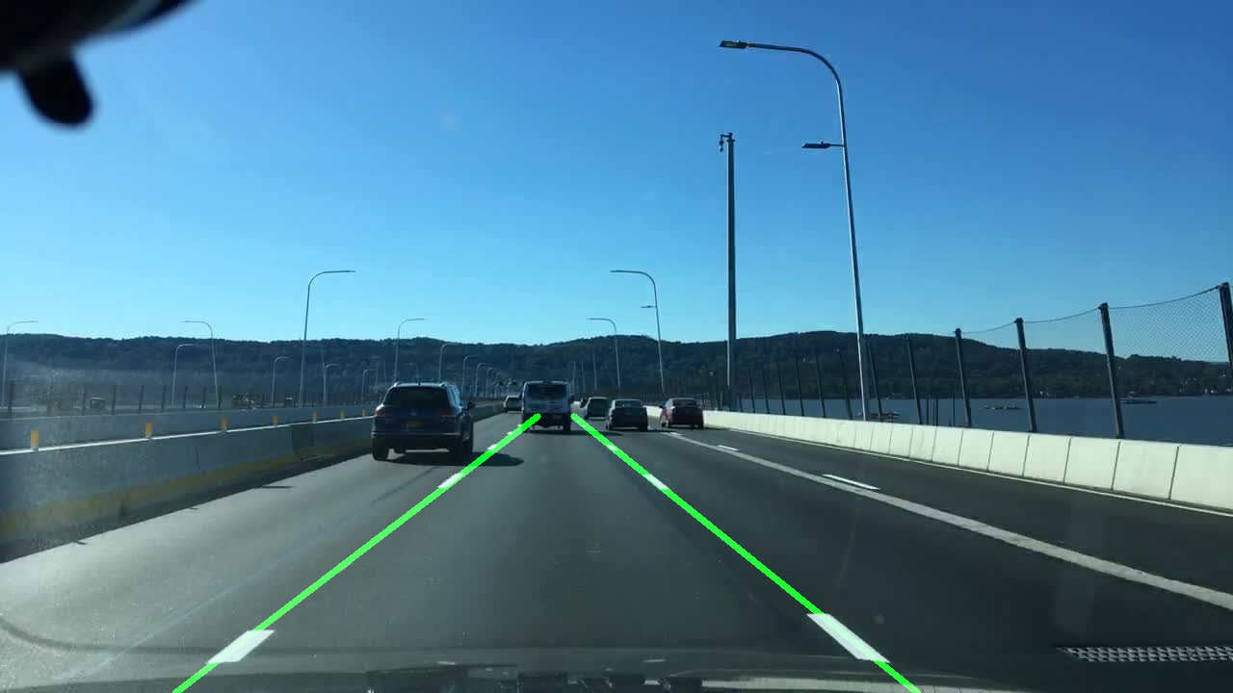
TASK 1
Lane Detection
Grayscale + blur → Canny edges → trapezoidal ROI mask → morphological closing → probabilistic Hough transform → slope filtering → outlier rejection → weighted regression per side.
Identifies the ego-vehicle's lane boundaries — a core low-level building block for lane-keeping and path planning.
Clean-image result
Robust Autonomous Driving Under Image Distortions
5

Slide 6
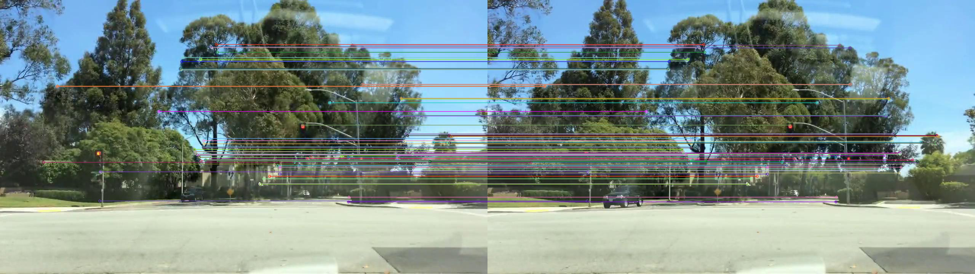
TASK 2
Feature Matching
ORB keypoint detection → BFMatcher (Hamming distance) k-NN → Lowe's ratio test → RANSAC homography, keeping only geometrically consistent inlier matches.
Building block behind visual odometry and tracking — matched between two consecutive frames of the same driving sequence, mimicking real frame-to-frame matching.
Clean-image match visualization — two consecutive frames
Robust Autonomous Driving Under Image Distortions
6

Slide 7
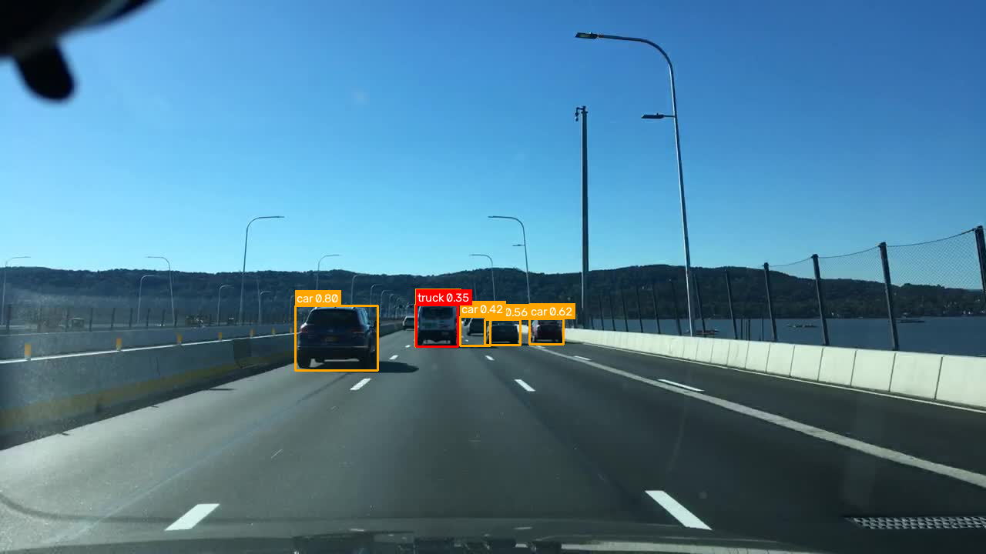
TASK 3
Vehicle Detection
YOLOv8n (nano) — pretrained on COCO, later fine-tuned on distorted driving images. Locates and classifies car / truck / bus / motorcycle / bicycle.
★ The only task with real BDD100K ground truth — unlike Tasks 1 & 2, which use pseudo-GT (clean-image output as reference).
Clean-image detection result
Robust Autonomous Driving Under Image Distortions
7

Slide 8
EVALUATION
One Headline Metric per Task
Chosen for actually telling a robustness story — monotonic with severity, not flat or noisy.
Task 1
Task 2
Task 3
survival_rate
match_ratio_vs_baseline
matched_recall
Lane line neither lost nor displaced >45px vs. clean-image reference
Match coverage relative to the clean-baseline's fixed keypoint budget
Fraction of real GT boxes found (class-aware IoU ≥ 0.5)
1.00
0.083
0.366
clean baseline
mean, 178 pairs
mean, 300 images, vs. real GT
Robust Autonomous Driving Under Image Distortions
8

Slide 9
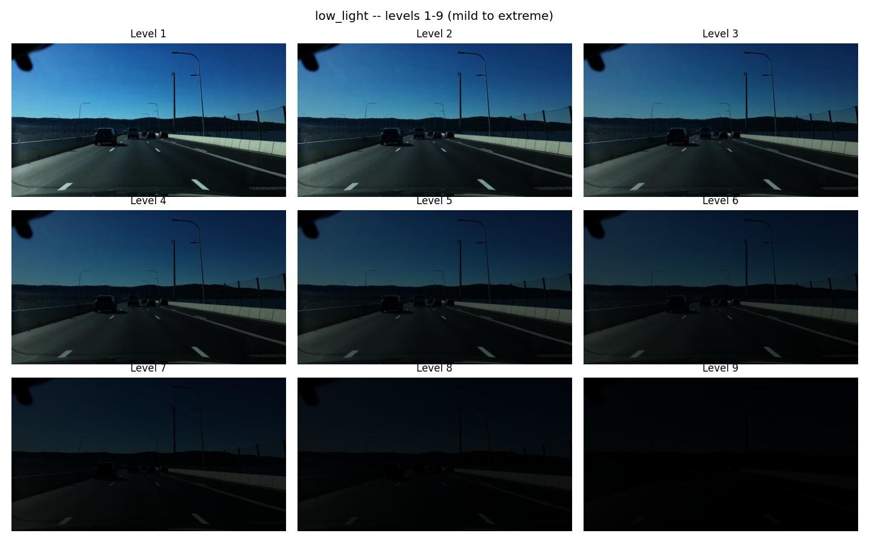
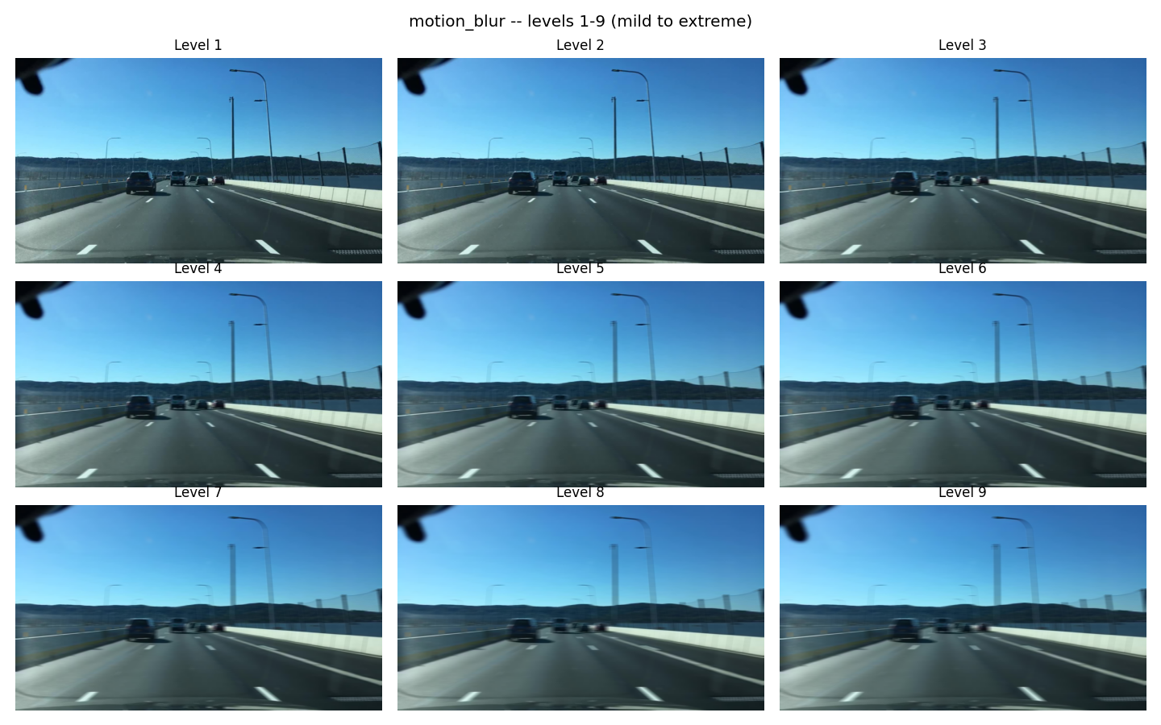
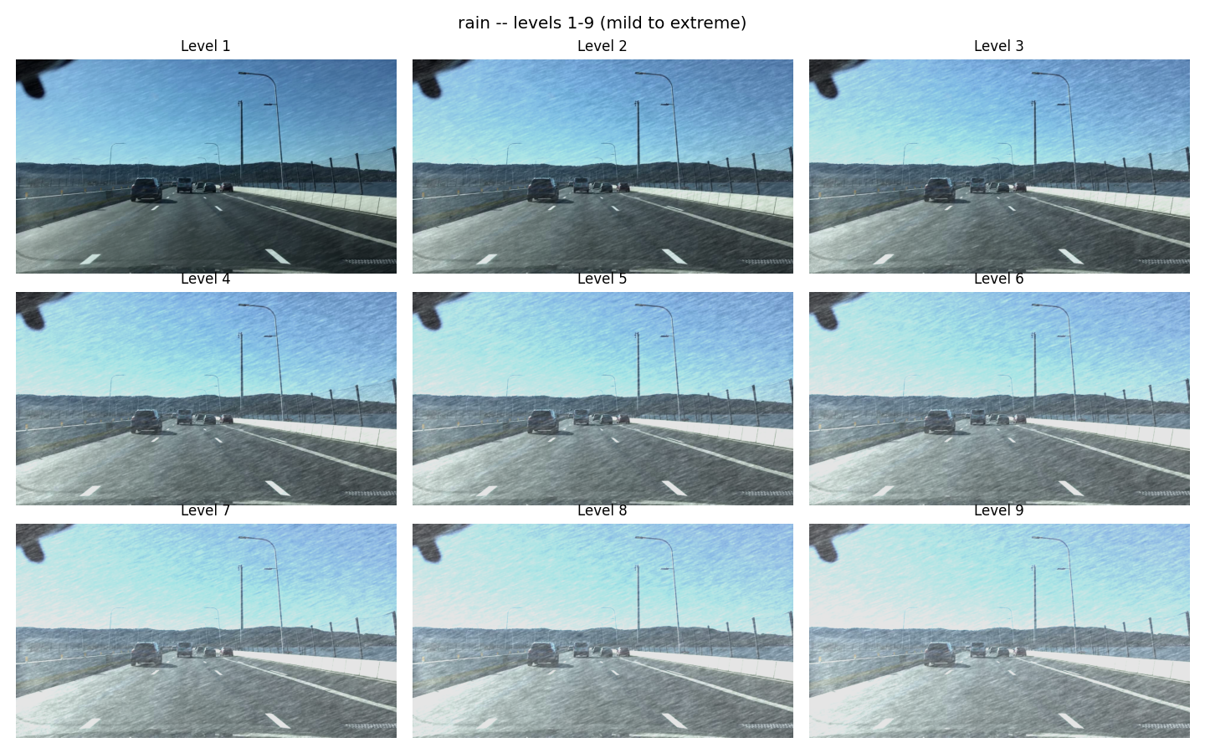
SIMULATED REAL-WORLD CONDITIONS
Three Distortions × Nine Severity Levels
Each swept mild → extreme, scored against achieved SNR (dB).
Low Light
Motion Blur
Rain
Dusk / night / tunnel driving — brightness + gamma darkening.
Camera/vehicle motion during exposure — linear blur kernel.
Rain-streak occlusion — adds clutter, keeps scene structure.
Robust Autonomous Driving Under Image Distortions
9

Slide 10
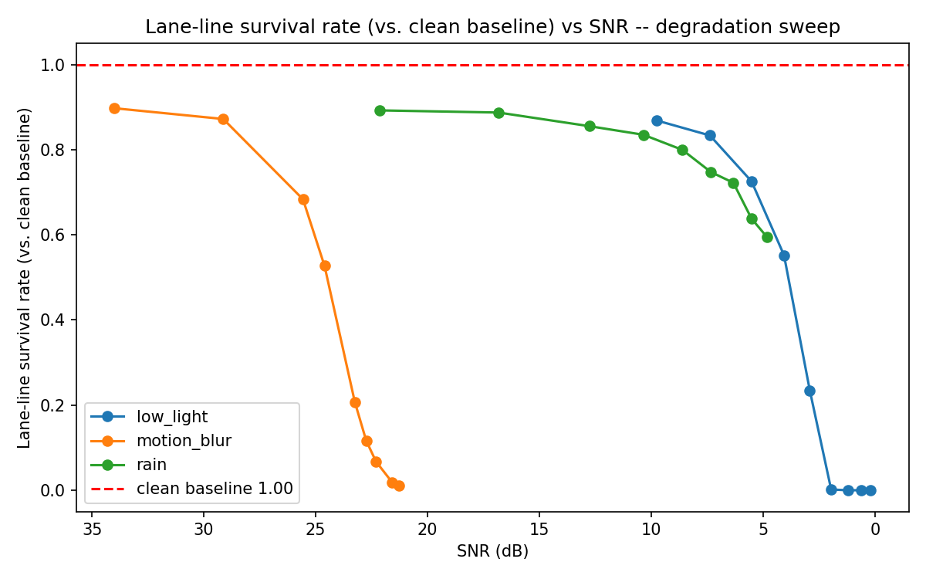
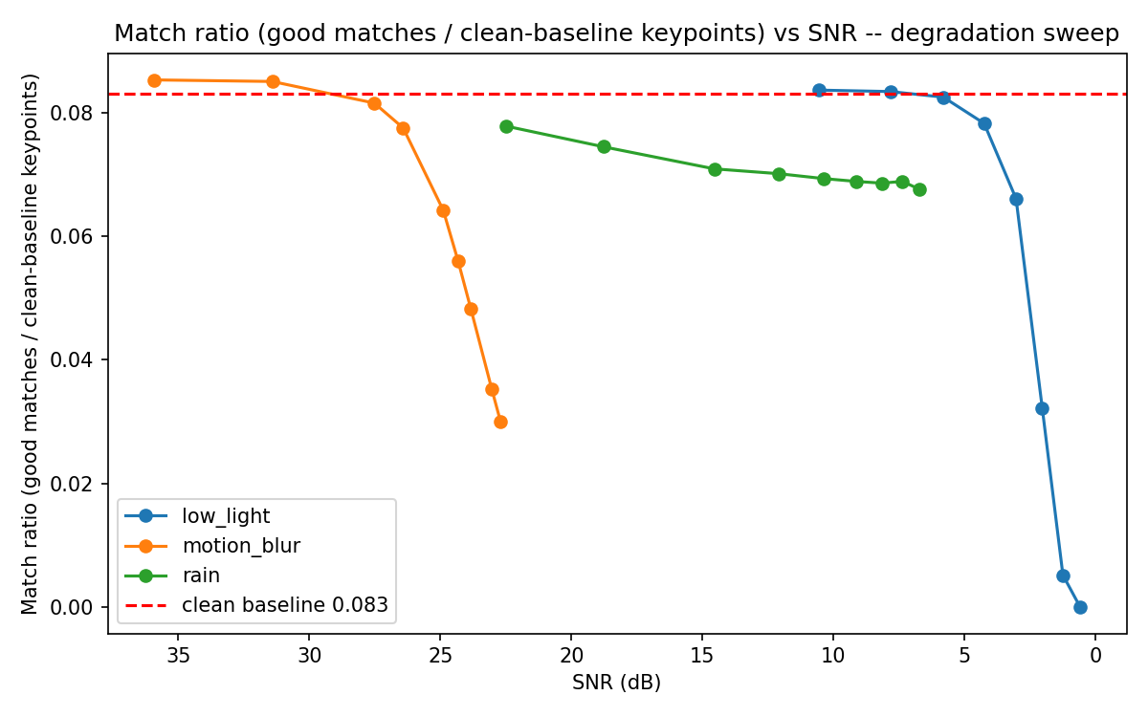
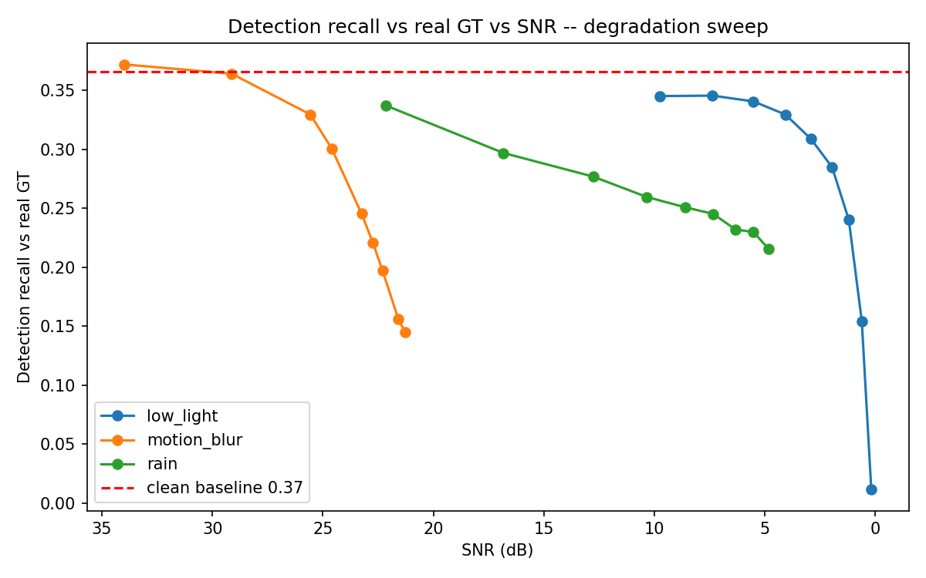
UNDER DISTORTION
Robustness Falls — At Different Rates
Metric vs. SNR for each task, all three distortions overlaid.
Task 1 — survival_rate
Task 2 — match_ratio_vs_baseline
Task 3 — matched_recall
Task 1: low_light/motion_blur collapse at extreme severity; rain degrades gently. Task 2: monotonic decline, sharpest for blur/darkness. Task 3: recall drops monotonically; low_light hurts most.
Robust Autonomous Driving Under Image Distortions
10

Slide 11
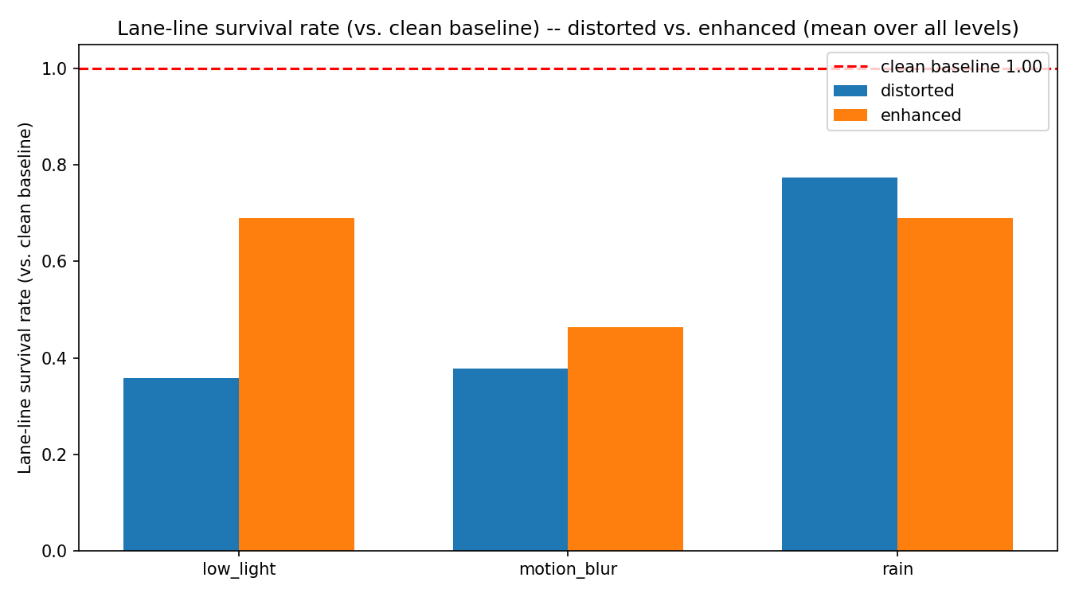
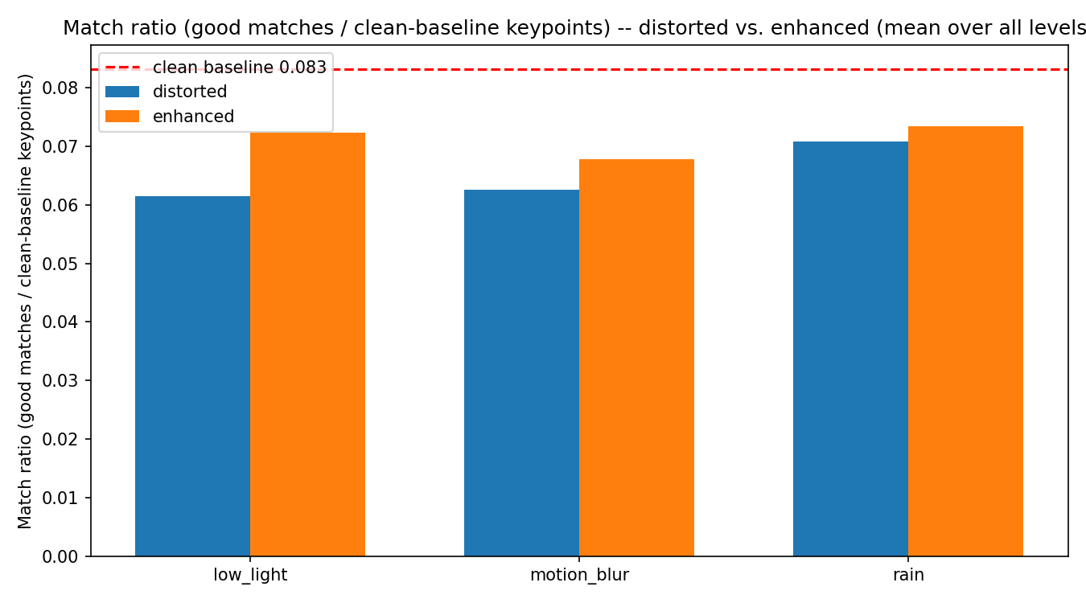
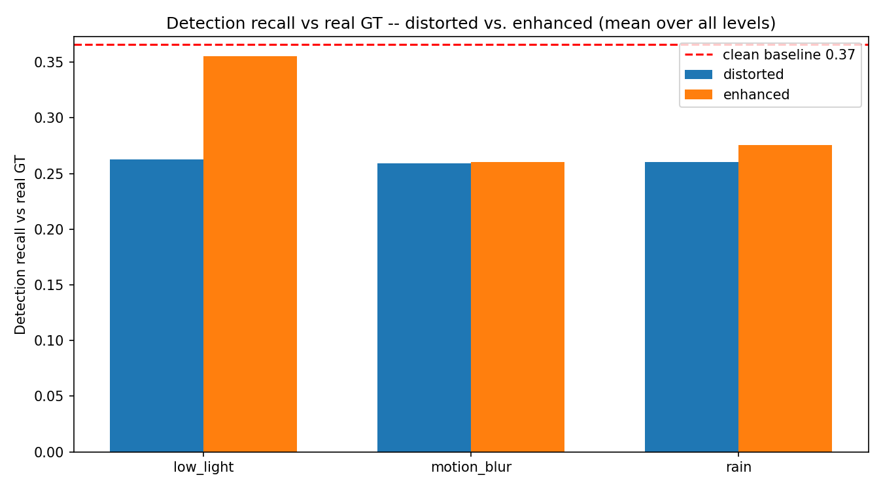
RECOVERY STRATEGY 1
Image Enhancement
Fixed pre-processing restoration, applied before re-running each method.
Low Light Gamma lift + CLAHE (LAB L-channel)
Motion Blur Unsharp masking
Rain Edge-preserving bilateral filter
Task 1 — clean vs. distorted vs. enhanced
Task 2 — clean vs. distorted vs. enhanced
Task 3 — clean vs. distorted vs. enhanced
Enhancement helps unevenly: Task 1's low_light/motion_blur improve but rain slightly worsens (de-rain filter smooths the thin edges Hough needs); Task 2 improves for motion_blur/rain; Task 3 improves for low_light/rain, flat for motion_blur.
Robust Autonomous Driving Under Image Distortions
11

Slide 12
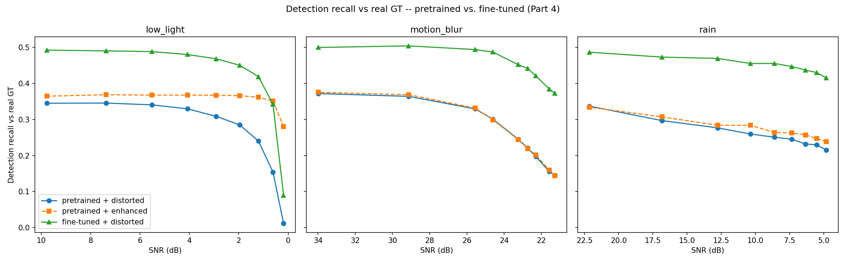
RECOVERY STRATEGY 2
Fine-Tuning YOLOv8n
Adapting the model's weights to the distorted domain, using real ground truth.
Mean recall across all 9 levels
distorted
enhanced
fine-tuned
low_light
0.262
0.355
0.414
motion_blur
0.259
0.261
0.451
rain
0.260
0.275
0.452
Fine-tuning wins on all 3 distortions — the gap over enhancement is largest exactly where enhancement helped least (motion_blur, rain).
Robust Autonomous Driving Under Image Distortions
12

Slide 13
TRANSPARENCY
Known Issues & Limitations
Pseudo-GT for Tasks 1 & 2
BDD100K's lane-marking and fine-grained-matching label releases weren't locally available; clean-image output serves as the reference instead of human-labeled GT.
Dataset pruning
Task 3 narrowed 675→300 images to match Task 1 and guarantee 100% real-GT coverage; this subset has zero motorcycle/bicycle instances. 105 source images were found corrupt and replaced before any results were produced.
CPU-only fine-tuning
15 epochs, 240 training images, one fixed severity/distortion each — a larger, more varied set and GPU training would likely improve results further.
SNR as a proxy
A uniform-noise measure that doesn't perfectly reflect perceptual severity for structured distortions like rain.
Robust Autonomous Driving Under Image Distortions
13

Slide 14
Key Takeaway
Enhancement recovers some performance;
fine-tuning recovers more.
Every task degrades under real-world distortion — the two recovery strategies are complementary, not interchangeable: enhancement is cheap and model-agnostic, fine-tuning adapts the model itself and wins when the domain shift is large.
Thank you

