Slide 1
Robot Tour
2024-25 CVHS Scioly

Slide 2
Agenda
Welcome and Introductions
Team goals
Overview of Robot tour
Timeline
Materials and Resources
Robot Design Discussion
Safety
Team Policies
Next steps and Assignments

Slide 3
Welcome!
Coaches
  Frank Deng
    https://www.linkedin.com/in/frankdeng/
    2nd year RT coach
  Bryce Deng
Team assignments

Slide 4
Welcome!
Green
  Dylan Kwan
  Jordan Tran
Blue
  Brandon Li
  Eden Teclemariam
Team assignments

Slide 5
Welcome!
Yellow
  Arin Yang
  Judah Chung
Purple
  Bryce Deng
  Tulasi Venkatesh
Team assignments

Slide 6
Team goals
Skills and knowledge
  Mechanical and Electronics
  Robotics engineering
  Software development
Innovation
  Apply theoretical knowledge in practical ways
Problem solving and troubleshooting
  Identify and fix issues in design, programming
  Iterative testing
Teamwork and project management
  Collaborative design
  Time management
Notes:
Consider talking about:
Box office
Critical response
Accolades

Slide 7
Robot tour Overview
https://www.soinc.org/robot-tour-c
Science_Olympiad_Div_C_Rules_2025_for_Web_Secured.pdf

Slide 8
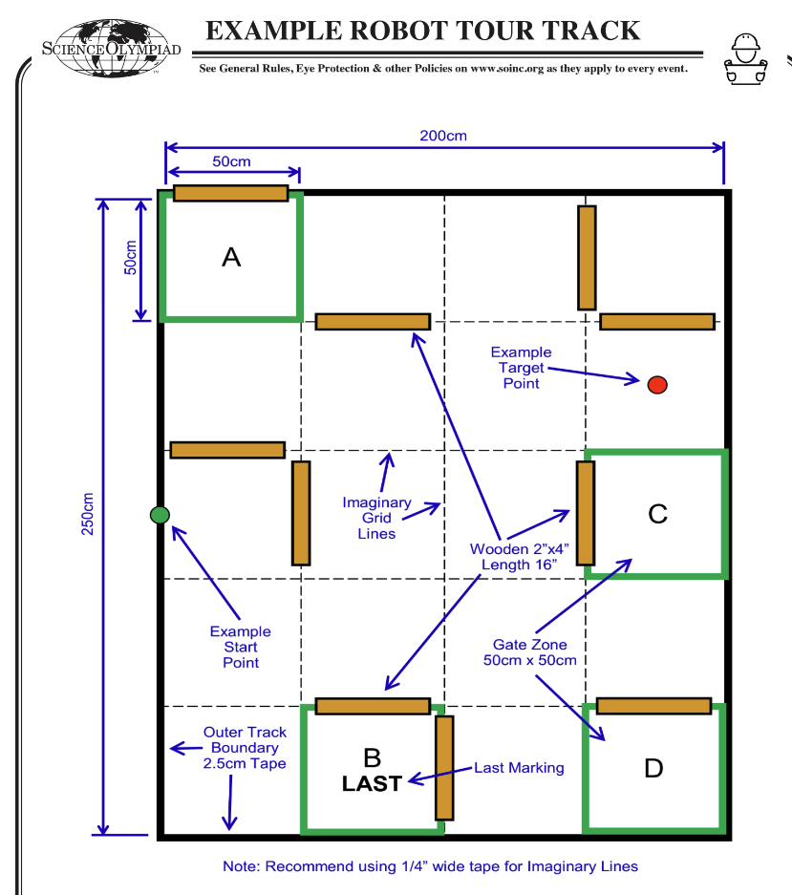
Robot tour Overview
https://www.soinc.org/robot-tour-c
Science_Olympiad_Div_C_Rules_2025_for_Web_Secured.pdf

Slide 9
Robot tour Overview
• Build an autonomous Robotic Vehicle to navigate a track
  Not Remote Controlled
  Event goals allow low cost robot kits to be competitive •
Powered by up to 6 AA or AAA batteries
Must completely fit in a 30cm by 30cm space of any height
•1/4” to 3/8” Dowel attached to front of Robotic Vehicle
Sensors
Alignment device
Build

Slide 10
Robot tour Overview
• Impound
  Track setup and target time released after impound
Setup Time: 10 min
  Install batteries
  Code and upload program
  May only be tested provided the robot is held
Track Time: 8 mins
  2 successful Runs or 3 failed runs
competition

Slide 11
Robot tour Overview
• Track Area: 200 x 250 cm
  4x5 = 20 imaginary square zones
Start point
Target point
Wooden obstacles – up to 10
Bonus gate zones
  Regional: 4, States: 5, nationals 6
  One gate zone is marked “last” (-15 pts vs -30 pts)
Target time: 55 – 85 seconds
Track

Slide 12
Robot tour Overview
• Lowest final score wins
Final score = Time score + Distance score + Gate bonus + Last gate bonus + Penalties
  Time score: 200
    Less than target time: (target time – run time) x 2
    Greater than target time: (run time – target time
  Gate zone bonus: -15 pts
  Last gate zone bonus: -30 pts
  Penalties
    Contact(obstacles): 70 pts
    No obstacles: 50 pts
    Stalling: 20 pts
    Competition violation: 150pts
    Construction violation: 300 pts
Scoring

Slide 13
Robot tour Overview
• Track Area: 200x200 vs 200 x 250 cm
Target time: 55-75 secs vs 55 – 85 seconds
Distance score, 1 pts/cm vs 2 pts/cm
One more gate zone marked as “last”
Enter gate zone, forward, backward, sideways
Clear definition of Stalling
Key changes and updates
Q & A

Slide 14
Timeline
Milestone
Sep – Nov
  Theoretical study
    Basic Mechanical principles
    Electronics and power system basics
    Arduino, ESP32
    Motor, sensors and control loop systems
  Activities
    Programing with Arduino, motors, sensors
Nov 2024 – Feb 2025
  Build
    Build your robot
    Build your program
  Activities
    Practice
    Competitions – Invitationals, Regionals
Notes:
Consider talking about:
Box office
Critical response
Accolades

Slide 15
Materials Resources
Event home page https://www.soinc.org/robot-tour-c
Forum https://scioly.org/forums/viewforum.php?f=454
FAQ https://www.soinc.org/faq/robot-tour-div-c
Science Olympiad community discord server – robot tour channel https://discord.gg/fPXJHnm9DE
Youtube – search “scioly robot tour”
Notes:
Consider talking about:
Home media

Slide 16
Safety
Electrical
  Batteries
  Circuit
  Motors
Tool usage
  Cutting
  Soldering
Storage
Notes:
Consider talking about:
Home media

Slide 17
Team polices
Rules
Meetings
Communication
  Discord RT channel
Notes:
Consider talking about:
Home media

Slide 18
Next steps Assignments
Wrap-up
Final question
Next meeting time and location
Action items
  Github account, create private repository
Notes:
Consider talking about:
Score

Slide 19
”Good Luck"
Robot tour
Notes:
Quotes by Robots:
"No."
"What?"
"Yes."
"For what?"
"Thanks."
"Oh!"
"Or..."
"But..."
"No"
"Come on!"

