Slide 1

Signal-to-Action Agent
An AI-native Enterprise Revenue Operating System
Built by Team VentureOS · Live demo: SMB Growth & Seller Action · v3
TRACK A · AGENTIC WORKFLOWS
Signals
Multi-Agent
NVIDIA-Ready
Decision Ledger
Human Approval
CEO-level thesis
Enterprises do not need another dashboard or chatbot. They need an accelerated, observable, governed operating system that moves safely from signal → decision → human-approved business outcome — now evolving toward voice-native.

Slide 2
Contents
The original application structure — evolved over two weeks into a working, deployed product.
01 · Team introduction
Deck intent
Why this team can execute a business-grade agentic workload.
This is version 3 of our original submission. The architecture is unchanged in spirit; the product has been built, deployed, and hardened — and is now evolving toward a voice-native Chief of Staff.
02 · AI use case
Product workflow, demo, dataset, evaluation, architecture, governance, and execution.
03 · NVIDIA workload & stack
Provider-abstracted today; NVIDIA NIM / Nemotron / NeMo / Triton-ready by configuration.
04 · Roadmap & mentor asks
Three horizons — current, hackathon (voice), and future — plus mentor asks.
PROOF OF EXECUTION · LIVE ON PRODUCTION
99 accounts
108 signals
6 AI agents
10 recommendations
10/10 evals passing
Live Vercel + Render

Slide 3
TEAM INTRODUCTION
SKILLSET / EXPERIENCE

Slide 4
Team introduction
Product strategy + engineering execution — two builders who shipped a deployed product in two weeks.
Amit Pandey · Product / AI Architecture
Saurabh Talreja · Engineering / Full-stack Build
Principal PM experience across enterprise platforms, agentic AI prototypes, customer signal systems, experimentation, governance, and AI product storytelling. Two-time global hackathon winner and top-builder recognition in India.
Engineering partner focused on implementation, frontend/backend integration, agent runtime wiring, API integration, testing, performance tuning, and demo readiness.
Agentic AI skills
What we shipped
NVIDIA readiness
Multi-agent workflow design
RAG/provenance patterns
Evaluation and governance
Business workflow automation
Deployed web app + API
FastAPI + Next.js, live
HubSpot CRM integration
Provider abstraction + BYOK
NeMo Agent Toolkit / NemoClaw
Nemotron / NIM endpoints
GPU-backed inference
Mentor-led optimization
Execution principle: business problem first · bounded autonomy · measurable workload · human approval before action

Slide 5
AI Use Case
From fragmented signals to one governed next-best action

Slide 6
AI use case: the Signal-to-Action workflow
One governed loop — from a raw customer signal to an explainable, human-approved business outcome, then back into learning.
1 · Signals
2 · Recommend
3 · Human Approval
4 · Execution
5 · Outcome
CRM, spend, engagement, support, usage
Ranked next-best action + confidence
Seller reviews evidence, approves or edits
Execution Center orchestrates the action
Meeting booked · risk reduced · pipeline
Executive Brief & Portfolio Pulse
Evidence Intelligence
Decision Ledger
Continuous Learning
What changed overnight, why it matters, and what to do — ranked across the entire book of accounts.
Every recommendation cites the underlying signals and notes — no unexplained scores, no black box.
Append-only record of evidence, confidence, caveats, approval, and the outcome that followed.
Captured outcomes return as fresh signals — the loop compounds and the system gets sharper over time.

Slide 7
Project motivation: why this matters
TRACK | A
Enterprises need an action layer, not another passive dashboard or generic chatbot.
Growth teams often start Monday with thousands of accounts and scattered signals. The hard part is not seeing data — it is deciding where to act, why to act, and how to act safely.
Current pain
Why agentic AI
Why sovereign
Customer context sits across CRM, spend, engagement, product usage, campaign response, support risk, and follow-up history. Human teams spend time stitching context before acting.
A controlled agent workflow can assign reasoning tasks to specialized agents, compare evidence, generate action options, and explain every recommendation.
Enterprise teams need data boundaries, traceability, audit logs, confidence, and human approval before AI-generated recommendations become business action.
Now shipped
Over two weeks we turned this thesis into a working Enterprise Revenue Operating System — deployed, governed, and now evolving toward voice. Everything that follows is built, not hypothetical.
Notes:
Teams are recommended to be as much descriptive as possible and highlight the methodology clearly.
Teams are recommended to expand on this topic and use as many slides as you prefer.

Slide 8
Demo scenario: SMB Growth & Seller Action
TRACK | A
A concrete enterprise workflow that reviewers can understand in five minutes.
1
2
3
4
5
Morning brief
Portfolio Pulse
Open account
Approve
Execute & capture
Seller opens Signal-to-Action; the Executive Attention Brief shows what changed overnight.
Portfolio Pulse highlights the accounts that moved and why they matter right now.
The Workspace opens the top account; Evidence Intelligence explains the why behind the score.
Recommendation reviewed; the seller approves, edits, or rejects with full evidence in view.
Revenue Execution Center orchestrates the action; outcome captured; Decision Ledger updated.
In the live demo
Live on production: 99 accounts, 108 signals, 6 agents, and 10 ranked recommendations.
Every recommendation carries evidence, confidence, caveats, and a hard human-approval gate.
Signal → brief → recommendation → approval → execution → outcome → ledger, end to end.
Notes:
Teams are recommended to be as much descriptive as possible and highlight the methodology clearly.
Teams are recommended to expand on this topic and use as many slides as you prefer.

Slide 9
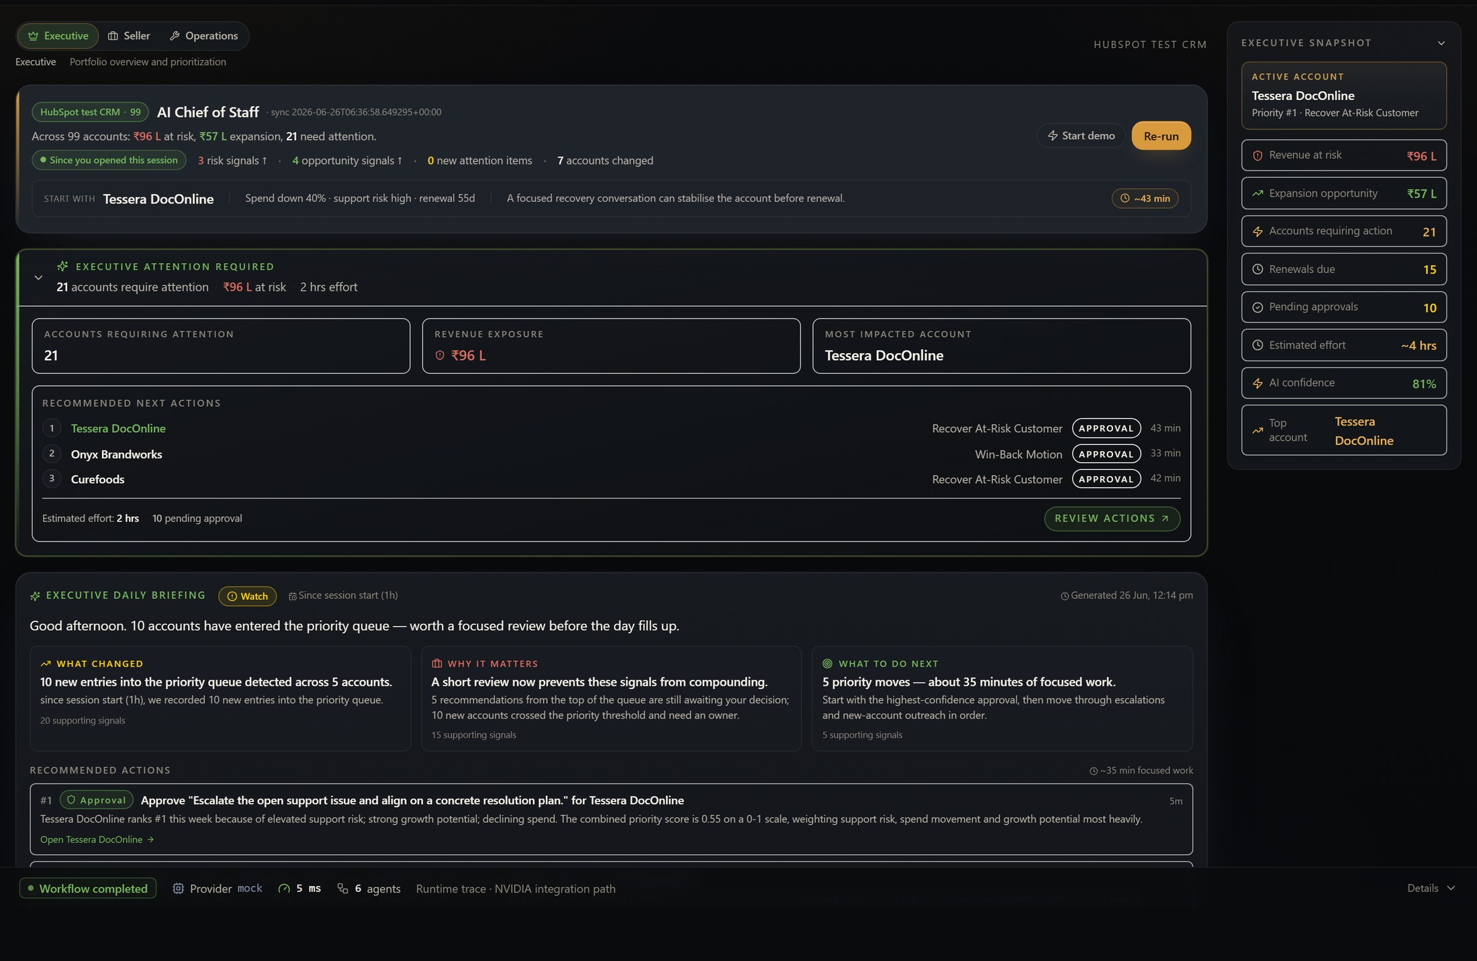
The executive morning brief — live
EXECUTIVE COMMAND CENTER · ON PRODUCTION TODAY
Executive Attention Brief
What changed overnight, why it matters, and what to do — ranked across all 99 accounts.
Portfolio Pulse
₹96L at risk and ₹57L expansion surfaced in a single executive snapshot.
Human approval gate
Every next action carries a confidence score and waits for explicit seller approval.
● LIVE ON PRODUCTION

Slide 10
Dataset for training and inferencing
TRACK | A
Synthetic-by-default plus a HubSpot test CRM — safe, portable, and sovereign by design.
Live dataset
Current scale
License and safety
Synthetic SMB accounts plus a connected HubSpot test CRM: account profile, spend trend, engagement, support, product usage, campaign response, segment, and follow-up history.
99 accounts · 108 signals · 6 agents · 10 ranked recommendations live on production — with synthetic generators for larger stress tests.
No customer-confidential or employer data. Synthetic-by-default; the HubSpot link is a test portal. Safe to share and fully portable.
Inference & provider plan
Model strategy
Why not fine-tune initially
Inference-only with provider abstraction: deterministic mock today, NVIDIA NIM / Nemotron when access lands. No fine-tuning required for the workflow.
The product proves agent workflow quality — routing, reasoning, structured outputs, evidence validation, latency, and human approval. Fine-tuning is a later optimization, not a dependency.
Notes:
Teams are recommended to be as much descriptive as possible and highlight the methodology clearly.
Teams are recommended to expand on this topic and use as many slides as you prefer.

Slide 11
Evaluation: results and how we measure
TRACK | A
Transparent by design: automated evals run green, and every decision is reviewable end to end.
Current status
What we measure
Evaluation signals
Built, deployed, and hardened. Architecture, data schema, demo flow, and an automated evaluation harness all run today — live on Vercel + Render.
Schema validity, evidence presence, confidence range, governance caveats, default-pending approval, and latency budget — 10 automated checks, currently 10/10 passing.
Agent trace quality, hallucination checks, evidence sufficiency, confidence calibration, default-pending approval, and time-to-action.
What the system proves today
Every recommendation cites multiple relevant signals from the live dataset.
Every recommended action includes evidence, confidence, caveats, and an explicit human-approval step.
Sub-second to low-second end-to-end workflow for a full account-prioritization query.
Visible agent execution, decision ledger, and provider abstraction — NVIDIA-ready when access lands.
Notes:
Teams are recommended to be as much descriptive as possible and highlight the methodology clearly.
Teams are recommended to expand on this topic and use as many slides as you prefer.

Slide 12
Tech Stack
The production stack behind a deployed product

Slide 13
Technology stack: what the product runs on
A shipped full-stack system: typed agents, provider abstraction, governed actions — deployed to production.
Frontend
Backend
Model & data layer
Next.js + TypeScript + Tailwind. Executive Command Center, Workspace, Evidence Intelligence, Decision Ledger, and adaptive experience modes — live on Vercel.
Python FastAPI + Pydantic schemas, multi-agent orchestrator, deterministic scoring, SQLite decision ledger, HubSpot connector — deployed on Render.
ModelAdapter provider abstraction (mock today, NVIDIA NIM / Nemotron ready), BYOK session-only keys, and synthetic + HubSpot test-CRM data sources.
Operating model
Amit drives problem framing, architecture, agent contracts, evaluation, and demo story. Saurabh drives app implementation, backend integration, model/API wiring, testing, and deployment readiness.

Slide 14
NVIDIA SDKs, tools, and inference strategy
Provider abstraction ships today; NVIDIA-native runtime plugs into the same typed contract — Current, Hackathon, and Future cleanly separated.
NVIDIA API / NIM
Nemotron
NeMo Agent Toolkit
NemoClaw
GPU Compute
Hackathon: hosted endpoints
Hackathon: reasoning + drafts
Future: agent orchestration
Future: long-running agents
Future: latency optimization
Current (today)
Hackathon build
Future
Visible proof in demo
Provider abstraction + BYOK already route to any model. The deterministic engine is the benchmark and fallback; the NVIDIA adapter stub is in place.
Swap NVIDIA NIM endpoints + Nemotron into the existing adapter for live reasoning and seller drafts — no architecture change required.
NeMo Agent Toolkit orchestration, NemoClaw long-running agents, Triton + GPU optimization, and agent evaluation at scale.
Agent traces, model calls, structured outputs, latency timings, decision ledger, and the human-approval path — all already in the product.

Slide 15
Development and deployment approach
What we did differently: an enterprise-grade workflow around typed agents, observability, and human approval — not a generic chatbot wrapper.
1. Define contracts
2. Build dataset service
3. Provider abstraction
Each agent has role, inputs, tools, output schema, allowed data, confidence logic, and escalation conditions.
Synthetic SMB accounts plus a HubSpot test-CRM connector — spend, support, product usage, campaign, and engagement signals with edge cases.
ModelAdapter routes to any provider; the deterministic engine is the benchmark; NVIDIA NIM / Nemotron plug in through the same typed contract.
4. Add action layer
5. Add governance
6. Deploy and evaluate
Rank accounts, explain why, recommend next actions, generate seller-ready call scripts and email drafts, then orchestrate execution.
Decision ledger with evidence, caveats, confidence, source trace, and approval before action.
Deployed to Vercel + Render with latency profiling, automated evals (10/10), evidence checks, and reviewer-visible agent traces.
Architecture in production: provider-agnostic agent runtime · deployed web app · inference-first · human-in-the-loop by design

Slide 16
One governed runtime: six typed agents, NVIDIA-ready, voice-ready
A typed or spoken signal enters one runtime. Six agents reason, governance gates every action, and the ledger records it.
Seller
typed or spoken
Interaction Layer
Typed today · Voice (Gnani.ai SALM) planned
Executive Command Center
one governed entry point
NVIDIA-READY RUNTIME
● Nemotron
reasoning · hackathon
● NVIDIA NIM
inference endpoints · hackathon
● NeMo Agent Toolkit
orchestration · future
● NemoClaw
long-running agents · future
● Triton
GPU optimization · future
● Gnani.ai SALM
voice interaction · planned
Provider abstraction routes to any model — mock today, NVIDIA the moment access lands.
Signal-to-Action Orchestrator
controlled, auditable agent sequence · typed contracts · NVIDIA-ready runtime
MULTI-AGENT RUNTIME · SIX TYPED AGENTS · STRUCTURED OUTPUTS
Signal Ingestion
normalize signals
Account Health
detect risk
Opportunity
growth upside
Governance
evidence · confidence
Action
next-best action
Communication
seller-ready drafts
Governance Engine · evidence · confidence · human-approval gate
no action is executed without explicit human approval
Revenue Execution Center
governed execution
Business Outcomes
measured · attributed
Continuous Learning
outcomes return as signals
Decision Ledger — append-only: evidence · confidence · caveats · approval · outcome (underpins every step)

Slide 17
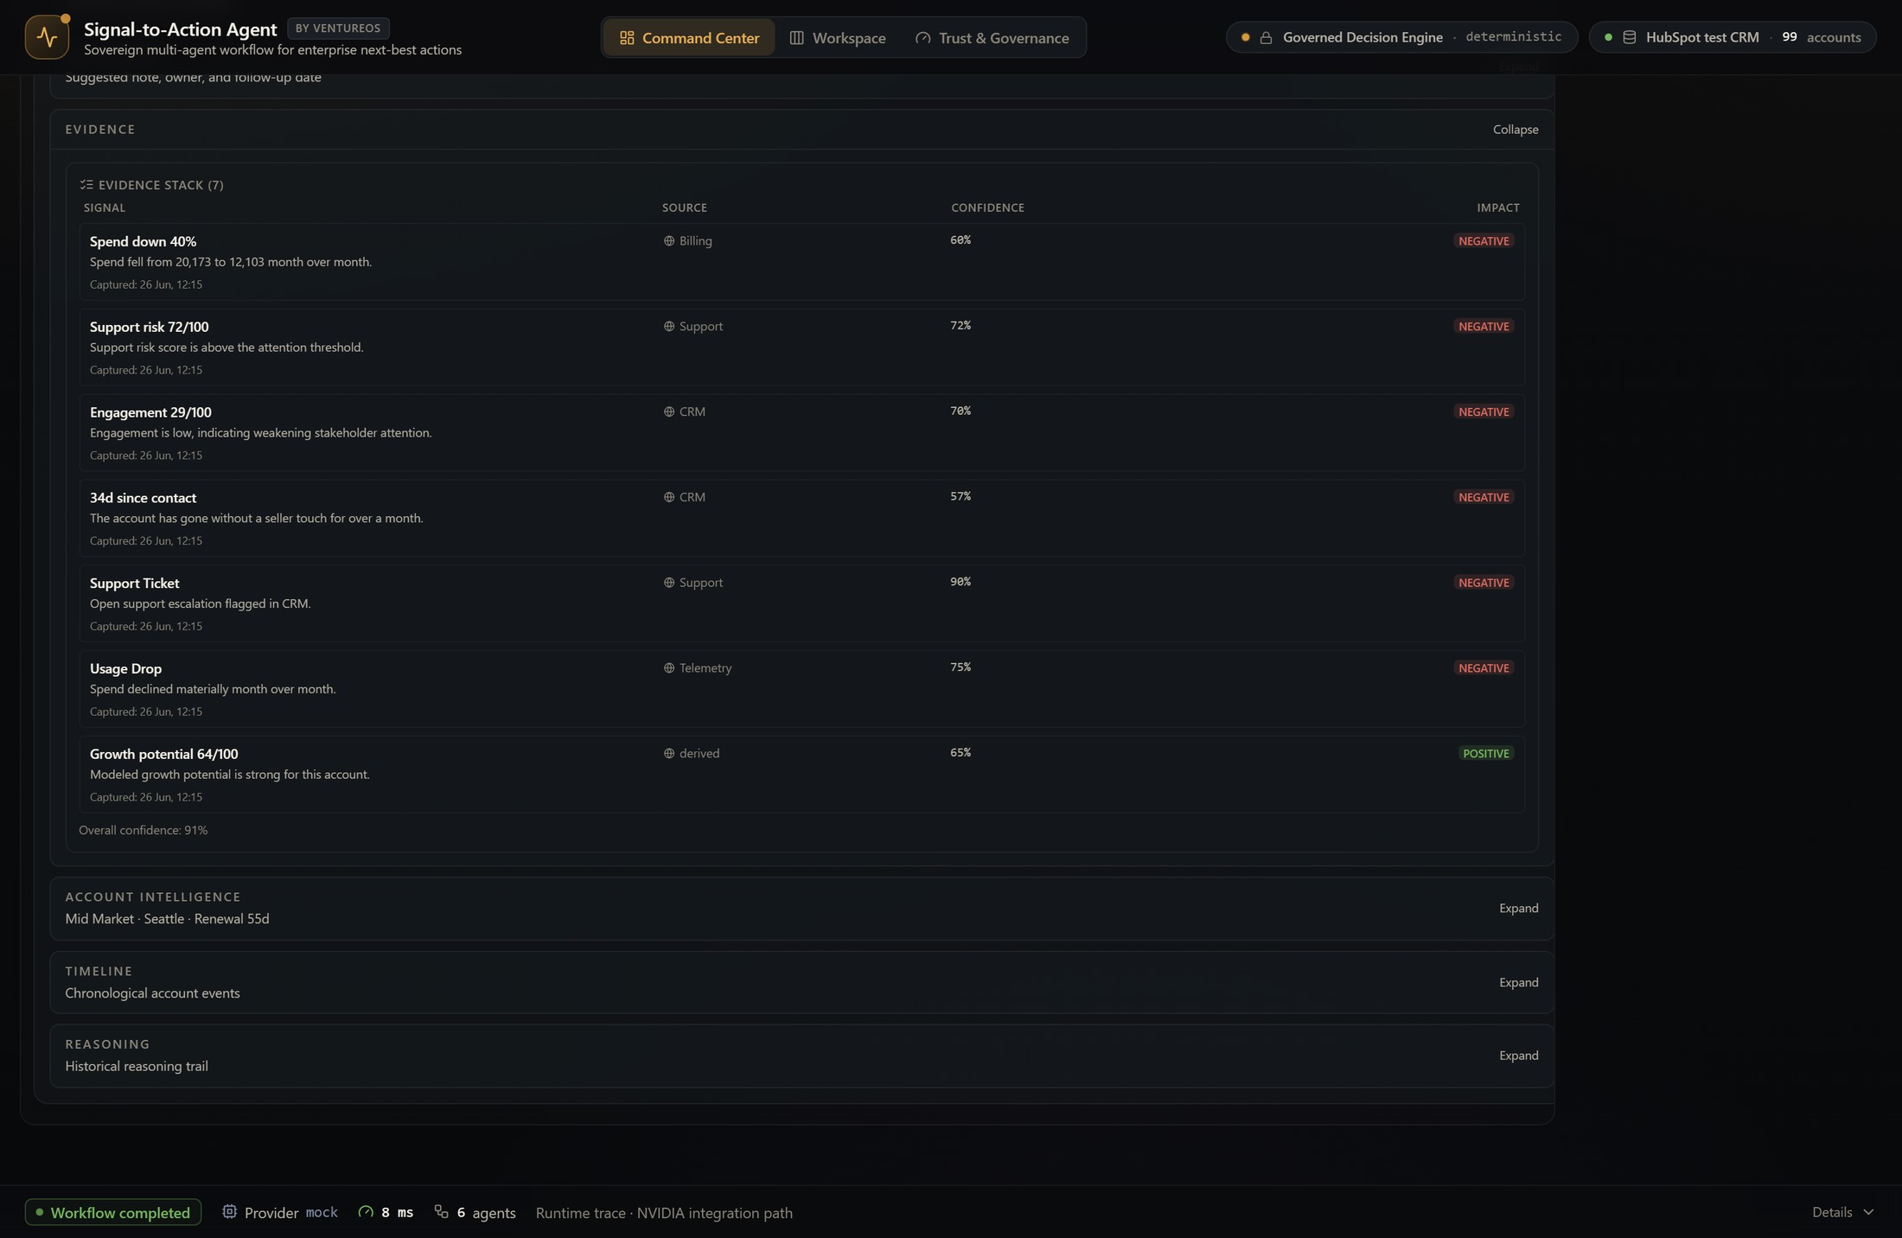
Every recommendation, fully explained
EVIDENCE INTELLIGENCE · NO BLACK BOX
Traceable evidence stack
Each score links to source signals across billing, support, CRM and telemetry.
Confidence + impact
Every signal is scored and tagged positive or negative — no unexplained numbers.
91% overall confidence
Recommendations cite their evidence so reviewers can trust the reasoning.
● 7 SIGNALS · 5 SYSTEMS

Slide 18
Governance: AI explains, humans decide
TRACK | A
Accountability is a feature, not an afterthought — the same governance whether input is typed or spoken.
Every recommendation is evidence-backed, confidence-scored, and gated by a human. No action reaches a customer without explicit approval.
AI boundary
Human approval gate
Decision Ledger
Agents rank, explain, and draft. They never finalize priority or execute on their own — the model cannot write the decision.
A seller reviews evidence, confidence, and caveats, then approves, edits, or rejects. Approval is a hard contract, not a suggestion.
Append-only single source of truth: query, agents invoked, evidence used, confidence, caveats, approval, and the outcome.
Data & key posture
Synthetic-by-default data; no real customer records. BYOK keys live in session storage only — never persisted, logged, returned, or deployed — with a deterministic fallback always available.

Slide 19
Revenue Execution Center
TRACK | A
The execution layer that turns an approved decision into a measured business result.
1
2
3
4
5
Execution Agent
Customer Response
Outcome
Ledger Updated
Business Outcome
Orchestrates the approved action — outreach, scheduling, follow-up — as a guided, event-driven flow.
The account responds: meeting accepted, reply received, or no-response captured.
The result is recorded against the recommendation — win, partial, or escalation needed.
Execution events stream into the Decision Ledger, Lifecycle ribbon, and Timeline automatically.
Stated in business terms: meeting booked, renewal risk reduced, opportunity created, customer engaged.
Business outcomes, not workflow steps
Auto-advance or manual control — the seller watches an orchestrated flow, not a wizard to push through.
Every execution event is governed and logged; nothing writes back to the live CRM in demo mode.
Closes the operating loop: signal → recommendation → approval → execution → outcome → ledger.

Slide 20
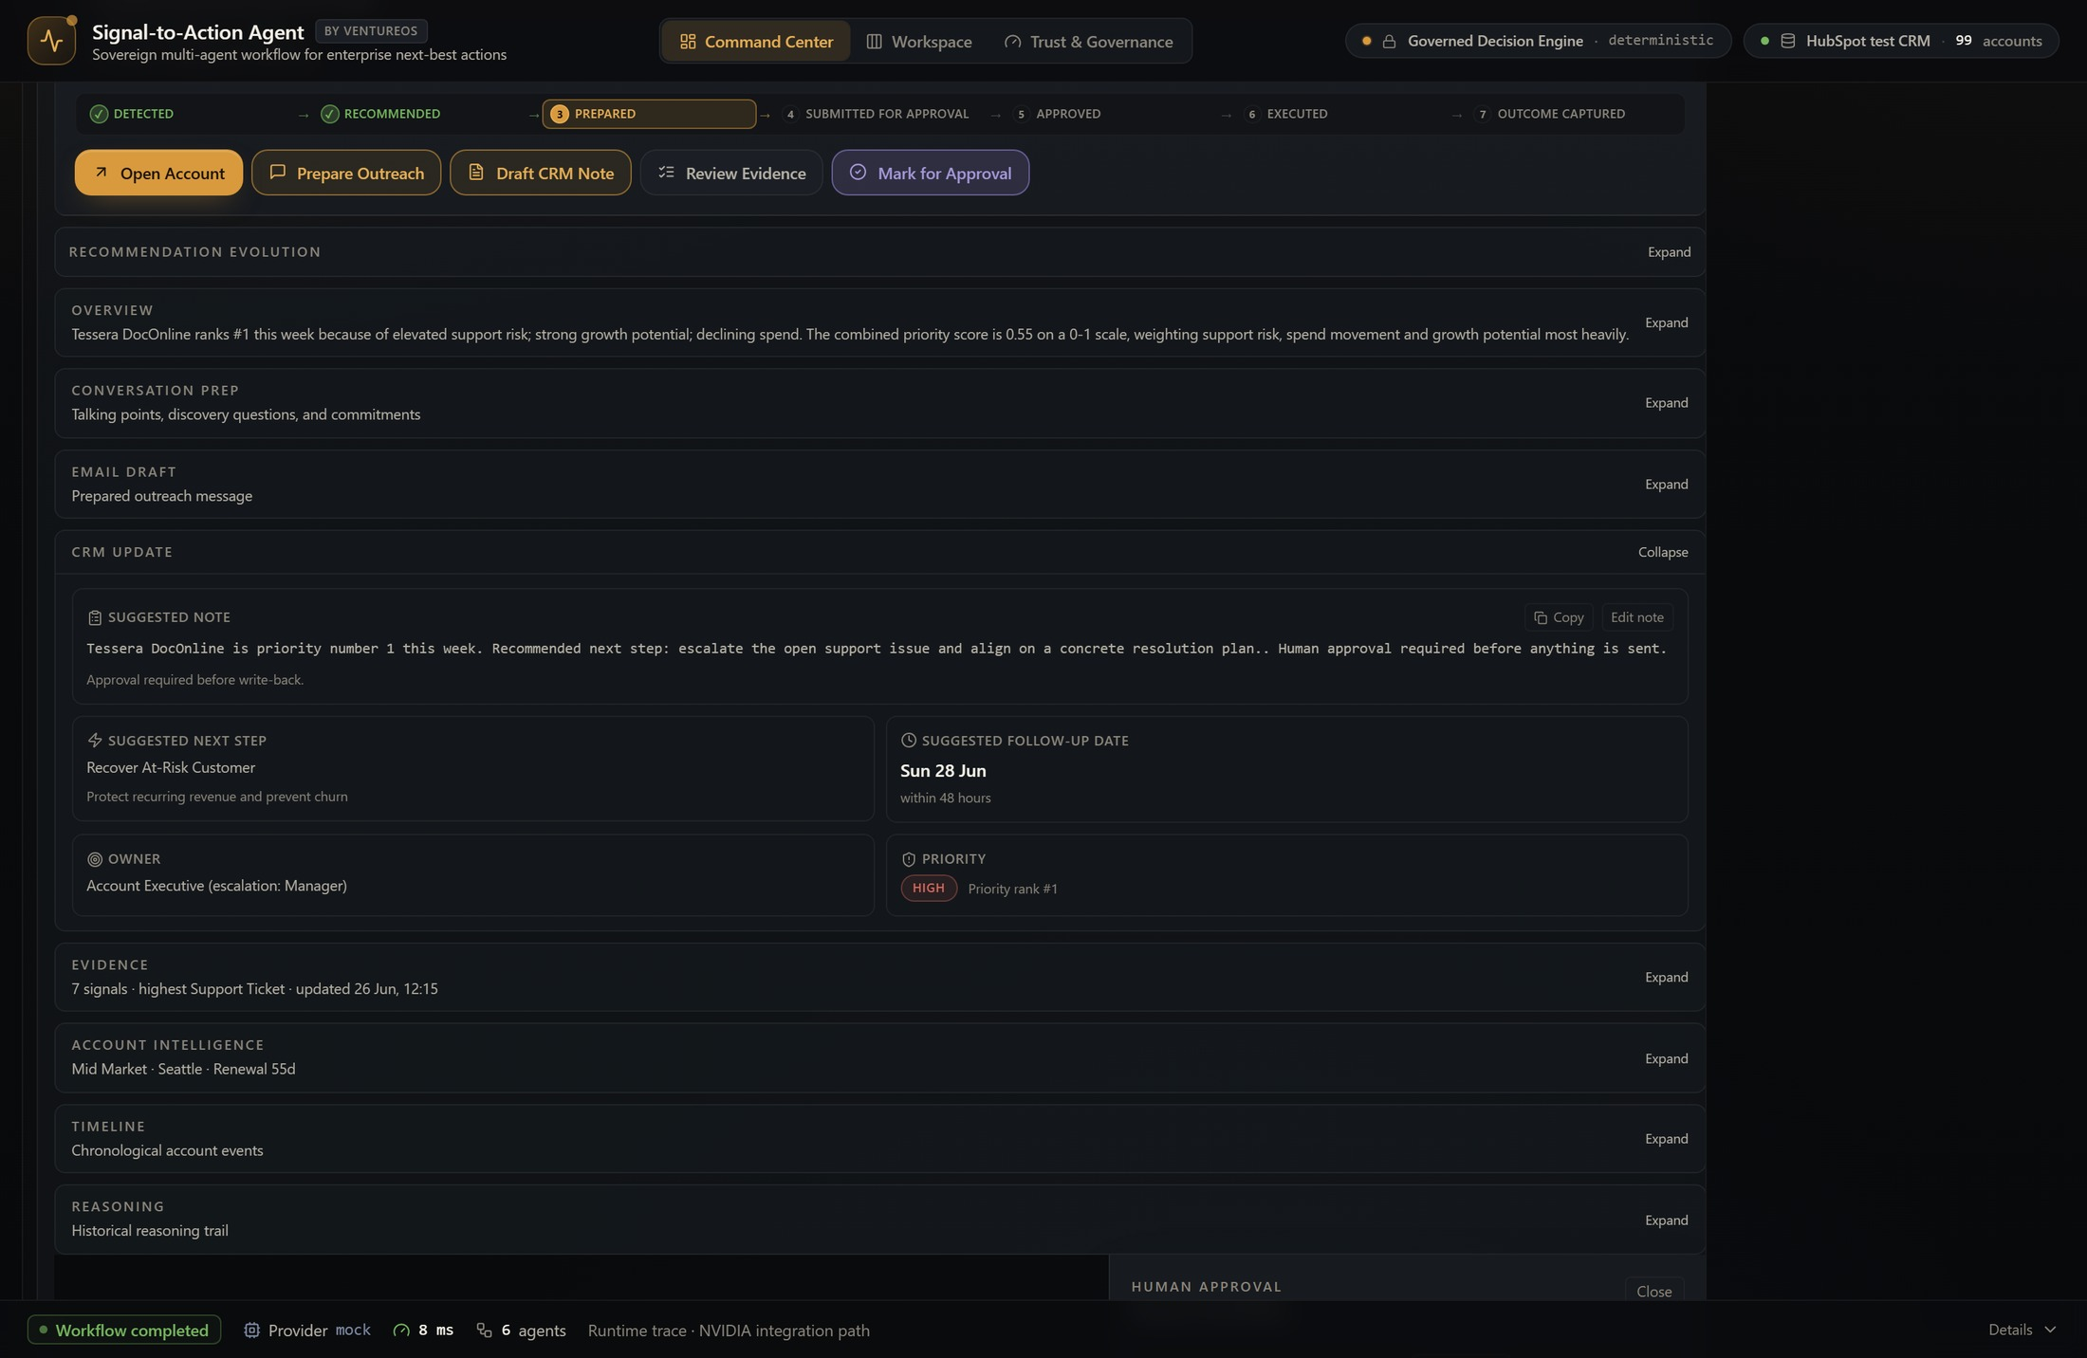
Approved decisions become measured outcomes
REVENUE EXECUTION CENTER · GOVERNED EXECUTION
Governed approval
Approve, reject or request review — each action carries a governance caveat.
Business outcomes captured
Meeting booked, renewal risk reduced or opportunity created — tagged to the ledger.
No silent CRM writeback
Approved actions stage for the connector pipeline; nothing auto-writes in demo mode.
● APPROVAL → OUTCOME → LEDGER

Slide 21
The Voice Chief of Staff (planned hackathon)
Voice becomes another enterprise interaction channel — not another AI model. The governed core stays unchanged.
Seller speaks
Gnani.ai · STT
Governed core
Gnani.ai · TTS
Voice answer
Natural spoken request
Speech-to-text · SALM
Same agents · evidence · approval
Text-to-speech response
Spoken brief & next steps
Planned hackathon implementation
Enterprise speech
Indian languages + code-switching
Product evolution
Gnani.ai is our planned speech layer for the hackathon build — not yet implemented. The architecture is voice-ready today.
Low-latency, telephony-optimized recognition built for noisy, real-world enterprise conditions.
Multilingual support with English / regional code-switching for Indian enterprise revenue teams.
Revenue OS → Enterprise AI Chief of Staff → voice-native Revenue OS. Voice is an interaction layer, not a new brain.

Slide 22
Business value: the executive case
Every capability maps to a number a revenue leader already owns — this reads like a CIO business case.
Revenue at risk
Revenue saved
Pipeline protected
Surface at-risk renewals and declining accounts early, while there is still time to intervene.
Recovery plans on flagged accounts protect renewals that would otherwise churn silently.
Expansion and cross-sell signals are caught and acted on, not missed in a crowded book.
Seller productivity
Decision cycle time
Governed & explainable
Minutes, not days: brief, evidence, and draft are prepared so sellers act instead of stitching context.
Signal to approved action in one governed loop, compressing the time from insight to outcome.
Every decision is evidence-backed, confidence-scored, human-approved, and auditable in the ledger.
The moat — why this is hard to copy. A governed decision ledger, a provider-neutral runtime, full auditability, and a voice-ready core.
Competitors can bolt on a chatbot — they cannot retrofit governed, explainable, accountable execution.

Slide 23
Potential bottlenecks and mitigation plan
The main risk is not building “more agents”; it is building a reliable, explainable workflow that stays fast and reviewable.
Bottleneck 1: NVIDIA access path
Bottleneck 2: orchestration noise
Bottleneck 3: latency
Mitigation: provider abstraction already runs on a deterministic engine; NVIDIA NIM / Nemotron plug in via the same adapter when access lands — zero rework.
Mitigation: bounded agents, typed outputs, fixed workflow graph, validation checks, and no open-ended autonomous execution.
Mitigation: parallelize independent agents, cache summaries, reduce unnecessary model calls, and profile each step.
Bottleneck 4: data realism
Bottleneck 5: trust quality
Bottleneck 6: scope control
Mitigation: synthetic accounts with missing fields, conflicting signals, stale notes, noisy engagement, and realistic prioritization conflicts.
Mitigation: evidence-first recommendation format, confidence scoring, caveats, human approval, and rejection/edit capture.
Mitigation: one sharp workflow: rank accounts → explain why → recommend action → draft message → approval ledger.

Slide 24
Road Map
Three horizons: shipped, hackathon, and vision

Slide 25
Roadmap: three horizons + execution plan
Where the product is today, what we build at the hackathon, and where it goes next — one continuous arc.
Where we want NVIDIA / OpenACC mentor support
Current — shipped today
Hackathon — voice
Future — vision
NVIDIA acceleration
Executive Command Center, Portfolio Intelligence, Revenue Execution Center, Governance, and Decision Ledger.
Voice Chief of Staff with Gnani.ai: voice conversations, multilingual support, and spoken portfolio reviews over the governed core.
Digital executive avatar, live meeting coach, and an enterprise multimodal workspace.
NIM + Nemotron reasoning, NeMo orchestration, and Triton + GPU optimization plug into every horizon through the provider layer.
Execution roadmap
1
Jun 19
2
Jun 26–27
3
Jul 1
4
Jul 16
5
Jul 24–25
Application + MVP built
Deployed to production
Revenue Execution + Ledger shipped
Hackathon: Voice CoS + NVIDIA runtime
Final: optimized voice demo + metrics
Final demo target: “Which accounts need attention this week?” → ranked actions with evidence, confidence, voice summary, approval controls,
and visible NVIDIA model/runtime calls.
Notes:
Teams are recommended to be as much descriptive as possible.
Teams are recommended to expand on this topic and use as many slides as you prefer.

Slide 26
Mentor ask: where NVIDIA guidance accelerates us
A deployed product today, with a credible path to a reusable VentureOS action-layer workflow later.
Where we want NVIDIA mentorship
1. NeMo + Nemotron
2. NIM + Triton deployment
3. Voice pipeline + SALM
NeMo Agent Toolkit orchestration patterns and Nemotron tuning for reasoning, ranking, and structured action generation.
NIM endpoint deployment and Triton optimization for low-latency, GPU-backed inference across the agent workflow.
Speech pipeline optimization and SALM integration guidance for the planned Gnani.ai voice layer — low-latency, multilingual, enterprise voice.
Key limitations and how we will improve them
Limitation
Improvement plan
Synthetic data only
Synthetic-by-default plus a HubSpot test CRM today; connect permitted enterprise sources later with privacy and access controls.
Provider abstraction
Deterministic engine is the benchmark; NVIDIA NIM / Nemotron and BYOK providers plug in through the same typed contract.
Agent reliability risk
Use typed outputs, bounded steps, explicit fallback logic, confidence thresholds, and human approval before any action.
Latency and cost
Parallelize independent agents, cache account summaries, profile NIM calls, and use mentor support for GPU-backed optimization.
Long-term ambition: make agentic AI accountable enough for enterprise action — accelerated by NVIDIA, governed by design, approved by humans.
Notes:
Teams are recommended to be as much descriptive as possible.
Teams are recommended to expand on this topic and use as many slides as you prefer.

Slide 27
From systems of record to systems of reasoning
Where AI reasons, humans govern, and every recommendation becomes an accountable business outcome.
Clear real-world use case
Strong Track A fit
NVIDIA-centered build
Enterprise teams struggle to convert fragmented signals into timely, explainable action. Signal-to-Action is deployed and demo-ready today.
The solution is a controlled multi-agent workflow, not a generic chatbot. It has orchestration, specialized agents, tool routing, traces, and approval.
Provider abstraction makes NVIDIA NIM / Nemotron a drop-in runtime; optimization and evaluation are first-class goals.
We believe enterprise software is evolving from systems of record to systems of reasoning. Signal-to-Action Agent is our first step toward an Enterprise AI Chief of Staff — a governed, explainable, voice-native operating system that helps every revenue team move confidently from signal to business outcome.
Systems of Record
Systems of Engagement
Systems of Intelligence
Systems of Reasoning
Notes:
Teams are recommended to be as much descriptive as possible.
Teams are recommended to expand on this topic and use as many slides as you prefer.

Slide 28
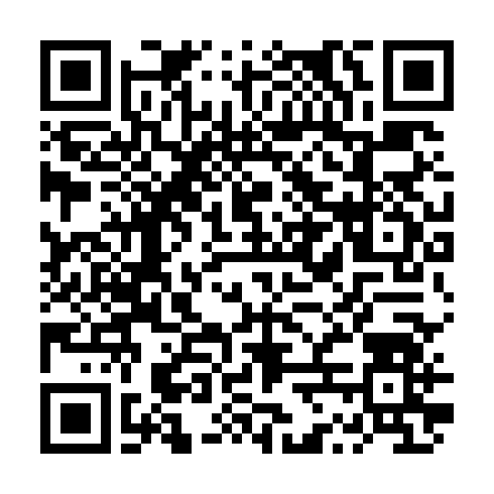
Need Help? Contact Us!!
Join the Slack Workspace here

Slide 29
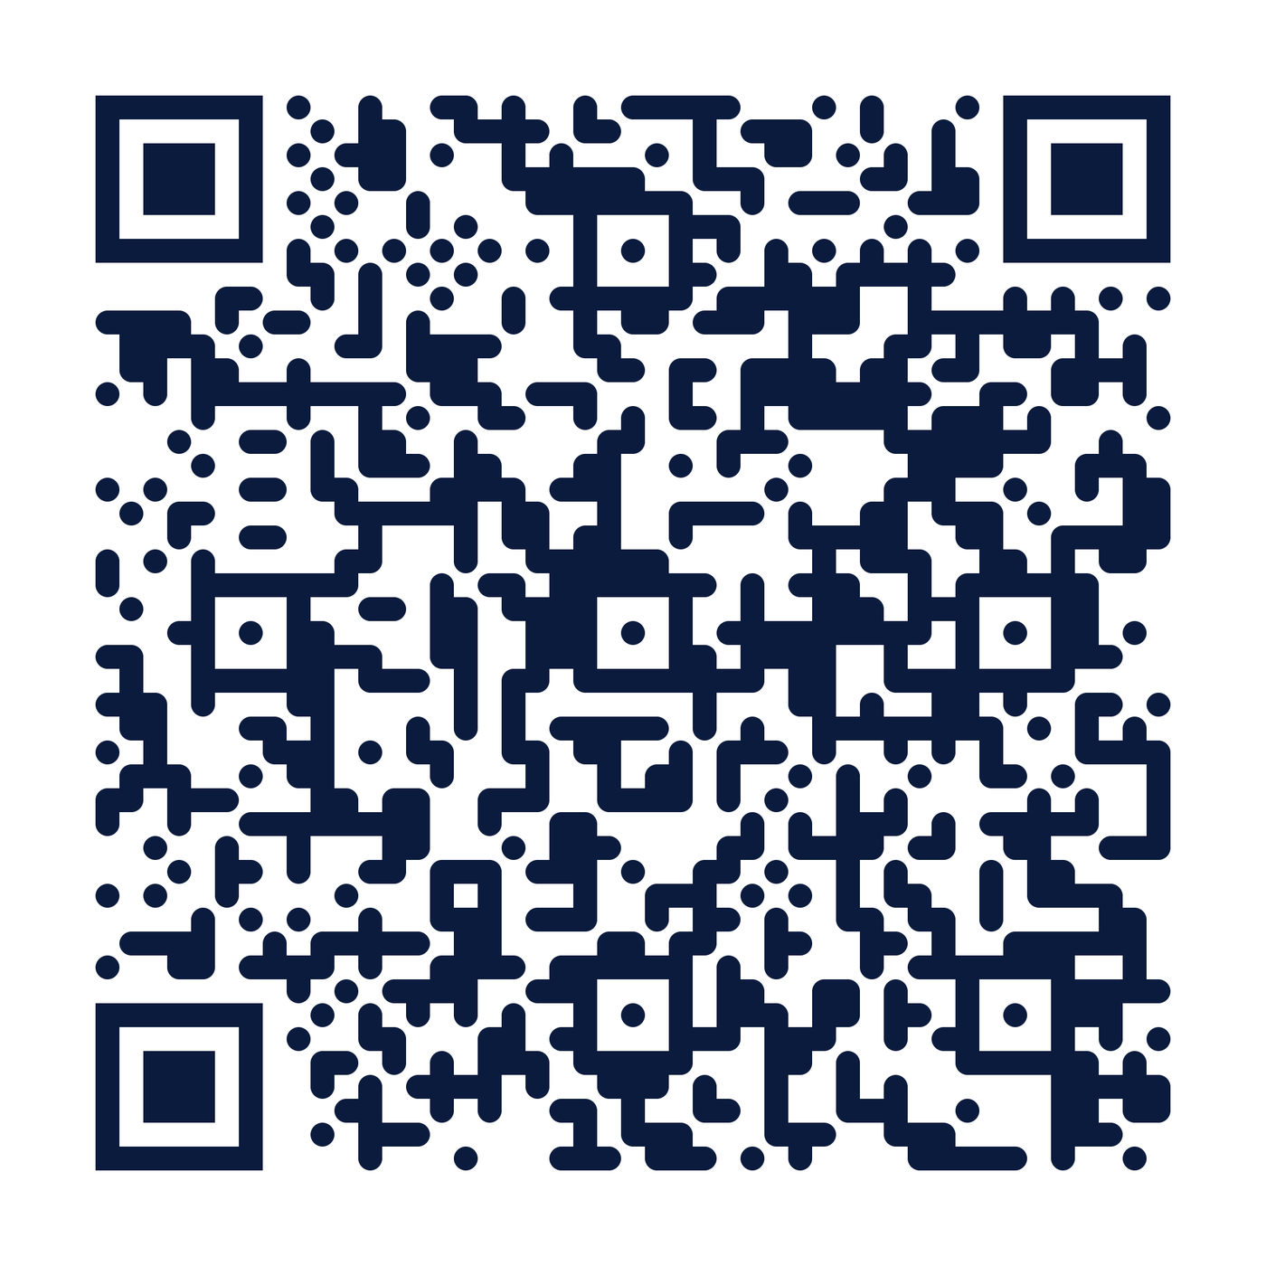
Experience Signal-to-Action Agent
The enterprise AI revenue operating system — explore the live, deployed product
EXPLORE THE COMPLETE PROJECT
Live production app
ventureos-signal-to-action-agent.vercel.app
Open source repository
github.com/amit1858/ventureos-signal-to-action-agent
PRODUCT HIGHLIGHTS
▸ Executive Command Center
▸ AI Chief of Staff
▸ Portfolio Intelligence
▸ Revenue Execution Center
▸ Decision Ledger
▸ Governance
▸ Multi-Agent Runtime
Scan to explore the complete project
Signal-to-Action Agent represents this next evolution — where AI reasons, humans govern, and every recommendation becomes an accountable business outcome.
Systems of Record
Systems of Engagement
Systems of Intelligence
Systems of Reasoning
Voice Chief of Staff, powered by a planned Gnani.ai speech integration, is part of our NVIDIA Open Hackathon implementation roadmap.

