Slide 1
VENTUREOS
TRACK · AGENT SWARMS
VentureOS
AI-native multi-agent venture operating system.
Turn raw ideas into validated, build-ready ventures with agent swarms.
LIVE APP
REPO
DEMO
ventureos-dun.vercel.app
github.com/amit1858/ventureos
ventureos-dun.vercel.app/demo/faceless-crm
Amit Pandey · Microsoft Build AI / HackerEarth · v1.0-submission

Slide 2
VentureOS
02 / 10
02
PROBLEM
Teams start building before they have evidence.
70%
Ideas are easy. Validated execution is hard.
Founders and PMs juggle interviews, competitors, assumptions and roadmaps in disconnected docs.
Customer discovery, research, planning and architecture each live in different tools, in different formats, on different days.
Result: weak or under-validated ideas consume real engineering effort. Strong ideas wait.
of products launched fail to find product–market fit.
6×
cheaper to invalidate an idea than to ship the wrong one.
"There is nothing so useless as doing efficiently that which should not be done at all." — Peter Drucker
VentureOS · ventureos-dun.vercel.app · github.com/amit1858/ventureos

Slide 3
VentureOS
03 / 10
03
SOLUTION
VentureOS gives every idea an agent swarm.
A single product surface that orchestrates specialized AI agents across the venture lifecycle. Every step produces a typed, versioned artifact the next agent reads.
PersonaLab
Buying Committee
Research Graph
AGENT GROUP 01
AGENT GROUP 02
AGENT GROUP 03
Synthetic customers simulate buyer behaviour, pains, jobs-to-be-done and decision drivers.
Multi-persona agents debate, challenge assumptions, and converge on a recommendation.
Graph agents structure problems, evidence, competitors and contradictions.
VentureLab
BuildSquad
Evaluation
AGENT GROUP 04
AGENT GROUP 05
AGENT GROUP 06
Scores readiness and recommends Proceed / Pivot / Kill with provenance and rationale.
Converts validation into PRD, architecture, roadmap, user stories and risks.
Generates readiness reports with confidence, evidence coverage and next steps.
VentureOS · ventureos-dun.vercel.app · github.com/amit1858/ventureos

Slide 4
VentureOS
04 / 10
04
AGENT SWARM ARCHITECTURE
One idea in. An execution-ready venture out.
01
02
03
04
05
06
07
08
Idea
Intake
Persona
Lab
Buying
Committee
Research
Graph
Venture
Lab
Build
Squad
Evaluation
Report
GitHub
Export
Shared Venture context
VentureJob pipeline
Typed artifacts
BYOK provider layer
Every agent reads and writes against one typed Venture object.
Async execution primitive with provenance, retries and cancellation.
Contracts-first. Every step emits a versioned JSON contract.
OpenAI, Anthropic, Gemini, Azure OpenAI. Keys are user-owned and encrypted.
VentureOS · ventureos-dun.vercel.app · github.com/amit1858/ventureos

Slide 5
VentureOS
05 / 10
05
DEMO SCENARIO
Faceless CRM for SMB.
A small-business CRM idea is pressure-tested end-to-end through synthetic SMB personas, a buying-committee debate, evidence mapping, validation scoring, build planning and evaluation — all from one zero-key demo link.
TRY IT → ventureos-dun.vercel.app/demo/faceless-crm
5
8
97
14
synthetic personas
agent-swarm steps
readiness score / 100
GitHub-ready files
Zero-key. No sign-in. No API keys. No GitHub PAT. Real Mode adds BYOK + per-user workspaces via Google sign-in.
VentureOS · ventureos-dun.vercel.app · github.com/amit1858/ventureos

Slide 6
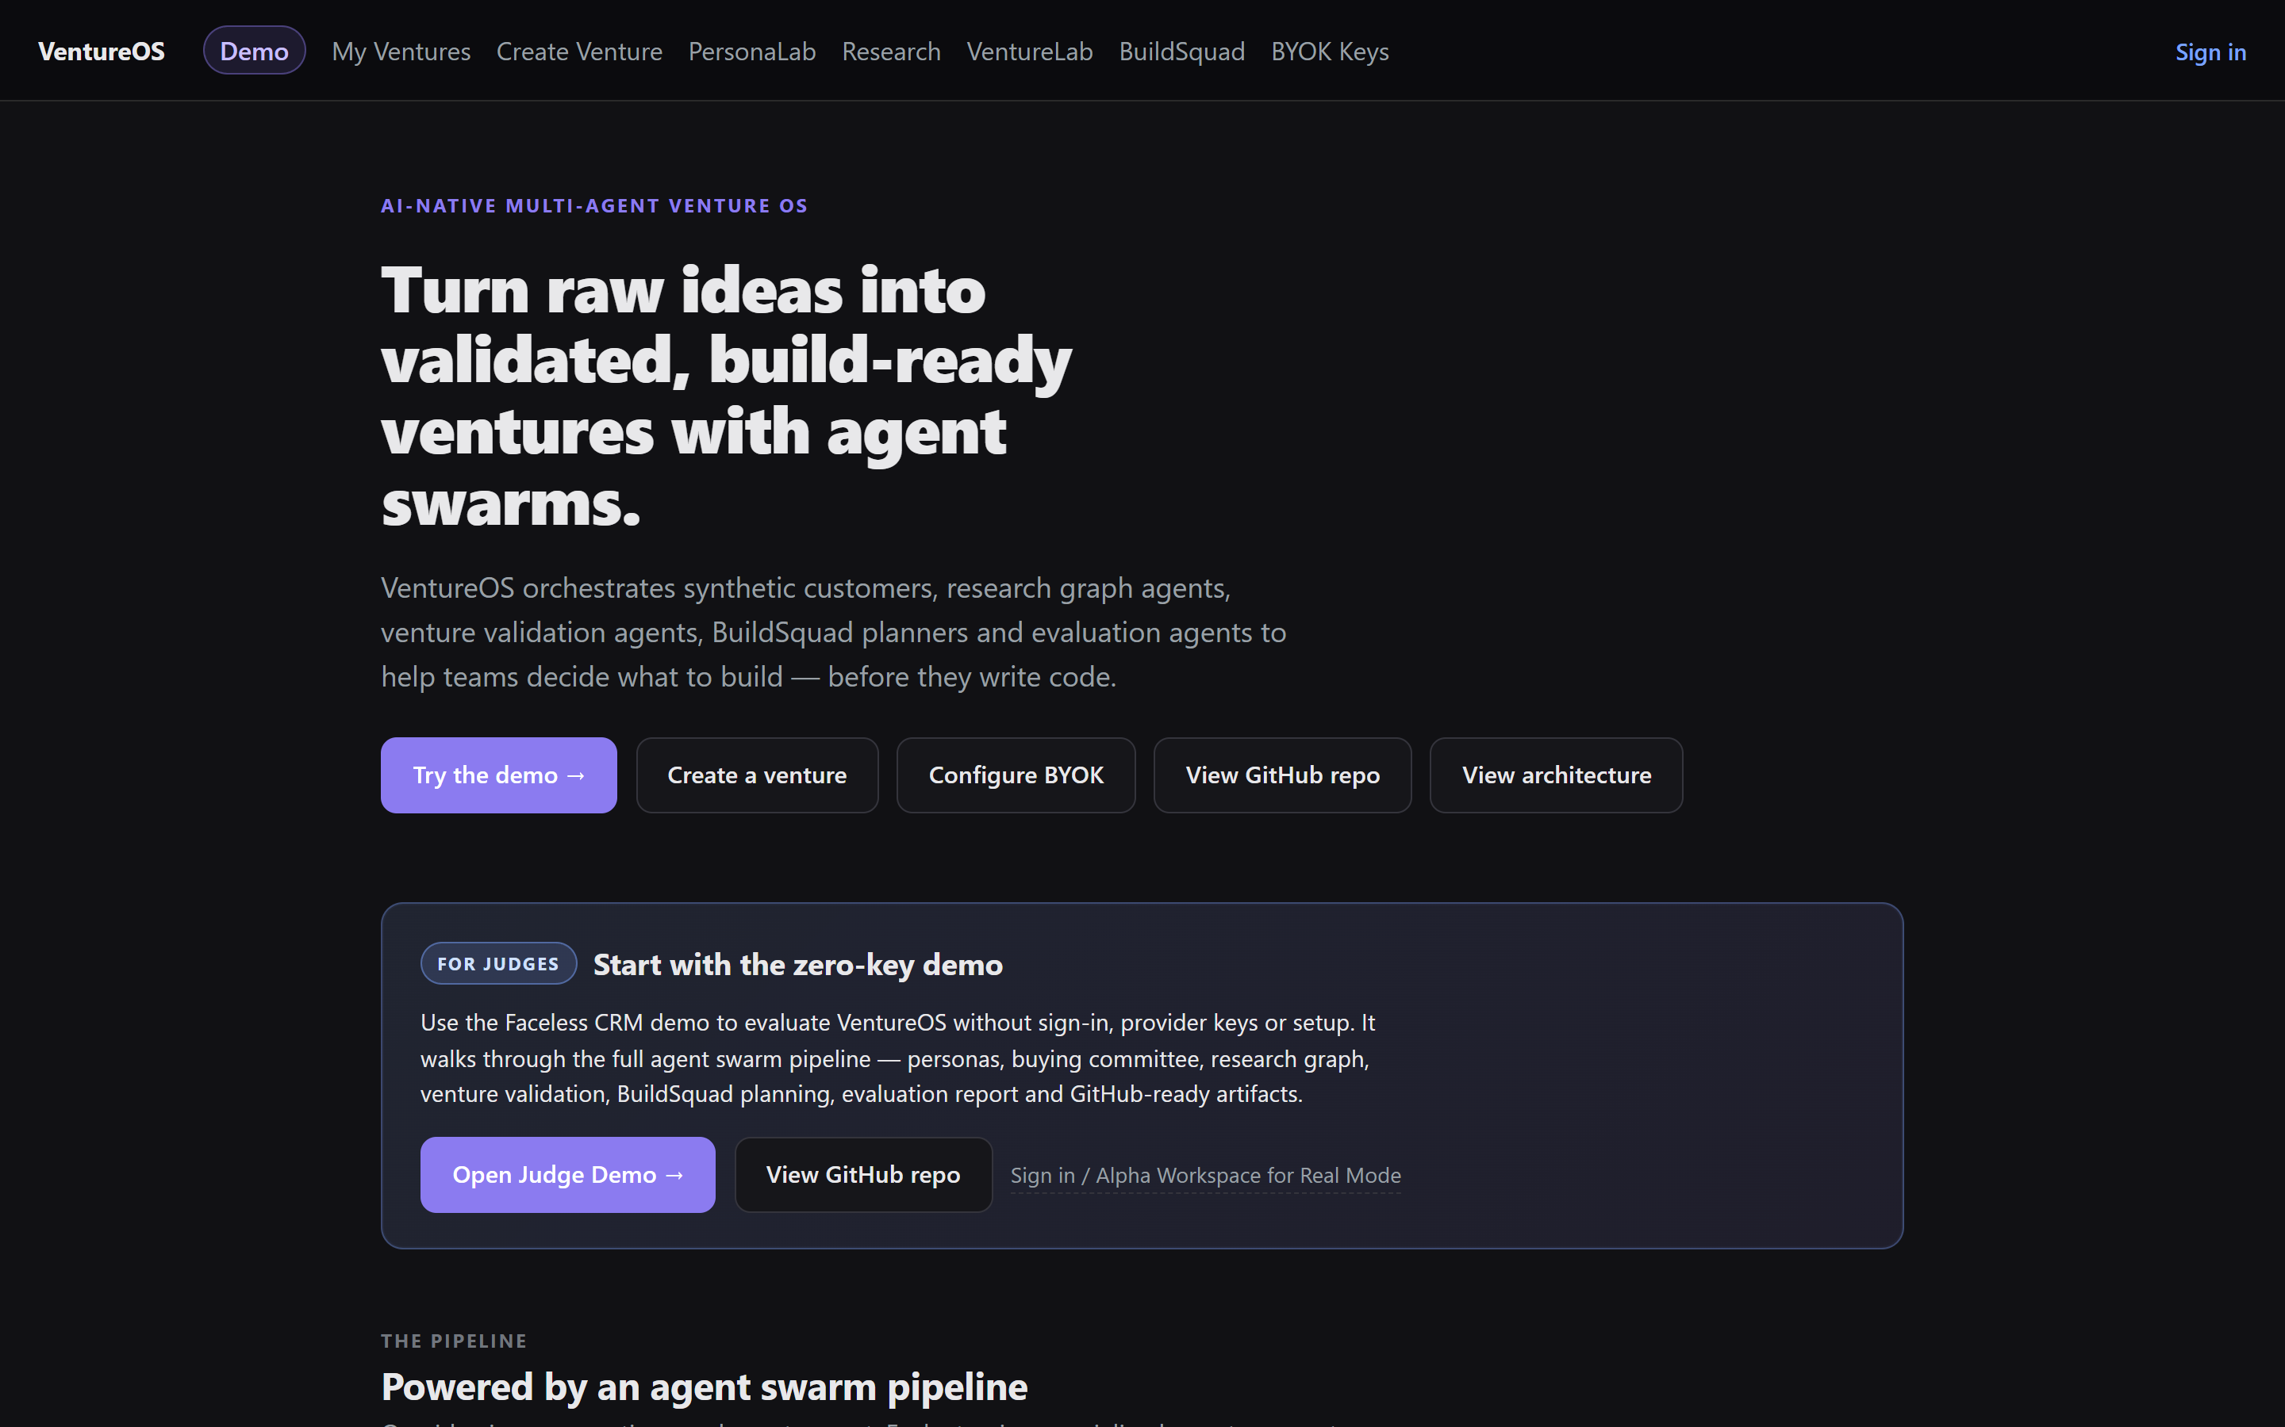
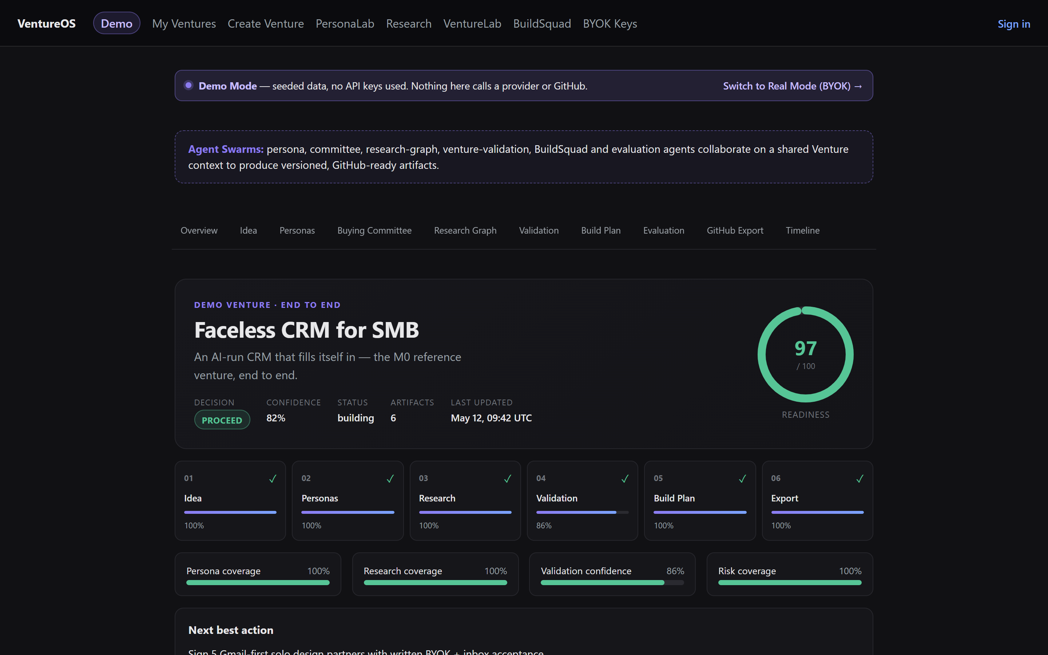
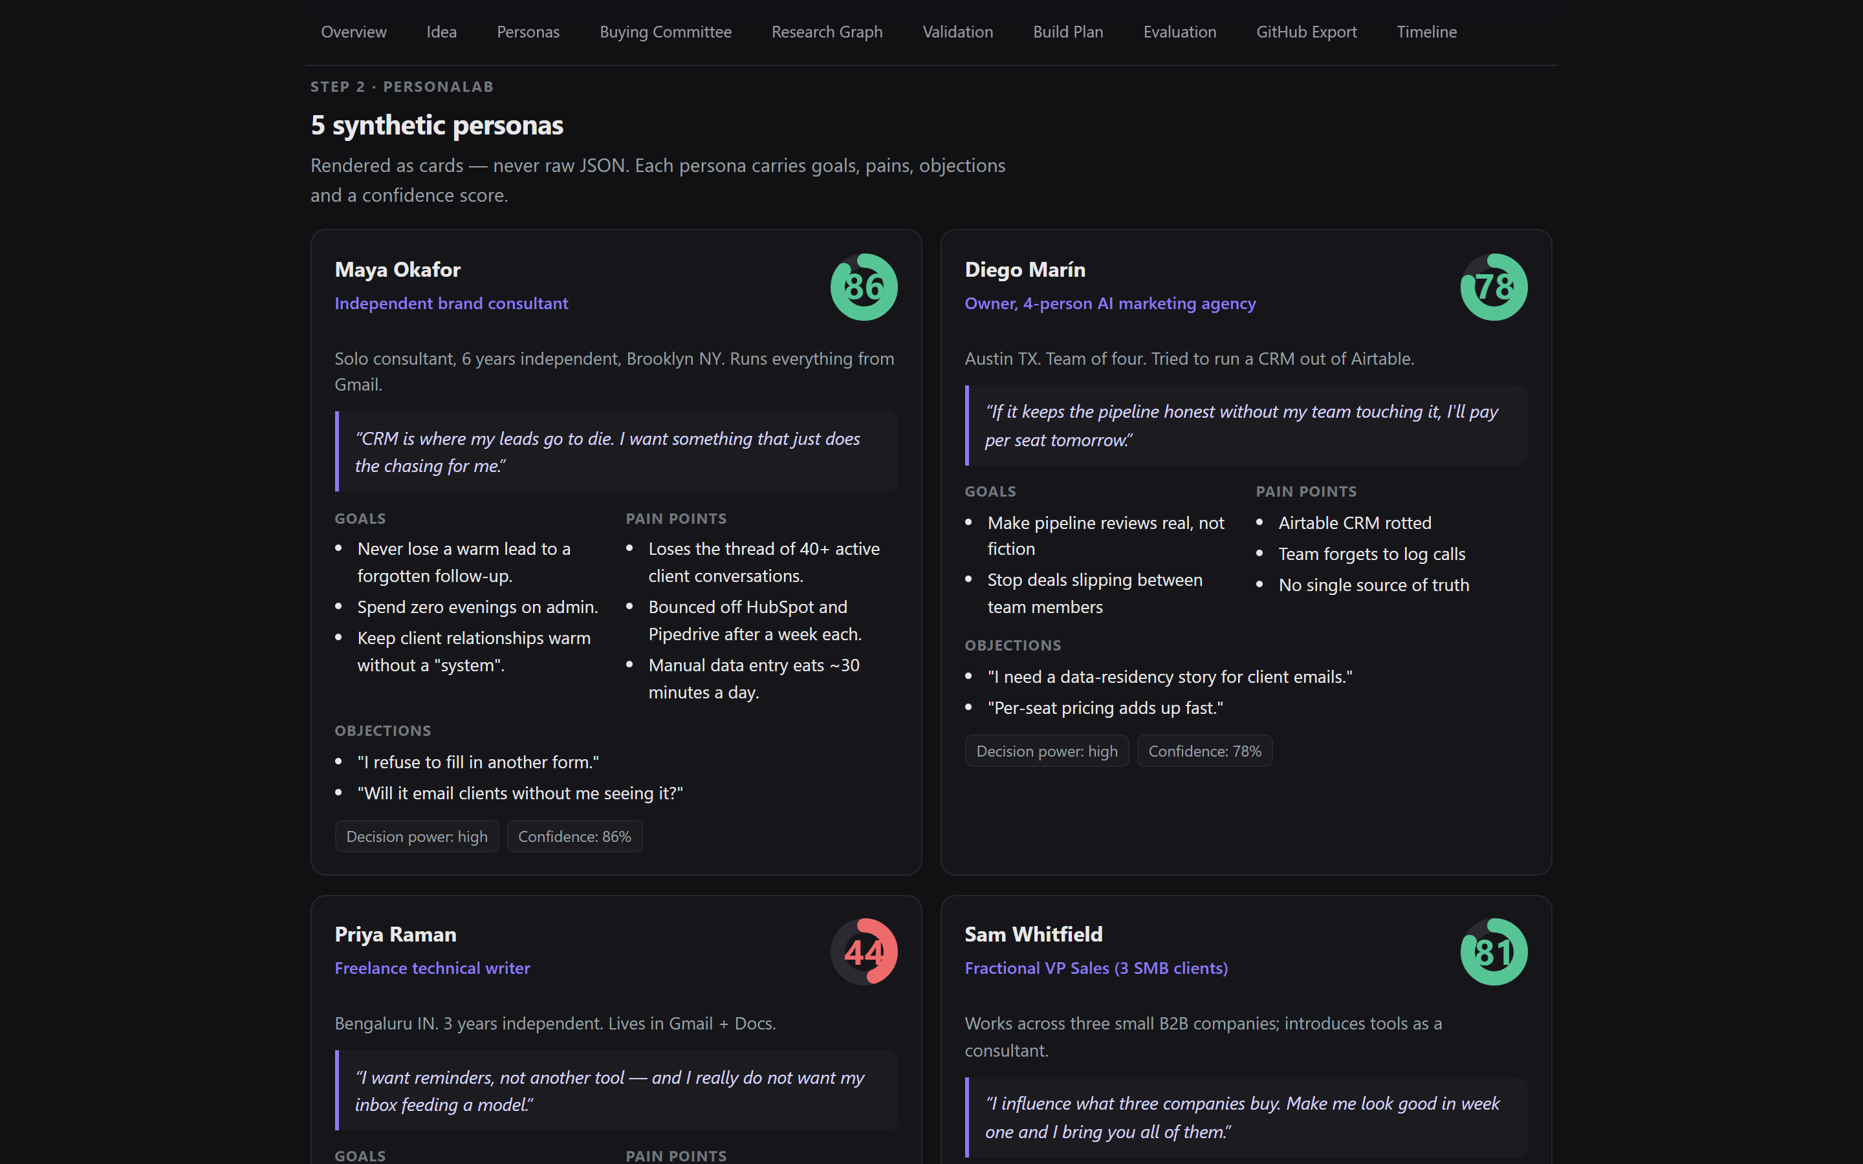
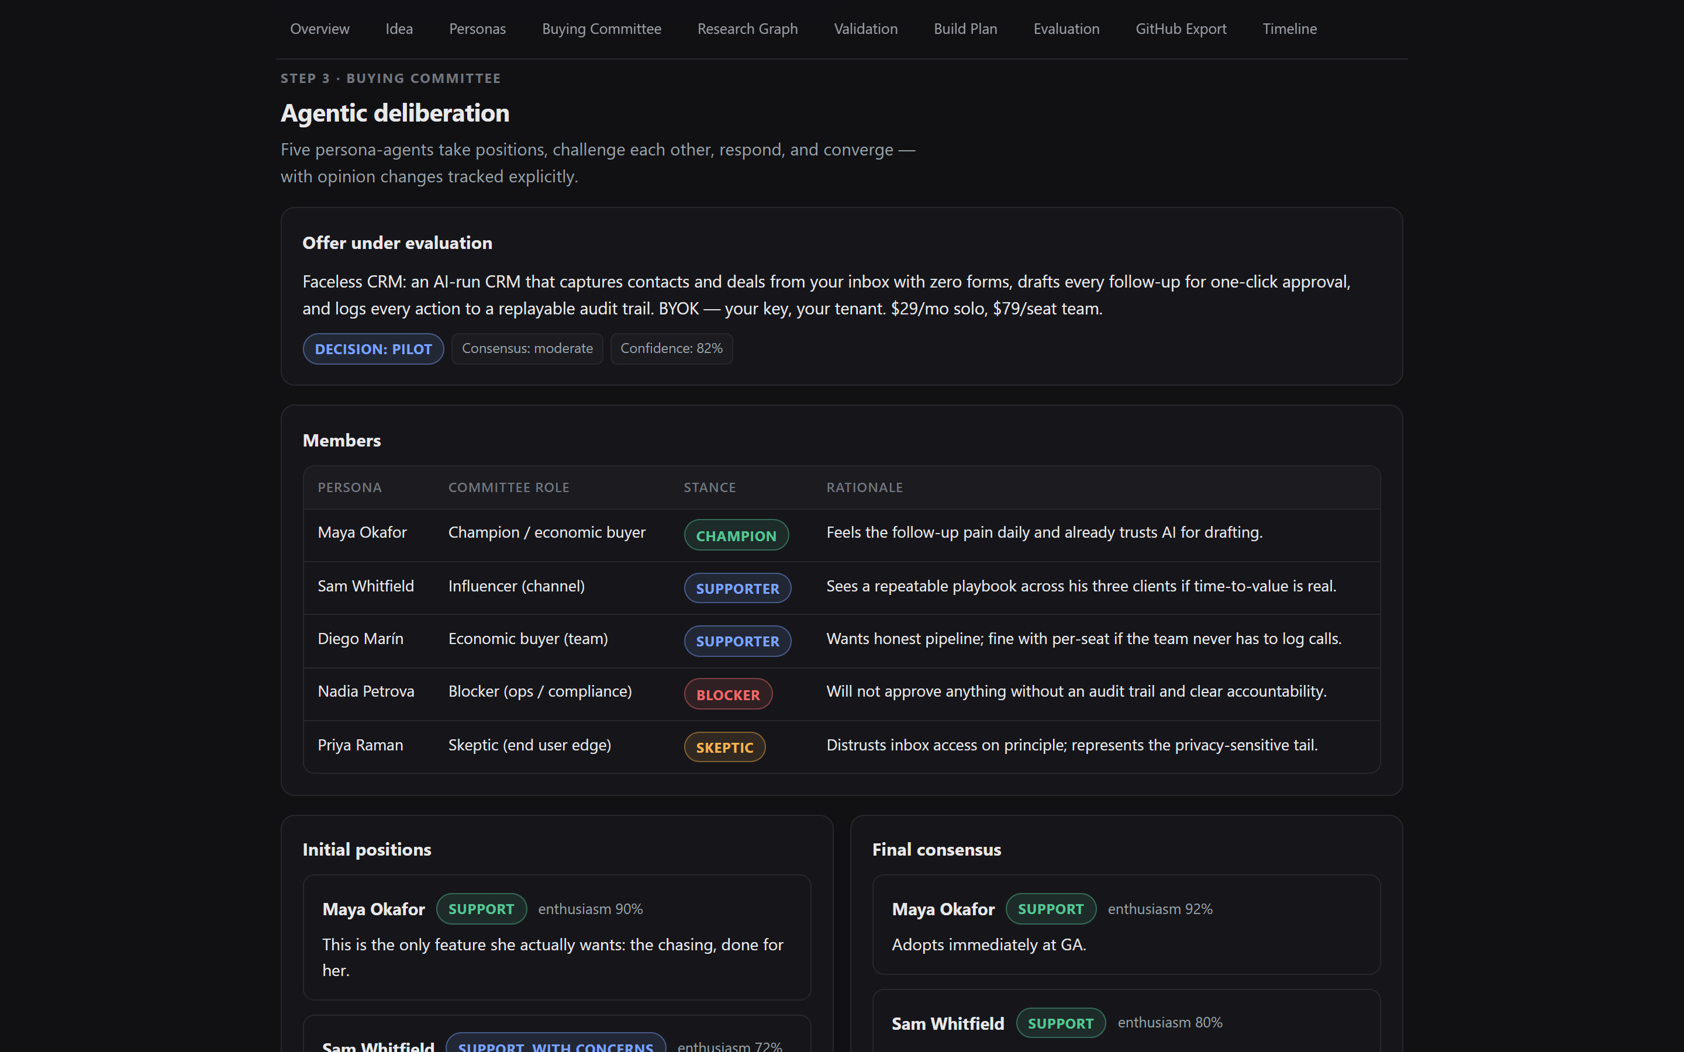
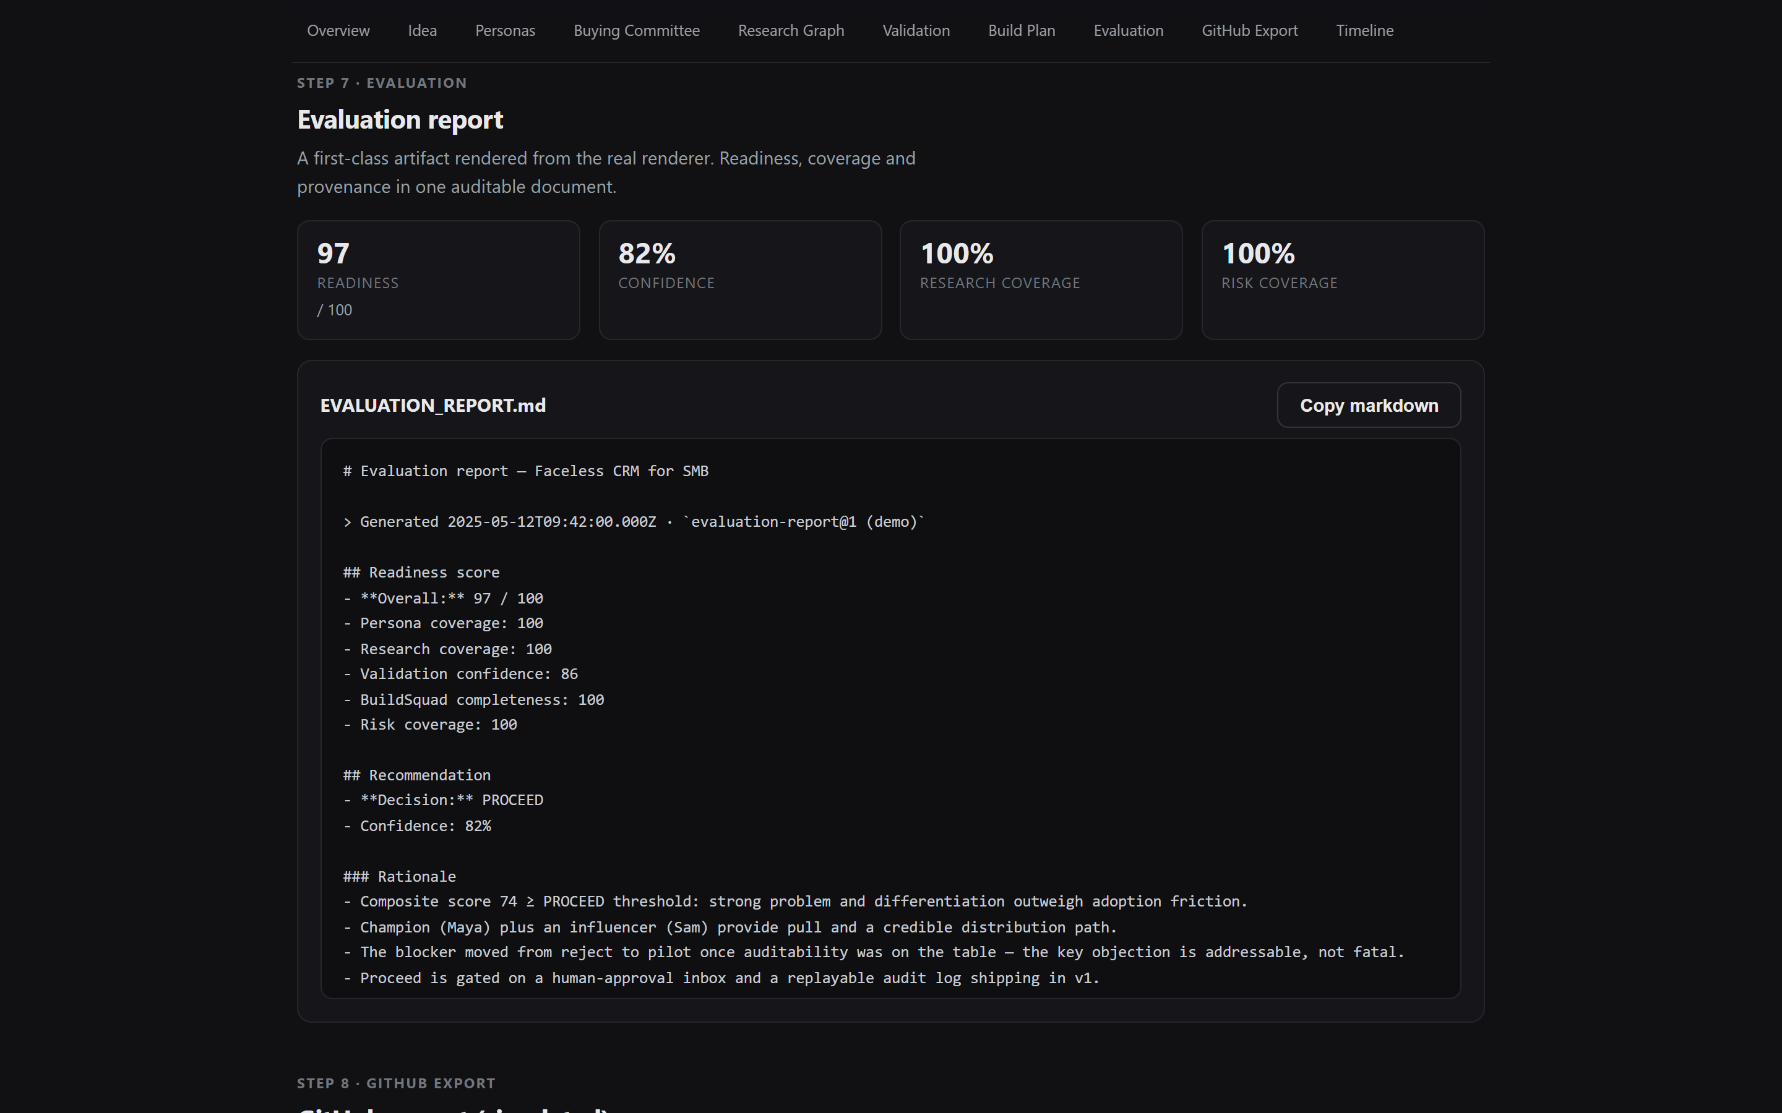
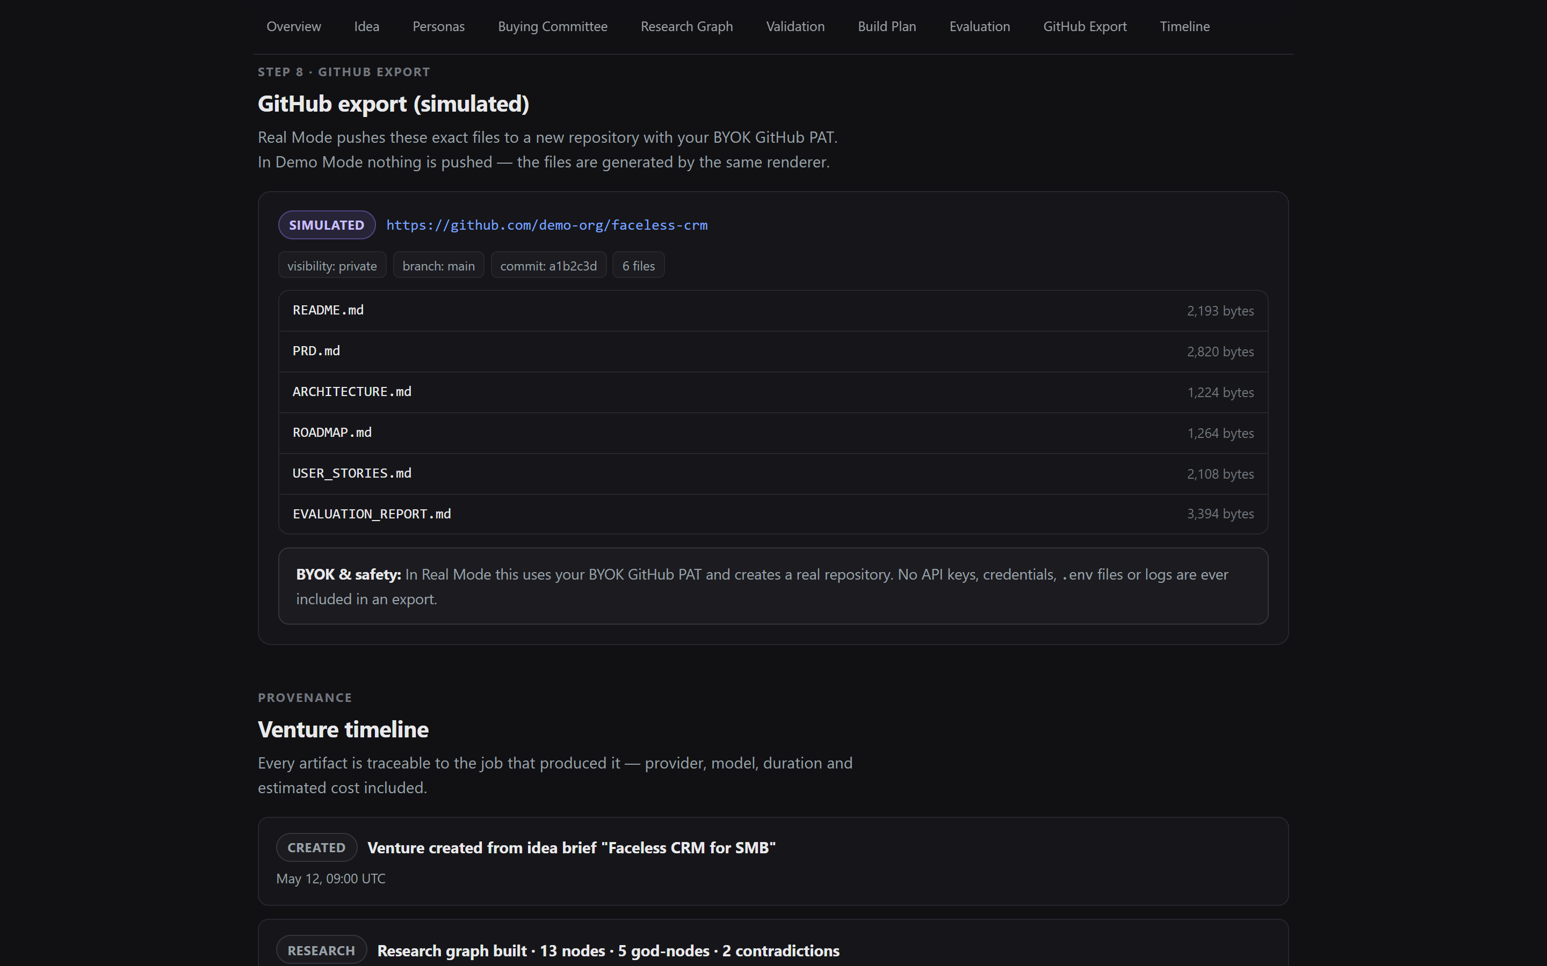
VentureOS
06 / 10
06
PRODUCT WALKTHROUGH
Live screens from the deployed app.
Homepage · "For judges" guidance + agent swarm pipeline
Faceless CRM · readiness 97/100, 6-stage progress
PersonaLab · 5 synthetic SMB personas
Buying Committee · agentic deliberation
EvaluationReport.md · provenance + rationale
GitHub Export · 14-file repo scaffold
VentureOS · ventureos-dun.vercel.app · github.com/amit1858/ventureos

Slide 7
VentureOS
07 / 10
07
TECHNICAL ARCHITECTURE
Production-minded, alpha-honest.
Stack
Engineering controls
PLATFORM
GUARDRAILS
Next.js 14 (app router) web app · Vercel-deployed
Supabase: Postgres + Auth (Google OAuth, email allowlist)
BYOK provider layer: OpenAI · Anthropic · Gemini · Azure OpenAI
GitHub export via Octokit BYOK token, classified error codes
Encrypted credentials at rest (server-side AES-GCM)
pnpm + turbo monorepo · contracts-first architecture
VentureJob async execution primitive · timeline + provenance
Typed contracts in @ventureos/contracts package
lint:arch import-boundary checks — SDKs only in approved packages
Sanitized API errors — no provider-keys or stack traces leak
72 web tests · vitest · static-source contract tests on UI
Demo Mode is fully sandboxed: seeded data, never calls a provider
16
6
72
14
pnpm workspace packages
BYOK provider adapters
web tests · all green
GitHub-export artifacts
VentureOS · ventureos-dun.vercel.app · github.com/amit1858/ventureos

Slide 8
VentureOS
08 / 10
08
AI INTEGRATION
Multi-agent, BYOK, no provider lock-in.
OpenAI
Anthropic
Google Gemini
Azure OpenAI
Synthetic personas
Research graph
Build + Evaluation
AGENT KIND 01
AGENT KIND 02
AGENT KIND 03
TinyTroupe-style multi-persona simulation. Pain, JTBD and decision drivers are first-class fields, debated in a buying committee.
Graphify-inspired workflow that maps problems, assumptions, competitors and contradictions into a navigable graph.
BuildSquad planners convert validation into PRD / architecture / roadmap / stories. Evaluation renders a versioned report.
Model + provider metadata
BYOK isolation
Honest scope
AGENT KIND 04
AGENT KIND 05
AGENT KIND 06
Every artifact records model id, provider, tokens and cost so judges can audit "who said what".
Provider keys never leave the server. Encrypted at rest. Never logged. Never sent to the browser.
Adapters are scaffolded; the full Python runtime parity for TinyTroupe / Graphify is a roadmap item.
VentureOS · ventureos-dun.vercel.app · github.com/amit1858/ventureos

Slide 9
VentureOS
09 / 10
09
IMPACT
For anyone deciding what to build next.
Founders
Product teams
Venture studios
Hackathon builders
Pressure-test a pitch before writing a line of code. Get a Proceed / Pivot / Kill in minutes, not weeks.
Replace scattered docs with one versioned, agent-generated artifact pack tied to a single Venture object.
Standardize discovery, validation and planning across many bets. Compare confidence across the portfolio.
Zero-key Demo Mode runs end-to-end. Real Mode ships GitHub-ready scaffolding with one BYOK token.
<10m
14
100%
idea → readiness score in a single run
GitHub-ready artifacts per export
BYOK · keys stay on the server, never logged
VentureOS · ventureos-dun.vercel.app · github.com/amit1858/ventureos

Slide 10
THANK YOU
Decide what to build,
before you build it.
AI-native multi-agent venture operating system. Built for the Agent Swarms track.
TEAM
LINKS
Amit Pandey
LIVE APP
ventureos-dun.vercel.app
Solo build · Microsoft Build AI / HackerEarth · Agent Swarms track
DEMO PATH
ventureos-dun.vercel.app/demo/faceless-crm
Tagged release: v1.0-submission
REPO
github.com/amit1858/ventureos
VentureOS · ventureos-dun.vercel.app · github.com/amit1858/ventureos

