Slide 1

ZERODHA USER TRANSACTION ANALYSIS
PROJECT PROPOSAL & PROJECT SCHEDULE
PRESENTED BY:
PALAK BANSAL
AMIT CHAURASIA

Slide 2
INPUT AND OUTPUT
INPUT:
The user will input their transaction history (format: csv)
OUTPUT:
    Overall wealth accumulation over a given time period
    Basic graphical analysis of their transactions (categorical)
    Best alternate categorical comparison and suggestion

Slide 3
WEEKLY SCHEDULE
WEEK NO. | TASK DESCRIPTION
WEEK 1 | Input and output description
WEEK 2 | Data collection, data analysis(basic) and converting the data according to our use.
WEEK 3 | Overall user data analysis with categorical data analysis
WEEK 4 | Comparison of data with the best alternative and graphical representation
WEEK 5 | Web page designing
WEEK 6 | Final project delivery
WEEK 7 | Other project related work :documentation,etc.

Slide 4
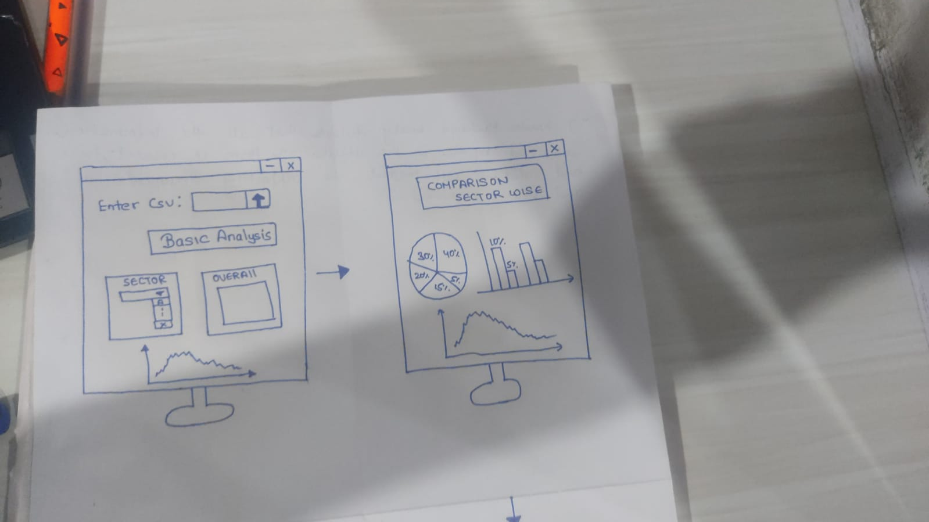
LAYOUT OF THE FINAL WEBPAGE

Slide 5
