Slide 1
A comparative approach for running a Cocos2d-x C++ cross- platform application on web browsers Master Thesis By Amit Bose

Slide 2
Agenda
Title Page Number
Problem set that the thesis deal with…………….. 3
Hypothesis……………………………………………... 4
Background…………………………………………… 5-8
What problems need to be solved…………......... 9
Reasons for working on this problem set………… 10
Approaches for solution……………………….......... 11
Comparison of the approaches…………………... 12
Evaluation of approaches………………………….. 13
Alternate approaches ……………………………… 14

Slide 3
Agenda continued…
Title Page Number
10. Requirement analysis ………………………… 15
11. Building the transpiler ………………………… 16
11.1 Lexical analysis …………………………... 17
11.2 Syntactical analysis ……………………... 18
11.3 Translation phase ……………….............. 19
11.4 Training of the system …………………… 20-21
12. Hidden markov model ………………….......... 22

Slide 4
Agenda continued…
Title Page Number
13. Comparative approach ……………………….. 23
13.1 Automatic generation of code ………... 23
13.2 web browser support……………………... 24
13.3 Portability ………………............................ 25
13.4 security ……………… ..…………………… 26
13.5 Performance………………………………... 27
14. Future work …………….. ………………….......... 29
15. Conclusion ………………………………………... 30
16. References ………………………………… .......... 32
4

Slide 5
Thesis Overview
+ Main Goal
- To port cocos2d-c++ application to web browser.
+ Timeline
+ People involved

Slide 6
Thesis Overview continued…
+ Main Goal
+ Timeline
- Timeline diagram– next page
+ People involved

Slide 7
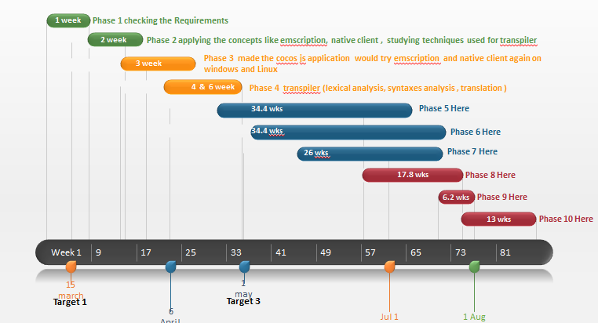
Timeline diagram

Slide 8
Thesis Overview continued…
+ Main Goal
+ Timeline
+ People involved
- Amit Bose (Me)
- Mario förster (Advisor)
committee
- Robert manzke (1st )
- Jens Lussem (2nd)

Slide 9
Problem set that the thesis deal with
Challenges involved in porting the cocos2d-x c++ to browser.
Comparison of the feasibility of the various technology.
Challenges involved in Implementation of the selected technology for porting.

Slide 10
Hypothesis
If the two languages(cocos2d-x c++ and cocos2d-JS) does not differ syntactically then they can be trans compiled using a transpiler.

Slide 11
Background
Evaluation of different type of transpiler for conversion of c++ to JS.
Emscripten
Flascc
Cheerp
Cocos
Cocos-sharp
Cocos2d-HTML
Cocos2d-JS

Slide 12
How the compiler and cross compiler works.
steps involved in the compiling:
lexical analysis
syntactical analysis
semantic analysis
analysis and optimization
memory management

Slide 13
How the transpiler works(its concept)
Discussion of some examples like psedu-master, coffescript transpiler.
Basic difference between c++ and JavaScript code.

Slide 14
What problems need to be solved
Challenges involved in implementation of porting using the various technology.
Evaluation of the error involved in the technology in porting and finding the solution.
Challenges involved in making the new transpiler for conversion of cocos2d c++ to cocos2d-JS.

Slide 15
Reason for working on this problem set
Trying to solved the problem in various technology already available for solving the problem will help us to port the exists solution to web browser.
In case the error are unsolvable then making my own transpiler for porting cocos2d c++ to cocos2d-JS.
It will save the time of the company from recoding the application.

Slide 16
Approaches for the solution
Emscripten
Flascc
Cheerp
Cocos
Cocos-sharp
Cocos2d-HTML
Cocos2d-JS

Slide 17
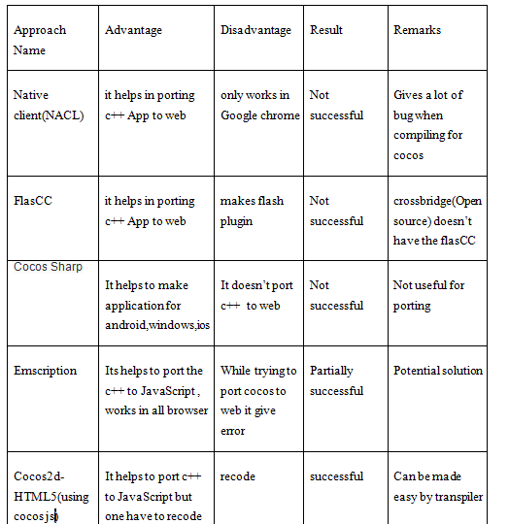
Comparison of the approaches

Slide 18
Evaluation of the approaches
The only solution found which ports the existing solution with a recode is Emscripten.
Reasons not using this approach
It converts the code into asm.js which is not so developer friendly.
It gives a lot of bug when compiling for porting cocos2d c++ to JavaScript.

Slide 19
Alternate approach
Making a transpiler which converts the existing code cocos2d c++ to cocos2d JS.
Steps followed…
Literature review of the existing transpiler. concepts.
Coding the new transpiler.

Slide 20
Requirement analysis
TrunApp is an existing application made in cocos2d-x c++.
It is a cross platform application.
Its is needed to be ported to web browser
Analysis of the technologies which can transfer this to web browser.
Coding the new transplier.

Slide 21
Building the transpiler
Coding the transpiler logic:
Lexical analysis
Syntactical analysis (grammar check)
Translation logic
Training the system

Slide 22
Lexical analysis
Source code is feed line wise.
Line is then broken into tokens with categories like separators, operators, keyword and identifier.
Theses tokens are then send to syntactical analyser and translator.

Slide 23
Syntactical analysis
Here the grammar of the line (in the forms of tokens) is checked.
Look ahead algorithm is used to check the proper grammar pattern.
Errors are reported if it doesn't matches with proper grammar.

Slide 24
Translation phase
The translation pair are retrieve from the trained xml file.
The word pairs are matched and then they are
replaced.
Some common syntactical difference like -> , :: are replaced by .(dot)

Slide 25
Training of the system
Probability and pattern matching is used to determine the type of the token.
Observation :
operator – 1 Letter
separator – 1Letter
Keyword – 4 letter
identifier – more than 4

Slide 26
Pattern:
keyword – Letters
Identifier – Alphanumeric
Separators – array of predefined symbol
operators – array of predefined symbol.
Avg = (probability of observation + probability of pattern)/2
Avg > 0.5 decides that type of token.

Slide 27
Using hidden markov model
To decide the accuracy of the token hidden markov model is used.
It uses look ahead and look behind algorithm to match the accuracy of token.
Predefine matrix made with observation of previous pattern is used.

Slide 28
Sequence diagram

Slide 29
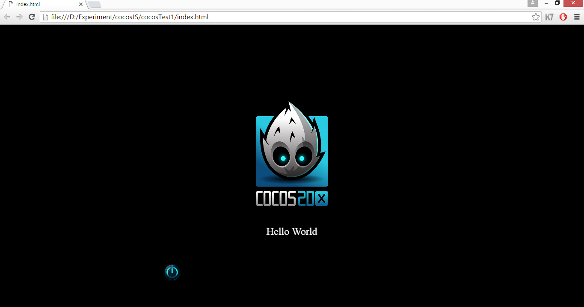
Result

Slide 30
Changes to get the result
Size visibleSize = Director::getInstance()->getVisibleSize();
menu(val,1) -----→ have to remove the ,1)
Vec2::Zero

Slide 31
Comparative approach
Automatic generation of code
Negative
- NACL
Cheerp
Flascc
Cocos2d Js
Positive
+ Emscripten
+ Transpiler

Slide 32
2. Web browser support
Dependence on plugin
Flascc
NACL
Independent from plugin
Emscripten
Cocos2d-Js
Transpiler

Slide 33
3.Portability
Nearly all the approaches are portable
Can run on any operating system and processor.

Slide 34

4.Security
NACL is safe as it uses sandboxing.
Flash dependent on swf are vulnerable to attacks like spoofing attack.
Emscription and cocos2d-x JS have same vulnerability as javascript like cross side scripting.

Slide 35

5.Performance
Native client runs as fast as the native code
Flash really slow the browser performance as it chew up a huge amount of memory and CPU cycles.
Emscripten have is little slow because asm.js huge intake of memory.
Cheerp and cocos2d-js browser performance is good.

Slide 36

Future Work
Increase the accuracy of the transpiler.
Make it more robust by adding grammar for newer version.
Add new features to make it more user friendly.

Slide 37
Conclusion
+ What I did
- evaluation of different approaches for porting.
- compare there feasibility.
- coding a new transpiler for porting cocos2d-x c++
to cocos2d-JS.
+ What I achieved
- successfully trans complied the cocos2d-x C++ code to cocos2d-JS.

Slide 38
+ What I Learned
- How the compiler and transpiler works.
- challenges involved in transpiling and how to solve them.

Slide 39
References
https://d30y9cdsu7xlg0.cloudfront.net/png/16766-200.png
http://www.seagate.com/files/www-content/product-content/enterprise-performance-savvio-fam/enterprise-performance-10k-hdd/_cross-product/_shared/images/int-es-2.5-savvio-10k-overview-2-270x308.png
http://southern-il-security.com/wp-content/uploads/2016/04/security-1.jpg
http://secretsofthehire.com/wp-content/uploads/2014/04/Do-you-have-any-questions-for-me-interview-tips.png

Slide 40

Thank You

