Slide 1
A comparative approach for running a Cocos2d-x C++ cross- platform application on web browsers Master Thesis By Amit Bose September, 2016 Dissertation Coordinator Prof.Dr. Robert Manzke Prof.Dr. Jens Lüssem

Slide 2
Agenda
Title Page Number
Problem set does the thesis deal with…………….. 3
Hypothesis……………………………………………..... 4
Background…………………………………………… 5-8
What problems need to be solved…………......... 9
Reasons for working on this problem set………… 10
Relevance for working on this problem set ........ 11
Solution that are already available …………... 12
Task that I performed ……………………….. 13

Slide 3
Agenda continued…
Title Page Number
09. Task performed and accomplishments ...… 16
11.1 Analysis of different approaches……... 17
11.2 Overview of the transpiler ……………... 18
11.3 Translation phase ……………….............. 19
11.4 Training of the system …………………… 20-21
12. Hidden markov model ………………….......... 22

Slide 4
Agenda continued…
Title Page Number
13. Comparative approach ……………………….. 23
13.1 Automatic generation of code ………... 23
13.2 web browser support……………………... 24
13.3 Portability ………………............................ 25
13.4 security ……………… ..…………………… 26
13.5 Performance………………………………... 27
14. Future work …………….. ………………….......... 29
15. Conclusion ………………………………………... 30
16. References ………………………………… .......... 32
4

Slide 5
Task performed and accomplishments
Introduction
Summary

Slide 6
Thesis Overview
+ Main Goal
- To port cocos2d-c++ application to web browser.
+ Timeline
+ People involved

Slide 7
Thesis Overview continued…
+ Main Goal
+ Timeline
- Timeline diagram– next page
+ People involved

Slide 8
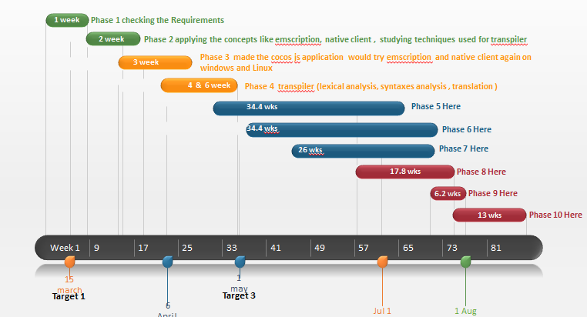
Timeline diagram

Slide 9
Thesis Overview continued…
+ Main Goal
+ Timeline
+ People involved
- Amit Bose (Me)
- Mario förster (Advisor)
Dissertation coordinator
- Prof.Dr.Robert manzke (1st )
- Prof.Dr.Jens Lüssem (2nd)

Slide 10
Problem set that the thesis deal with
Challenges involved in porting the cocos2d-x C++ to browser.
Comparison of the feasibility of the various technology.
Challenges involved in Implementation of the selected technology(transpiler) for porting.

Slide 11
Hypothesis
If the two cocos2d-x framework languages(cocos2d-x C++ and cocos2d-JS) that have some syntactical similarities then they can be trans compiled using a transpiler.

Slide 12
Background
Evaluation of different type of transpiler for conversion of c++ to JS.
Emscripten
Flascc
Cheerp
Cocos
Cocos-sharp
Cocos2d-HTML
Cocos2d-JS

Slide 13
Introduction to compiler and cross compiler.
Steps involved in the compiling:
lexical analysis
syntactical analysis
semantic analysis
analysis and optimization
memory management

Slide 14
How the transpiler works(its concept)
Discussion of some examples like psedu-master, coffeescript transpiler.
Basic difference between c++ and JavaScript code.

Slide 15
What problems need to be solved
Challenges involved in implementation of porting using the various technology.
Evaluation of the error involved in the technology in porting and finding the solution.
Challenges involved in making the new transpiler for conversion of cocos2d c++ to cocos2d-JS.

Slide 16
Reason for working on this problem set
Trying to solved the problem in various technology already available for solving the problem will help us to port the exists solution to web browser.
In case the error are unsolvable then making my own transpiler for porting cocos2d c++ to cocos2d-JS.
It will save the time of the company from recoding the application.

Slide 17
New idea needed to work on
Transpiler architecture
Coding for the transpiler

Slide 18
Task performed and accomplishments
Introduction
Summary

Slide 19
Requirement analysis
TrunAPP is an existing application made in cocos2d-x C++.
It is a cross platform application.
Its is needed to be ported to web browser
Analysis of the technologies which can transfer this to web browser.

Slide 20
Approaches for the solution
Emscripten
Flascc
Cheerp
Cocos
Cocos-sharp
Cocos2d-HTML
Cocos2d-JS

Slide 21
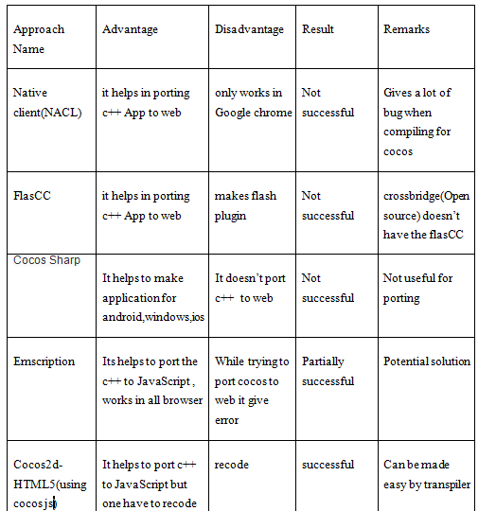
Comparison of the approaches

Slide 22
Comparative approach
Automatic generation of code
Negative
- NACL
Cheerp
Flascc
Cocos2d Js
Positive
+ Emscripten
+ Transpiler

Slide 23
2. Web browser support
Dependence on plugin
FlasCC
NaCL
Independent from plugin
Emscripten
Cocos2d-JS
Transpiler

Slide 24
3.Portability
Nearly all the approaches are portable
Can run on any operating system and processor.

Slide 25

4.Security
NaCL is safe as it uses sandboxing.
Flash dependent on swf are vulnerable to attacks like spoofing attack.
Emscription and cocos2d-x JS have same vulnerability as JavaScript like cross side scripting.

Slide 26
Evaluation of the approaches
The only solution found which ports the existing solution without recoding is Emscripten.
Reasons not using this approach
It converts the code into asm.js which is not so developer friendly.
It gives a lot of bug when compiling for porting cocos2d c++ to JavaScript.

Slide 27
Alternate approach
Making a transpiler which converts the existing code cocos2d c++ to cocos2d JS.
Steps involved…
Literature review of the existing transpiler concepts.
Coding the new transpiler.

Slide 28
Some similarity
Loop
Comment
Variable
Operators
arithmatic

Slide 29
Building the transpiler
Coding the transpiler logic:
Lexical analysis
Syntactical analysis (grammar check)
Translation logic
Training the system

Slide 30
Lexical analysis
Source code is feed line wise.
Line is then broken into tokens with categories like separators, operators, keyword and identifier.
Theses tokens are then send to syntactical analyser and translator.

Slide 31
Syntactical analysis
Here the grammar of the line (in the forms of tokens) is checked.
Look ahead algorithm is used to check the proper grammar pattern.
Errors are reported if it doesn't matches with proper grammar.

Slide 32
Translation phase
The translation pair are retrieve from the trained xml file.
The word pairs are matched and then they are
replaced.
Some common syntactical difference like -> , :: are replaced by .(dot)

Slide 33
Training of the system
Probability and pattern matching is used to determine the type of the token.
Observation :
operator – 1 Letter
separator – 1Letter
Keyword – 4 letter
identifier – more than 4

Slide 34
Pattern:
keyword – Letters
Identifier – Alphanumeric
Separators – array of predefined symbol
operators – array of predefined symbol.
Avg = (probability of observation + probability of pattern)/2
Avg > 0.5 decides that type of token.

Slide 35
Sequence diagram

Slide 36
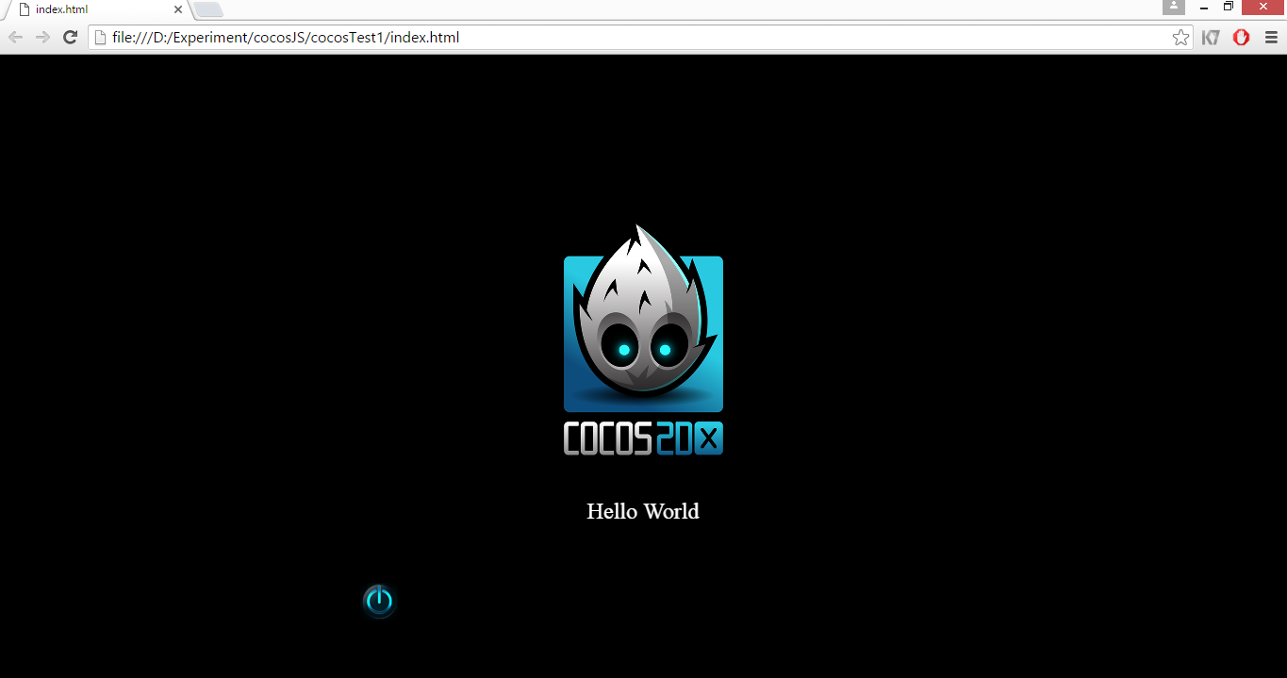
Result

Slide 37
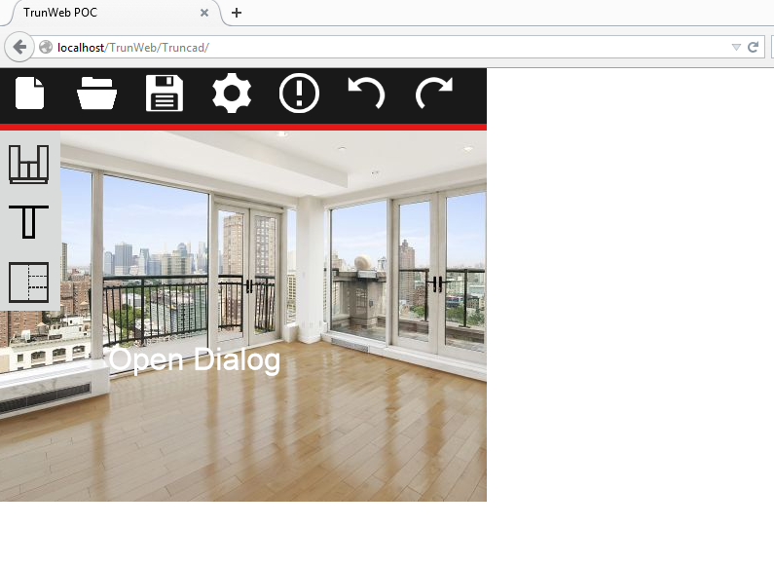
Web version

Slide 38
Task performed and accomplishments
Introduction
Summary

Slide 39

Future Work
Increase the accuracy of the transpiler.
Make it more robust by adding grammar for newer version. Jaro–Winkler_distance
Using string similarity alogorithm.

Slide 40
Conclusion
+ What I did
- evaluation of different approaches for porting.
- compare there feasibility.
- coding a new transpiler for porting cocos2d-x c++
to cocos2d-JS.
+ What I achieved
- successfully trans complied the cocos2d-x C++ code to cocos2d-JS.

Slide 41
+ Ambitions and expectation
- To trans compile the code with 95-100%
accuracy.
+ Limitation
- The difference in coding style of both the
languages leads to some limitation
+ What I Learned
- How the compiler and transpiler works.
- challenges involved in trans piling and how
to solve them.

Slide 42

Thank You

