Slide 1
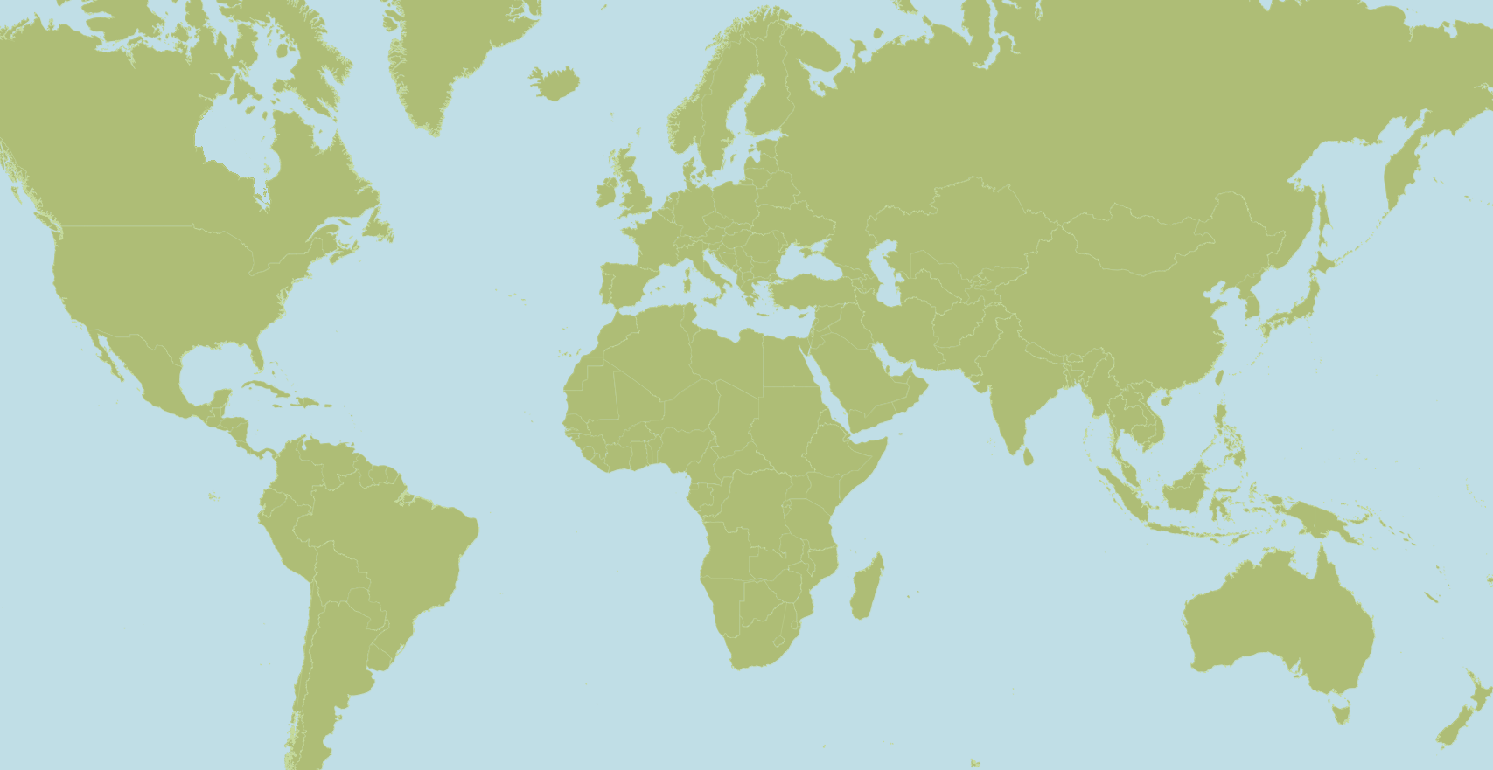
Senozon models
research models

