Slide 1
WELCOME TO Core Python Programming A 4-day Hands-on Workshop
BY
YOGESHWAR SHUKLA

Slide 2
INTRODUCTION OF SPEAKER
B.E. in Computer Science from SPPU.
Research Fellow at European Group of Nuclear Research (CERN) on grid computing.
Studied Advanced Computing Science from University of Nottingham.
A corporate trainer, private consultant, and an owner of Core Programming Academy.

Slide 3
GOALS AND APPROACH
Learn Python Programming Language in depth!
No coverage of application domain! This is not Python with Machine learning or Data science in Python course!
We at core programming academy, firmly believe in the adage that, ‘everything you learn to do, you learn by doing!’. Without any further ado, lets get the hands dirty with code!

Slide 4
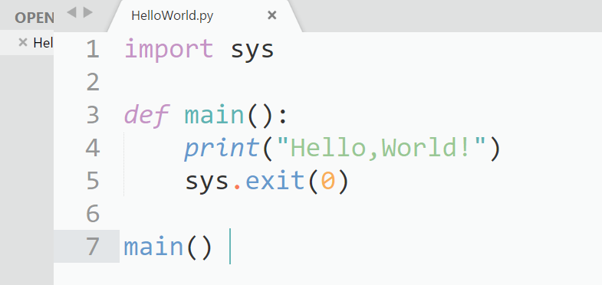
The Hello, World Program

Slide 5
Build Process of Python
Python supports two build mechanisms :
Interpretation
Virtual machine based.
We are going to focus on interpretation at first. The interpreter is a program written for native platform meaning underlying processor and operating system combination which takes Python file as an arguments and does everything necessary to run it on underlying platform!

Slide 6
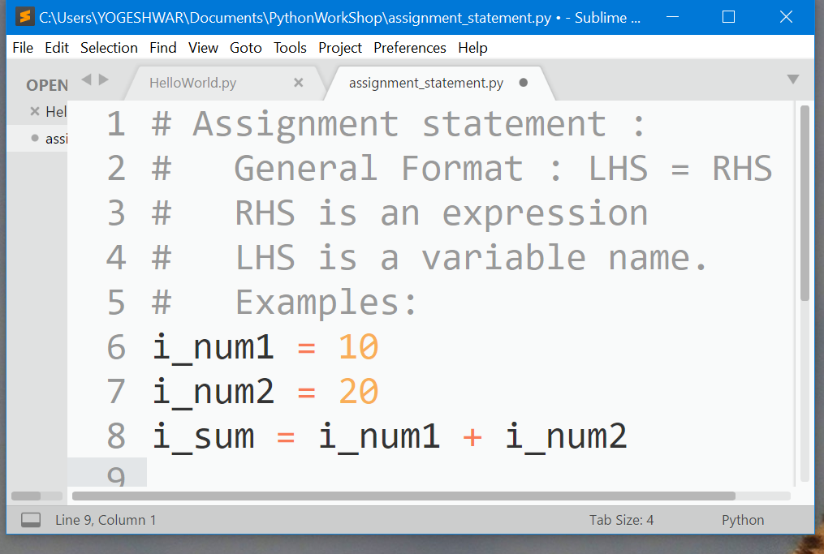
An Assignment Statement
Expression is made up of operators and operands, in a certain sequence.
Operands are data.
Operators are functions.
You need to know following things about an operator.
Ary of operator. E.g. unary, binary etc.
Operand, operator sequence.
Prefix. (e.g not True)
Infix (e.g i_num1 + i_num2)
Postfix (e.g L[i], sin(math.pi))
Associativity
Precedence

Slide 7
Built-In Python Data Types
Data Types
Atomic
Aggregate
Boolean
Integer
Float
Non-container
Container
Sequential
String
Associative
Neither
List
Tuple
Dictionary
Set

Slide 8
Mutability And Immutability
Immutable Types
Boolean
Integer
Float
Mutable Types
List
Dictionary
Set
String
Tuple

Slide 9
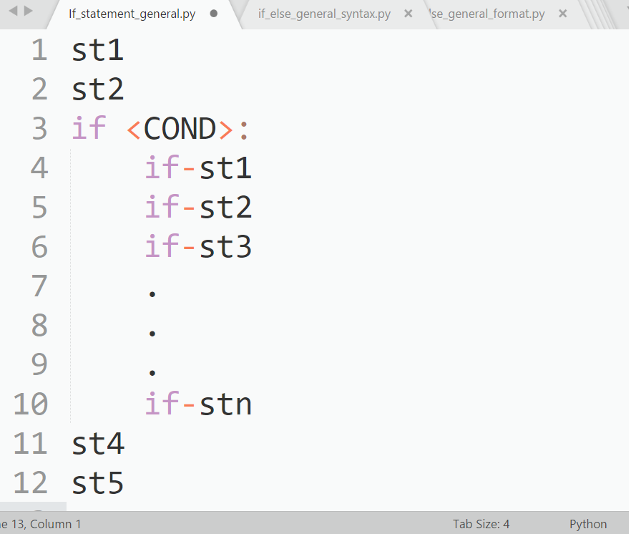
If Statement

Slide 10
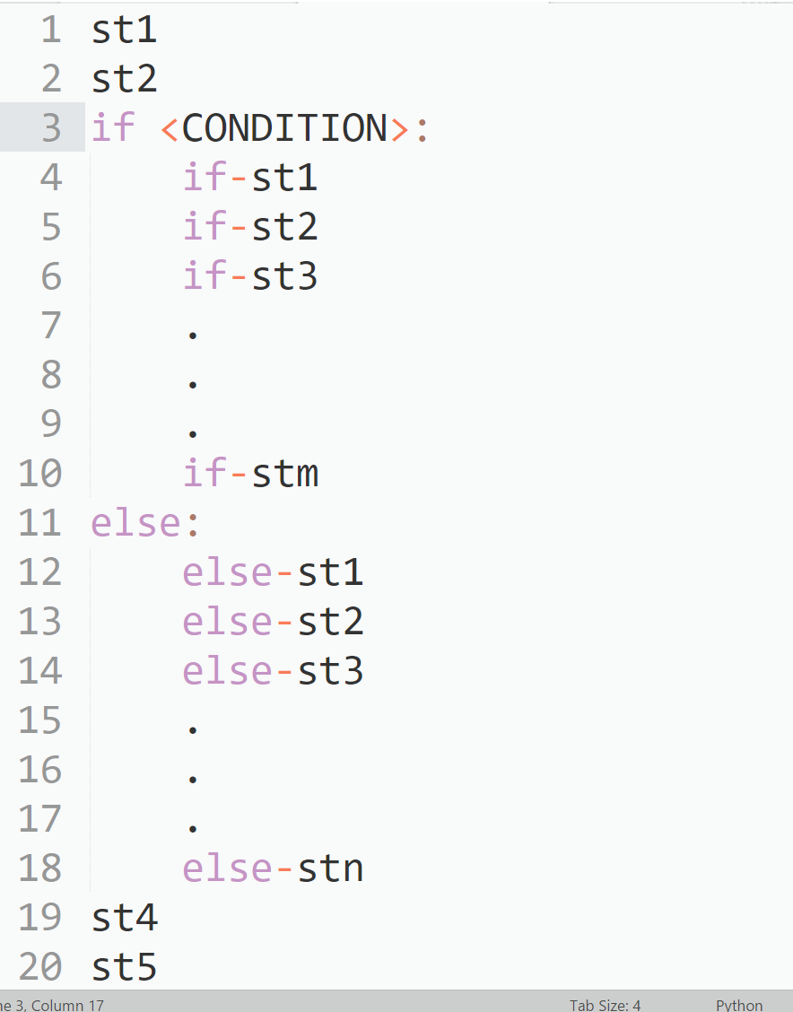
If – else statement

Slide 11
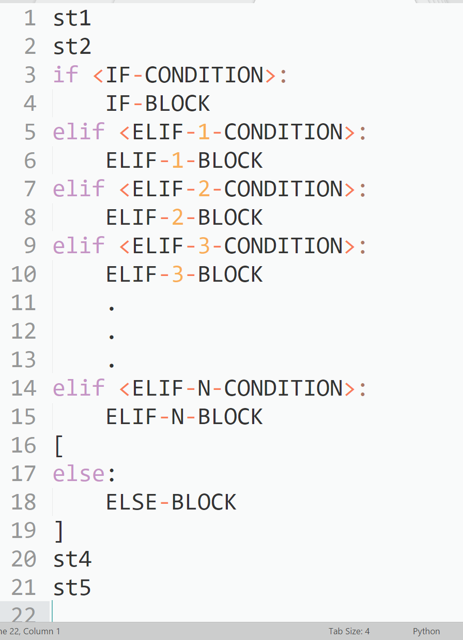
If-elif-else Statement

Slide 12
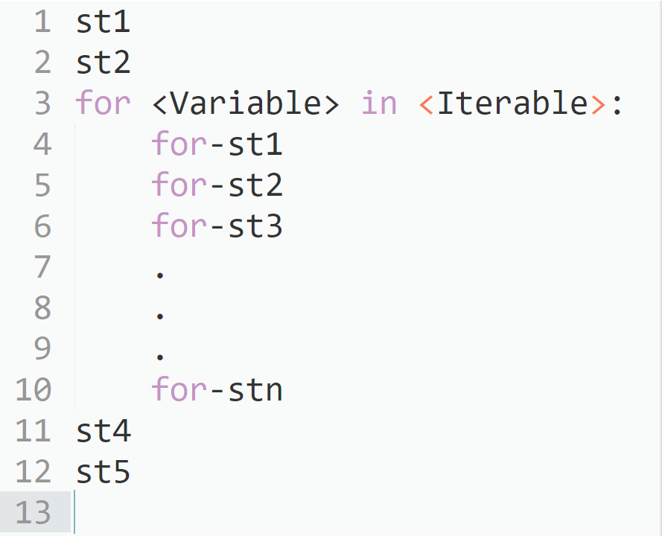
For statement

Slide 13
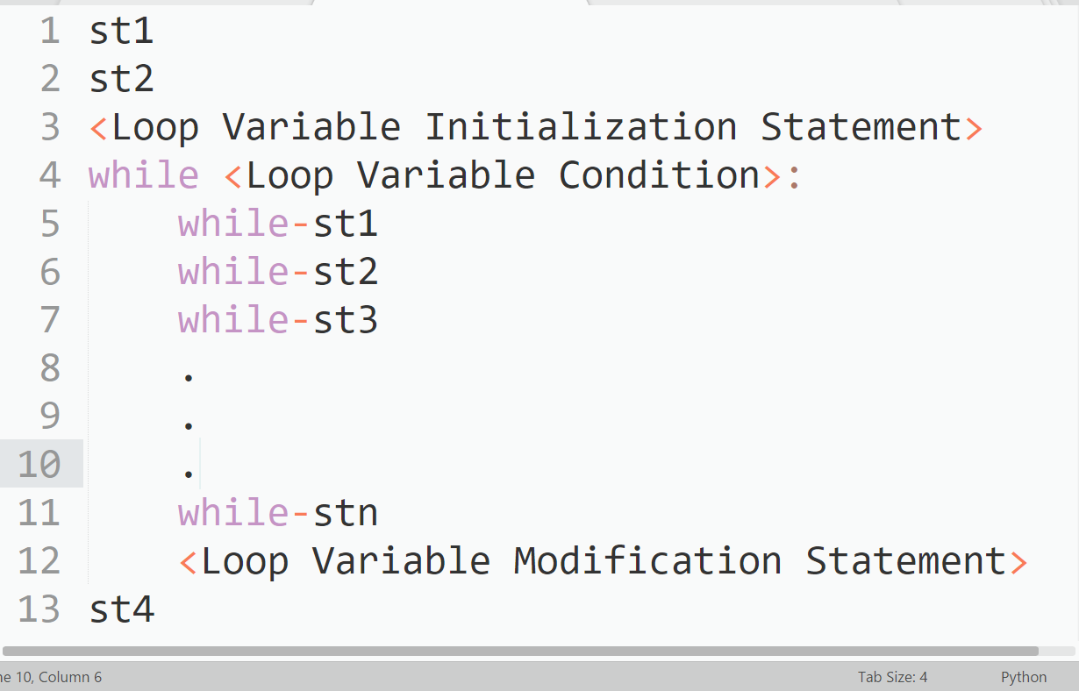
While Statement

Slide 14
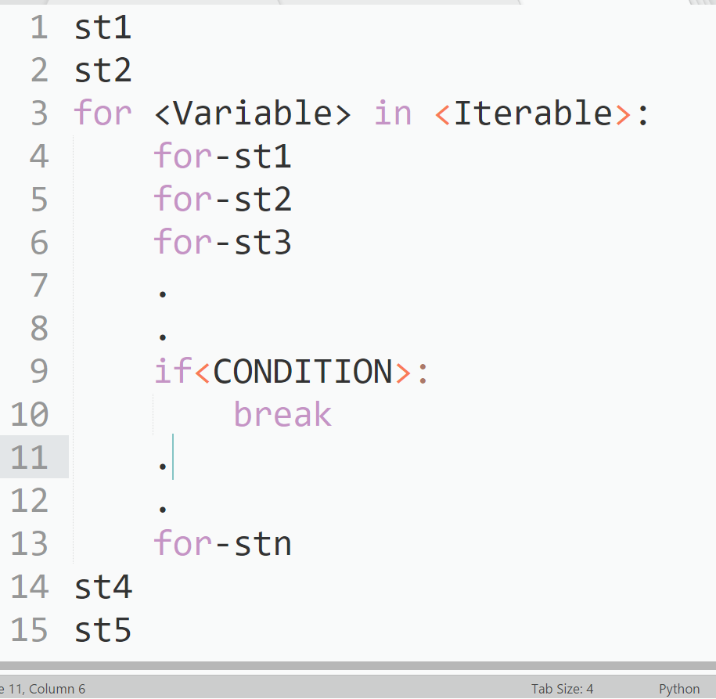
Break Statement

Slide 15
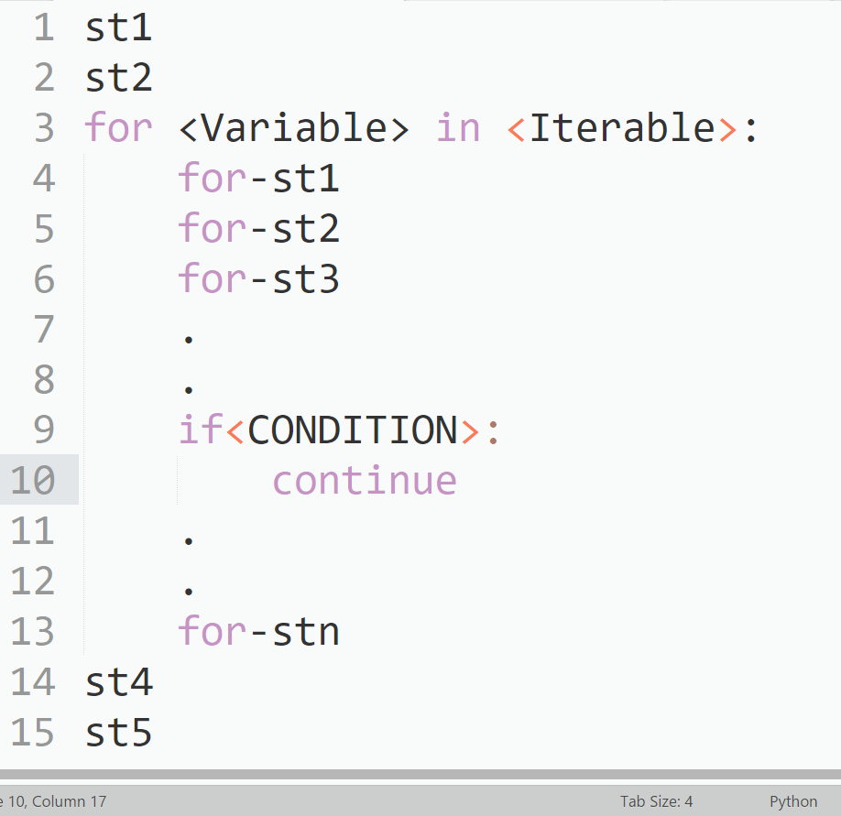
Continue Statement

Slide 16
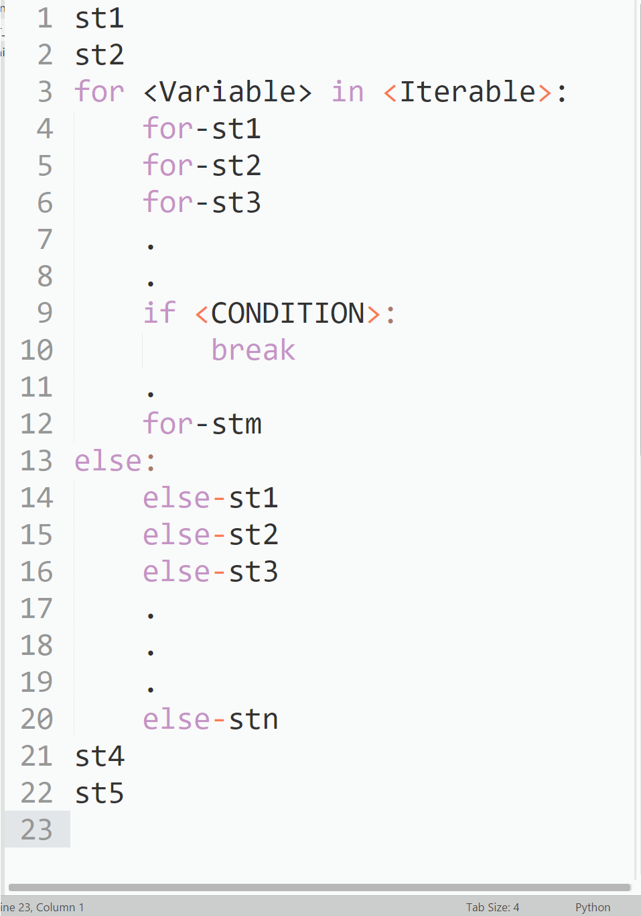
For Else Statement

