Slide 1
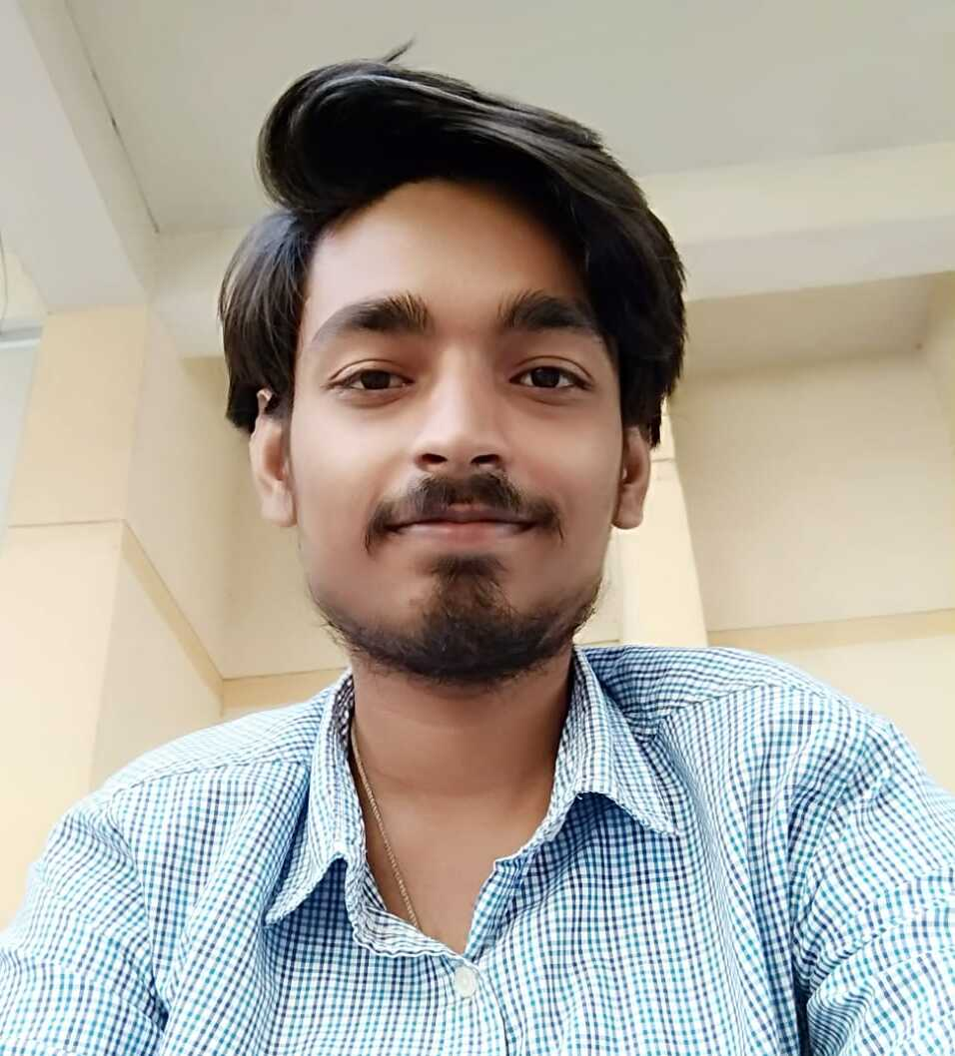
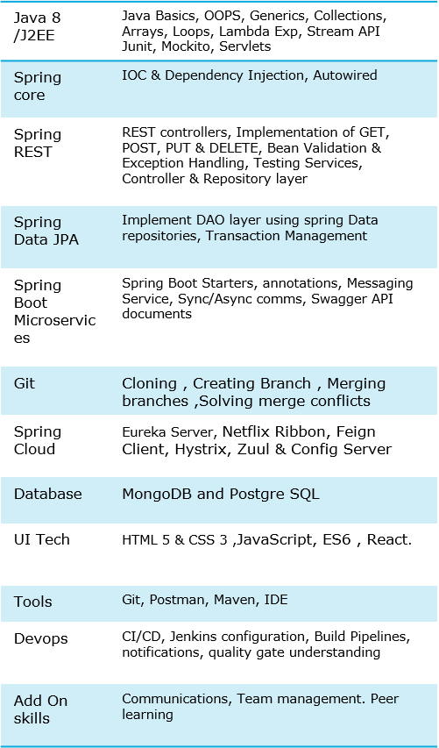



Amit kumar
Analyst/Software Engineer
Bachelor of Technology
Electronics & Communication : 2018-2022
Skills
Bangalore
amit.eb.kumar@capgemini.com
+91 6397921103
A4
Full Stack Developer
Hands on experience in implementing spring boot application and Experience in creating documentation with Java docs and swagger and in unit testing using Junit, Mockito including code quality compliance using Sonar cube
Basic understanding of deploying spring boot applications in GCP Cloud environment, creating VM instance , bucket, load balancing, deployment, traffic-handling using GCP Cloud.
Basic understanding of AWS
Hands on experience in developing web pages using HTML5, CSS3, Object Oriented Java script, ES6, JSON, XML. Good understanding of Document Object Model (DOM) and DOM Functions.
Hands on experience in data analysis using python, NumPy, pandas, matplotlib, SciPy
CROP-DEAL BASIC
Completed end to end case study of Crop-deal basic portal along with JWT authentication, Swagger and payment gateway. React Bootstrap is used for user interface.
Learning- management System
Developed LMS using Spring Boot, PSQL and tested all API through Postman
Sentiment Analysis of covid-19 tweets
Analyzed more than 160k covid-19 tweets using NLP and compared supervised algorithms to predict the type of tweets.
Certifications – SQL for data science, Introduction to data science in python, AWS CCP, Agile software development.
Check out my work on GitHub & Video Profile

